Slide 1

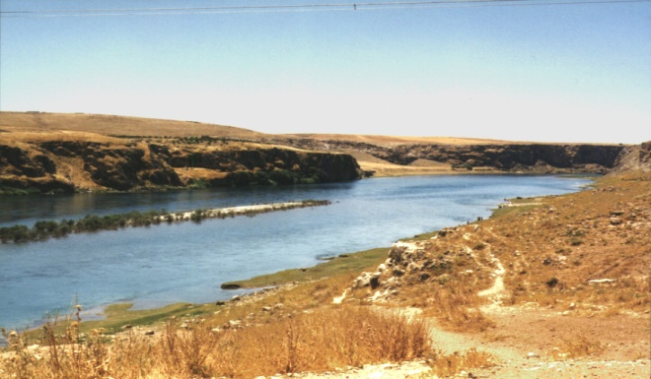
Abraham: Man of Faith
Two
Patriarchs
I. The Life of Abraham.
A. Background.
  1. Abram “Father of Height.”
  2. 20th generation from Adam (Luke 3:34-38) 10th from Noah.
  3. Born 292 years after flood in “Ur of the Chaldees” (Gen. 11).
  4. His father Terah moved to Harran where he died.
  5. At 75 he left Harran as God commanded him (Gen. 12:1-5).
Delete text and place photo here.
Euphrates River
Background
In Canaan
Covenant
Faith Tested

Slide 2
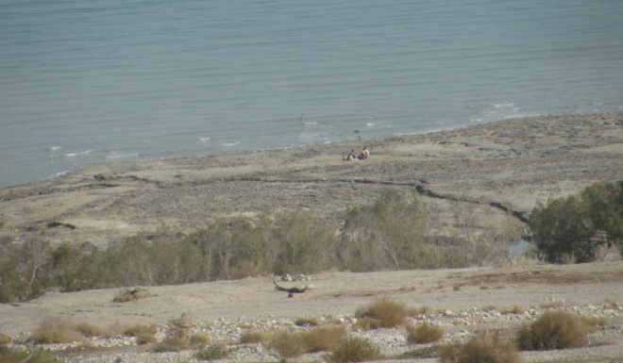
Abraham: Man of Faith
Two
Patriarchs
I. The Life of Abraham.
B. Abram in Caanan.
  1. The Lord’s appearance to Abram (Gen. 12:7).
  2. Deception of Pharaoh (cf. Gen. 20:12).
  3. Division of land with Lot (Gen. 13:8-12).
  4. Rescue of Lot (Gen. 14:14-17).
  5. Blessing of Melchizedek (Gen. 14:18-20).
Delete text and place photo here.
Dead Sea
Background
In Canaan
Covenant
Faith Tested

Slide 3
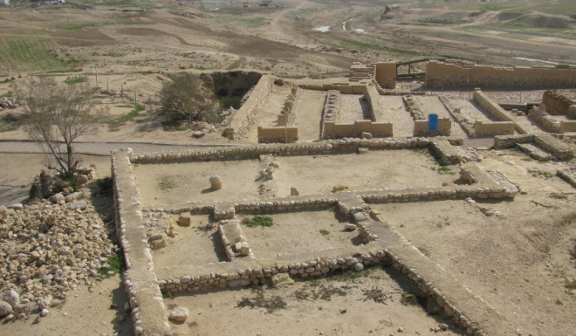
Abraham: Man of Faith
Two
Patriarchs
I. The Life of Abraham.
C. Covenant with Abraham.
  1. Promise of a son (Gen. 15:1-6).
  2. Hagar and Ishmael
  3. Covenant of circumcision (Gen. 17:1-7; 17:10-12). Abraham “Father of a multitude.”
  4. Intercedes for Sodom.
  5. Deception of Abimelech.
  6. Birth of Isaac.
Delete text and place photo here.
Beersheba
Background
In Canaan
Covenant
Faith Tested

Slide 4
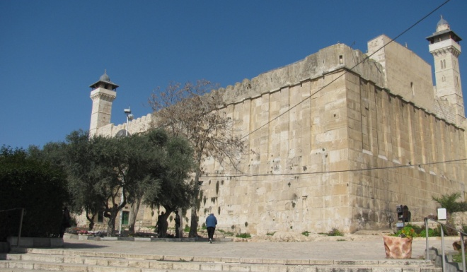
Abraham: Man of Faith
Two
Patriarchs
I. The Life of Abraham.
D. Abraham Tested.
  1. Command to sacrifice Isaac (Gen. 22:1-3; 15-18).
  2. Sarah died and was buried at Hebron.
  3. Abraham marries Keturah.
  4. Inheritance goes to Isaac.
  5. Died at 175 years of age (Gen. 25:7-9).
Delete text and place photo here.
“Abraham’s Tomb” at Hebron
Background
In Canaan
Covenant
Faith Tested

Slide 5
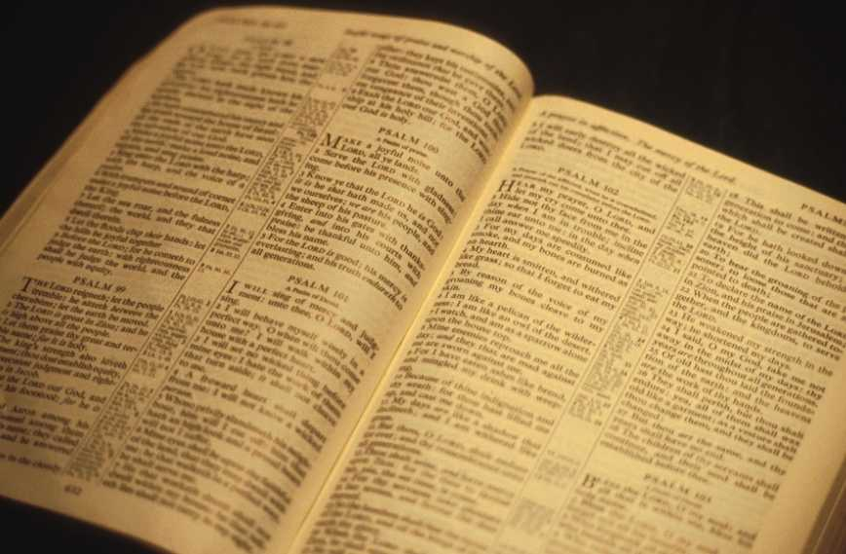
Abraham: Man of Faith
Two
Patriarchs
II. The New Covenant.
A. He is the Father of the Faithful.
  1. Not just children of flesh (Gal. 3:4-9).
  2. “Father of many nations” (Gen. 17:4).
  3 Descendants as the stars and the sand (Gen. 22:17).
Delete text and place photo here.
Father of Faith
Example of Saving Faith
Example of Godly Life

Slide 6
Abraham: Man of Faith
Two
Patriarchs
II. The New Covenant.
B. He Exemplifies Saving Faith.
  1. True faith, not passive belief (James 2:14-26).
  2. Faith “accounted as righteousness (Rom. 4:1-4).
  3 This is forgiveness (Rom. 4:5-8).
  4. It is found in the gospel (Rom. 1:16-17).
Delete text and place photo here.
Father of Faith
Example of Saving Faith
Example of Godly Life

Slide 7
Abraham: Man of Faith
Two
Patriarchs
II. The New Covenant.
C. He Exemplifies a Godly Life.
  1. Obedience (Gen. 12:4).
  2. Unselfishness (Gen. 13:9).
  3 Courage (Gen. 14:14).
  4. Giving (Gen. 14:20).
  5. Spirituality (Heb. 11:8-10; 11:17-19).
Are You a Child of Abraham?
Hebrews 11:13-16
Delete text and place photo here.
Father of Faith
Example of Saving Faith
Example of Godly Life

