Slide 1
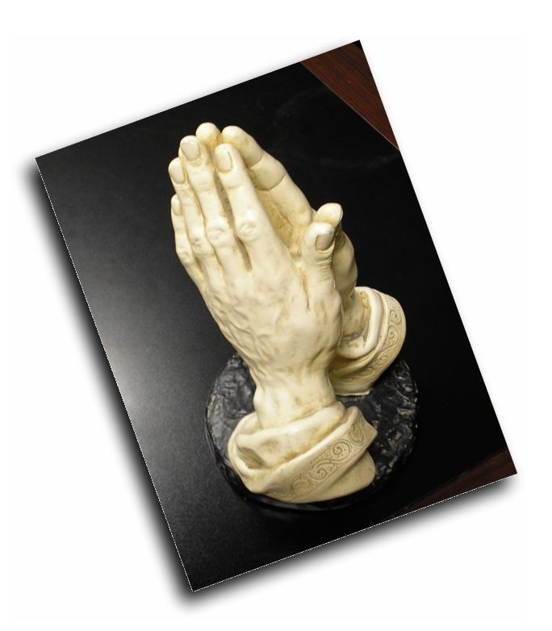
Help Me Lord
Dear Lord, help me to love you more each day (Romans 5:8),
and to realize how much you love me (Matt. 6:30).

Slide 2
Help Me Lord
Help me to love others with a sincere concern for their needs and interests. (Matthew 22:39; 1 John 3:18; Philippians 2:4).

Slide 3
Help Me Lord
Help me to be more devoted to my family (Eph. 5:28),
and give them the spiritual guidance that I should (Eph. 6:4).

Slide 4
Help Me Lord
Help me to have a greater concern for the lost in the world (Matthew 5:13),
and the courage to turn that concern into action.

Slide 5
Help Me Lord
Help me to be more devoted to my brothers and sisters in Christ.
To watch more carefully for their times of trial and commit myself to be there for them regardless of my struggles (Galatians 6:2; Romans 12:10).

Slide 6
Help Me Lord
Lord give me a greater confidence in your Word. (John 15:10).

Slide 7
Help Me Lord
Help me not to be envious or discouraged when I see others turning from what Scripture says, but help me to have a quiet resolution to abide in your Word (2 John 9).

Slide 8
Help Me Lord
Help me to be more spiritually minded. (Romans 12:2; Colossians 3:2).

Slide 9
Help Me Lord
Help me to better resist temptation. (James 4:7).
Let me love doing right and hate doing what you have forbidden (Romans 12:9).

Slide 10
Help Me Lord
Lord, please help me to have more patience with others.
When my family needs me or my brethren don't act like I want them to help me to realize how patient You are with me (1 Cor. 13:4; Rom. 2:3-5).

Slide 11
Help Me Lord
Help me when I have a hard time forgiving others. Let me see how great my need is for your forgiveness and how little the wrong done to me truly is (Matthew 6:14,15; Matthew 7:2; 1 Peter 2:21-24 ).

Slide 12
Help Me Lord
Help me not to feel a sense of despair when I see the world growing more corrupt.
Help me to be able to grieve when I see a world that is lost but take comfort in the fact that you are still in control (John 16:33).

Slide 13
Help Me Lord
Help me to realize every moment that you are with me.
Let that awareness change the way I act, and think, and treat others (Matthew 28:20; Hebrews 13:5).

Slide 14
Help Me Lord
Let me realize that any moment you could return in judgment.

Slide 15
Help Me Lord
Please keep me from assuming that I have more time than this very moment you have given me, but help me to prepare myself to stand before you (2 Peter 3:10; Revelation 22:12).

Slide 16
Help Me Lord
Help me to see that what I am is my own choice. Please keep me away from the snare of blaming others for my shortcomings (Galatians 6:5; Romans 14:12; 2 Corinthian 5:10).

Slide 17
Help Me Lord
Help me to see the power of your Word to help me and change me. (Hebrews 4:12).

Slide 18
Help Me Lord
Don't let me be misguided into thinking that someday you will magically make me what I don't make myself (2 Timothy 3:16,17; John 6:63).

Slide 19
Help Me Lord
Lord help me each day to seek heaven more than anything else.

Slide 20
Help Me Lord
Help me to seek service in your kingdom realizing this world is not my home (Matthew 6:19,20; Matthew 6:33; 2 Corinthians 4:16-5:2).

