Slide 1
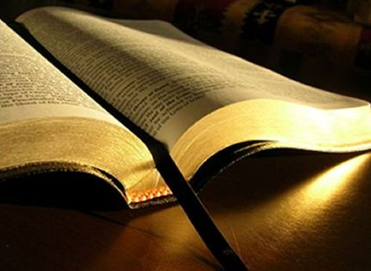
Hosea 4:1-6
No “knowledge of God in the land” (1).
They are “destroyed for lack of knowledge” (6a).
In fact they had “rejected knowledge” (6b).
They had “forgotten the law of your God” (6c).

Slide 2
“Destroyed for Lack of Knowledge”
I. The Knowledge of God.
  A. How can we gain knowledge of God?
    Not within ourselves (Jeremiah 10:23).
  B. Only through His word.
    Gentiles “do not know God” (1 Thess. 4:5).
    The word keeps us from sin and cleanses our way (Psalm 119:9-16).

Slide 3
“Destroyed for Lack of Knowledge”
I. The Knowledge of God.
  C. The word is all-sufficient (2 Tim. 3:14-17).
    Sola Scriptura “The Scriptures Alone!”
    It is how we know God.

Slide 4
“Destroyed for Lack of Knowledge”
II. Sources to Grow in the Knowledge of God.
  A. Preaching.
    Importance of preaching the Bible (Amos 8:11-12).
    This is only twice (sometimes only once) a week.

Slide 5
“Destroyed for Lack of Knowledge”
II. Sources to Grow in the Knowledge of God.
  B. Bible classes.
    This is a way the elders feed the flock (Acts 20:28-30) “feed the flock” (ASV).
    Only valuable if we participate and show up. No value otherwise.

Slide 6
“Destroyed for Lack of Knowledge”
II. Sources to Grow in the Knowledge of God.
  C. Parents.
    Parents the primary source for children (Eph. 6:1-4; 2 Tim. 1:5).
    Do we have the knowledge of God to pass to our children? (Prov. 29:15).

Slide 7
“Destroyed for Lack of Knowledge”
II. Sources to Grow in the Knowledge of God.
  D. Personal initiative.
    Only source of knowledge that will sustain us (Psalm 119:97-14).
    Bible study (devotional and analytical) (1 Tim. 4:11-13).
    Reading good literature by sound writers.

Slide 8
“Destroyed for Lack of Knowledge”
Why is this Important?
Because of the danger of other influences.
Matthew 24:10-13

Slide 9
“Destroyed for Lack of Knowledge”
What is Important to You?
We find time for what is important to us.
Matthew 13:45-46
Psalm 119:7-11

