Slide 2
1 Timothy 2:8-10
“I desire therefore that the men pray everywhere, lifting up holy hands, without wrath and doubting; in like manner also, that the women adorn themselves in modest apparel, with propriety and moderation, not with braided hair or gold or pearls or costly clothing, but, which is proper for women professing godliness, with good works.”

Slide 3
1 Timothy 2:9-10
Adorn Themselves
In Modest Apparel
“To-order themselves in orderly apparel.”

Slide 4
1 Timothy 2:9-10
Adorn Themselves
In Modest Apparel
with
Gr. aidos “bashfulness, that is (towards men), modesty (towards God) awe: reverence, shamefacedness” (Strong’s).
KJV “shamefacedness”
ASV “shamefastness.”
Propriety

Slide 5
1 Timothy 2:9-10
Adorn Themselves
In Modest Apparel
with
Some Israelites had “forgotten how to blush” (Jeremiah 6:15).
The Laodiceans needed the “shame” of their “nakedness” covered (Revelation 3:18).
Propriety

Slide 6
1 Timothy 2:9-10
Adorn Themselves
Gr. sophrosune “soundness of mind, that is (literally) sanity, (figuratively) self-control: soberness, sobriety” (Strong’s).
In Modest Apparel
with
Propriety
Moderation
“Discreet behavior” Tyndale, Bishop’s.
“Sobriety” KJV, ASV.
“Discreetly” NASB.
“Sensibly” RSV.
“Self-control” ESV.

Slide 7
1 Timothy 2:9-10
Adorn Themselves
In Modest Apparel
with
Propriety
Moderation
Some body parts are “unpresentable” (1 Cor. 12:20-25).
“Nakedness” belongs to one’s mate (Lev. 18:6-8).

Slide 8
1 Timothy 2:9-10
Adorn Themselves
In Modest Apparel
with
Propriety
Moderation
Mates have “authority” over each other’s bodies (1 Cor. 7:3-5).
This is special (Prov. 5:15-17).

Slide 9


Would someone do this?

Slide 10
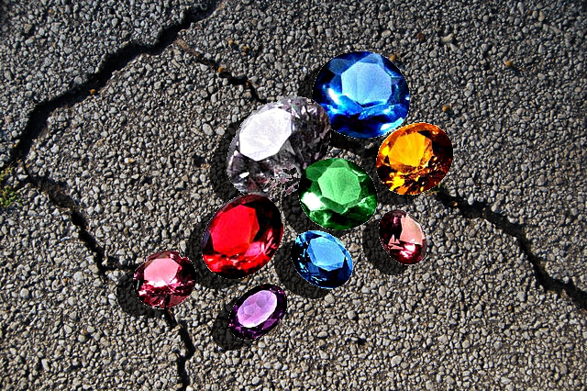
Would someone do this?

Slide 11
Would someone do this?
Why Give the World Something Precious that Belongs to Your Mate?

Slide 12
1 Timothy 2:9-10
Adorn Themselves
In Modest Apparel
with
Propriety
Moderation
What constitutes “unpresentable” parts needing “greater modesty”?

Slide 13
1 Timothy 2:9-10
Adorn Themselves
In Modest Apparel
with
Propriety
Moderation
How does Scripture define this “nakedness” that is “shameful” to uncover to the world?

Slide 14
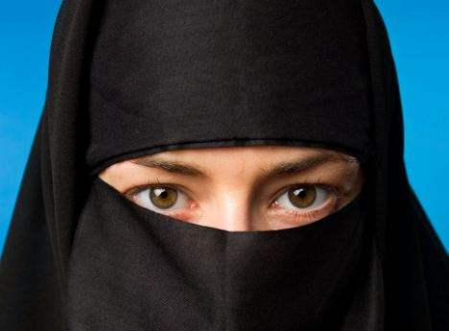
Is this the standard?

Slide 15
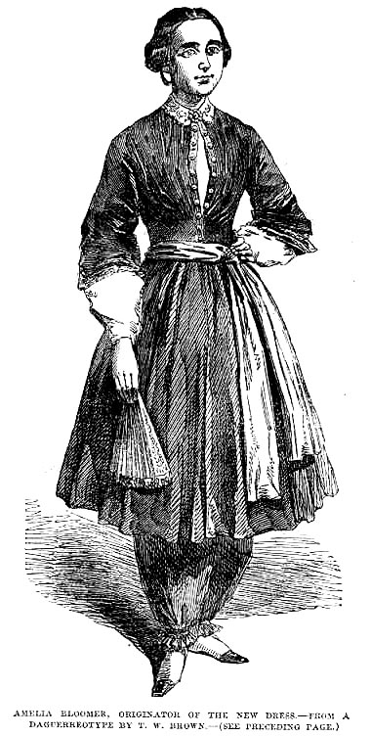
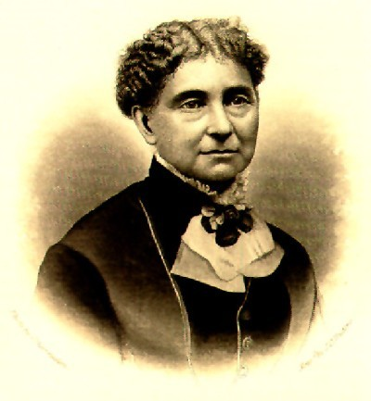
Is this the standard?
Amelia Bloomer
(1818-1894)

Slide 16
1 Timothy 2:9-10
Adorn Themselves
In Modest Apparel
with
Propriety
Moderation
In the garden there was no need for “modesty” (Genesis 2:25).
After sin, they tried to cover themselves (Genesis 3:6-7).

Slide 17
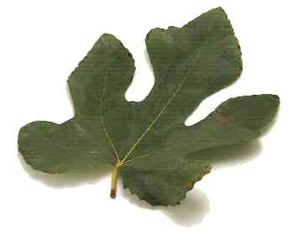
Fig leaves vary in size but even sewn together they were an insufficient covering.

Slide 18
1 Timothy 2:9-10
Adorn Themselves
In Modest Apparel
with
Propriety
Moderation
God made “tunics” for them of animal skins (Genesis 3:21).
“Tunic” kithoneth was a word used throughout ancient world – Chiton.

Slide 19
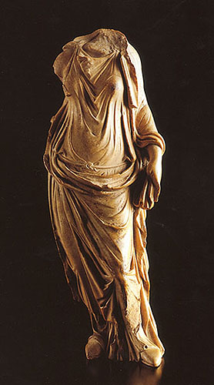
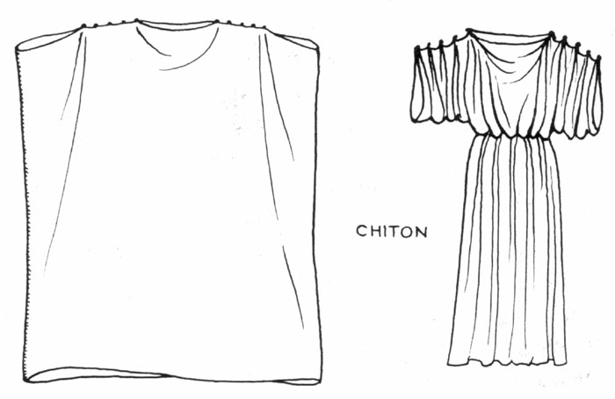
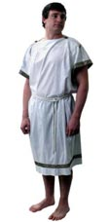
The Ancient Chiton

Slide 20
1 Timothy 2:9-10
Adorn Themselves
In Modest Apparel
with
Propriety
Moderation
No stepped altars lest nakedness be exposed (Exodus 20:26).
Priests wore “tunics” and “trousers” to “cover their nakedness” (Exod. 28:40-43).

Slide 21
1 Timothy 2:9-10
Adorn Themselves
In Modest Apparel
with
Propriety
Moderation
Isaiah 47:2-3 includes “uncovering the thigh” in “uncovering nakedness.”

Slide 22
1 Timothy 2:9-10
Adorn Themselves
In Modest Apparel
Braided Hair
Gold
Pearls
Costly Clothing
with
not with
Propriety
Moderation
Gr. plegma “entwined, woven, braided) (BAGD).
Beauty of the inner person (1 Peter 3:1-6).

Slide 23
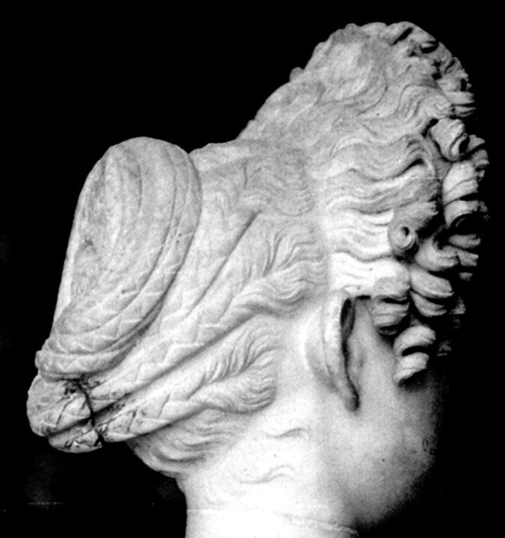
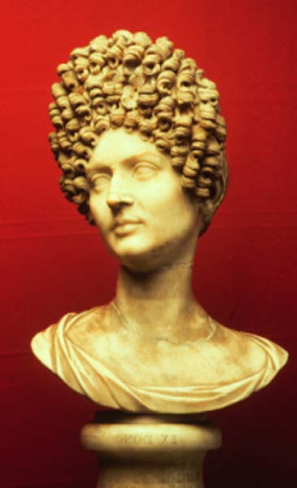
Roman Braiding of Hair

Slide 24
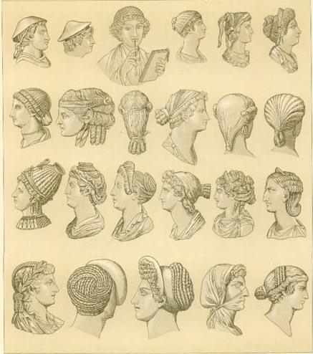
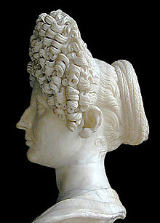
Roman Braiding of Hair

Slide 25
1 Timothy 2:9-10
Adorn Themselves
In Modest Apparel
Braided Hair
Gold
Pearls
Costly Clothing
with
not with
Propriety
Moderation
Servant gave gold bracelets to Rebekah (Gen. 24:22, 53).
James 2:2 condemns favoritism to one with “gold rings” and “fine apparel” but not the one wearing them.

Slide 26
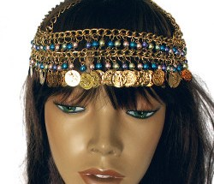
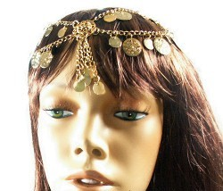
Gold Headdresses

Slide 27
1 Timothy 2:9-10
Adorn Themselves
In Modest Apparel
Braided Hair
Gold
Pearls
Costly Clothing
with
not with
Propriety
Moderation
That Which is Proper For Women Professing…
but
“Proper” Gr. prepo “to be suitable or proper… often used impersonally, it is fit or right)” (Strong’s).

Slide 28
1 Timothy 2:9-10
Adorn Themselves
In Modest Apparel
Braided Hair
Gold
Pearls
Costly Clothing
with
not with
Propriety
Moderation
That Which is Proper For Women Professing…
but
“Professing” Gr. euanggello is in essence “women professing the good news about…”

Slide 29
1 Timothy 2:9-10
Adorn Themselves
In Modest Apparel
Braided Hair
Gold
Pearls
Costly Clothing
with
not with
Propriety
Moderation
That Which is Proper For Women Professing…
but
Gr. theosebeia lit. “fear of God.”
Godliness

Slide 30
1 Timothy 2:9-10
Adorn Themselves
In Modest Apparel
Braided Hair
Gold
Pearls
Costly Clothing
with
not with
Propriety
Moderation
That Which is Proper For Women Professing…
but
with
Godliness
Good Works

Slide 31
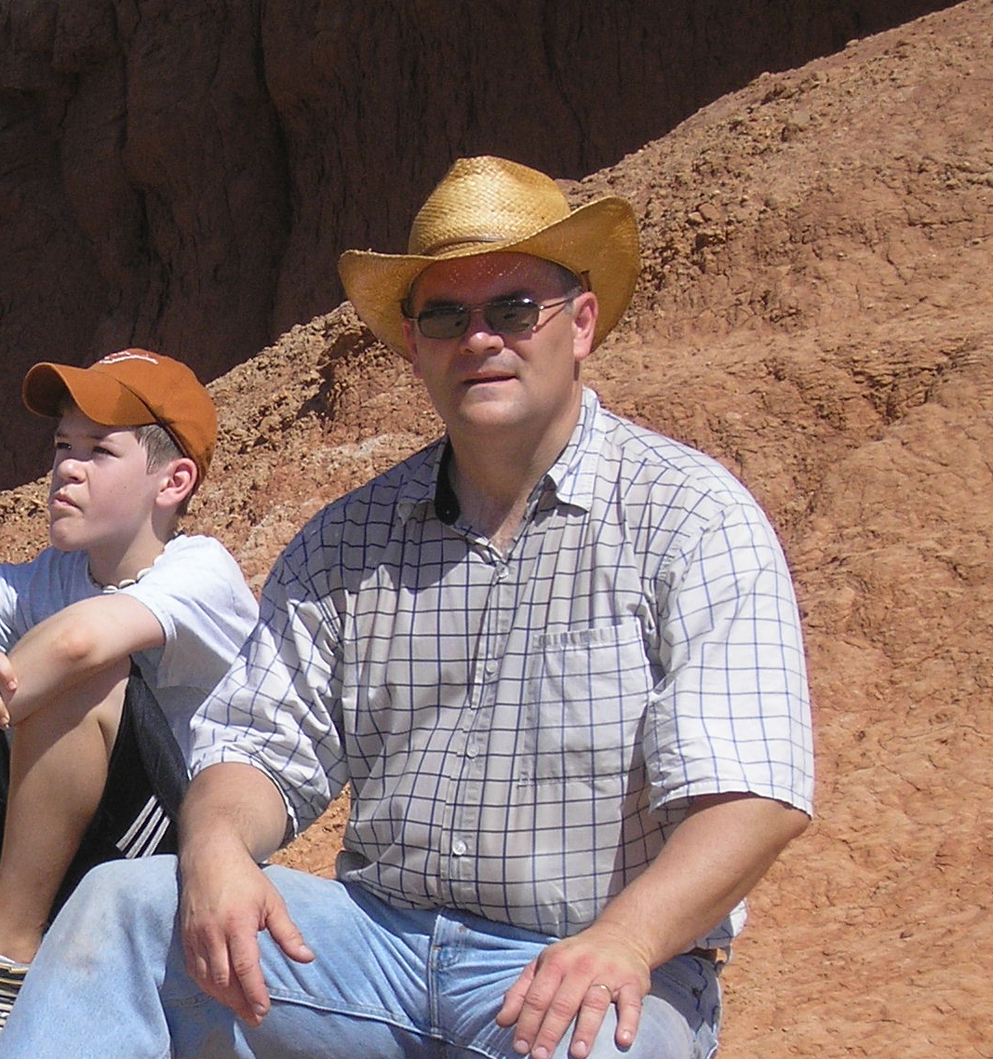
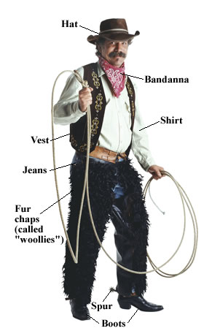
Would I Dress Like This?
If I Preached Against Cowboys…

Slide 32
“Professing Godliness with Good Works”
God teaches that we must not lust (Matthew 5:27-30).
We must give up whatever it takes to do what is right!
We must do all to avoid leading others to sin (Matthew 18:6-9).

Slide 33
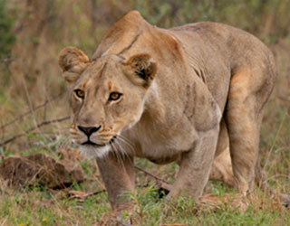
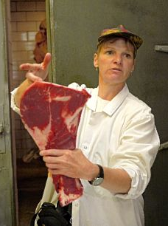
Would you do this?

Slide 34
Would you do this?
Why Risk Tempting Another to Sin?

