Slide 2
The Two Sides of Elijah

Slide 3
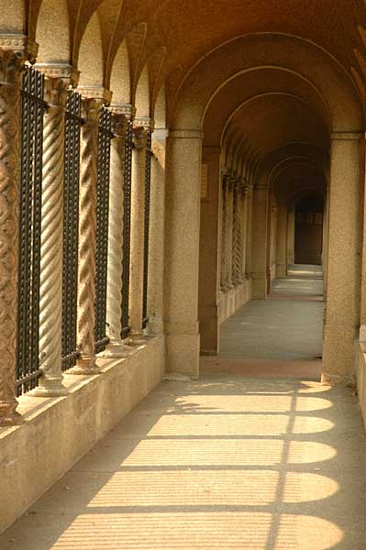
Elijah
Elijah & Moses were at the transfiguration of Christ
The first person raised from the dead was through the hands of Elijah

Slide 4
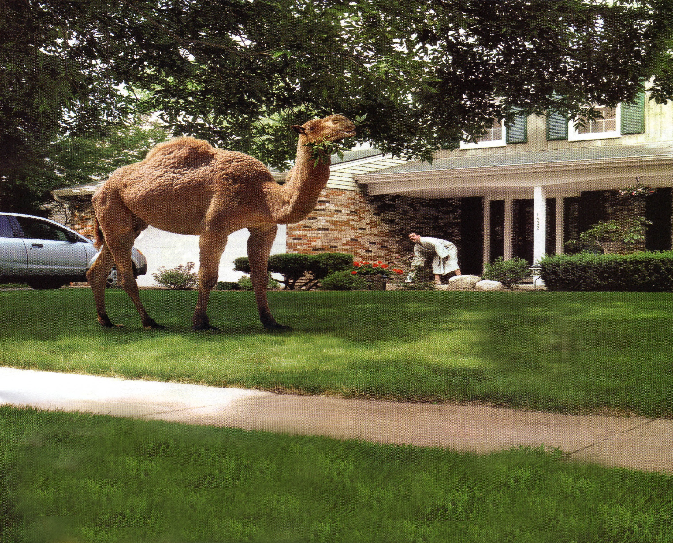
Elijah
James 5:17 “Elijah was a man with a nature like ours…”
NIV: “He was just like us…”

Slide 5

Elijah appeared at a time in Israel’s dark days
Bloodshed, idolatry, assassinations, immorality, conspiracy, deception and cruelty were common
For 6 decades this was the history of Israel

Slide 6

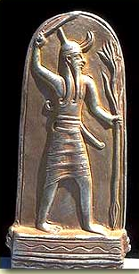
Elijah appeared at a time in Israel’s dark days
Ahab becomes the king, Jezebel the queen
Built idols to Baal
Killed the prophets of God
Supported & promoted the prophets of Baal

Slide 7
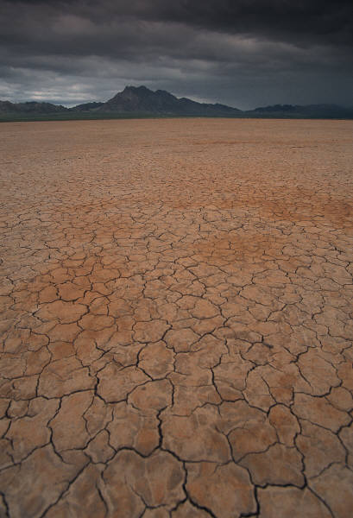
1 Kings 17:1-3 Now Elijah the Tishbite, who was of the settlers of Gilead, said to Ahab, "As the LORD, the God of Israel lives, before whom I stand, surely there shall be neither dew nor rain these years, except by my word.“ And the word of the LORD came to him, saying, "Go away from here and turn eastward, and hide yourself by the brook Cherith, which is east of the Jordan.

Slide 8


1 Kings 18:1-2 After a long time, in the third year, the word of the LORD came to Elijah: "Go and present yourself to Ahab, and I will send rain on the land.“ So Elijah went to present himself to Ahab. Now the famine was severe in Samaria,

Slide 9
1 Kings 18:17-19 And it came about, when Ahab saw Elijah that Ahab said to him, "Is this you, you troubler of Israel?" And he said, "I have not troubled Israel, but you and your father's house have, because you have forsaken the commandments of the LORD, and you have followed the Baals. "Now then send and gather to me all Israel at Mount Carmel, together with 450 prophets of Baal and 400 prophets of the Asherah, who eat at Jezebel's table."

Slide 10

The Chapter 18 side of Elijah
Elijah is strong
He is confident
He is a man of action
He knows what to do
He is a man of faith

Slide 11

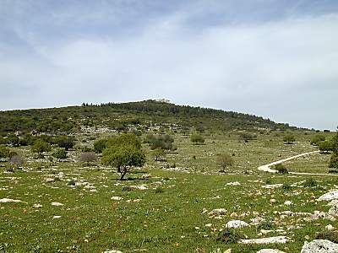
The nation is not like Elijah
18:21 And Elijah came near to all the people and said, "How long will you hesitate between two opinions? If the LORD is God, follow Him; but if Baal, follow him." But the people did not answer him a word.

Slide 12
18:23-29 "Now let them give us two oxen; and let them choose one ox for themselves and cut it up, and place it on the wood, but put no fire under it; and I will prepare the other ox, and lay it on the wood, and I will not put a fire under it. "Then you call on the name of your god, and I will call on the name of the LORD, and the God who answers by fire, He is God." And all the people answered and said, "That is a good idea."

Slide 13
18:23-29 So Elijah said to the prophets of Baal, "Choose one ox for yourselves and prepare it first for you are many, and call on the name of your god, but put no fire under it." Then they took the ox which was given them and they prepared it and called on the name of Baal from morning until noon saying, "O Baal, answer us." But there was no voice and no one answered. And they leaped about the altar which they made.

Slide 14
18:23-29 And it came about at noon, that Elijah mocked them and said, "Call out with a loud voice, for he is a god; either he is occupied or gone aside, or is on a journey, or perhaps he is asleep and needs to be awakened." So they cried with a loud voice and cut themselves according to their custom with swords and lances until the blood gushed out on them. And it came about when midday was past, that they raved until the time of the offering of the evening sacrifice; but there was no voice, no one answered, and no one paid attention.

Slide 15
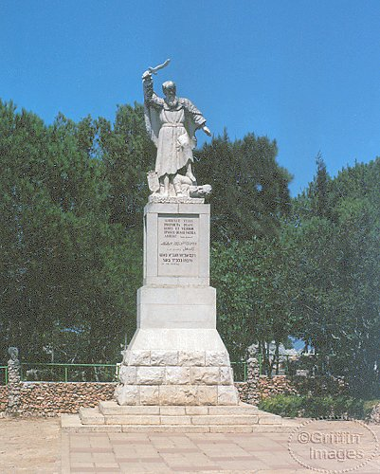
Elijah does three remarkable things
Repaired the broken altar of God (30)
He made a separation (32)
He prayed (36-40)
The contrast is stunning
The response was immediate

Slide 16

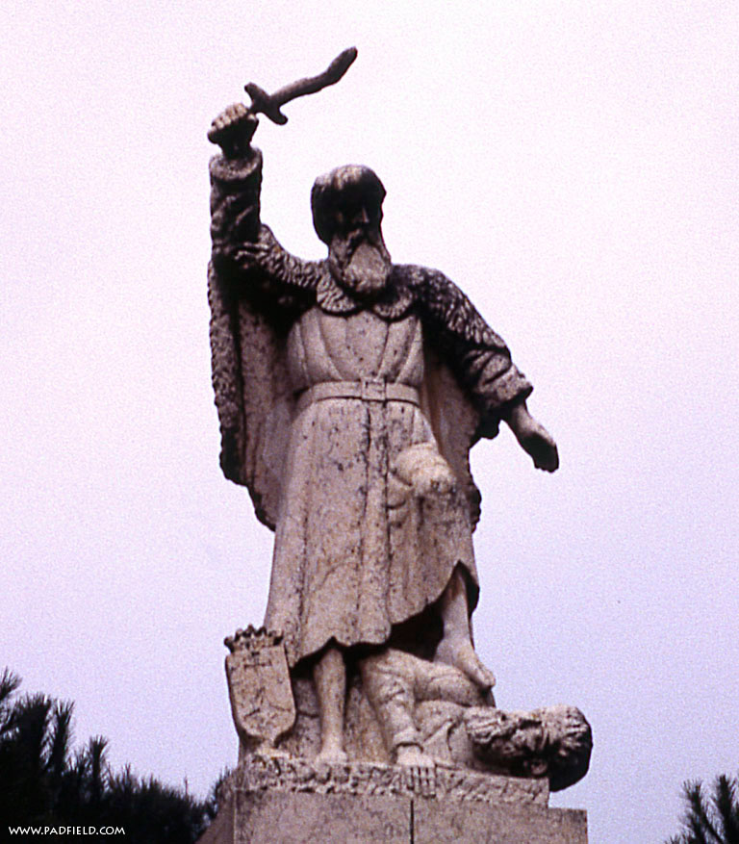
18:39 When all the people saw this, they fell prostrate and cried, "The LORD--he is God! The LORD--he is God!“

Slide 17

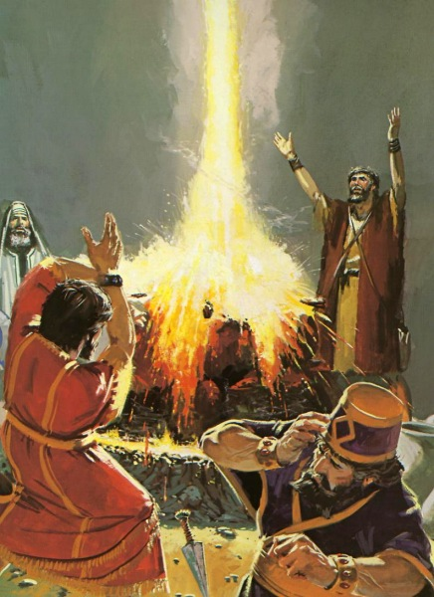
We want to be like this

Slide 18

The chapter 19 side of Elijah
His confidence is gone
The sure answers are not there
Darkness and despair has replaced the great feelings.
Instead of being on a mountain top, he is hiding in a cave

Slide 19
19:1-9 Now Ahab told Jezebel all that Elijah had done, and how he had killed all the prophets with the sword. Then Jezebel sent a messenger to Elijah, saying, "So may the gods do to me and even more, if I do not make your life as the life of one of them by tomorrow about this time." And he was afraid and arose and ran for his life and came to Beersheba, which belongs to Judah, and left his servant there. But he himself went a day's journey into the wilderness, and came and sat down under a juniper tree;

Slide 20
19:1-9 and he requested for himself that he might die, and said, "It is enough; now, O LORD, take my life, for I am not better than my fathers." And he lay down and slept under a juniper tree; and behold, there was an angel touching him, and he said to him, "Arise, eat." Then he looked and behold, there was at his head a bread cake baked on hot stones, and a jar of water. So he ate and drank and lay down again.

Slide 21
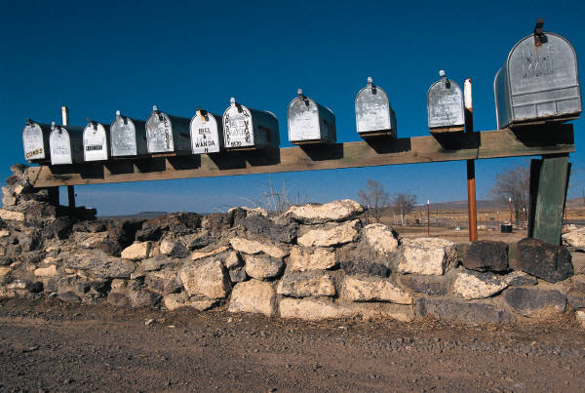
19:1-9 And the angel of the LORD came again a second time and touched him and said, "Arise, eat, because the journey is too great for you." So he arose and ate and drank, and went in the strength of that food forty days and forty nights to Horeb, the mountain of God. Then he came there to a cave, and lodged there; and behold, the word of the LORD came to him, and He said to him, "What are you doing here, Elijah?"

Slide 22

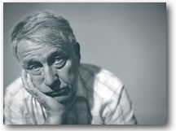
His Discouragement
Came after a mighty victory

Slide 23

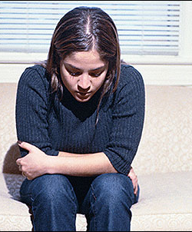
JAMA: “More suffering caused by depression than any other single disease known to man.”
World Health Organization: “Depression will be the leading cause of disability in the developing world by 2020.”
How many have walked away from a marriage and how many have walked away from the Lord, because they were discouraged?

Slide 24
His Discouragement
Came after a mighty victory
Caused him inability to deal with a crisis
Feelings of failure
Desire to quit

Slide 25

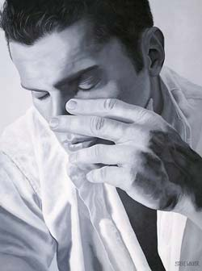
A pessimist is one who feels bad when he feels good for fear he’ll fear worse when he feels better.”
A pessimist is one who smells the flowers and looks around for the coffin.

Slide 26
His Discouragement
Came after a mighty victory
Caused him inability to deal with a crisis
Feelings of failure
Desire to quit
Led to isolation

Slide 27
Chapter 18
Chapter 19
Stand up, stand up for Jesus
Does Jesus care?
Soldiers of Christ arise
When my love for Christ grows weak…
Dare to stand like Joshua
When the way groweth drear…

Slide 28
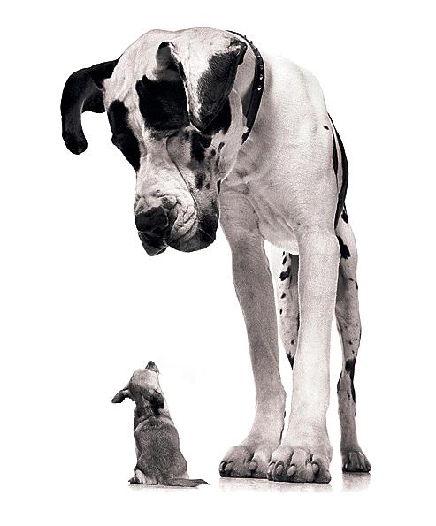
All of us want to be the Elijah of chapter 18
That is not realistic
The God who sent Elijah in chapter 18, came looking for him in chapter 19

Slide 29

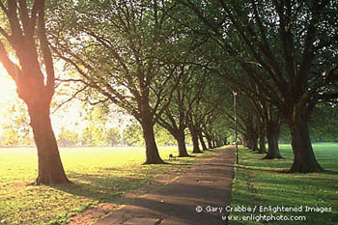
God will not abandon you because you are not having a chapter 18 day

Slide 30

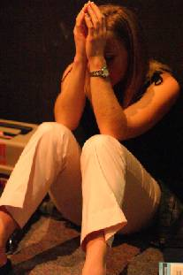
God came to Elijah in a gentle breeze
Discouraged people do not need to be beat up verbally
Discouraged people do not need cheap solutions
They do not need to be made fun of, nor threatened

Slide 31

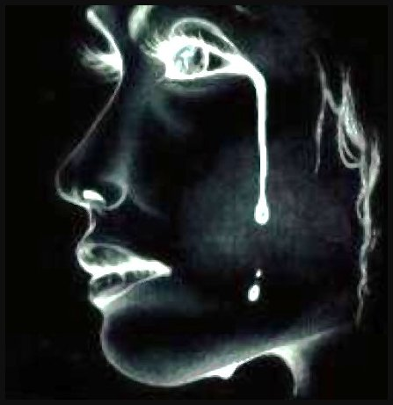
1 Pet 5:7 casting all your anxiety upon Him, because He cares for you.

Slide 32
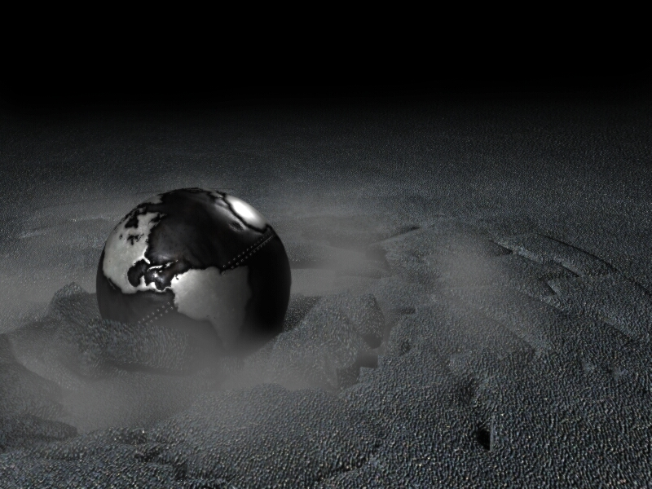
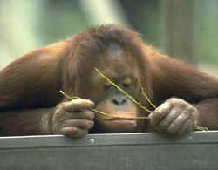
Notice what God does for Elijah
Leave the cave and take care of yourself
Search his heart
To get busy in the work of the kingdom
To believe Him

Slide 33
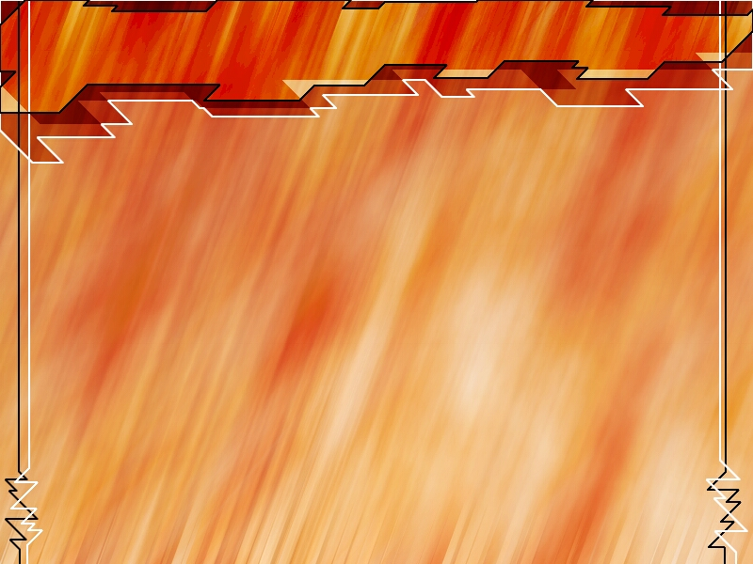
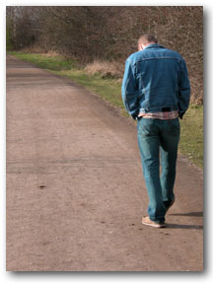
The God who calls you to fight the battle is also the one that will be at your side when you are wounded or simply do not feel like going to fight.

Slide 34

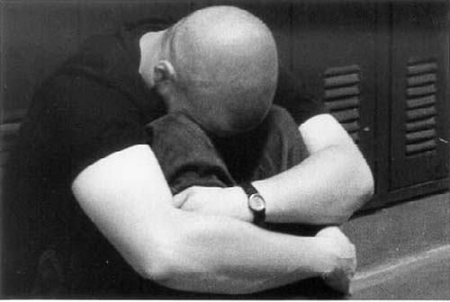
Ps 34:18 The LORD is near to the brokenhearted, And saves those who are crushed in spirit.

Slide 35
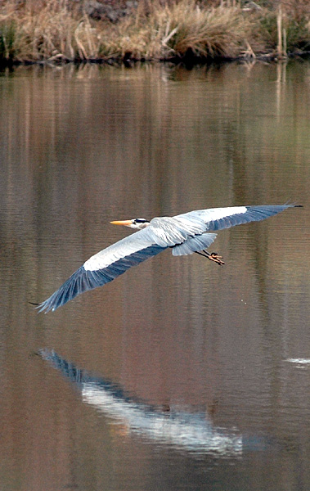
Ps 147:1-6 Praise the LORD! For it is good to sing praises to our God; For it is pleasant and praise is becoming. The LORD builds up Jerusalem; He gathers the outcasts of Israel. He heals the brokenhearted, And binds up their wounds. He counts the number of the stars; He gives names to all of them. Great is our Lord, and abundant in strength; His understanding is infinite. The LORD supports the afflicted; He brings down the wicked to the ground.

Slide 36
Chapter 18
Chapter 19
Chapter 18 will get you through the chapter 19’s of your life.
Chapter 19 reminds us that we need help…we need each other... But mostly, we need Jesus
Without chapter 18 – we crumble and we fail

Slide 37

Elijah
“He was just like us…”

