Slide 1

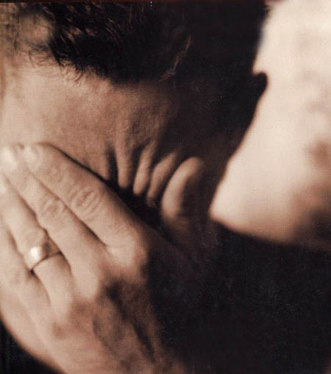
God wants us to Forgive
Mt 6:12, 14, 15 ‘And forgive us our debts, as we also have forgiven our debtors… “For if you forgive others for their transgressions, your heavenly Father will also forgive you. “But if you do not forgive others, then your Father will not forgive your transgressions.

Slide 2

C.S. Lewis: “Forgiveness is a beautiful word until you have something to forgive.”

Slide 3


Slide 4

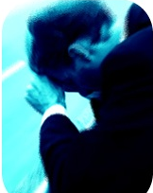
God wants us to Forgive
Jesus said that
Paul said that
Eph 4:32 Be kind to one another, tender-hearted, forgiving each other, just as God in Christ also has forgiven you.

Slide 5
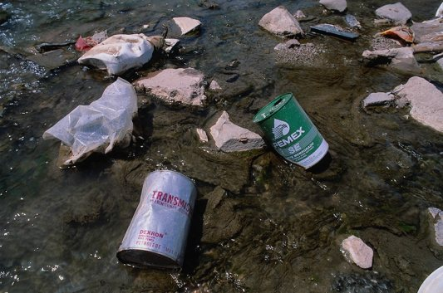
Unforgiveness is a TOXIN

Slide 6

When we refuse to forgive it is like a toxin in our soul
It poisons our heart & mind
It distorts our whole view of life
Anger & resentment feed unhealthy emotions
We become obsessed with the wrong
We feel compelled to tell others
We are left with pain and anger

Slide 7

1. I don’t think I’ll ever get over it. How can I forgive?
2. If I forgive, why do I still hurt so much?
3. If I forgive, do I have to return to the same situation?
4. Do I have to forgive someone who refuses to say they are sorry?
5. If my mate is unfaithful, my options are to divorce or forgive. Right?

Slide 8

6. What if the person is unaware that they have hurt you; unmoved that they hurt you; or unwilling to admit that they have hurt you?

Slide 9

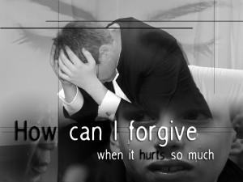
I Still Remember

Slide 10


Urban Legends
We often get the idea that forgiveness is pretending that nothing happened
Others see forgiveness as the complete restoration of a broken relationship including the same levels of trust & privileges
Others tell you that forgiveness means to literally forget what happened

Slide 11

Forgiving means Forgetting

Slide 12

Ps 103:12 As far as the east is from the west, So far has He removed our transgressions from us.
God forgives
Isa 1:18 “Though your sins are as scarlet, They will be as white as snow;
Micah 7:19b He will tread our iniquities under foot. Yes, You will cast all their sins into the depths of the sea.

Slide 13

Isa 43:25 “I, even I, am the one who wipes out your transgressions for My own sake, And I will not remember your sins.
God forgives
Jer 31:34 “They will not teach again, each man his neighbor and each man his brother, saying, ‘Know the LORD,’ for they will all know Me, from the least of them to the greatest of them,” declares the LORD, “for I will forgive their iniquity, and their sin I will remember no more.”

Slide 14

Heb 8:12 “For I will be merciful to their iniquities, And I will remember their sins no more.”
God forgives

Slide 15

When God forgives He forgets
It puts us into some real theological problems
It means that you and I know things God doesn’t
2 Sam 12:13 “The Lord also has taken away your sin…”

Slide 16

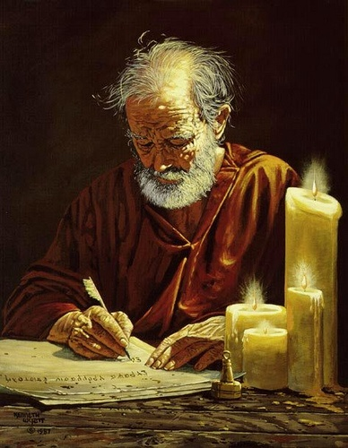
When God forgives He forgets
It puts us into some real theological problems
It also creates a problem with how God inspired people

Slide 17

1 Tim 1:13 even though I was formerly a blasphemer and a persecutor and a violent aggressor. Yet I was shown mercy because I acted ignorantly in unbelief;
God Forgets When He Forgives

Slide 18

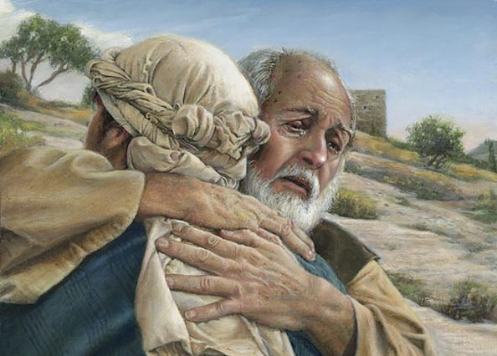
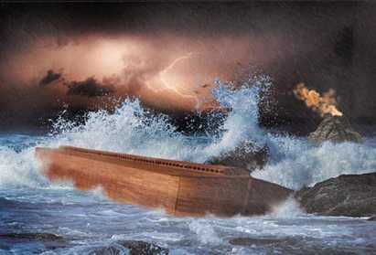
The word “remember” is much more than the opposite of “forget”
When God uses the word “remember” it means to renew His work with a person
Gen 7:23-8:1
But God remembered Noah and all the beasts and all the cattle that were with him in the ark;

Slide 19

When God remembers our sins “no more” it means that he no longer responds to us in light of those sins…they no longer derail our relationship with Him. They no longer garner His wrath.

Slide 20


All the things associated with sin (need for justice; separation; punishment) are gone
Mt 18:27 “released him and forgave him the debt”

Slide 21


The opposite of this is true
Rev 18:4-6a I heard another voice from heaven, saying, “Come out of her, my people, so that you will not participate in her sins and receive of her plagues; for her sins have piled up as high as heaven, and God has remembered her iniquities. “Pay her back even as she has paid, and give back to her double according to her deeds;

Slide 22
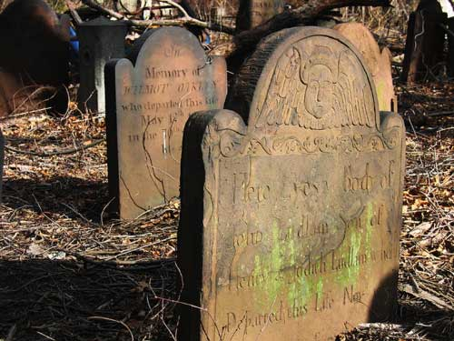
Rom 6:23 For the wages of sin is death, but the free gift of God is eternal life in Christ Jesus our Lord.

Slide 23



1. To forget is not a memory issue, but a relationship issue
2. To forget is not a deficiency of the mind, but a choice of the heart
3. To forget is not to ignore, but rather to restore

Slide 24

Forgiveness is NOT:
1. Saying “It’s alright.”
2. Ignoring a person
3. Simply withholding retribution
4. Denial
5. The same as reconciliation

Slide 25


When You Have Been Hurt You Have Three Options…
1. Get Even (Rom 12:17-21)

Slide 26
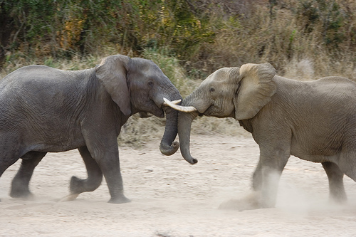
Nigerian Expression: “When two elephants fight, the grass suffers”

Slide 27
When You Have Been Hurt You Have Three Options…
1. Get Even (Rom 12:17-21)
2. Do nothing
3. To Forgive

Slide 28
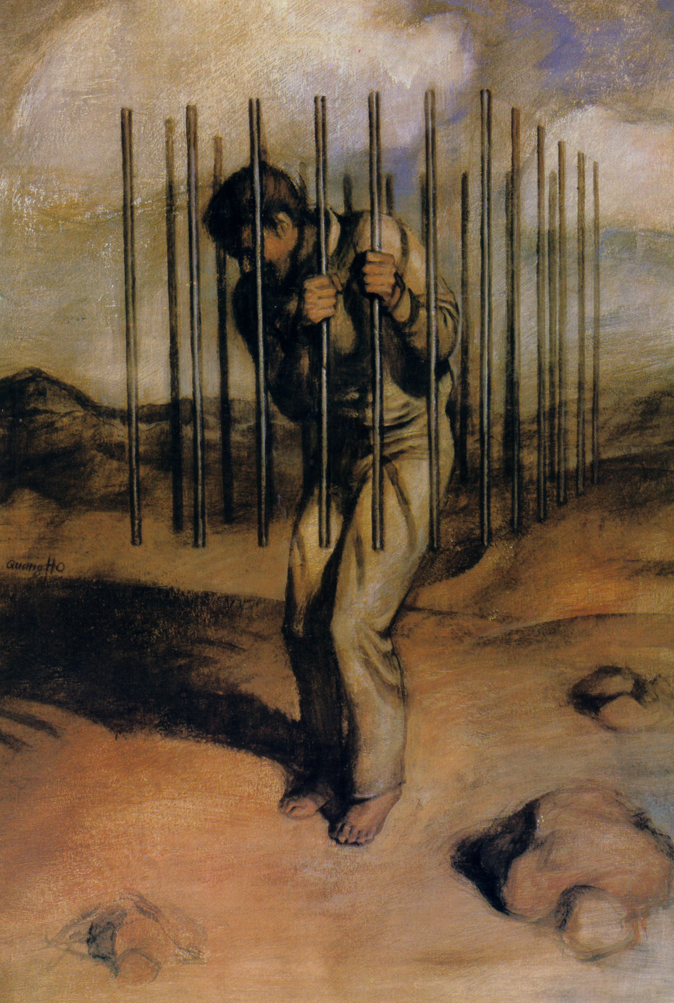

The word “forgive” means to “release”
Mt 18:21-35
Release of my feelings
Release of my right to hurt you for hurting me
Release of your obligation to me

Slide 29
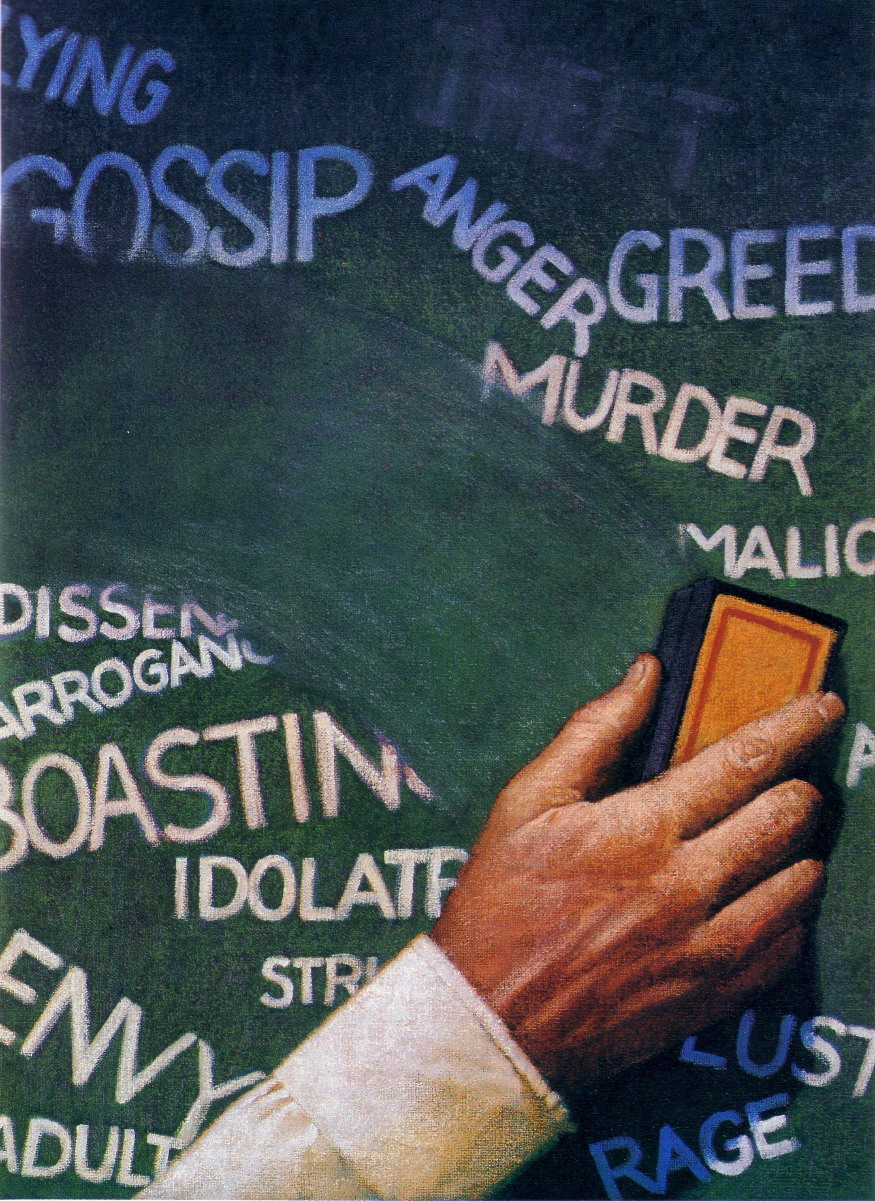
Forgiveness is an attitude
Forgiveness is an act of Grace

Slide 30

The Choice of Forgiveness

Slide 31

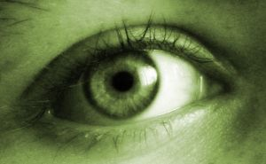
Three things God’s Forgiveness does not do
1. It does not remove consequences
2. It does not fix everything broken
3. It does not mean people will forgive you

Slide 32


It helps to remember that I have been forgiven
It helps to want the best and spend time with the Lord
It helps to leave room for God to be God

Slide 33


