Slide 2

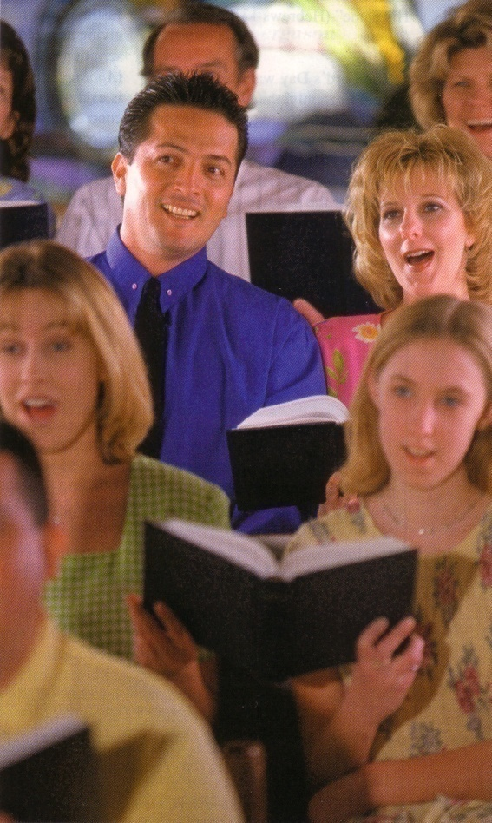
“What does it mean to be a church member?”

Slide 3

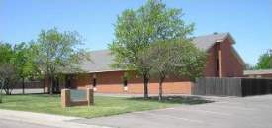
What Does It Mean To Belong?

Slide 4

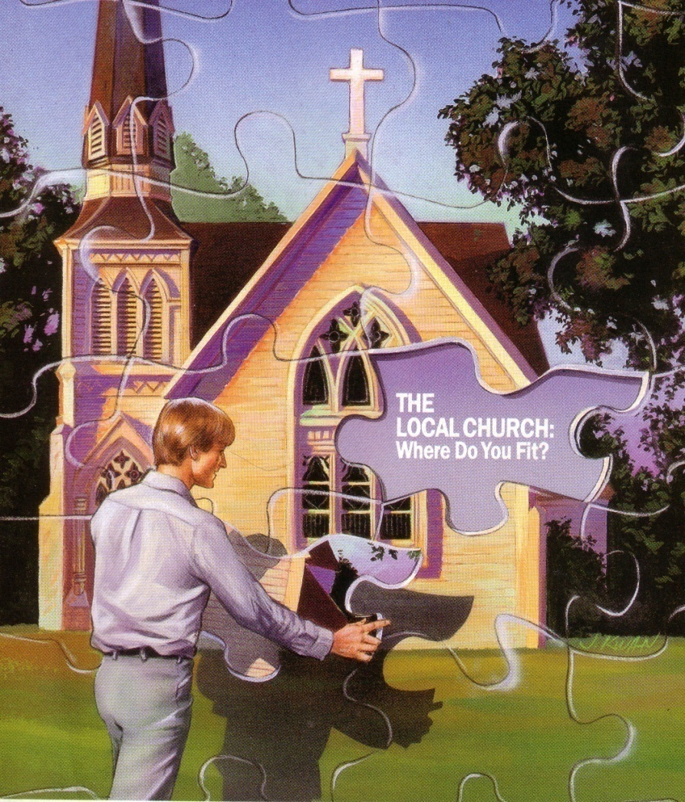
A Christian is three things:
1. He is a Believer
2. He is a Becomer
3. He is a Belonger

Slide 5
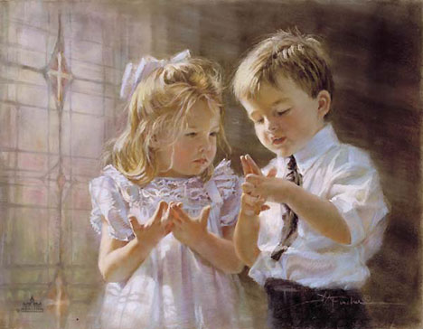

Slide 6

We are sheep in the flock (Jn 10:16)

Slide 7
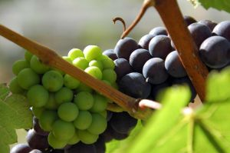
We are branches on a vine (Jn 15:5)

Slide 8

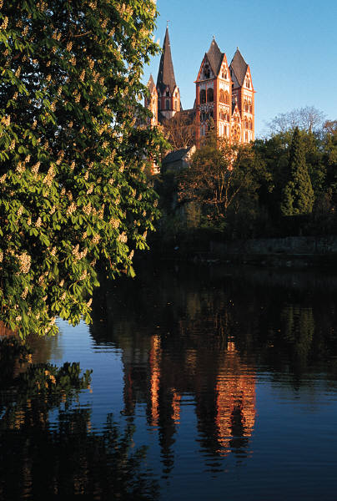
We are citizens in the kingdom (Jn 3:5)

Slide 9


We are children in the family (1 Tim 3:15)

Slide 10

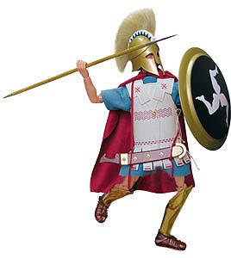
We are soldiers in the army (2 Tim 2:3)

Slide 11
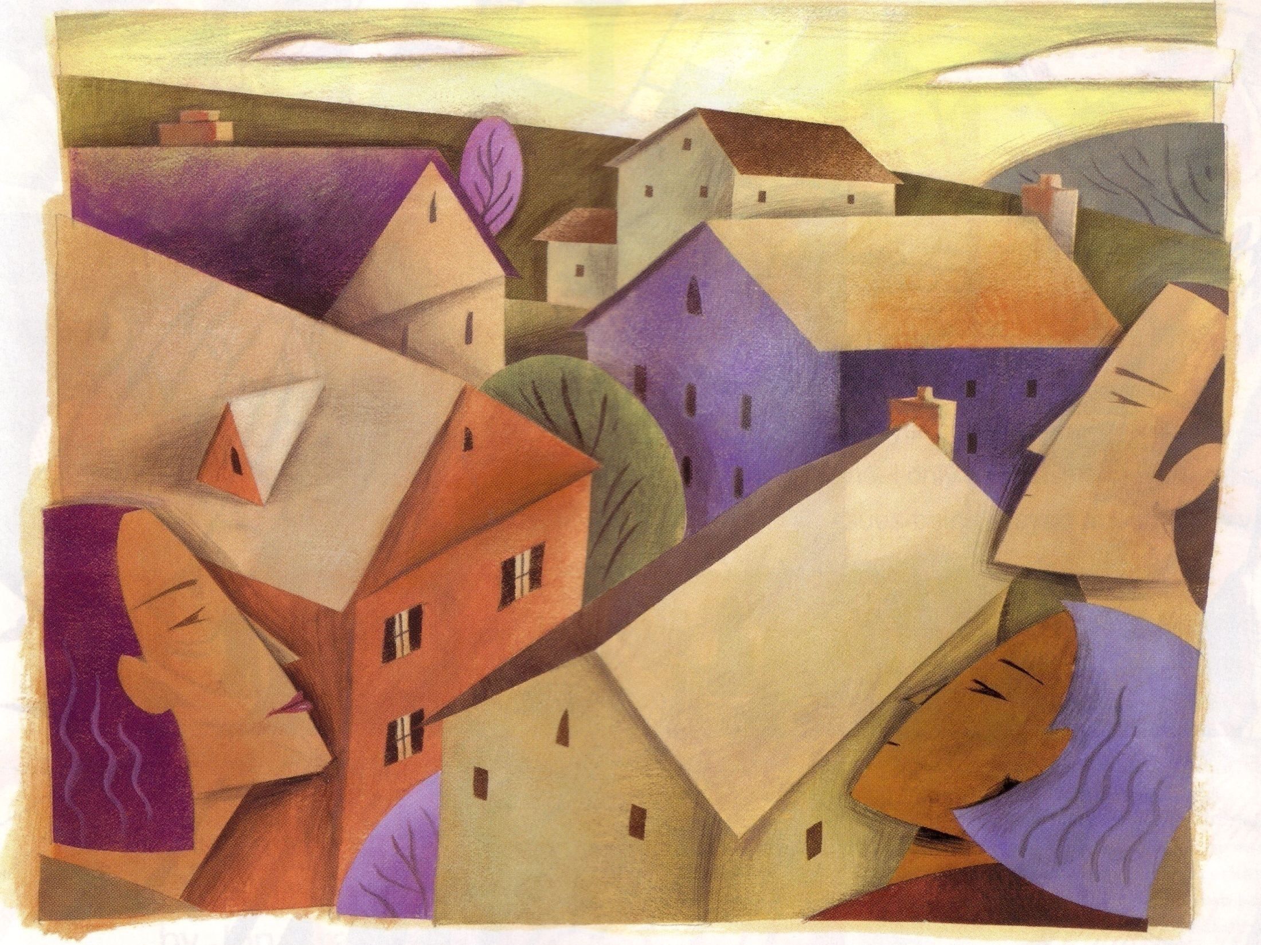
These illustrations teach three valuable principles:
we are joined together
involves function
implies unity

Slide 12

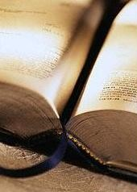
1 Cor. 12:12-27

Slide 13

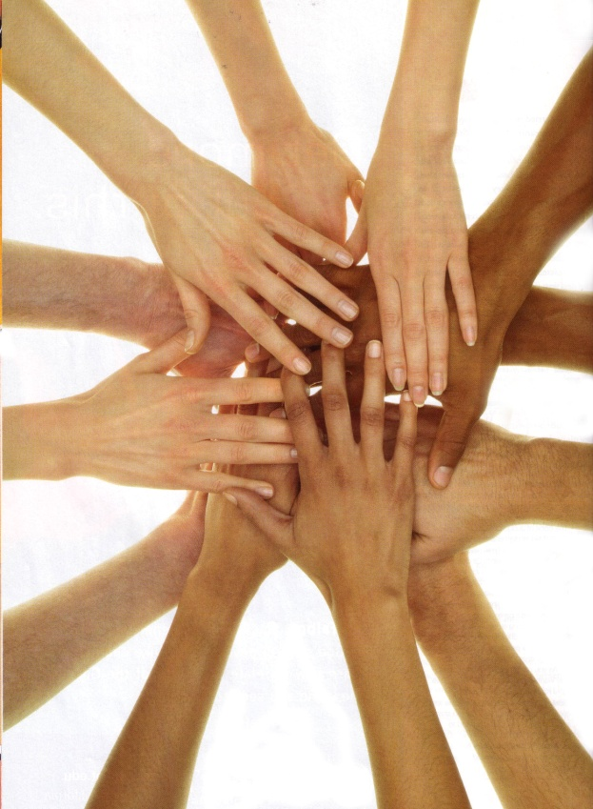
1. Realize we are connected

Slide 14

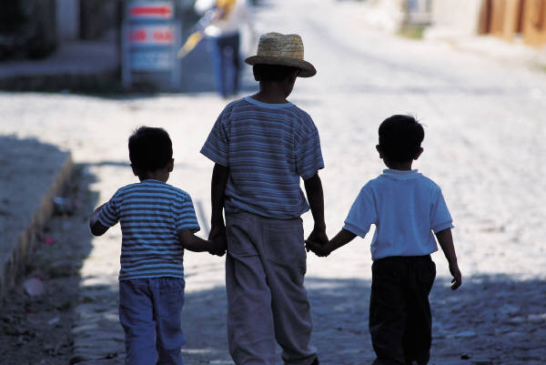
Romans 12:4-5 “For just as we have many members in one body and all the members do not have the same function, so we, who are many, are one body in Christ, and individually members of one another.”

Slide 15
Love one another (9)
Honor one another (10)
Empathize with one another (15)
Get along with one another (16)
Be honest with one another (17)
Be good to one another (21)

Slide 16

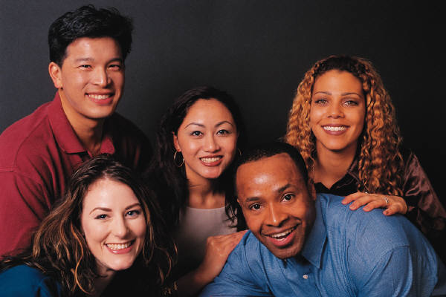
Being connected implies two thoughts
We give and receive from one another
There is an awareness of one another

Slide 17

2. Grasp the value of one another
1 Cor 12:26 “And if one member suffers, all the members suffer with it; if one member is honored, all the members rejoice with it”

Slide 18

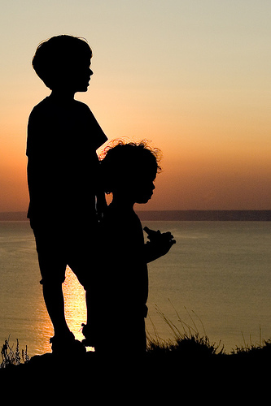
Mt 25:40 “The king will answer and say to them, ‘Truly I say to you, to the extent that you did it to one of these brothers of Mine, even the least of them, you did it to me”

Slide 19

Heb. 13:7, 24

Slide 20


3. Become a team player
Hitchhiker

Slide 21

When we become members of a congregation we take on responsibility
To help with the growth of the body (Eph 4:16)
To help unify the body (Eph 4:3)
To help purify the body (Eph 5:27)
To help maintain the reputation of the body (Phil 2:15)

Slide 22

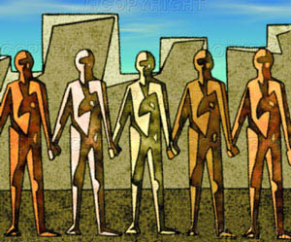
Our attitude and spirit has much to do with this responsibility

Slide 23

Spirit of gratitude
Spirit of enthusiasm
Spirit of diligence
Spirit of “open eyes”
Spirit of positiveness
Spirit of persistence

Slide 24

What do you as a member owe?
Need to attend
Need to be available to others
Need to support others
Need to praise God

Slide 25

This is what it means to belong

