Slide 1
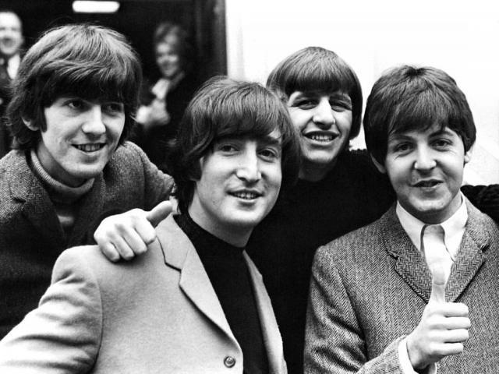
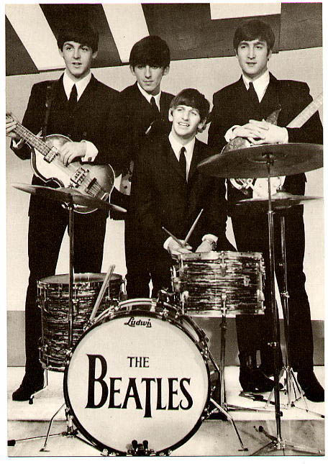
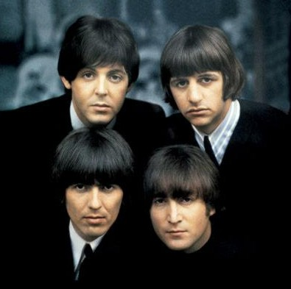
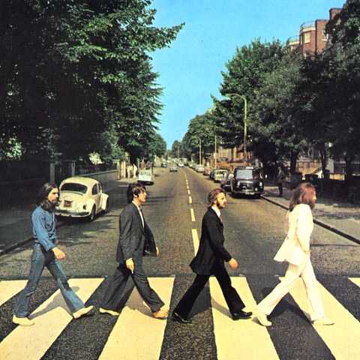

Slide 2

Harmony

Slide 3


1 Peter 3:8
To sum up, all of you be harmonious, sympathetic, brotherly, kindhearted, and humble in spirit;
ESV: have the unity of mind

Slide 4
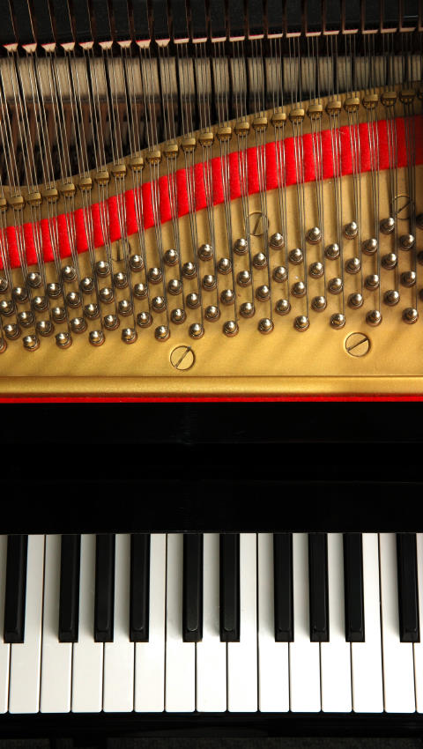
Blending
Together

Slide 5


Phil 2:2 be of the same mind
Phil 1:27 one spirit
Rom 15:6 one voice

Slide 6


Where harmony and unity exist, it is a beautiful thing

Slide 7
Psalm 133:1-3
Behold, how good and how pleasant it is for brothers to dwell together in unity! It is like the precious oil upon the head, Coming down upon the beard, Even Aaron's beard, Coming down upon the edge of his robes. It is like the dew of Hermon Coming down upon the mountains of Zion; For there the LORD commanded the blessing- life forever
refreshing
invigorating
encouraging

Slide 8

John 17:21,23
that they may all be one; even as You, Father, are in Me and I in You, that they also may be in Us, so that the world may believe that You sent Me.
Inviting to the world
I in them and You in Me, that they may be perfected in unity, so that the world may know that You sent Me, and loved them, even as You have loved Me.

Slide 9
How does God Bring Us Together?

Slide 10

It doesn’t just happen
Acts 6:1
Now at this time while the disciples were increasing in number, a complaint arose on the part of the Hellenistic Jews against the native Hebrews, because their widows were being overlooked in the daily serving of food.

Slide 11
Acts 15:36-39 After some days Paul said to Barnabas, "Let us return and visit the brethren in every city in which we proclaimed the word of the Lord, and see how they are." Barnabas wanted to take John, called Mark, along with them also. But Paul kept insisting that they should not take him along who had deserted them in Pamphylia and had not gone with them to the work. And there occurred such a sharp disagreement that they separated from one another, and Barnabas took Mark with him and sailed away to Cyprus.

Slide 12


Philippians 4:2
I urge Euodia and I urge Syntyche to live in harmony in the Lord.

Slide 13

James 2:2-3
For if a man comes into your assembly with a gold ring and dressed in fine clothes, and there also comes in a poor man in dirty clothes, and you pay special attention to the one who is wearing the fine clothes, and say, "You sit here in a good place," and you say to the poor man, "You stand over there, or sit down by my footstool,"

Slide 14
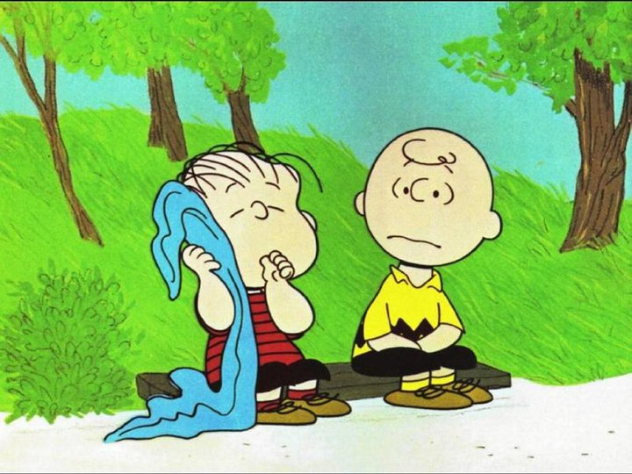

Slide 15





Slide 16

The people that we ought to care about the most are the very ones’ that cause us the most heartache and grief

Slide 17


The lack of harmony results in tension and divisions

Slide 18

How can I love the people in the church when I don’t even like them?

Slide 19

Philip Yancey observed that when Jesus was on earth, troubled people ran to Him to find refuge. Now it seems they are running from His church. What has happened?

Slide 20

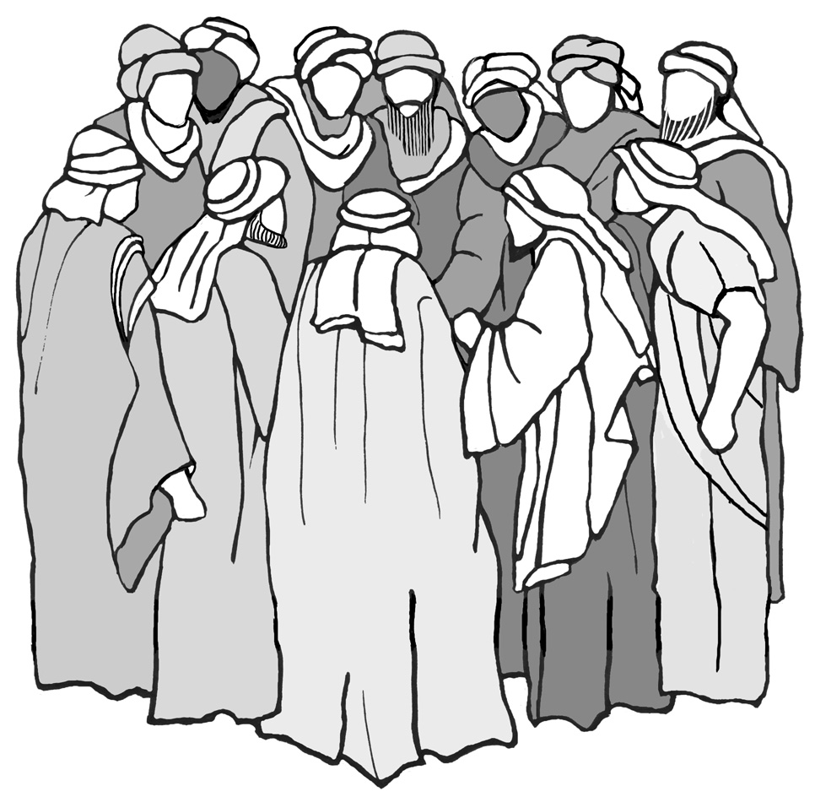
Harmony begins with Christ
they were not public speakers
they had no outstanding talents
they were not people in which you saw future stardom
they were not rabbis or preachers

Slide 21

Harmony begins with Christ
1. They were not all the same
- 11 from Galilee and one from Judea
- 11 who were typical and one tax collector
11
1 Judea
Galilee
- one who was a zealot
- one who was outspoken
- Jesus called two of them, “sons of thunder”

Slide 22
Harmony begins with Christ
1. They were not all the same
- 11 from Galilee and one from Judea
- 11 who were typical and one tax collector
11
1 tax collector
typical
- one who was a zealot
- one who was outspoken
- Jesus called two of them, “sons of thunder”

Slide 23
Harmony begins with Christ
1. They were not all the same
- 11 from Galilee and one from Judea
- 11 who were typical and one tax collector
11
1 Zealot
- one who was a zealot
- one who was outspoken
- Jesus called two of them, “sons of thunder”

Slide 24
Harmony begins with Christ
1. They were not all the same
11
1 Out spoken

Slide 25


Harmony begins with Christ
1. They were not all the same
2. They were judgmental
Luke 9:53-54
But they did not receive Him, because He was traveling toward Jerusalem. When His disciples James and John saw this, they said, "Lord, do You want us to command fire to come down from heaven and consume them?"

Slide 26


Harmony begins with Christ
1. They were not all the same
2. They were judgmental
They were selfish
Mark 9:33-34
They came to Capernaum; and when He was in the house, He began to question them, "What were you discussing on the way?" But they kept silent, for on the way they had discussed with one another which of them was the greatest.

Slide 27


Harmony begins with Christ
1. They were not all the same
2. They were judgmental
They were selfish
4. They lacked faith
Mark 4:40
And He said to them, "Why are you afraid? Do you still have no faith?"

Slide 28


Harmony begins with Christ
1. They were not all the same
2. They were judgmental
They were selfish
4. They lacked faith
5. They lacked understanding

Slide 29

John 14:8-9
Philip said to Him, "Lord, show us the Father, and it is enough for us." Jesus said to him, "Have I been so long with you, and yet you have not come to know Me, Philip? He who has seen Me has seen the Father; how can you say, 'Show us the Father'?

Slide 30
Mark 8:19-21
when I broke the five loaves for the five thousand, how many baskets full of broken pieces you picked up?" They said to Him, "Twelve." "When I broke the seven for the four thousand, how many large baskets full of broken pieces did you pick up?" And they said to Him, "Seven." And He was saying to them, "Do you not yet understand?"

Slide 31


Harmony begins with Christ
1. They were not all the same
2. They were judgmental
They were selfish
4. They lacked faith
5. They lacked understanding
6. They lacked commitment
Mark 14:50
And they all left Him and fled.

Slide 32

Luke 6:40
A pupil is not above his teacher; but everyone, after he has been fully trained, will be like his teacher.
they saw that Jesus put others first
they saw that Jesus loved
they saw that Jesus glorified the Father in all things

Slide 33


Their natures changed

Slide 34
Isaiah 11:6-9
And the wolf will dwell with the lamb, And the leopard will lie down with the young goat, And the calf and the young lion and the fatling together; And a little boy will lead them. Also the cow and the bear will graze, Their young will lie down together, And the lion will eat straw like the ox. The nursing child will play by the hole of the cobra, And the weaned child will put his hand on the viper's den. They will not hurt or destroy in all My holy mountain, For the earth will be full of the knowledge of the LORD

Slide 35
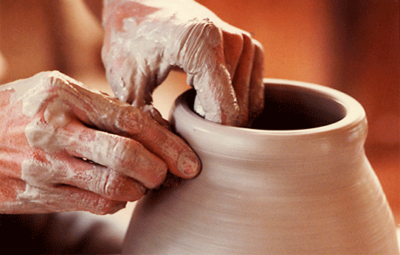
Isaiah 64:8
But now, O LORD, You are our Father,
We are the clay, and You our potter; And all of us are the work of Your hand.

Slide 36


1 Peter 3:8
To sum up, all of you be harmonious, sympathetic, brotherly, kindhearted, and humble in spirit;

Slide 37
1 Peter 3:8
To sum up, all of you be harmonious, sympathetic, brotherly, kindhearted, and humble in spirit;
care

Slide 38
1 Peter 3:8
To sum up, all of you be harmonious, sympathetic, brotherly, kindhearted, and humble in spirit;
care
connected

Slide 39
1 Peter 3:8
To sum up, all of you be harmonious, sympathetic, brotherly, kindhearted, and humble in spirit;
care
connected
compassionate

Slide 40
1 Peter 3:8
To sum up, all of you be harmonious, sympathetic, brotherly, kindhearted, and humble in spirit;
care
connected
compassionate
crucify self

Slide 41

Philippians 4:2
I urge Euodia and I urge Syntyche to live in harmony in the Lord.
this problem was serious enough that Paul addressed it

Slide 42
Philippians 1:27
Only conduct yourselves in a manner worthy of the gospel of Christ, so that whether I come and see you or remain absent, I will hear of you that you are standing firm in one spirit, with one mind striving together for the faith of the gospel;

Slide 43
Philippians 2:2-5
make my joy complete by being of the same mind, maintaining the same love, united in spirit, intent on one purpose. Do nothing from selfishness or empty conceit, but with humility of mind regard one another as more important than yourselves; do not merely look out for your own personal interests, but also for the interests of others. Have this attitude in yourselves which was also in Christ Jesus,

Slide 44
Philippians 4:2
I urge Euodia and I urge Syntyche to live in harmony in the Lord.
this problem was serious enough that Paul addressed it
Paul didn’t take sides—he doesn’t address the issue that caused it
The admonition is the same…I urge…I urge

Slide 45
Philippians 4:2
I urge Euodia and I urge Syntyche to live in harmony in the Lord.
He reminded them who they were; what they were after; and what they had done

Slide 46
Philippians 4:3
Indeed, true companion, I ask you also to help these women who have shared my struggle in the cause of the gospel, together with Clement also and the rest of my fellow workers, whose names are in the book of life.

Slide 47
Philippians 4:2
I urge Euodia and I urge Syntyche to live in harmony in the Lord.
Paul expected them to harmonize
2 Cor 5:18 “God…settled the relationship between us and Him and then called us to settle our relationship with each other” (Peterson).

Slide 48
Philippians 4:2
I urge Euodia and I urge Syntyche to live in harmony in the Lord.
Indeed, true companion, I ask you also to help these women…(v. 3)
Paul asked others to help (4:3)

Slide 49
Blending
Together

