Slide 1
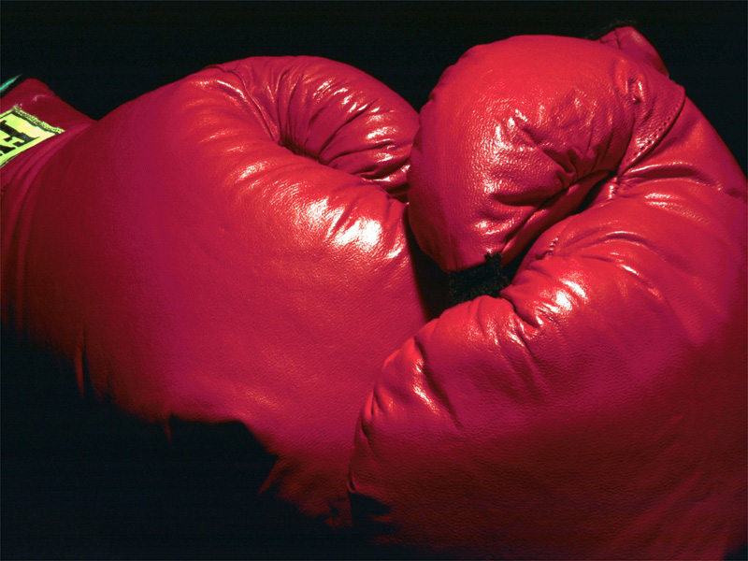
When Christians have acted “unchristian” to us it is very troubling. We expect our enemies to hurt us. One of the hardest things to understand is why our own brethren disappoint and hurt us.

Slide 2
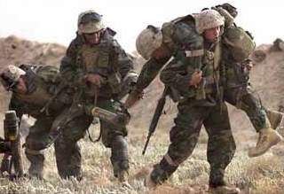
Wounded by Friendly Fire

Slide 3


2 Timothy 4: A Chapter of Contrasts
Wonderful Principles
preach the word; be ready in season and out of season; reprove, rebuke, exhort, with great patience and instruction. (4:2)

Slide 4

2 Timothy 4: A Chapter of Contrasts
Sterling Examples
I have fought the good fight, I have finished the course, I have kept the faith (4:7)

Slide 5

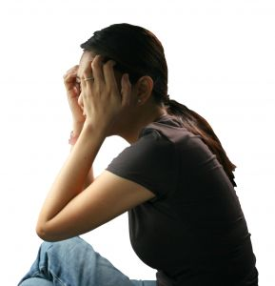
2 Timothy 4: A Chapter of Contrasts
Great Disappointments
and will turn away their ears from the truth, and will turn aside to myth (4:4)

Slide 6

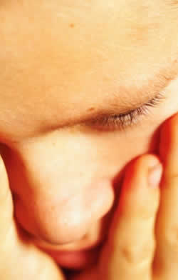
2 Timothy 4: A Chapter of Contrasts
Great Disappointments
for Demas, having loved this present world, has deserted me (4:10)

Slide 7

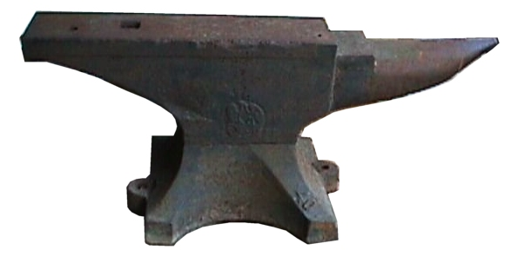
2 Timothy 4: A Chapter of Contrasts
Great Disappointments
Alexander the coppersmith did me much harm (4:14)

Slide 8


2 Timothy 4: A Chapter of Contrasts
Great Disappointments
At my first defense no one supported me, but all deserted me (4:16)

Slide 9

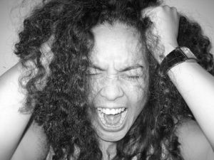
1 Cor 1:11-12 Division
1 Cor 6:6 lawsuits against each other
1 Cor 11:30 many are weak, sick and asleep
1 Cor 15:12 saying there is no resurrection

Slide 10

Phil 1:12-17 tried to harm Paul
Phil 4:2 sisters not getting along
Acts 20:29-30 elders who were going to divide church
Gal 1:7 teaching a different gospel

Slide 11

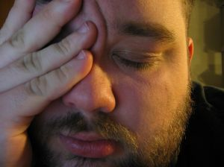
When we have been hurt by fellow Christians
It is shocking to us

Slide 12
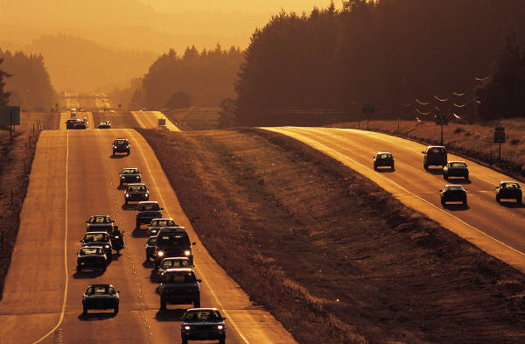
When we have been hurt by fellow Christians
Eph 5:3-4 But do not let immorality or any impurity or greed even be named among you, as is proper among saints; and there must be no filthiness and silly talk, or coarse jesting, which are not fitting, but rather giving of thanks.

Slide 13


When we have been hurt by fellow Christians
It is shocking to us
It undermines all the good that is trying to be done

Slide 14

The greatest single cause of atheism in the world today is Christians who acknowledge Jesus with their lips then walk out the door and deny him by their lifestyle. That is what an unbelieving world simply finds unbelievable.

Slide 15


When we have been hurt by fellow Christians
It is shocking to us
It undermines all the good that is trying to be done
It discourages
Gal 4:11 I fear for you, that perhaps I have labored over you in vain.

Slide 16

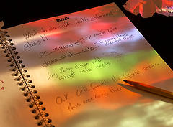
What should you do when you have been hurt by another Christian?
1. Don’t be vindictive
2. God has a plan for what to do

Slide 17

Mt 18:15-17 "And if your brother sins, go and reprove him in private; if he listens to you, you have won your brother. "But if he does not listen to you, take one or two more with you, so that BY THE MOUTH OF TWO OR THREE WITNESSES EVERY FACT MAY BE CONFIRMED. "And if he refuses to listen to them, tell it to the church; and if he refuses to listen even to the church, let him be to you as a Gentile and a tax-gatherer.

Slide 18

First, pray
Next, think about what you want to say
Don’t attack character
Don’t bring up things unrelated to the problem
Express clearly how you feel
Give the person an opportunity to apologize
Forgive them

Slide 19
Mt 18:15-17 "And if your brother sins, go and reprove him in private; if he listens to you, you have won your brother. "But if he does not listen to you, take one or two more with you, so that BY THE MOUTH OF TWO OR THREE WITNESSES EVERY FACT MAY BE CONFIRMED. "And if he refuses to listen to them, tell it to the church; and if he refuses to listen even to the church, let him be to you as a Gentile and a tax-gatherer.

Slide 20

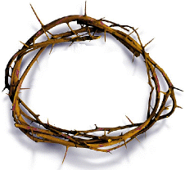
What should you do when you have been hurt by another Christian?
1. Don’t be vindictive
2. God has a plan for what to do
3. Realize that Jesus never let you down

Slide 21

Never a time He talked out of turn
Never a time He gossiped
Never a time He wasn’t there for you
Never a time He gave up on you

Slide 22

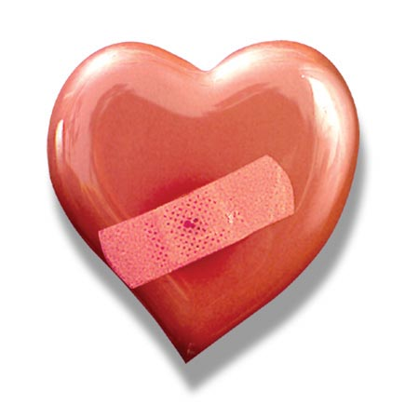
What should you do when you have been hurt by another Christian?
1. Don’t be vindictive
2. God has a plan for what to do
3. Realize that Jesus never let you down
4. Don’t use your hurt as an excuse to hurt others

Slide 23
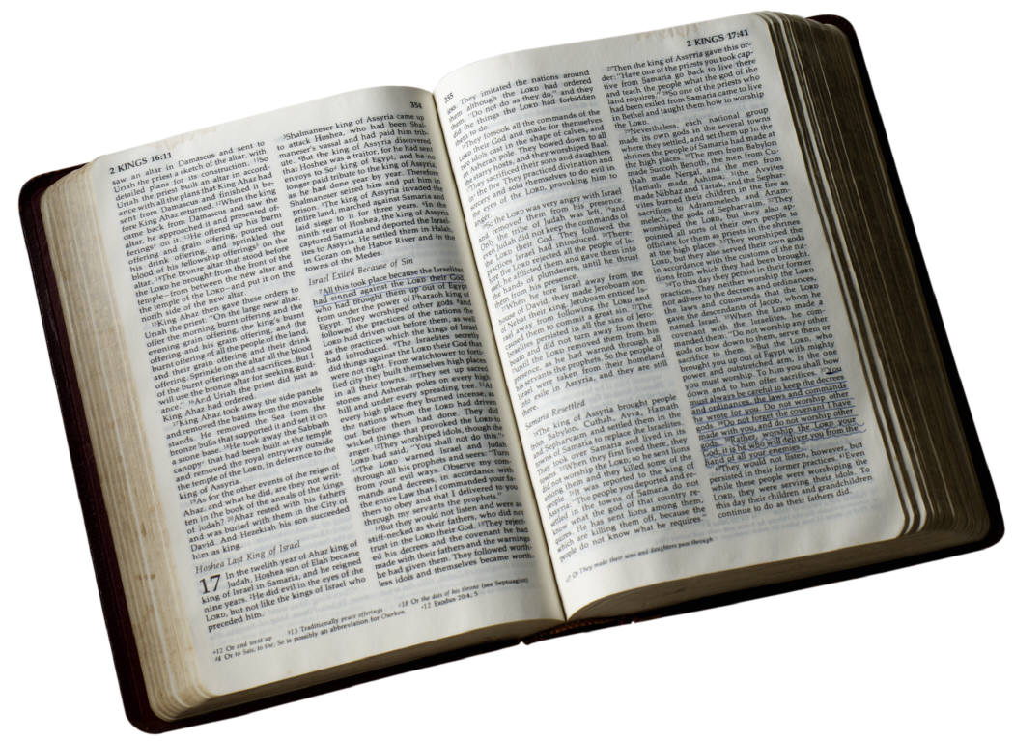
1 Jn 3:23 And this is His commandment, that we believe in the name of His Son Jesus Christ, and love one another, just as He commanded us.

Slide 24

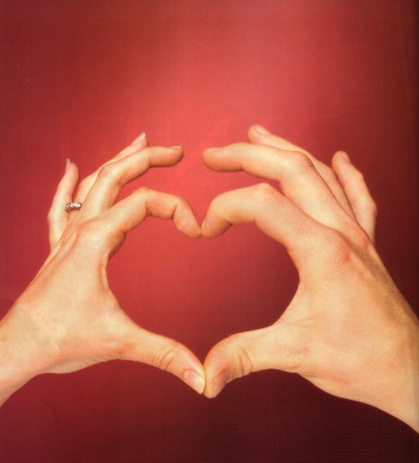
1 Jn 4:7-8 Beloved, let us love one another, for love is from God; and everyone who loves is born of God and knows God. The one who does not love does not know God, for God is love.

Slide 25

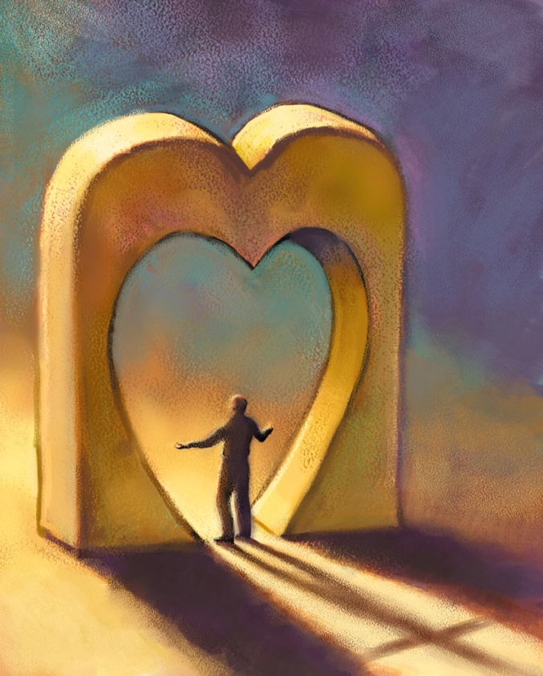

1 Jn 4:11-12 Beloved, if God so loved us, we also ought to love one another. No one has beheld God at any time; if we love one another, God abides in us, and His love is perfected in us.

Slide 26

1 Jn 4:20-21 If someone says, "I love God," and hates his brother, he is a liar; for the one who does not love his brother whom he has seen, cannot love God whom he has not seen. And this commandment we have from Him, that the one who loves God should love his brother also.

Slide 27

What should you do when you have been hurt by another Christian?
1. Don’t be vindictive
2. God has a plan for what to do
3. Realize that Jesus never let you down
4. Don’t use your hurt as an excuse to hurt others
5. Don’t judge everyone by the behavior of a few

Slide 28


2 Tim 4:11 Pick up Mark and bring him with you, for he is useful to me for service.

Slide 29

Rev 7:9-17

Slide 30
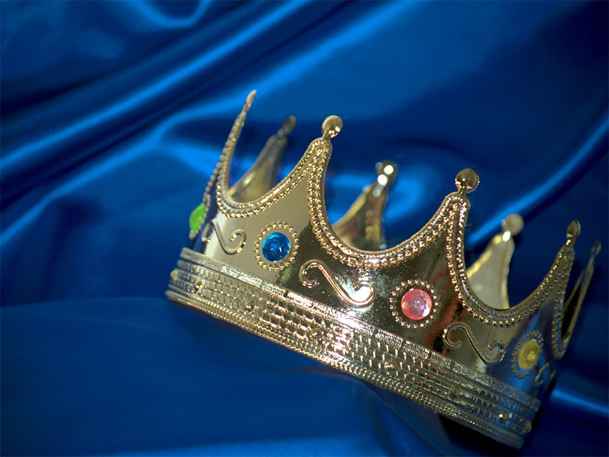
When we all get to Heaven…What a day of rejoicing that will be

