Slide 1

Home

Slide 2

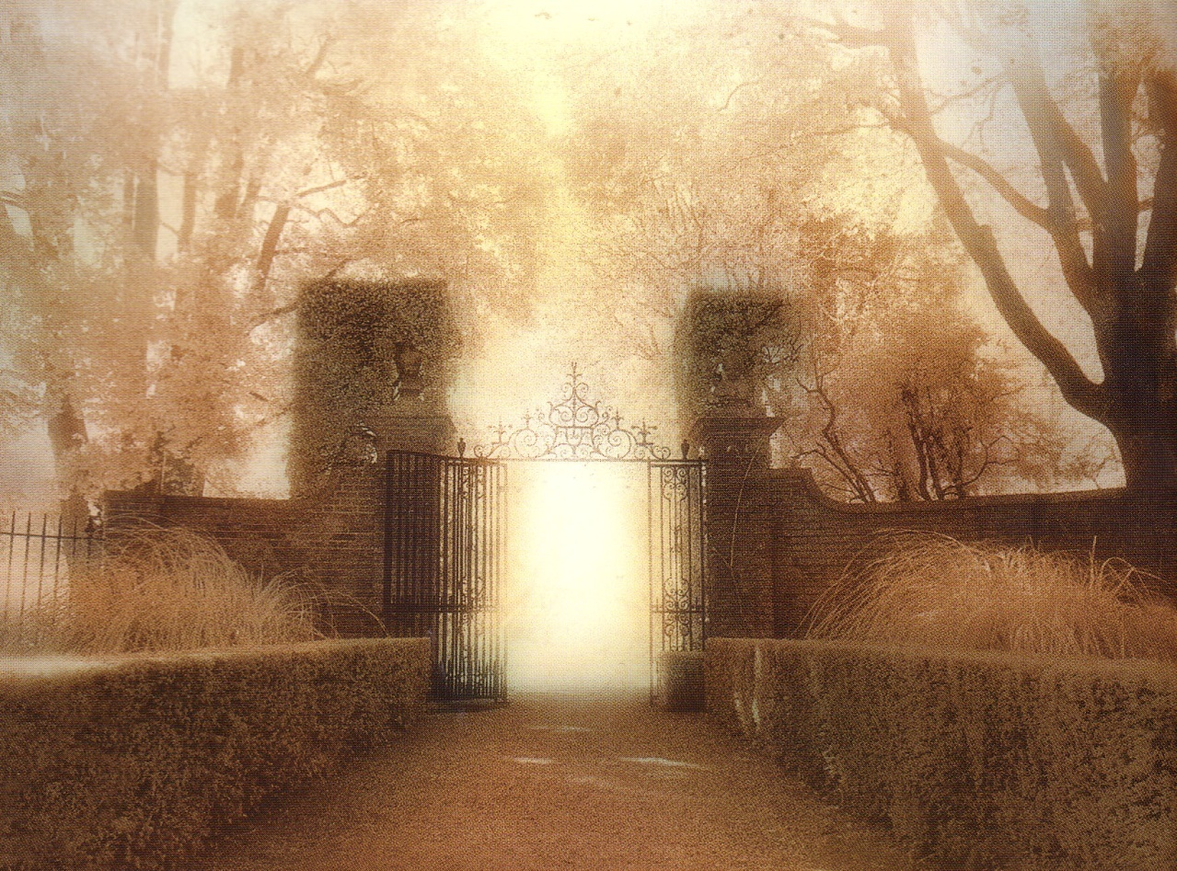
As God Sees Heaven

Slide 3

John 14:1-3 “Do not let your heart be troubled; believe in God, believe also in Me. “In My Father’s house are many dwelling places; if it were not so, I would have told you; for I go to prepare a place for you. “If I go and prepare a place for you, I will come again and receive you to Myself, that where I am, there you may be also.”

Slide 4
John 14:1-3 “Do not let your heart be troubled; believe in God, believe also in Me. “In My Father’s house are many dwelling places; if it were not so, I would have told you; for I go to prepare a place for you. “If I go and prepare a place for you, I will come again and receive you to Myself, that where I am, there you may be also.”

Slide 5
John 14:1-3 “Do not let your heart be troubled; believe in God, believe also in Me. “In My Father’s house are many dwelling places; if it were not so, I would have told you; for I go to prepare a place for you. “If I go and prepare a place for you, I will come again and receive you to Myself, that where I am, there you may be also.”

Slide 6
John 14:1-3 “Do not let your heart be troubled; believe in God, believe also in Me. “In My Father’s house are many dwelling places; if it were not so, I would have told you; for I go to prepare a place for you. “If I go and prepare a place for you, I will come again and receive you to Myself, that where I am, there you may be also.”

Slide 7
John 14:1-3 “Do not let your heart be troubled; believe in God, believe also in Me. “In My Father’s house are many dwelling places; if it were not so, I would have told you; for I go to prepare a place for you. “If I go and prepare a place for you, I will come again and receive you to Myself, that where I am, there you may be also.”

Slide 8


Heaven is God’s House
“In My Father’s house…”
Mt 6:9 “Our Father who art in Heaven…”
Ps 23:6b“And I will dwell in the house of the Lord forever”
Ps 27:4 “One thing I have asked from the Lord, that I shall seek: that I may dwell in the house of the Lord all the days of my life…”

Slide 9

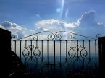
People have manufactured a concept of Heaven
Very worldly
Assume that Heaven is different for each person

Slide 10

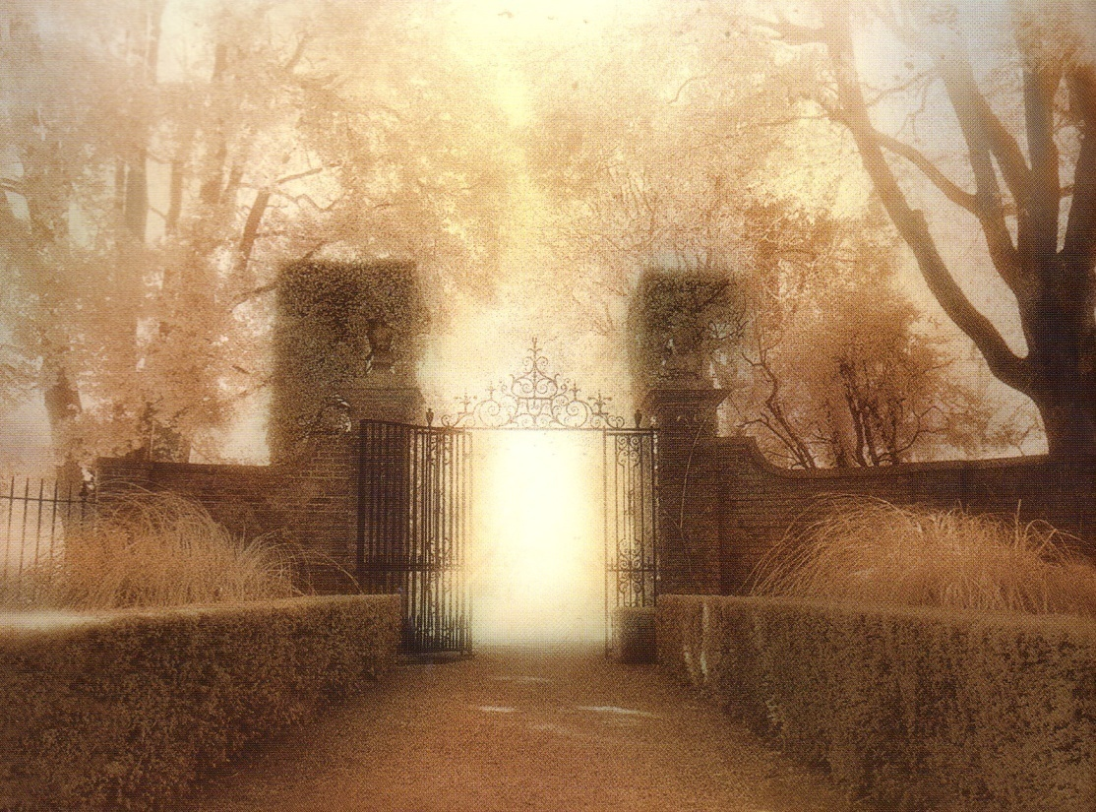
Heaven is God’s House
1. Like God, Heaven is Perfect
2. Like God, Heaven is Pure

Slide 11


Heaven Calms Troubled Hearts
The bigger Heaven is to us the smaller our problems seem to be…
2 Cor 4:16-5:6

Slide 12

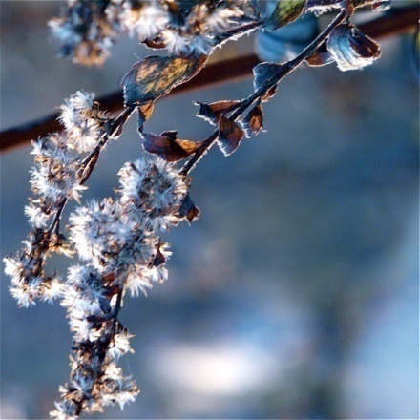
Heaven
Our inclination to rebel will end
Our occupation with time will end
Our frustration in devotion to God will end

Slide 13

Heaven means being with Jesus
Where I am there you may be also
1 Thes 4:17b “…and so we shall always be with the Lord”

Slide 14
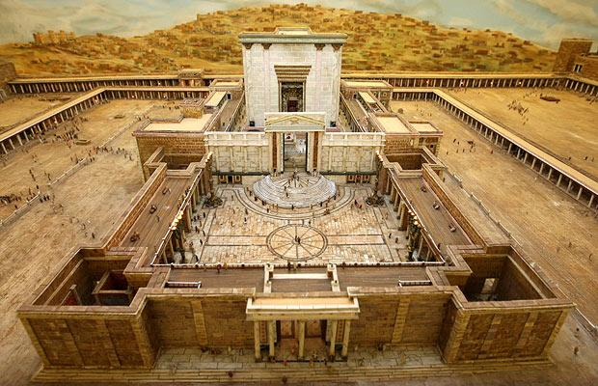
Rev 21:22 I saw no temple in it, for the Lord God the Almighty and the Lamb are its temple
There is no separation

Slide 15
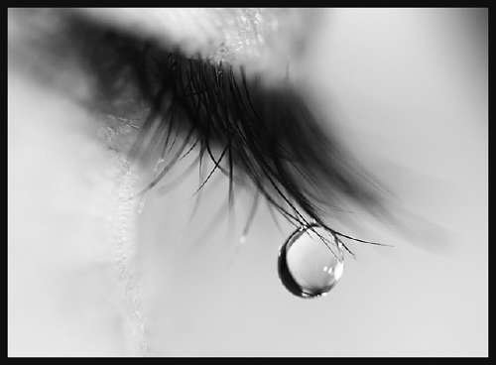

Slide 16


Heaven is FOR YOU

Slide 17
As God Sees Heaven
What would it mean to be in Heaven?

Slide 18


Slide 19
As God Sees it

