Slide 1
Joshua 8:1-3
“Now the LORD said to Joshua: ‘Do not be afraid, nor be dismayed; take all the people of war with you, and arise, go up to Ai. See, I have given into your hand the king of Ai, his people, his city, and his land. And you shall do to Ai and its king as you did to Jericho and its king. Only its spoil and its cattle you shall take as booty for yourselves. Lay an ambush for the city behind it.’ So Joshua arose, and all the people of war, to go up against Ai; and Joshua chose thirty thousand mighty men of valor and sent them away by night” (NKJV).

Slide 2
Joshua 1:6
“Be strong and of good courage, for to this people you shall divide as an inheritance the land which I swore to their fathers to give them.”

Slide 3
Deuteronomy 9:5
“It is not because of your righteousness or the uprightness of your heart that you go in to possess their land, but because of the wickedness of these nations that the LORD your God drives them out from before you…”

Slide 4
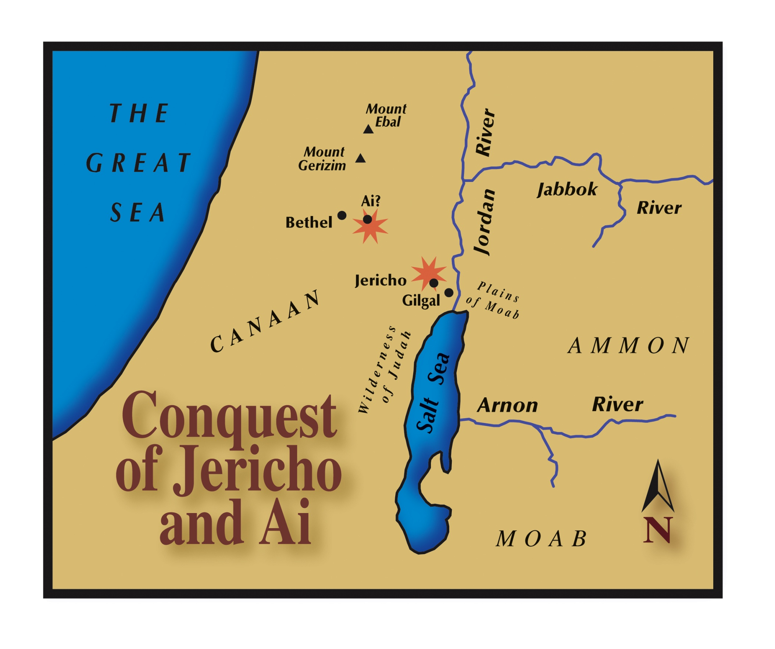

Slide 5
A Strategy for Victory
The Battle of Ai.
First Attempt led to defeat (Josh. 7:2-5; 6:17-19).

Slide 6
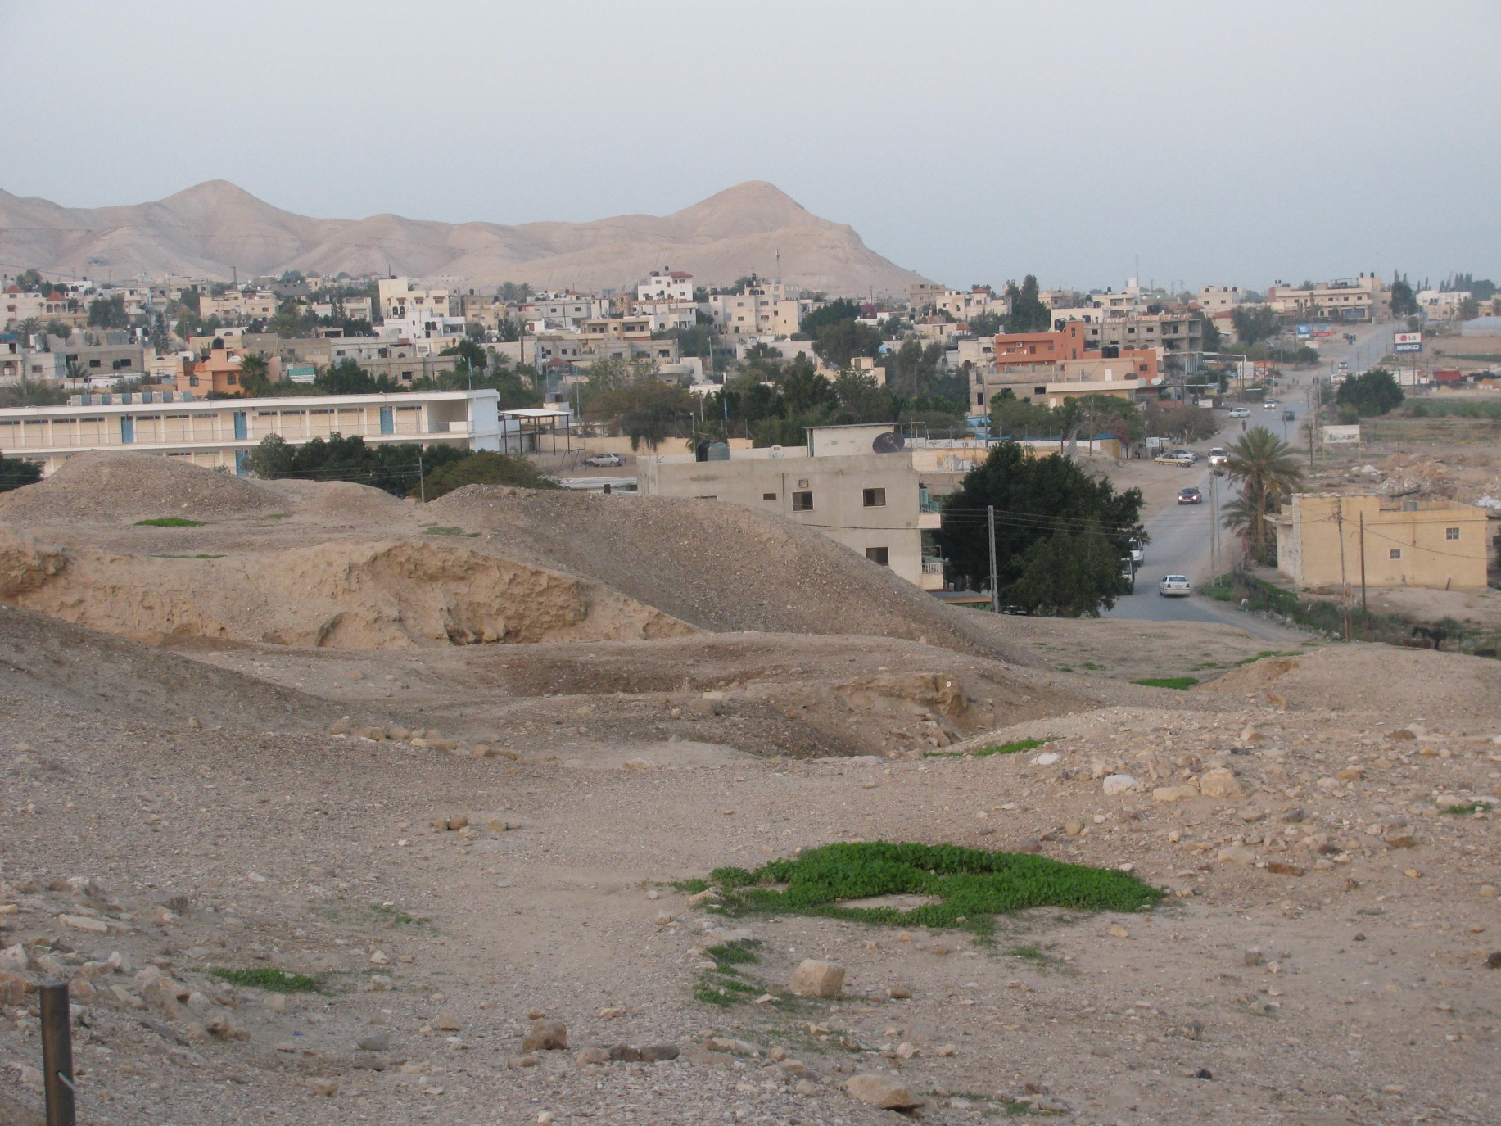
Ruins of Jericho

Slide 7
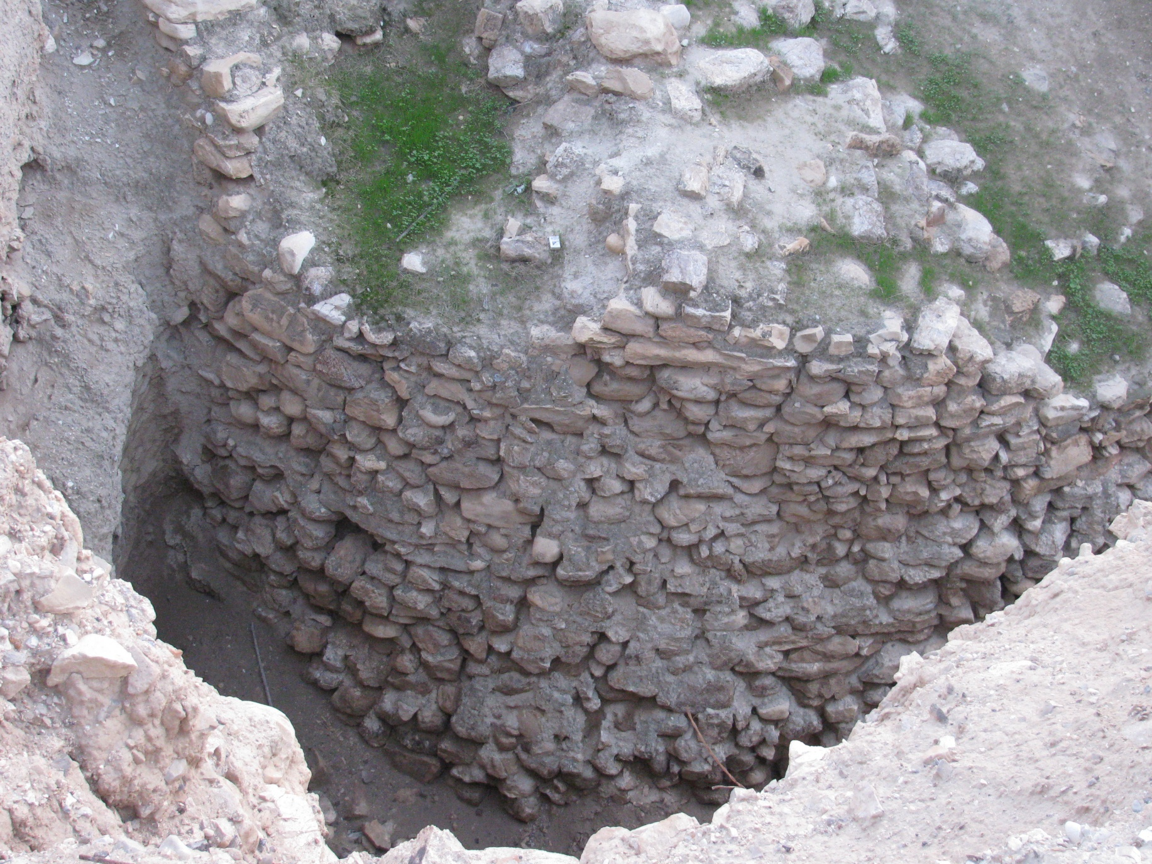
Ruins of Jericho

Slide 8
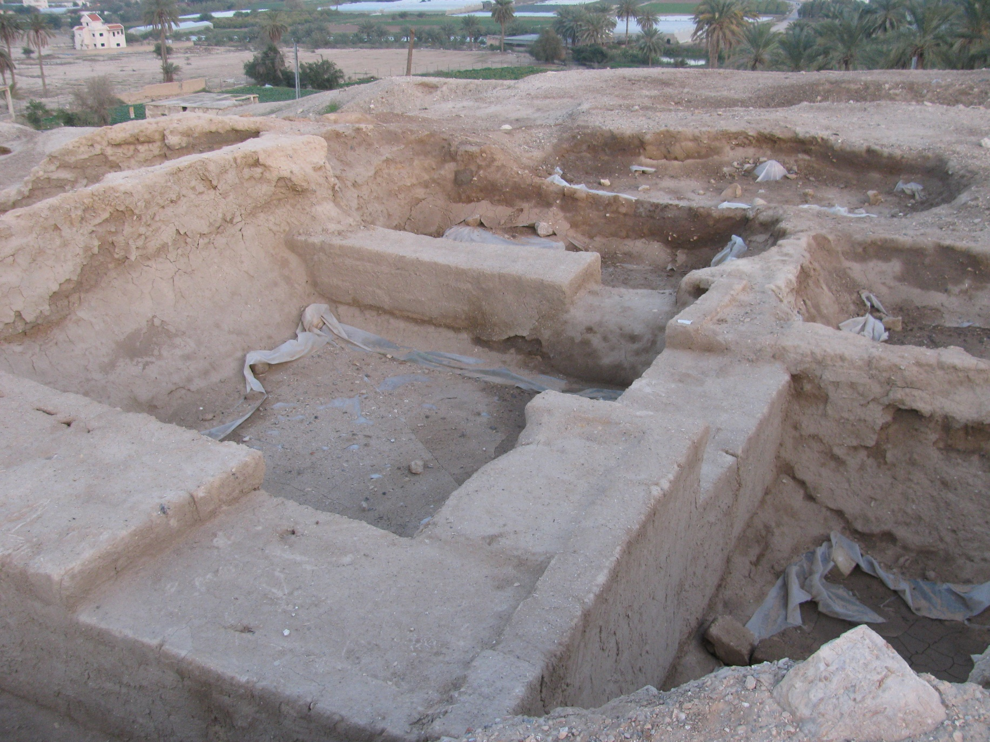
Ruins of Jericho

Slide 9
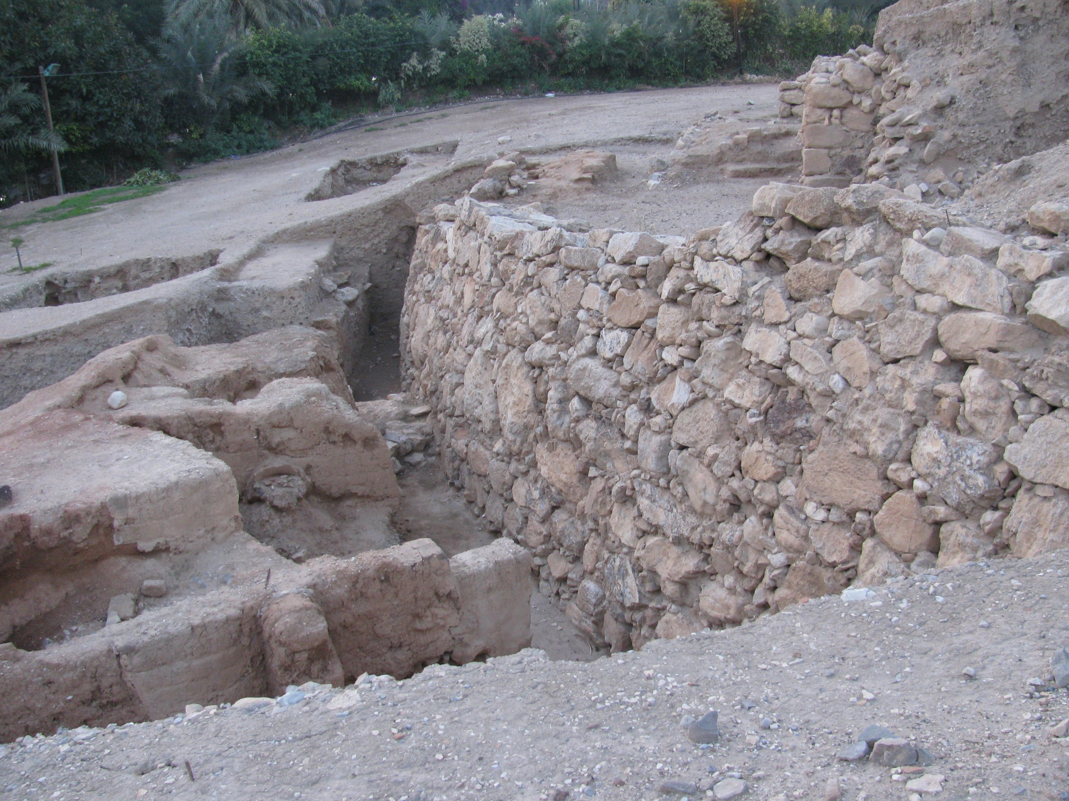
Ruins of Jericho

Slide 10
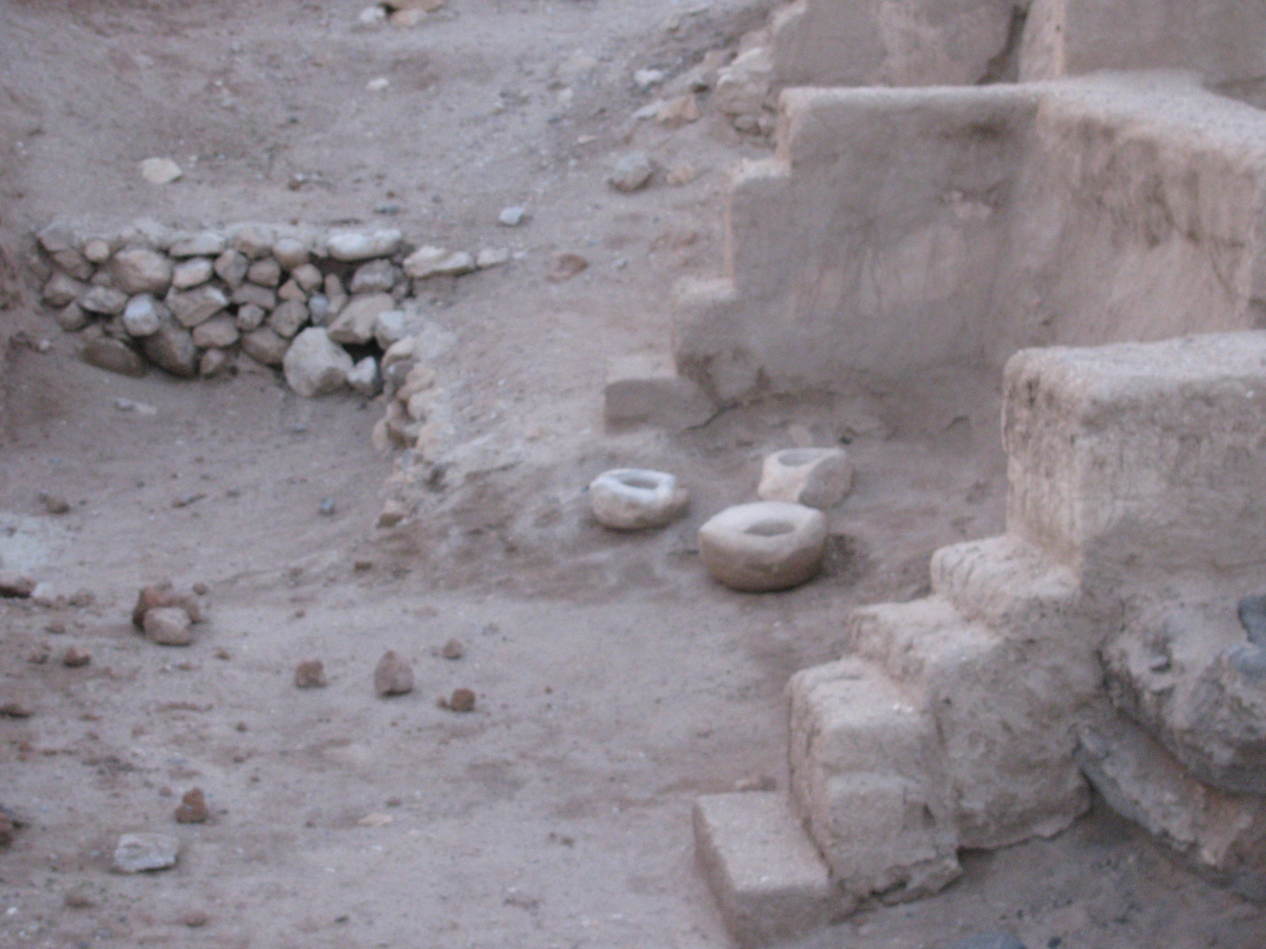
Ruins of Jericho

Slide 11
A Strategy for Victory
The Battle of Ai.
First Attempt led to defeat (Josh. 7:2-5; 6:17-19).
Achan’s sin (Josh. 7:1).
Joshua’s anguish (Josh. 7:6-8).
God’s justice (Josh. 7:10-13; 1 Cor. 10:6; Josh 6:18).
Achan’s punishment (Josh. 7:16-21; 24-26).

Slide 12
A Strategy for Victory
The Battle of Ai.
Second Attempt to Take Ai.
The Plan (Josh. 8:3-9).

Slide 14
A Strategy for Victory
The Battle of Ai.
Second Attempt to Take Ai.
The Plan (Josh. 8:3-9).
The Execution (Josh. 8:10-13).
The Battle (Josh. 8:14-21).

Slide 15
A Strategy for Victory
Lessons for Spiritual Battle.
Beware of false confidence (1 Cor. 10:13; Rev. 21:3; 20:10).
Watch for hidden weapons (1 Pet. 5:8; 2 Cor. 2:11; Luke 4:13; Eph. 6:11-17).
Avoid foolish judgments (Heb. 4:12; 1 Pet. 3:15).
Stand back up when defeated (1 John 1:9; James 5:16).

