Slide 1
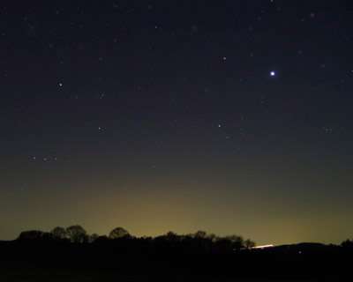
Ecclesiastes 3:9-13
“What profit has the worker from that in which he labors? I have seen the God-given task with which the sons of men are to be occupied. He has made everything beautiful in its time. Also He has put eternity in their hearts, except that no one can find out the work that God does from beginning to end. I know that nothing is better for them than to rejoice, and to do good in their lives, and also that every man should eat and drink and enjoy the good of all his labor--it is the gift of God” (NKJV).

Slide 2
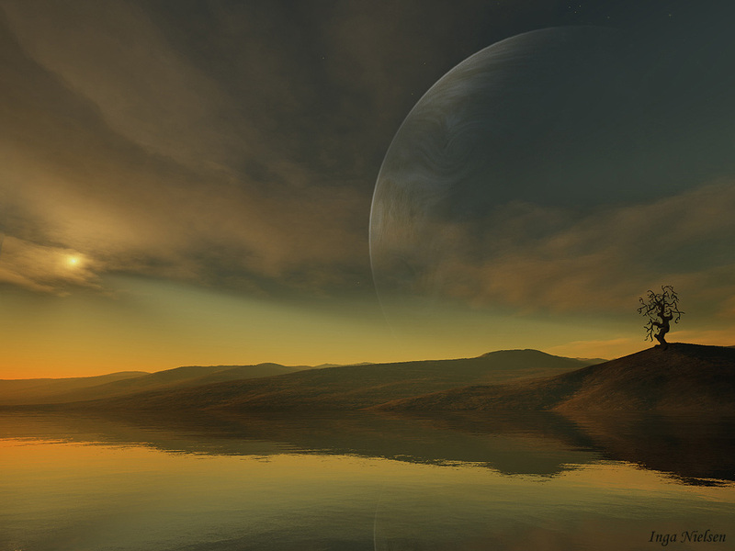
Things Eternal
I. God is Eternal.
A. In General. “Everlasting God” (Rom. 16:26; Isa. 40:28-31; 1 Tim. 1:17).
B. Jesus (John 1:1-3).
C. The Holy Spirit (Heb. 9:14).

Slide 3
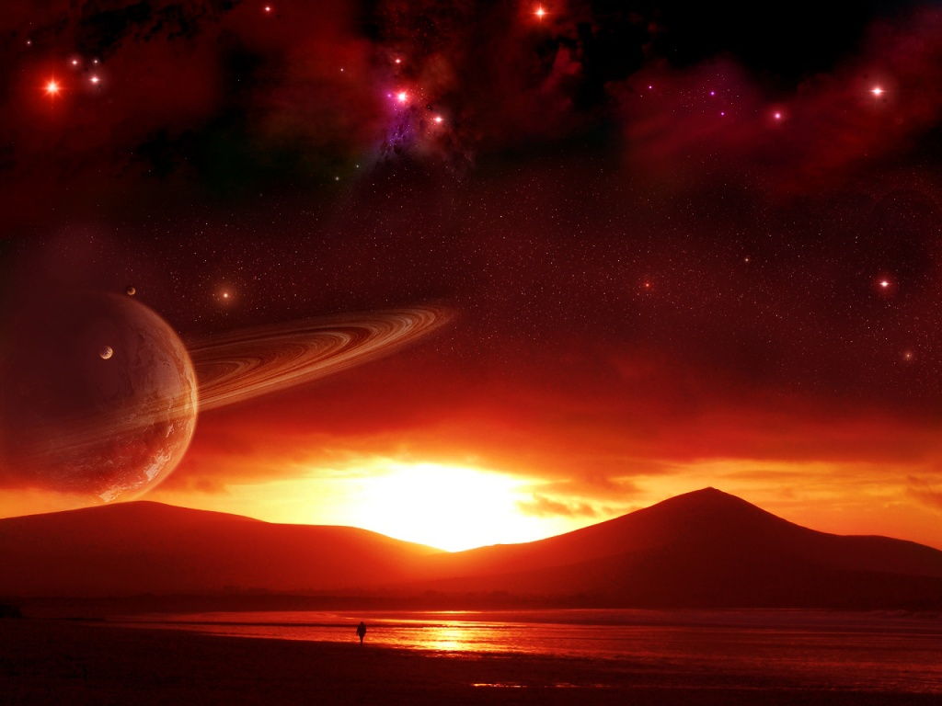
Things Eternal
II. God’s Nature and Purpose are Eternal.
His power (Rom. 1:20).
His love (Jer. 31:3).
His purpose (Eph. 3:8-12).
His word (1 Pet. 1:22-25).

Slide 4
Things Eternal
III. Things Eternal for His People.
An eternal home (Ecc. 12:7).
Eternal Joy (Isa. 35:8-10).
Eternal glory (1 Pet. 5:6-11).
Eternal life (John 5:24-29).

Slide 5
Things Eternal
IV. Things Eternal for His Enemies.
Eternal fire (Matt. 25:31-32; 41).
Eternal punishment (Mt. 25:46).
Eternal destruction (2 Th. 1:6-9).

