Slide 1
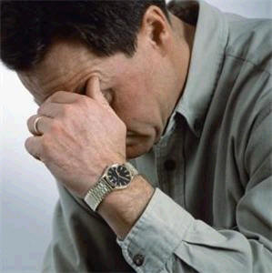
Isaiah 53:6
“All we like sheep have gone astray; We have turned, every one, to his own way; And the LORD has laid on Him the iniquity of us all.”

Slide 2
THE PRODIGAL SON
All Have Gone Astray
Self-Will (15:12).
Indulgence (15:13).
Waste (15:14).
Starvation (15:16).
Association (15:15).
Galatians 5:16-17
Ecclesiastes 2:10-11
Proverbs 29:2-3
Proverbs 21:20-21
Matthew6:19-20
Proverbs 13:12
Proverbs 6:12-15
Luke 15:11-24

Slide 3
THE PRODIGAL SON
All Have Gone Astray
2 Peter 2:15-17
Luke 15:11-24

Slide 4
THE PRODIGAL SON
All Have Gone Astray
Realization (15:16).
Resolution (15:17).
Repentance (15:18-19).
Reconciliation (15:20-21).
Renewal (15:22-24).
Romans 5:7-10
Acts 26:20
2 Timothy 2:19
1 Timothy 4:2
1 John 2:11
Ephesians 4:19
Acts 2:36-37
Luke 19:8-10
Luke 15:11-24

Slide 5
THE PRODIGAL SON
All Have Gone Astray
Romans 12:1-2
Luke 15:11-24

