Slide 1
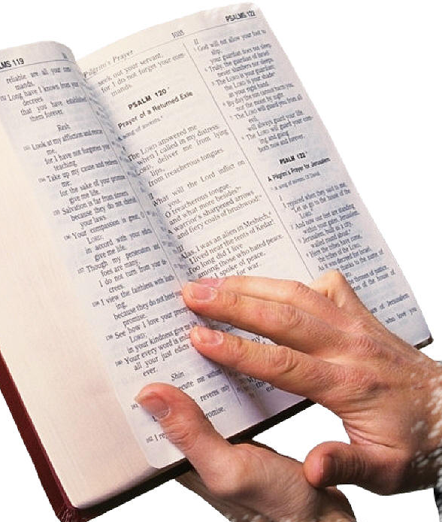
Ephesians 2:8-10
“For by grace you have been saved through faith, and that not of yourselves; it is the gift of God, not of works, lest anyone should boast. For we are His workman-ship, created in Christ Jesus for good works, which God prepared beforehand that we should walk in them” (NKJV).

Slide 2
God’s Workmanship
I. We were created by God.
  We were made in the image of God (Gen. 1:26-27).
  We did not make ourselves (Psalm 100:1-3).

Slide 3
God’s Workmanship
II. Converts are Re-Created in Christ.
  Dead in sin (Eph. 2:1).
  Put on “new man” (Eph. 4:20-24).
  Characteristics of the “new man” (Eph. 4:25-32).

Slide 4
God’s Workmanship
II. Converts are Re-Created in Christ.
  All things new (2 Cor. 5:17).
  Image of Him who created him (Col. 3:9-10).
  Crucified to the world (Gal. 6:14, 16).

Slide 5
God’s Workmanship
III. Created unto good works.
  Grace (Eph. 2:1-10).
  Good works (1 Jn. 2:15-17).
  Growth from faith—faith is dead without them (James 2:14-18).

