Slide 1
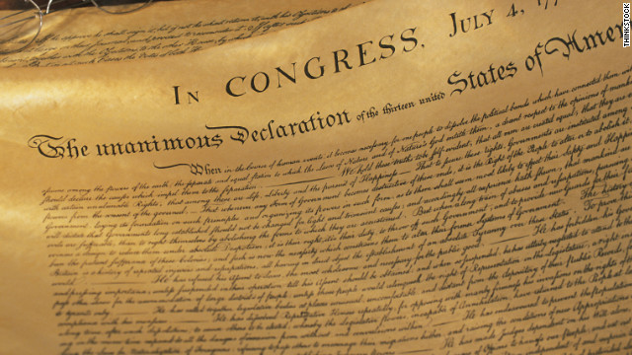

The Declaration of Independence

Slide 2

The Declaration of Independence

Slide 3

The Declaration of Independence

Slide 4

The Declaration of Independence

Slide 5

The Declaration of Independence

Slide 6

The Declaration of Independence

Slide 7

The Pursuit of Happiness
I. Solomon’s Pursuit.
  Wisdom (Eccl. 1:12-18).
  Pleasure (Eccl. 2:1-11).
  Folly (Eccl. 2:12-16).
  Selfishness (Eccl. 4:4-8, 13-16).
  Riches (Eccl. 5:8-20).
  Everything is vanity (Eccl. 1:1-11).

Slide 8
The Pursuit of Happiness
II. The Christian’s Approach.
  The Blessed (Matt. 5:1-12).
  Seek the kingdom (Mt. 6:25-34).
  The peace of God (Phil. 4:6-7).

Slide 9
The Pursuit of Happiness
III. David’s Approach.
  The Blessed man (Psa. 1:1-6).
  Whose God is the Lord (Psa. 144:15).
  Whose hope is in the Lord (Psa. 146:5).

Slide 10
The Pursuit of Happiness
Solomon’s Conclusion.
Ecclesiastes 12:9-14

