Slide 1
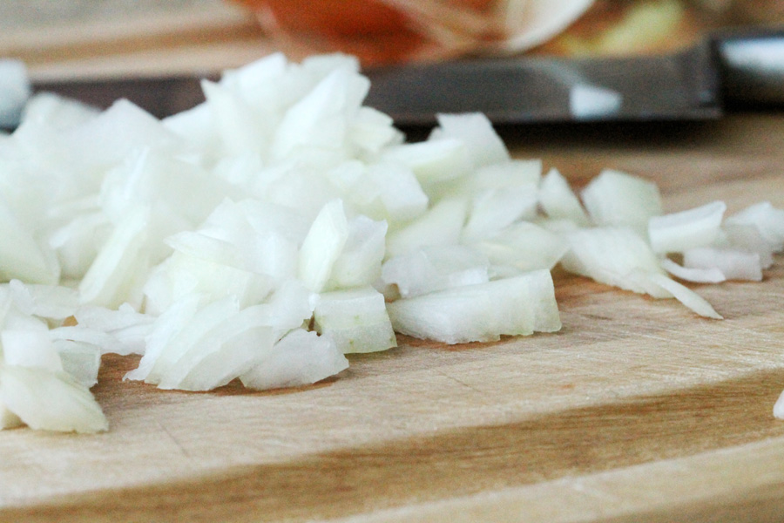
“Cut the Onions!”

Slide 2
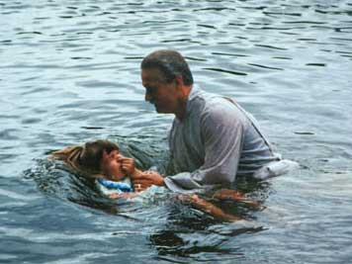

Slide 3
CHURCH

Slide 4
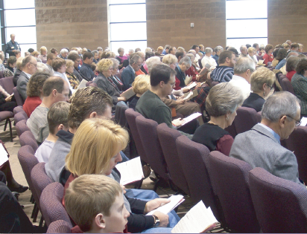
Fellowship

Slide 5
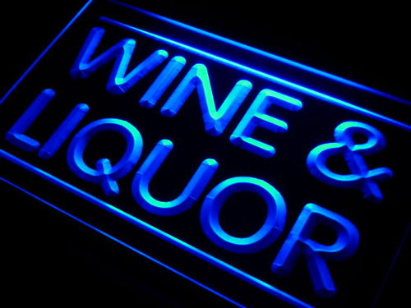
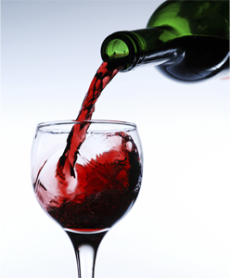
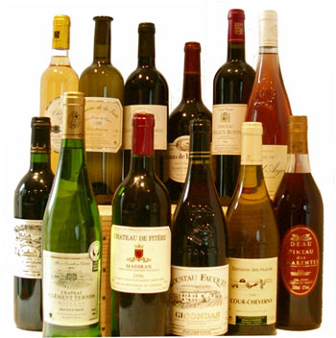
WINE

Slide 6
WINE
Alcoholic
There was alcoholic wine in the Bible.
1. Noah (Gen. 9:20-21).
2. Lot (Gen. 19:32-33).
3. Uriah (2 Sam. 11:13).
4. Descriptions of drunkenness (Psa. 107:27; Job 12:25; Jer. 23:9; Isa. 19:14; Jer. 25:27).

Slide 7
WINE
Alcoholic
Facts about modern wines.
Most modern wines are “fortified” with added yeasts, sugars, or even distilled alcohol.
Distillation was not known in ancient times.
Most yeasts die at 12% alcohol content by volume.
Distilled liquor can attain as much as 95% alcohol content by volume.

Slide 8
WINE
Alcoholic
Wine Coolers | 4–7%
Table Wine general | 8-14%
White, dry | 11.0
White, sparkling | 12.0
White, sweet | 12.4
Cabernet, Pinot Noir | 11–14%
Dessert Wine | 14-20%
Zinfandels | 17-22%
Vermouth | 17-22%
Port Wine | 20%
Taken from : Alcohol Content Database http://www.alcoholcontents.com/wine/

Slide 9
A Different
WINE
There was a different type of drink also called “wine” in the Bible.
1. Juice in the grape is called “wine” (Isa. 65:8; Deut. 32:14; Num. 6:3; Judg. 13:7).
2. Juice fresh from the grape is called “wine” (Gen. 40:11; Josephus Antiquities 2.5.2, gleukos “new wine” Acts 2:13).
3. Juice in the press is called “wine” (Micah 6:15; Prov. 3:10; Isa. 16:10; Jer. 48:33).

Slide 10
A Different
WINE
Is this a figure of speech?
Metonymy of effect
“the effect is put for the cause producing it” (Bullinger, Figures of Speech Used in the Bible, 560-67).
Genesis 25:23
“two nations are in your womb.”
Metonymy depends on a clear distinction.

Slide 11
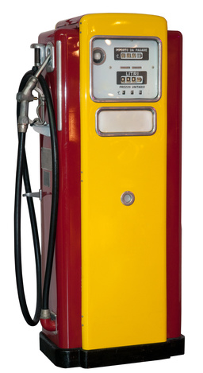
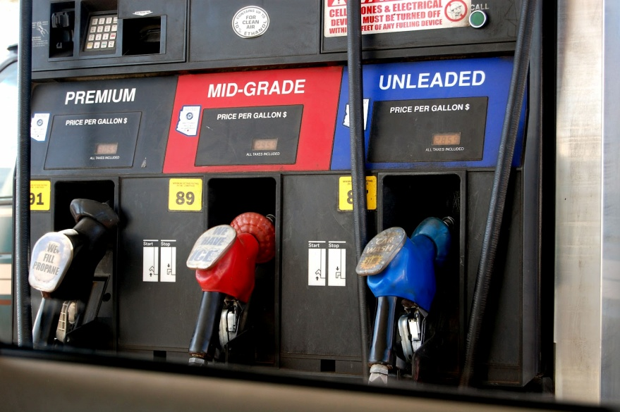
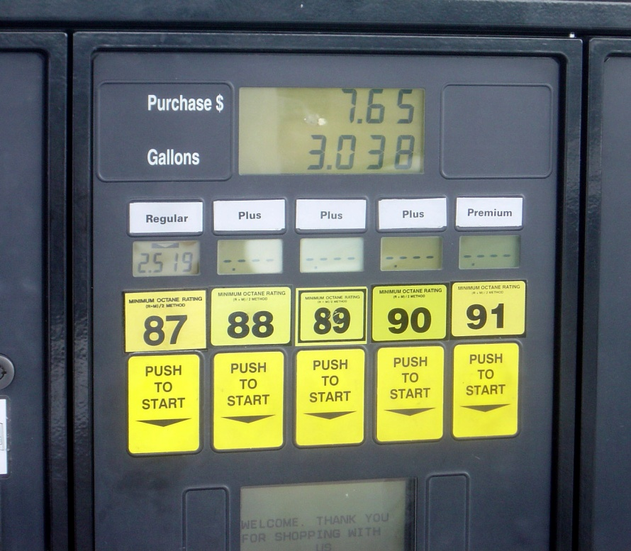
“I’m going to get gas”

Slide 12
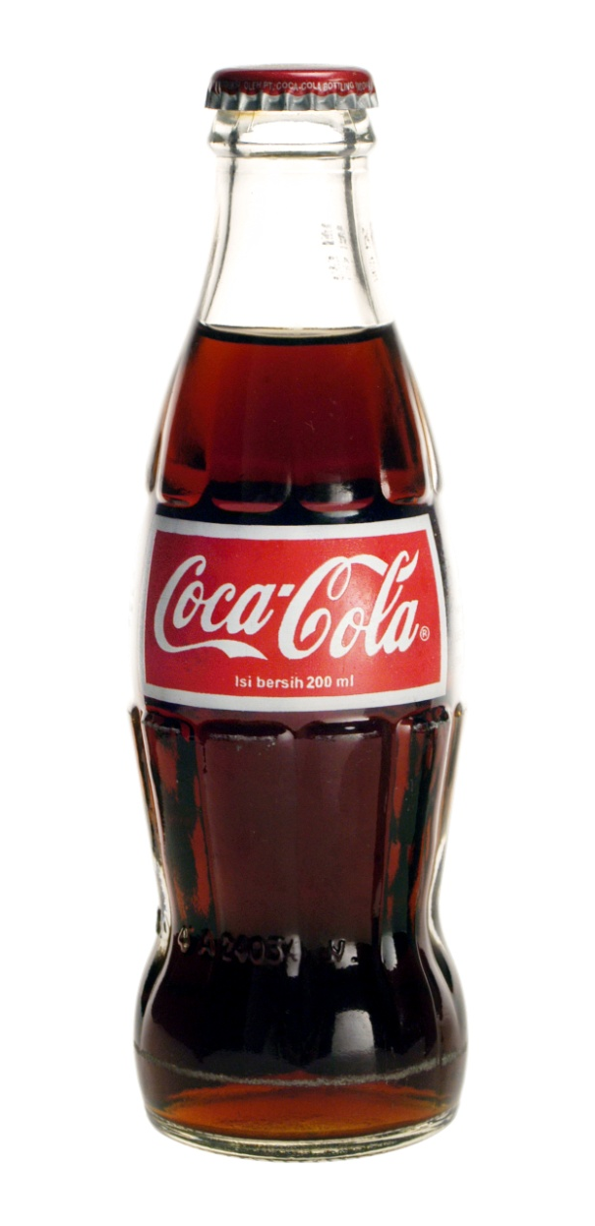
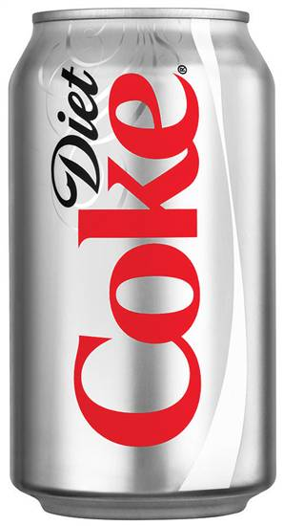
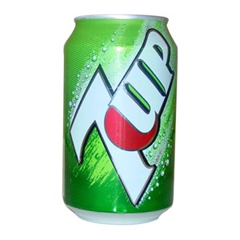
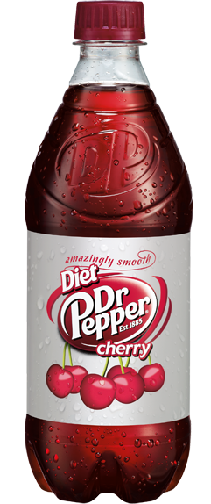
“Get me a coke, please”

Slide 13
WINE
Contrasting
Descriptions of
New Wine (tirosh) “cheers both God and men” (Judges 9:13), but wine (yayin) “is a mocker” (Prov. 20:1).
God speaks of those who drink “the wine of the condemned in the house of their god” (Amos 2:8).

Slide 14
WINE
Contrasting
Descriptions of
New Wine (tirosh) was considered a blessing from God (Deut. 7:13; 11:14; 33:28) and taken away as punishment (Deut. 28:51; Isa. 24:7; 62:8), but man is warned not to “look upon” wine (yayin)—“when it is red, when it giveth his colour in the cup, when it moveth itself aright” (Prov 23:31, KJV).

Slide 15
WINE
Contrasting
Descriptions of
Wine is used as a figure of punishment. Some “eat the bread of wickedness and drink the wine of violence” (Prov. 4:17). The wicked shall “drink the wine of the wrath of God” (Rev. 14:10), and “the wine of the fierceness of His wrath” (Rev. 16:19).

Slide 16
WINE
Contrasting
Descriptions of
Paul tells Timothy to drink “a little wine (oinos) for your stomach’s sake” (1 Tim. 5:23), but the wise man warns “it is not for kings to drink wine” (Prov. 31:4).

Slide 17
WINE
Contrasting
Descriptions of
Daniel, Shadrach, Meshach, and Abed-nego petitioned to be able to drink a different wine than the type of wine the king drank (Dan. 1:5, 8).
This could have been an issue of Mosaic cleanliness, but it could also have concerned the nature of the drink itself.

Slide 18
WINE
Contrasting
Descriptions of
Jesus gave the people 120-180 gallons of “water that was turned to wine” (John 2:1-10), and yet…
He taught that “drunkenness” can weigh down one’s heart causing the word to be choked within (Luke 21:34).
His disciples taught that men must turn away from “drunkenness, revelries” and “drinking parties” (1 Pet. 4:3; cf. Rom. 13:13), and that “drunkenness” and “revelries” prevent one from inheriting the kingdom of heaven (Gal. 5:21).

Slide 19
WINE
Contrasting
Descriptions of
Can this be referring to the exact same substance?
Is this only a matter of degree, or amount?
Is it not rather talking about a substance of a different nature, a different preparation, and a different manner of consumption?

Slide 20
WINE
Ancient Evidence Concerning
In ancient times drinks were called “wine” that ranged anywhere from pure grape juice all the way to vinegar.
There is evidence from ancient times that drinks called “wine” were prepared and consumed that were non-alcoholic.

Slide 21
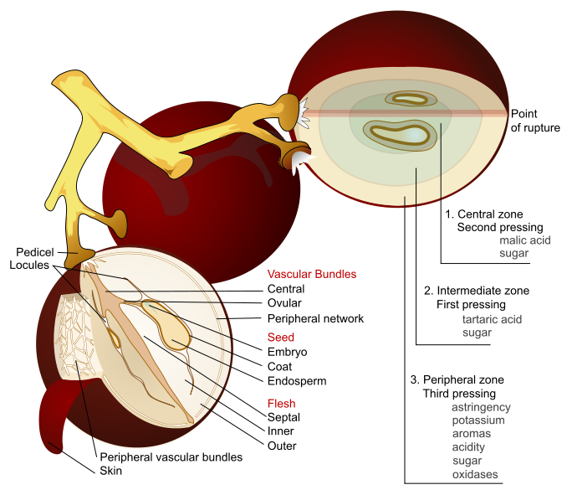
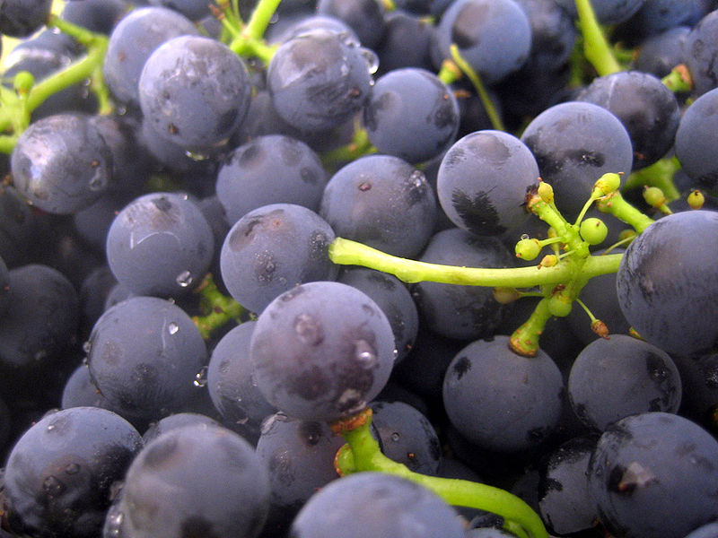
The Process of Fermentation
Grapes produce sugars which ferment under the right conditions.
These sugars must have contact with yeast.
This yeast turns sugar to alcohol.
The lower the yeast and sugar the lower the alcohol content.
Air deprivation, cold temperature, concentrated sugar, and separating the yeasts in the skins from the sugar can impede fermentation.

Slide 22
WINE
Ancient Evidence Concerning
FILTERING
Pliny the Elder wrote that the most suitable for all men was wine, “with strength reduced by the filter,” even explaining the difference between “must” and fermented wine (Natural History, 23.24).
Plutarch devotes an entire discussion to whether wine should be strained, declaring wine “cleansed” by a strainer, has its “strike and madness taken away” leaving one in a “mild and healthy state of mind” (Symposiacs, 693b 3-5).

Slide 23
WINE
Ancient Evidence Concerning
FILTERING
The Babylonian Talmud records debates regarding whether wine should be filtered on the Sabbath or not (Shabbat, 139b).

Slide 24
WINE
Ancient Evidence Concerning
BOILING
Aristotle wrote about wines in Arcadia so thick they were scraped off the wineskins to drink (Meterologica 388b, 6).
The Roman poet Virgil described housewives boiling down “sweet must (i.e. freshly squeezed grape juice)” (Georgics, 1.295).
The Jewish Mishnah records debates among Jews about whether boiled or unboiled wine was used in the heave-offering (Terumot 11:1).

Slide 25
WINE
Ancient Evidence Concerning
DILUTION
A common practice among the ancients (even among those not concerned with drunkenness) was diluting wine with water.
This was as much as 20/1 (Homer, Odyssey 9.208), 8/1 (Pliny, Natural History 14.6), or among the Jews 2 or 3/1 (Shabbat 77a; Pesachim 108b).
The apocryphal book of 2 Maccabbes claims, “It is hurtful to drink wine or water alone… wine mingled with water is pleasant” (15:39).

Slide 26
WINE
Ancient Evidence Concerning
DILUTION
In Plato’s Symposium a discussion is held at the beginning of a drinking party about whether they wanted to drink where they could get drunk fast, or water it down where they could drink all night (176a-c).
Athenaeus described and even quoted ancient Greek and Roman authors who valued diluting wine with water, “the sober stream” (Deipnosophists 11.13).
Different proportions of water to wine—authors centuries before him (Deipnosophists 10.21-39).

Slide 27
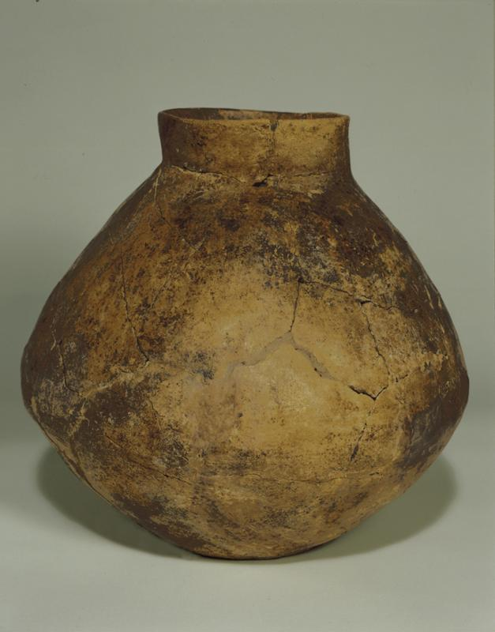
WINE
Ancient Evidence Concerning
STORAGE
Boiled or filtered wines (like other wines in ancient times) were stored in earthenware vessels or sometimes in animal skins for travel.
The University of Pennsylvania holds a two-and-one-half gallon jar that is believed to be the oldest wine jar ever found (Object No. 69-12-15). It is lined with terebinth resin to seal it.

Slide 28
WINE
Ancient Evidence Concerning
STORAGE
Cato the Elder (234 BC – 149 BC) claimed that “must” stored in an amphora coated with pitch and stored thirty days in a water tank could be removed and kept as “must” for the whole year (Cato, De Re Rustica 120).
Columella, who was the Roman tribune of Syria in 35 AD claimed the same thing but extended the period during which the amphora was submerged in water to forty days (De Re Rustica 12.29).

Slide 29
WINE
Ancient Evidence Concerning
STORAGE
Some earthenware vessels were also glazed. A multi-gallon Canaanite wine vessel found at Tel Kabri, near the Mediterranean coast in northern Israel, dated to around 1800 B.C. used to store gallons of red wine was covered with a white glaze.
Earthenware vessels could be sealed with a pitch coated cork (Horace, Carminum Liber 3, 8, 9-12), but other methods of sealing were used as well.

Slide 30
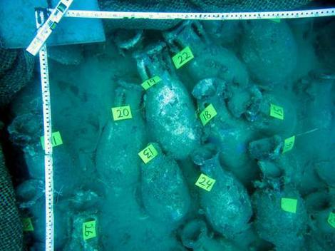
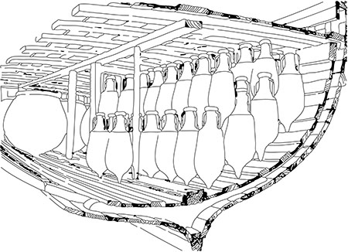
WINE
Ancient Evidence Concerning
STORAGE
Columella describes covering an amphora, plastering over the lid, and then covering it with leather (De Re Rustica 12.39).
In August of 2012 a 1st century AD or BC Roman shipwreck was dis- covered off the coast of Italy with nearly 200 amphora containing wine, oil, grain, and pickled fish with pine caps coated with pitch still sealed and in place.

Slide 31
WINE
Ancient Evidence Concerning
STORAGE
The ancients recognized that “must” stored in the cold does not ferment (Plutarch, Natural Questions 27).
When attempting to keep “must” it was generally stored in a cool place and could be kept as sweet “must” for as much as a year (Columella, On Agriculture 12.20.1; 12.37.1; 12.29.1).

Slide 32
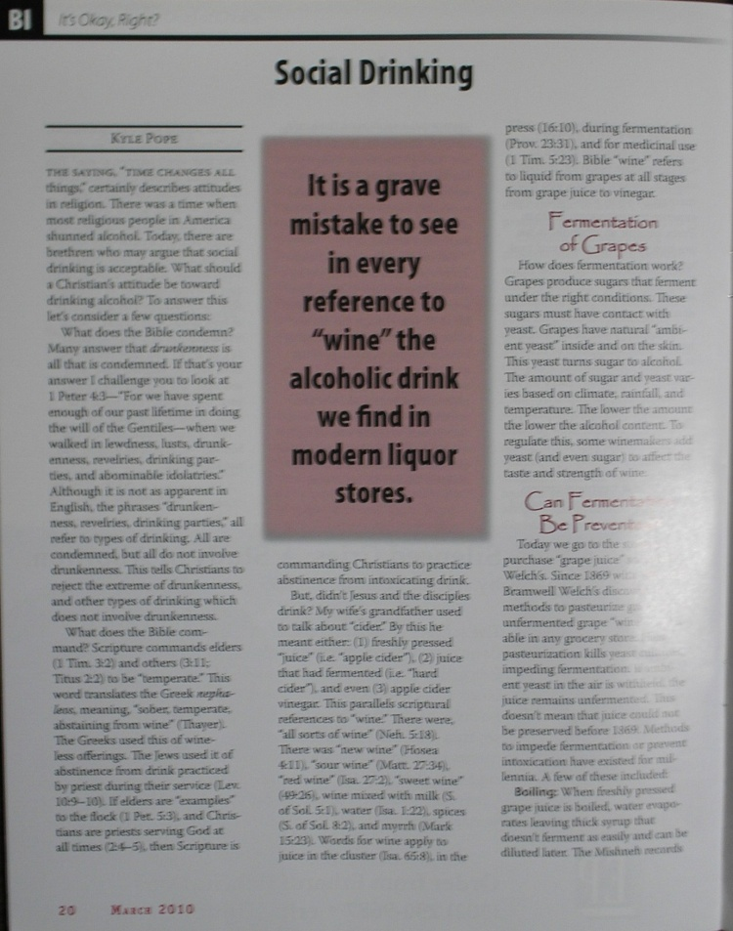
Are these claims true?
“Grasping for straws”

Slide 33
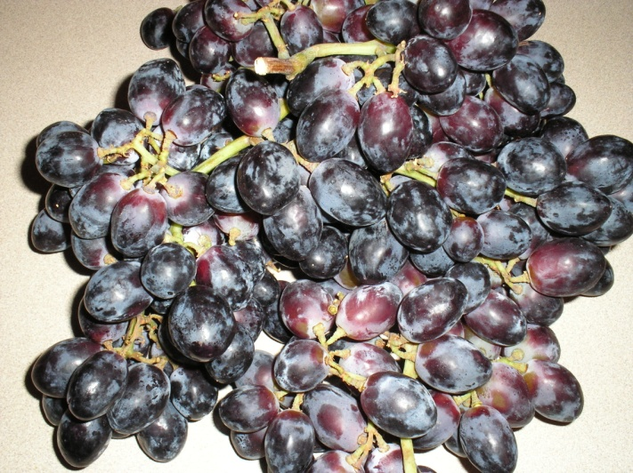
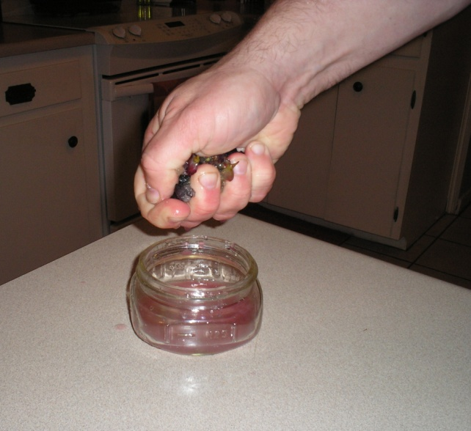
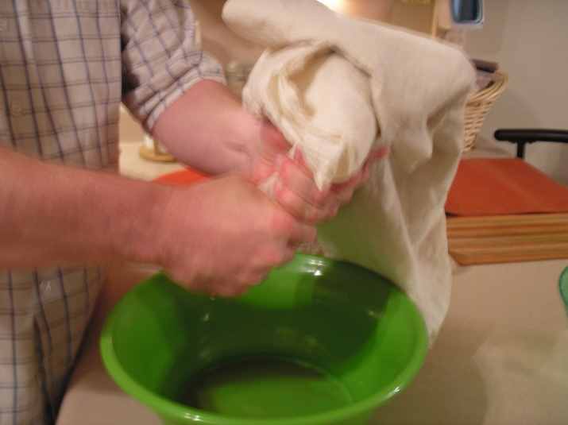
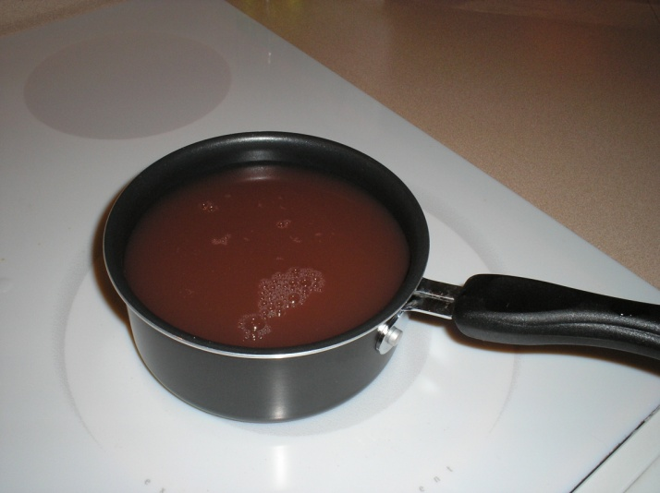
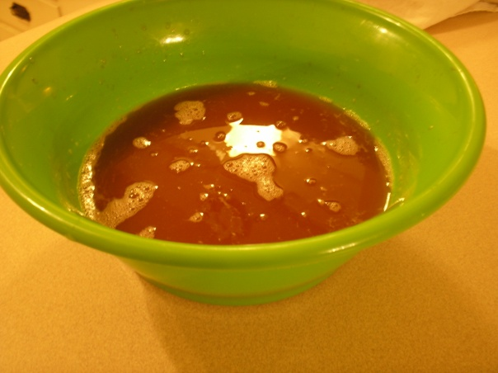
WINE
Testing Ancient Claims Concerning

Slide 34
WINE
Testing Ancient Claims Concerning
Six Test Samples
Filtered,
Boiled, & Reduced 1/3
Filtered,
Boiled, & Reduced 1/5
Pure Grape Juice
Filtered,
Boiled, & Reduced 1/10
Filtered
Filtered
& Boiled

Slide 35
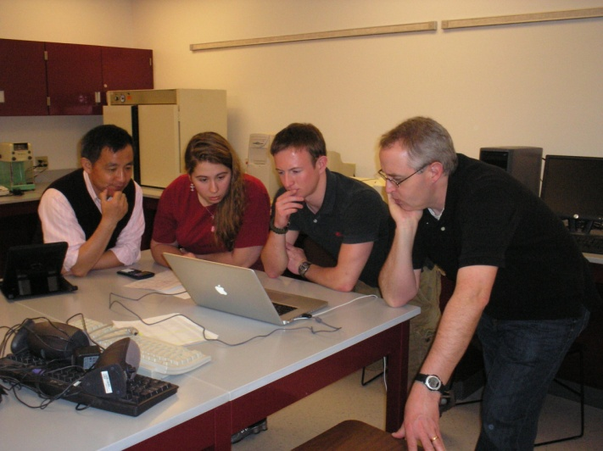
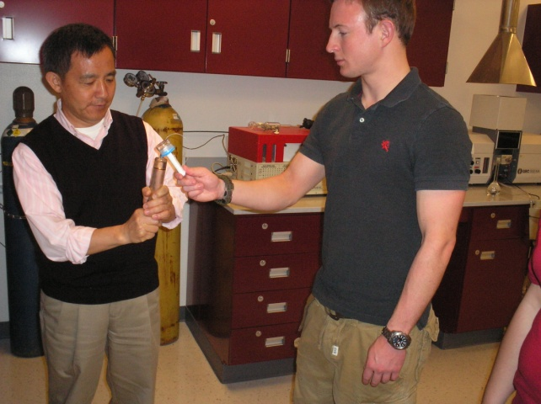
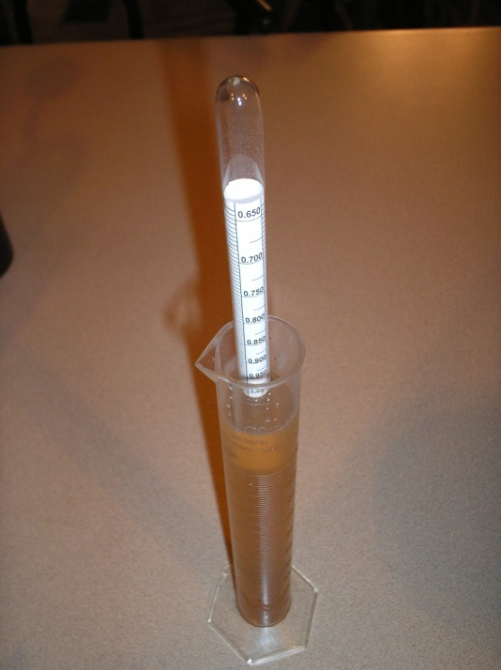
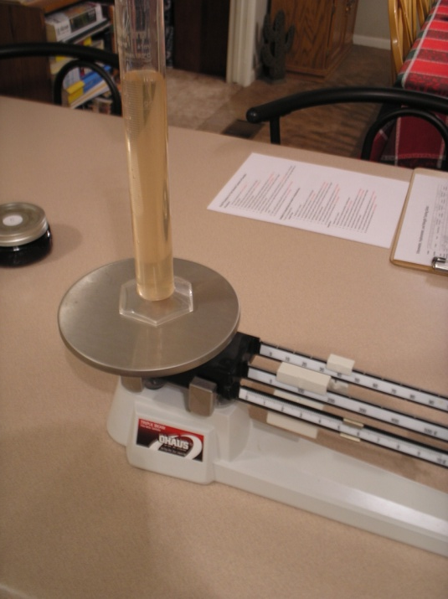
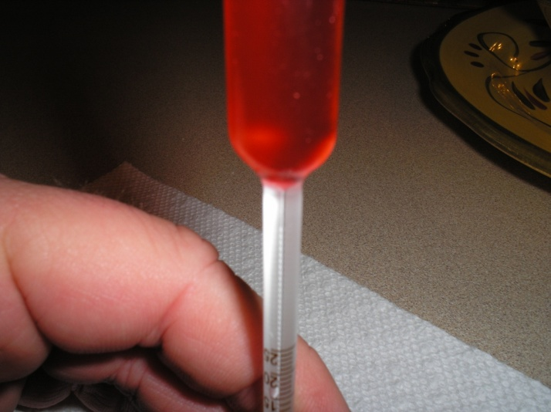
WINE
Testing Ancient Claims Concerning

Slide 36
WINE
Testing Ancient Claims Concerning
Final Results of Test Samples
Condition | Unfiltered |  | Filtered | Filtered & Boiled | Filtered, Boiled, & Reduced 1/3 | Filtered, Boiled, & Reduced 1/5 | Filtered, Boiled, & Reduced 1/10
Date Sealed | 5/5/2010 |  | 5/3/2010 | 5/4/2010 | 5/3/2010 | 5/4/2010 | 5/6/2010
Date Opened | WT Test 3/25/2011 | 1/3/ 2012 | 1/3/2012 | 1/5/2012 | 1/5/2012 | 1/7/2012 | 1/7/2012
Alcohol Content | 12 -6% | 6.6% | 0% | 0% | 0% | 0% | 0%

Slide 37
Were these methods used in the Bible?
FILTERING: Scripture directly refers to filtered “wine on the lees, well-refined” (Isa. 25:6, KJV, ASV). The word for “wellrefined” means, “to purify, distil, strain, refine” (Gesenius).
BOILING: “Wine mixed with water” (Isa. 1:22. The Hebrew word for “mixed”—mahol means “to cut down or reduce.” The word mezeg used in Song of Solomon 7:2—wine mixed with water.

Slide 38
WINE
Bible
There were, “all sorts of wine” (Neh. 5:18).
“New wine” (Hos. 4:11)
“Sour wine” (Matt. 27:34)
“Red wine” (Is. 27:2).
“Sweet wine” (Is. 49:26).
Wine mixed with milk (So. 5:1), water (Is. 1:22), spices (So. 8:2), myrrh (Mark 15:23), and for medicinal use (1 Tim. 5:23).

Slide 39
WINE
Bible
Some of these wines would not have been alcoholic or intoxicating
“New wine (gleukos)” (Acts 2:13).
Plutarch discussed why it is that “new wine (gleukos)” is not as intoxicating as other wines. He states, “few could drink enough to make them drunk” (Questiones Convivales 3.7).
This is not the same thing we call “wine.”

