Slide 1
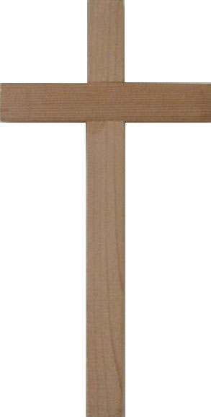
What Do We Know About This?
The Most Horrific
The Most Wondrous
“Then they crucified Him, and divided His garments, casting lots” (Matt. 27:35, NKJV).

Slide 2
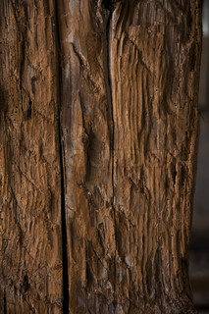
“The most miserable and most painful punishment appropriate to slaves alone”
Cicero, Against Verres, 2.5.169
“The offense of the cross”
Galatians 5:11

Slide 3
“They Crucified Him”
Roman Crucifixion
The Romans Did Not Begin Crucifixion
1. Antiochus Epiphanes practiced crucifixion (Josephus, Antiquities 12.5.4).
2. Alexander Jannaeus crucified 800 men (Ibid. 13.14.2).
3. Qumran Temple Scroll commands “hanging on wood” as the punishment for treason (11QTemple 64.6-13).

Slide 4
“They Crucified Him”
Roman Crucifixion
The Process of Crucifixion
1) Flagellation (a severe scourging intended to weaken the victim).
2) Crucifixion (the actual binding of the victim to a cross); and finally.
3) Crurifragium (breaking the legs of the victim to hasten death).
Anthony Sava,
“The Wound in the
Side of Christ,” 343.

Slide 5
“They Crucified Him”
Roman Crucifixion
Flagellation (or Scourging)
Could be given alone, but often accompanied crucifixion.
The severity of the scourging determined time spent on the cross.
Eusebius records that Christians persecuted in the Second Century were beaten so severely that “entrails, and organs were exposed to sight” (Ecclesiastical History 4.15.4).

Slide 6
“They Crucified Him”
Roman Crucifixion
“So Pilate, wanting to gratify the crowd, released Barabbas to them; and he delivered Jesus, after he had scourged Him to be crucified ”
Mark 15:15

Slide 7
“They Crucified Him”
Roman Crucifixion
Crucifixion
When a victim was finally put on the cross, death was usually slow and agonizing.
Horace described ravens feeding on bodies hung on a cross (Epistles. 1.16.48).

Slide 8
“They Crucified Him”
Roman Crucifixion
“Can anyone be found who would prefer wasting away in pain dying limb by limb, or letting out his life drop by drop, rather than expiring once for all? Can any man be found willing to be fastened to the accursed tree, long sickly, already deformed, swelling with ugly wounds on shoulders and chest, and drawing the breath of life amid long drawn-out agony? He would have many excuses for dying even before mounting the cross”
Seneca, Moral Epistles to Lucilius 101.14

Slide 9
“They Crucified Him”
Instruments
of Crucifixion
Types of Crosses
Crux Simplex (or stipes)
Patibulum
(or furca)

Slide 10
“They Crucified Him”
Instruments
of Crucifixion
The Patibulum (of Furca)
The Roman historian Livy describes a slaveholder punishing a condemned slave by driving him through the forum bearing a “yoke (furca)” and scourging him while he went (History of Rome 2.36.1).
Plutarch describes the same custom, using the Greek word xulon used in Acts 5:30 of the “cross” (or “tree”) on which Jesus was hung (Coriolanus 24.5).

Slide 11
“They Crucified Him”
Instruments
of Crucifixion
Crux Compacta
Crux Immissa
(or captita)
Crux Commissa
(or tau)

Slide 12
“They Crucified Him”
Instruments
of Crucifixion
Crux Compacta
Crux Immissa
(or captita)
Crux Commissa
(or tau)
Crux Decussata

Slide 13
“They Crucified Him”
Instruments
of Crucifixion
The Crux Compacta
Plautus described a condemned man “with hands spread out and nailed to the patibulum” (Miles Gloriosus 2.4).
Plautus said of another, “let him bear the yoke (patibulum) through the city; then let him be nailed to the cross (crux)” (Fragments, Carbonaria fr. 2).

Slide 14
“They Crucified Him”
Instruments
of Crucifixion
“And He, bearing His cross, went out to a place called the place of the Skull, which is called in Hebrew Golgotha, where they crucified Him… ”
John 19:17-18a

Slide 15
“They Crucified Him”
Instruments
of Crucifixion
“Now as they came out, they found a man of Cyrene, Simon by name. Him they compelled to bear His cross.”
Matthew 27:32

Slide 16
“They Crucified Him”
The Form of
Jesus’ Cross
The New Testament Does Not Specify the Form of Jesus’ Cross
Based on numerous claims of second century writers it was probably some type of a cross-beam construction.

Slide 17
“They Crucified Him”
The Form of
Jesus’ Cross
Second
Century Writers
Ignatius speaks of the “rope” that draws one up to be “raised up” on a cross (Second Epistle to the Ephesians 14), possibly referring to raising a patibulum into place.

Slide 18
“They Crucified Him”
The Form of
Jesus’ Cross
Second
Century Writers
Justin described Jesus’ cross as a beam set upright with a beam raised up to it (Dialogue 91).

Slide 19
“They Crucified Him”
The Form of
Jesus’ Cross
Second
Century Writers
Tertulluan described Jesus’ cross as consisting of a “cross-beam (antenna)” and a “projecting seat (sedile)” (Ad Nationes 1.12; cf. Contra Marcian 3.18).

Slide 20
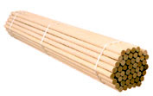
“They Crucified Him”
The Form of
Jesus’ Cross
Second
Century Writers
Sedile or “Seat”
a short post that went between the victim’s legs in order to bear some of the weight of the body.

Slide 21
“They Crucified Him”
The Form of
Jesus’ Cross
Second
Century Writers
Justin Martyr described the sedile of Christ’s cross projecting “out like a horn” (Dialogue 91).

Slide 22
“They Crucified Him”
The Form of
Jesus’ Cross
Second
Century Writers
Irenaeus claimed the cross of Christ had five extremities, describing the height and length but also the seat, “on which the person rests who is fixed by the nails” (Against Heresies 2.24.4).

Slide 23
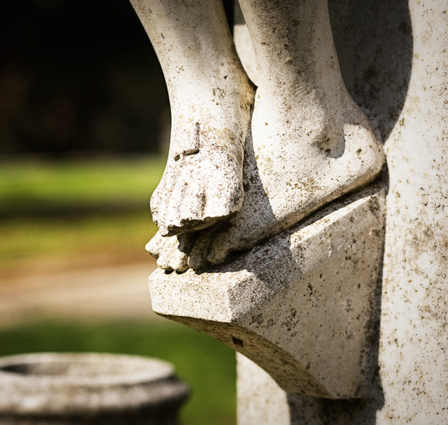
“They Crucified Him”
The Form of
Jesus’ Cross
The Footrest
“Was an invention of medieval Christian art, and is not mentioned by any ancient author as part of the cross used for crucifixion.”
John Wilkinson
“The Physical Cause
of Jesus’ Death,” 106

Slide 24
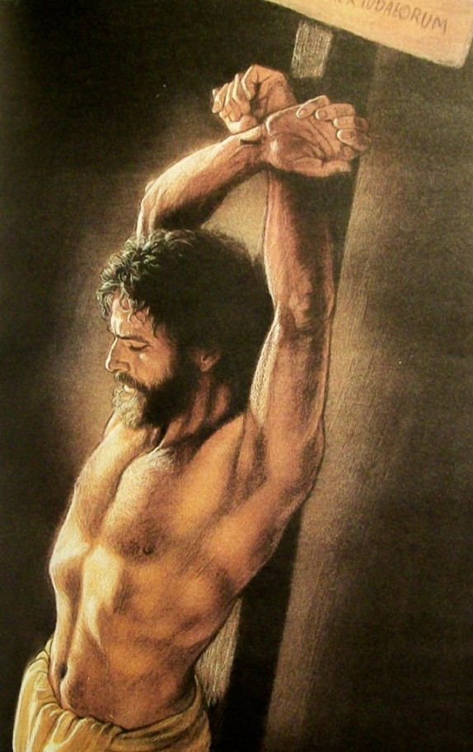
“They Crucified Him”
Cross or
“Torture Stake”
Watchtower Bible and Tract Society (The Publishing Control of the Jehovah’s Witnesses).
“Jesus died on an upright stake, and not on the traditional cross” (“Cross,” 90).
“It was not until about 300 years after Jesus’ death that some professed Christians promoted the idea that Jesus was put to death on a two-beamed cross” (“Did Jesus Really Die on a Cross?”).

Slide 25
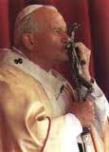
“They Crucified Him”
Cross or
“Torture Stake”
Their Motivation is Likely Opposition to Worship of Images
We agree that symbols of a crucifix should never be treated as objects of veneration.
However, linguistic evidence, the clear claims of early church writers, and the evidence from pagan Greek and Roman authors force us to acknowledge that two-beamed crosses were in common use in the first century.

Slide 26
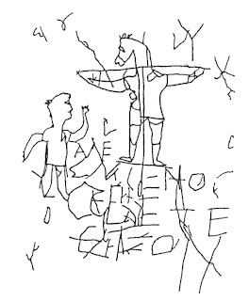
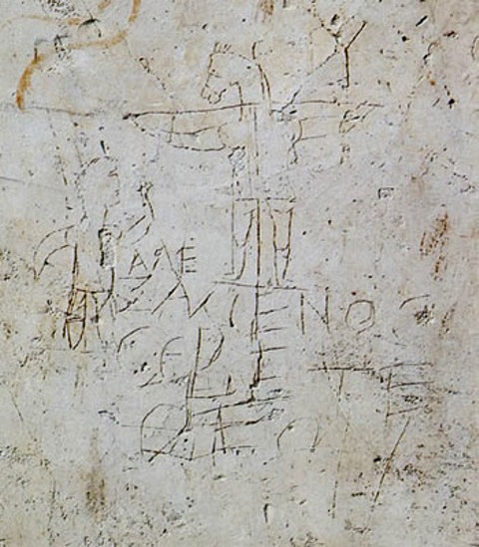
“They Crucified Him”
Cross or
“Torture Stake”
The Alexamenos
Graffito
“Alexamenos
worships his God”
Palatine Hill: Rome
ca. 1st-3rd Century

Slide 27
“They Crucified Him”
Cross or
“Torture Stake”
“For the message of the cross is foolishness to those who are perishing, but to us who are being saved it is the power of God”
1 Corinthians 1:18

Slide 28
“They Crucified Him”
“My Hands and Feet”
Jesus’ Hands and Feet Were Nailed
1. Jesus told His disciples, “behold my hands and my feet” (Luke 24:39).
2. Psalm 22:16 prophesied, “The congrega-tion of the wicked has enclosed me. They pierced my hands and my feet” (Ps. 22:16).
Justin and Tertullian applied this prophecy to Jesus (Justin, First Apology 35; Dialogue 97; Tertullian, Against Marcian 3.19).

Slide 29
“They Crucified Him”
“My Hands and Feet”
We Don’t Know if His Feet Were Nailed with a Single Nail or Two Nails
Plautus spoke of one put on a cross being fastened “twice in his feet and twice in his arms” (Mostellaria 2.1).
Fifth Century Ivory in the British Museum

Slide 30
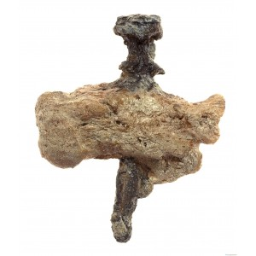
“They Crucified Him”
“My Hands and Feet”
Giv‘at ha-Mivtar Ossuary
In 1968, north of Mount Scopus in an area of Jerusalem, an ossuary (or bone box) was found containing the bones of an adult male, dated to the first century. The man was clearly the
victim of crucifixion
as revealed by the fact
that a large nail was
still driven through
the right heel bone.

Slide 31
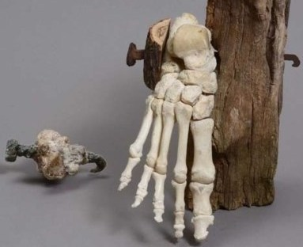
“They Crucified Him”
“My Hands and Feet”
Giv‘at ha-Mivtar Ossuary
Wood fragments were still present under the head and tip of the nail, indicating that it had first been driven into a wooden plate before it was nailed through the man’s heal and into
the cross. This likely
was intended to
prevent the heel
from slipping off
the nail.

Slide 32
“They Crucified Him”
“My Hands and Feet”
Giv‘at ha-Mivtar Ossuary
Dr. N. Haas, of Hebrew University, who wrote the initial report about the remains, claimed that the size of the nail indicated that, “the feet had not been securely fastened to the cross” (58).
The man’s legs were broken, similar to what is described of the thieves crucified with Jesus (John 19:32).

Slide 33
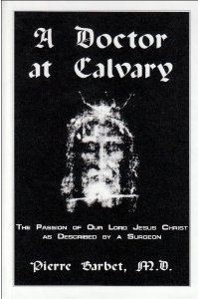
“They Crucified Him”
The Cause of
Jesus’ Death
Asphyxiation Theories
Since the mid-twentieth century, with the publication of A Doctor at Calvary by French surgeon Pierre Barbet, many commentators have explained Jesus’ death as the result of asphyxia.
According to Barbet’s theory, a victim suspended on a cross suffered intense constriction of the rib cage compressing the lungs.

Slide 34
“They Crucified Him”
The Cause of
Jesus’ Death
Asphyxiation Theories
Barbet argued that when exhaustion (or the breaking of legs) took place, the victim could no longer push himself up allowing the lungs to expand, resulting in a sustained inhalation ultimately depriving the victim of oxygen (74- 80).

Slide 35
“They Crucified Him”
The Cause of
Jesus’ Death
Asphyxiation Theories
Barbet cited eyewitness accounts of European prisoners of war suspended by their wrists with their feet weighted dying within six to ten minutes from asphyxia, due to the inability to exhale (76, 174).

Slide 36
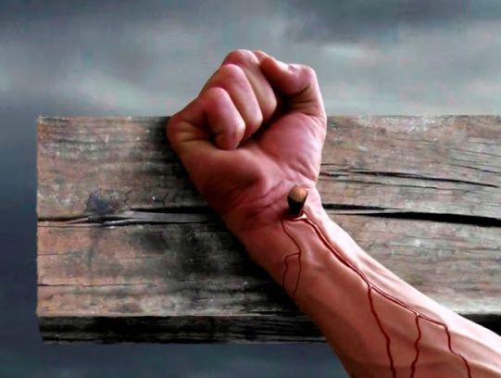
“They Crucified Him”
The Cause of
Jesus’ Death
Asphyxiation Theories
Barbet also challenged the view that a victim of crucifixion would be nailed through the palm of the hands.
He argued that the weight of a suspended body would tear through the palms where the nail had been driven into the cross (92-105).

Slide 37
“They Crucified Him”
The Cause of
Jesus’ Death
Modern Re-evaluation
Within recent years Barbet’s theory has been seriously challenged by Dr. Fredrick Zugibe.
In his book, The Crucifixion of Jesus: A Forensic Study, Zugibe tested the effects of suspension on a cross within a laboratory and found that with arms extended the effects on respiration were not as pronounced as Barbet theorized (101-122).

Slide 38
“They Crucified Him”
The Cause of
Jesus’ Death
Modern Re-evaluation
Zugibe argued instead, that the effects of severe scourging, followed by crucifixion would produce two conditions known as hypovolemic and traumatic shock, ultimately resulting in cardiac arrest.

Slide 39
“They Crucified Him”
The Cause of
Jesus’ Death
Modern Re-evaluation
Zugibe explains hypovolemic shock as resulting from “a significant fall in the blood volume due to hemorrhage or a loss of body fluids” and traumatic shock as “resulting from a serious injury” sometimes associated with “severe pain” (130-131).

Slide 40
“They Crucified Him”
The Breaking of Legs
Why Were Legs Broken?
1. One of the strengths of Barbet’s theory was that it appeared to explain the practice of crurifragium (breaking the legs of the victim).
2. We noted at the beginning of the lesson that this was generally considered the third and final stage of Roman crucifixion.

Slide 41
“They Crucified Him”
The Breaking of Legs
“Therefore, because it was the Preparation Day, that the bodies should not remain on the cross on the Sabbath (for that Sabbath was a high day), the Jews asked Pilate that their legs might be broken, and that they might be taken away…”

Slide 42
“They Crucified Him”
The Breaking of Legs
“…Then the soldiers came and broke the legs of the first and of the other who was crucified with Him”
John 19:31-32

Slide 43
“They Crucified Him”
The Breaking of Legs
The Sedile
Barbet’s theory failed to acknowledge the use of the sedile (or seat) on some crosses and said to have been on Christ’s cross by second century writers (e.g. Irenaeus, Against Heresies 2.24.4; Tertullian, Ad Nationes 1.12; Contra Marcian 3.18).
Sedile

Slide 44
“They Crucified Him”
The Breaking of Legs
The Sedile
Barbet cited early evidence regarding the use of the sedile (45), and acknowledged the problems its use would pose to his theory (78), but did not believe it was used in Christ’s crucifixion (100-101).
Sedile

Slide 45
“They Crucified Him”
The Breaking of Legs
“If this were present then the arms would not pull on the ribs to the same degree as if it were absent, and the chest would not be kept in a position” that impaired breathing in the same way”
John Wilkinson,
“The Physical Cause
of Jesus’ Death” 106

Slide 46
“They Crucified Him”
The Breaking of Legs
The Sedile
If the Sedile was used, why would the legs be broken?
Sedile

Slide 47
“They Crucified Him”
The Breaking of Legs
The Sedile
Zugibe argues that the fracture of a single thigh bone results in internal blood loss of two liters.
This would not only accelerate hypovolemic and traumatic shock, but would be a final “coup de grace blow to hasten death” (106).
Sedile

Slide 48
“They Crucified Him”
The Breaking of Legs
The Sedile
If the Sedile was used, it would also take some of the weight off of the hands.

Slide 49
“They Crucified Him”
The Breaking of Legs
Hand or Wrist?
Zugibe, argues from studies he has done on the hands of wound victims, that the upper palm, just under the thumb is “very strong and anatomically sound” and would be capable of supporting the body (78).
It has been argued that the Aramaic word for “hand” could refer to the wrist as well as the hand properly (Sava, “The Wounds of Christ,” 441).
It is true that even in modern Hebrew the wrist is called “the joint of the hand.”

Slide 50
“They Crucified Him”
The Breaking of Legs
Hand or Wrist?
Remains from Giv‘at ha-Mivtar are no longer believed to support the idea of a nail through the wrist.
One of the earliest depictions of Christ on the cross, from a fifth century ivory casket in the British Museum shows nails through the palms.
There seems little reason to even consider a broader definition of “hands.”

Slide 51
“They Crucified Him”
The Breaking of Legs
“Behold My hands and My feet, that it is I Myself. Handle Me and see, for a spirit does not have flesh and bones as you see I have.”
Luke 24:39

Slide 52
“They Crucified Him”
The Breaking of Legs
“Then He said to Thomas, ‘Reach your finger here, and look at My hands; and reach your hand here, and put it into My side. Do not be unbelieving, but believing.’”
John 20:27

Slide 53
“They Crucified Him”
Piercing Jesus’ Side
Jesus’ Legs Were Not Broken
“But when they came to Jesus and saw that He was already dead, they did not break His legs. But one of the soldiers pierced His side with a spear, and immediately blood and water came out…”

Slide 54
“They Crucified Him”
Piercing Jesus’ Side
Jesus’ Legs Were Not Broken
“…And he who has seen has testified, and his testimony is true; and he knows that he is telling the truth, so that you may believe. For these things were done that the Scripture should be fulfilled, ‘NOT ONE OF HIS BONES SHALL BE BROKEN’” (John 19:33-36).

Slide 55
“They Crucified Him”
Piercing Jesus’ Side
Jesus’ Legs Were Not Broken
Concerning the Passover: “They shall leave none of it until morning, nor break one of its bones. According to all the ordinances of the Passover they shall keep it”
Numbers 9:12

Slide 56
“They Crucified Him”
Piercing Jesus’ Side
Why did “blood and
water” flow from His side? Why did this indicate that He was dead?
1. A common explanation is that the spear pierced Jesus’ heart and the pericardial sac surrounding the heart.

Slide 57
“They Crucified Him”
Piercing Jesus’ Side
Why did “blood and
water” flow from His side? Why did this indicate that He was dead?
2. Dr. Anthony Sava, rejects this conclusion because of his own experiments on cadavers within six hours after death. He found that no such clear separation of blood and water resulted from this type of wound (“The Wound in the Side of Christ,” 344).

Slide 58
“They Crucified Him”
Piercing Jesus’ Side
Why did “blood and
water” flow from His side? Why did this indicate that He was dead?
3. He argues instead, that trauma caused by scourging could have led to conditions which have been observed.

Slide 59
“They Crucified Him”
Piercing Jesus’ Side
“...Non-penetrating injuries of the chest are capable of producing an accumulation of hemorrhagic fluid in the space between the ribs and the lung....Such collections of blood in closed cavities do not clot. The red blood cells tend by their weight to gravitate toward the bottom of the containing cavity, thus…”

Slide 60
“They Crucified Him”
Piercing Jesus’ Side
“... Dividing it into a dark red cellular component below, while the lighter clear serum accumulates in the upper half of the collection as a separate although contiguous layer...”

Slide 61
“They Crucified Him”
Piercing Jesus’ Side
“...The settling by this fluid into layers and its ultimate evacuation by opening the chest below the level of separation must inevitably result in the “immediate” flow of blood followed by the water”
Athony Sava, “The Wound
in the Side of Christ” 345

Slide 62
“They Crucified Him”
“Sent Away
the Spirit”
“…Cried out again with a loud voice, and yielded up His spirit.”
Matthew 27:50

Slide 63
“They Crucified Him”
“Sent Away
the Spirit”
“It is Finished.”
John 19:30

Slide 64
“They Crucified Him”
“Sent Away
the Spirit”
“Father, into your hands I commend My spirit.”
Luke 23:46

Slide 65
“They Crucified Him”
“Sent Away
the Spirit”
“Yielded up His spirit”
lit. “Sent away the spirit”
Matthew 27:50

Slide 66
“They Crucified Him”
“Sent Away
the Spirit”
The Other Gospels Record
“He breathed out His life” (Mark 15:37).
“He gave up the spirit” (John 19:30), which Vincent suggests, “seems to imply a voluntary yielding up of his life” (Word Pictures, 1.145).

Slide 67
“They Crucified Him”
“Sent Away
the Spirit”
“At his own free-will, he with a word dismissed from him his spirit”
Tertullian, Apology 21

Slide 68
“They Crucified Him”
“Sent Away
the Spirit”
We can appreciate some of the medical theories that offer explanations for the physical and biological factors involved in crucifixion.
Perhaps some or all of these factors played a role.
We must not discount the fact that in Jesus we are not talking about One who could simply be overtaken by death.

Slide 69
“They Crucified Him”
“Sent Away
the Spirit”
“Therefore My Father loves Me, because I lay down My life that I may take it again. No one takes it from Me, but I lay it down of Myself. I have power to lay it down, and I have power to take it again. This command I have received from My Father”
John 10:17-18

Slide 70
“They Crucified Him”
“Sent Away
the Spirit”
“We believe... that the view which most satisfactorily explains our Lord’s death is that he voluntarily surrendered his life on the cross before the usual physical causes of death in crucifixion could operate. He did not die from some inevitable physical necessity or pathological process.”
John Wilkinson,
“The Physical Cause
of Jesus’ Death” 107

Slide 71
“They Crucified Him”
“Sent Away
the Spirit”
We must not allow the consideration of science and medicine to blind us to who Jesus truly was.
He was God in the flesh, laying down his life for man by His own choice!

Slide 72
“They Crucified Him”
“Sent Away
the Spirit”
Commenting on Jesus’ declaration, “It is finished,” Augustine wrote that Jesus said this “as if he had been waiting for this, like one, indeed, who dies when he willed it to be so”
Harmony of the Gospels 3.18

Slide 73
“They Crucified Him”
“Sent Away
the Spirit”
“He came to the death of the flesh, because he did not leave it against his will, but because he willed, when he willed, as he willed”
Augustine, On the Trinity 4.13 {16}

Slide 74
The Most Horrific
The Most Wondrous
Why Did Jesus Do This?
“For God so loved the world that He gave His only begotten Son, that whoever believes in Him should not perish but have everlasting life”
John 3:16

