Slide 1
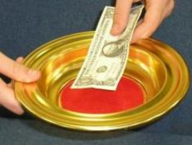

The Christian and Giving
I. God Has Always Required Sacrifice.
  Cain and Abel (Gen. 4:3-8; Heb. 11:4).
  After the flood, sacrifice was the first thing Noah did (Gen. 8:20).
  The Israelites were to offer many types of sacrifice.

Slide 2
The Christian and Giving
II. Our Relationship to Material Things.
  The earth is the Lord’s (1 Cor. 10:25-26).
  We bring nothing into life and will take nothing out with us (1 Tim. 6:6-8).
    We are stewards of what we possess.
  What we give already belongs to God (1 Chron. 29:13-14).
    We must give God our best.

Slide 3
The Christian and Giving
III. How Much Should We Give?
  First, ourselves (2 Cor. 8:5).
  Mosaic Law required a tithe (Lev. 27:30).
  Christians give willingly (2 Cor. 9:6-8).
    We should give as the need demands (Acts 2:44-45).
  We work to be able to give (Eph. 4:28).
    We do not just work to provide for ourselves (Gal. 6:10).

Slide 4
The Christian and Giving
IV. Examples of Giving.
  The church in Jerusalem (Acts 4:32-37).
  The churches of Macedonia (2 Cor. 8:1-4).
  The church in Philippi (Phil. 4:15-19).
    This is an act of worship to God.
    We must give Him our best in our worship to Him.

