Slide 1
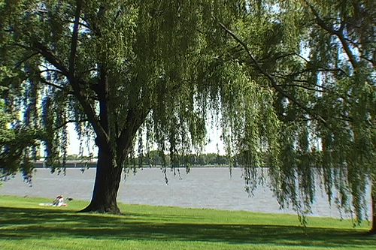
The Gospel in Psalm One

Slide 2
The Gospel in Psalm One
I. “Blessed is the Man…” (vs. 1a).
  A. “…Who Walks Not in the Counsel of the Ungodly…” (1b). – Prov. 12:5-7.
  B. “…Nor Stands in the Path of Sinners…” (vs. 1c). – Prov. 4:14-19.
  C. “…Nor Sits in the Seat of the Scornful…” (vs. 1d). – Matt. 23:2; Rom. 12:17.

Slide 3
The Gospel in Psalm One
II. “But His Delight…” (vs. 2a).
  A. “…Is In the Law of the Lord…” (2b). – Rom. 12:9; Deut. 6:4-9.
  B. “…And In His Law He Meditates Day and Night…” (vs. 2c). – Deut. 6:7; Josh. 1:9.

Slide 4
The Gospel in Psalm One
III. “He Shall Be…” (vs. 3a).
  A. “…Like a Tree…” (2b).
    “Planted by rivers of water…” (John 4:7-14).
    “That brings forth it fruit in its season...” (John 15:1-8; Luke 13:6-9).
    “Whose leaf also shall not wither…” (John 15:6).

Slide 5
The Gospel in Psalm One
III. “He Shall Be…” (vs. 3a).
  B. “…And Whatever He Does Shall Prosper…” (2c). – Rom. 8:28.

Slide 6
The Gospel in Psalm One
IV. “The Ungodly Are Not So…” (vs. 4a).
  A. “…But Are Like Chaff Which the Wind Drives Away…” (4b). – Matt. 3:7-12.
  B. “…Therefore the Ungodly Shall Not Stand in the Judgment…” (5a). – Acts 34:15.
  C. “…Nor Sinners in the Congregation of the Righteous…” (5b). – Rev. 21:7-8; 22:14-15.

Slide 7
The Gospel in Psalm One
V. “For the Lord Knows…” (vs. 6a).
  A. “…The Way of the Righteous…” (6b). – 2 Tim. 2:19.
  B. “…But the Way of the Ungodly Shall Perish…” (6c)..

