Slide 1
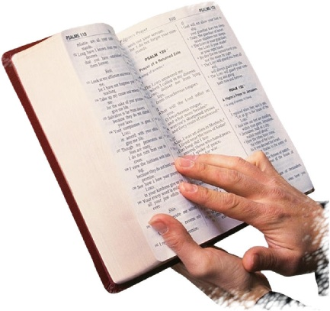
Psalm 142:1-7
A Contemplation Of David. A Prayer When He Was in the Cave.
“I cry out to the LORD with my voice; With my voice to the LORD I make my supplication. I pour out my complaint before Him; I declare before Him my trouble. When my spirit was overwhelmed within me, Then You knew my path. In the way in which I walk They have secretly set a snare for me. Look on my right hand and see, For there is no one who acknowledges me; Refuge has failed me;…”

Slide 2
Psalm 142:1-7
“…No one cares for my soul. I cried out to You, O LORD: I said, ‘You are my refuge, My portion in the land of the living. Attend to my cry, For I am brought very low; Deliver me from my persecutors, For they are stronger than I. Bring my soul out of prison, That I may praise Your name; The righteous shall surround me, For You shall deal bountifully with me’” (NKJV).

Slide 3

“No One Cares For My Soul” Psalm 142:4
I. Do Your Children Know
You Care for Their Souls?
They will know by your instruction (Deut. 6:6-9).
They will know by your discipline (Prov. 13:24).
They will know by your example (2 Tim. 1:5; Heb. 10:25).

Slide 4
“No One Cares For My Soul” Psalm 142:4
II. Does Your Spouse Know
You Care for His or Her Soul?
Christian spouses are “heir-together” of the grace of life (1 Peter 3:7).
  We must not hinder one another in serving God.
Non-Christian spouses need to see our care (1 Peter. 3:1-6).

Slide 5
“No One Cares For My Soul” Psalm 142:4
III. Do Your Friends Know
You Care for Their Souls?
Paul’s great desire was for the salvation of Israel (Romans 10:1-3; 1 Corinthians 9:16).
There are tools available to help.
Try to set up a Bible study.
Not guilt—motivation to show our care.

Slide 6
“No One Cares For My Soul” Psalm 142:4
IV. Do Brethren Know You
Care for Their Souls?
“Love as brothers” (1 Peter 3:8).
Love is expressed by action and concern (Gal. 2:20).
Do you help or hinder your brethren? (Hebrews 10:23-25).
“Edify one another” (1 Thessalonians 5:11).

