Slide 1
Redefining Marriage
A Historical Perspective

Slide 2





Defense of Marriage Act
“The word ‘marriage’ means only a legal union between one man and one woman as husband and wife, and the word ‘spouse’ refers only to a person of the opposite sex who is a husband and or a wife” (§ 7).
September 1996

Slide 3

Laws on “Homosexual Marriage”
Since
DOMA...
Nine states and the District of Columbia have now legalized homosexual marriages.
Four states recognize “civil unions” between homosexuals.
Twenty-seven states instituted constitutional amendments banning “same-sex” marriage.

Slide 4
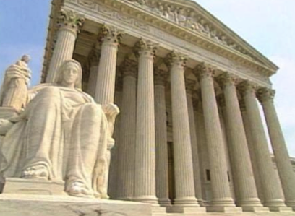
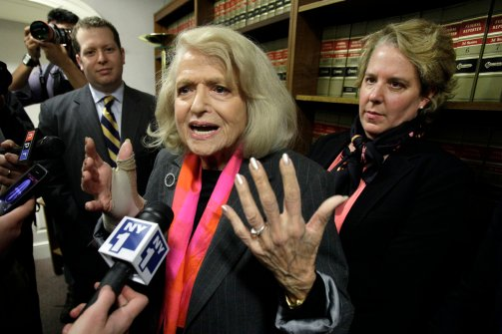
The United States Supreme Court
On June 26, 2013 in United States vs. Windsor the Supreme Court ruled that DOMA was unconstitutional.

Slide 5
Christians Must Understand
“That which has been is what will be, that which is done is what will be done, and there is nothing new under the sun” (Ecc. 1:9, NKJV).
“In the midst of a crooked and perverse generation” (Phil. 2:15).
We must be “salt” and “light” (Matt. 5:13-16), that we might “shine as lights”…

Slide 6

The Biblical Definition of Marriage
The “Marriage Constitution”
“Therefore a man shall leave his father and mother…”
“…and be joined to his wife…”
“…and they shall become one flesh” (Gen. 2:24).

Slide 7

The Marriage Constitution
Leaving Father and Mother.
  A new and distinct family unit.
  Independent and autonomous in nature.
Be Joined to a Wife.
  Specifies parties involved.
    Man and “his wife.”
  Not just “living together” (cf. John 4:18), but some recognized affirmation that a permanent union has taken place.

Slide 8
The Marriage Constitution
Becoming One Flesh.
  “The two shall become one flesh” (Matt. 19:5; Mark 10:8; 1 Cor. 6:16; Eph. 5:31).
    One Man and one woman.
  “One flesh” relationship is sexual contact (cf. 1 Cor. 6:16).
    Marriage is the sole place for the “one flesh” relationship.

Slide 9
“Wife by Covenant”
“…The Lord has been witness between you and the wife of your youth, with whom you have dealt treacherously; yet she is your companion and your wife by covenant. But did He not make them one, having a remnant of the Spirit? And why one? He seeks godly offspring. Therefore take heed to your spirit, and let none deal treacherously with the wife of his youth” (Mal. 2:14-15).

Slide 10
“Wife by Covenant”
Marriage is a “covenant.”
God acts as “witness between you and the wife of your youth” (Mal. 2:14).
  God is involved in every lawful marriage covenant as “witness.”
God is the one who “made them one” (Mal. 2:15).
  “What God has joined together, let not man separate” (Matt. 19:6).

Slide 11
Redefinitions Throughout History
Five Major Attempts
Polygamy, Homosexuality, Sex outside of marriage, Divorce and remarriage, and Human attempts to control and define marriage.

Slide 12
Polygamy

Slide 13
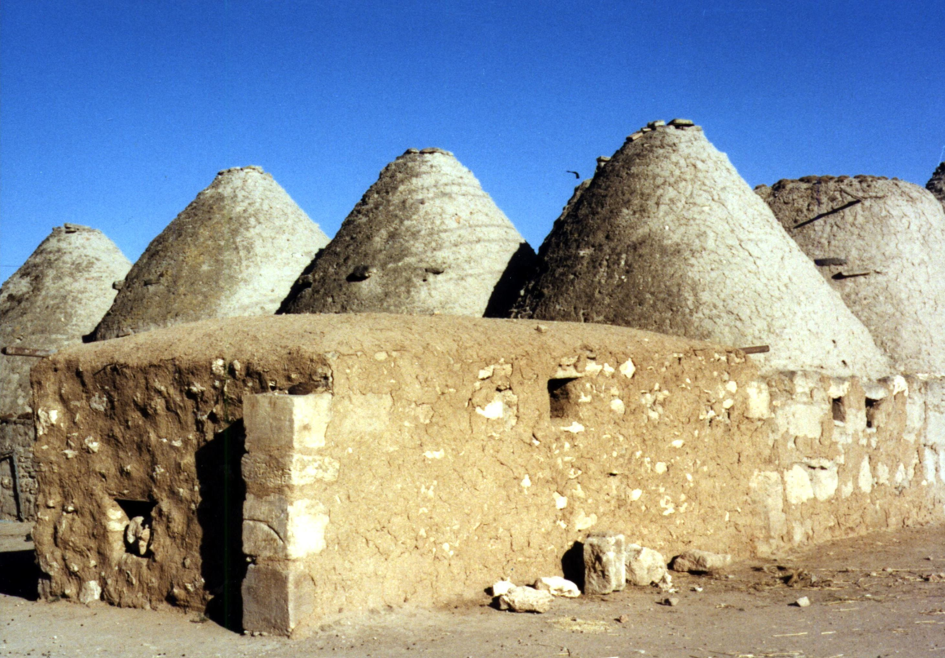
Ancient Polygamy and Concubinage
First recorded polygamist: Lamech married Adah and Zillah (Gen. 4:19).
Abraham and Hagar: Sarai “gave her to her husband to be his wife” (Gen. 16:3).
Jacob was tricked into marrying two wives: Leah and Rachel (Gen. 29:15-30).
  Rachel gave her servant Bilhah to Jacob “as wife” (Gen. 30:4, 7), and later, Leah also gave her servant Zilpah to him “as wife,” (Gen. 30:9, 12).

Slide 14
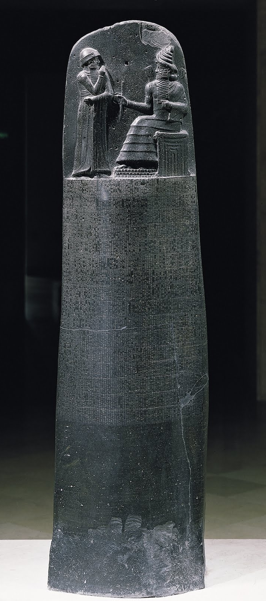
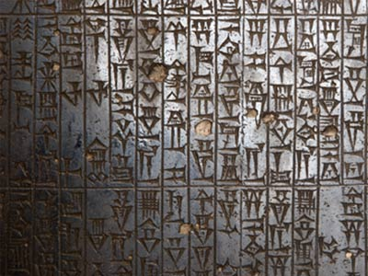
Concubine Surrogacy.
Code of Hammurabi.
  Allowed a husband to divorce a wife who had born him no children (138).
  To avoid this, the wife could give her husband a slave-girl to bear children (144).
  If she did not give him a slave-girl he could take a concubine to bear children (145).
18th century B.C. Babylonian Code

Slide 15
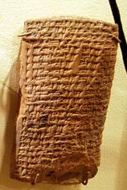
Concubine Surrogacy.
Nuzi Tablets.
  “If Gilimninu [the bride] will not bear children, Gilimninu will take a woman of N/Lullu-land [whence the choicest slaves were obtained] as a wife for Shennima [the bridegroom]” (HSS 5.67.19-21, Gordon).
  A slave-girl could be offered to a husband, and barrenness was an excuse to take a second wife (HSS 5 80:1-23; HSS 19 78; 84).
14-15th century B.C. Hurrian Law Tablets

Slide 16
God never commanded such customs—the family of Abraham followed the manmade customs of the people around them.

Slide 17
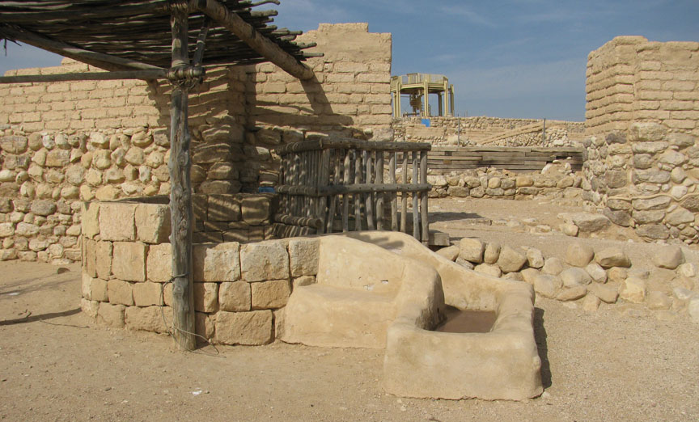
Biblical
Accounts
CONCUBINES:
After Sarah’s death, Abraham married Keturah (Gen. 25:1), but he is also said to have had “concubines” (Gen. 25:6).
Concubines were viewed as legal wives of secondary rank.
Mosaic Law made provisions for concubinage (Lev. 19:20), but it did not prohibit it.

Slide 18
Biblical
Accounts
POLYGAMY:
After Sarah’s death Keturah was Abraham’s “wife” (Gen. 25:1) but she is also called his “concubine” (1 Chron. 1:32).
If a man took a wife from foreign slaves he could not diminish her status “if he takes another wife” (Exod. 21:7-11).
Firstborn inheritance was retained “if a man has two wives” (Deut. 21:15-17).

Slide 19
Biblical
Accounts
POLYGAMY:
Mosaic law, when compared to the laws of other nations, protected women even when it allowed redefinitions that had not been intended “from the beginning” (cf. Matt. 19:8).
Under Christ, a restatement and clarification of God’s original design for marriage has now been fully implemented.
No faithful Christian can be a polygamist!

Slide 20
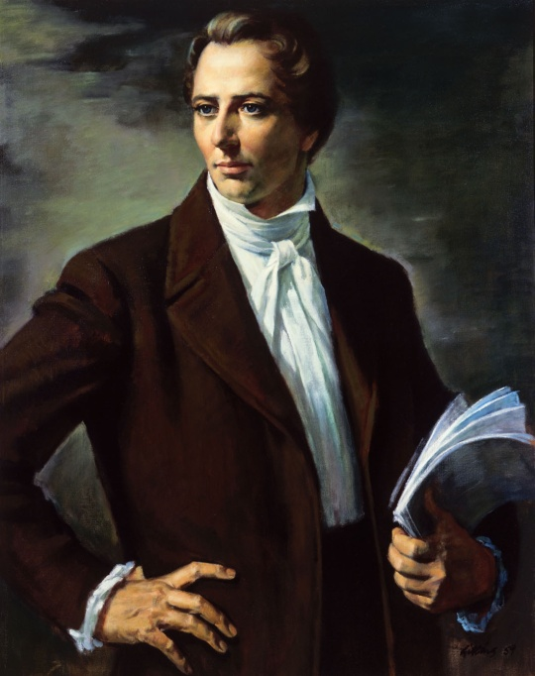
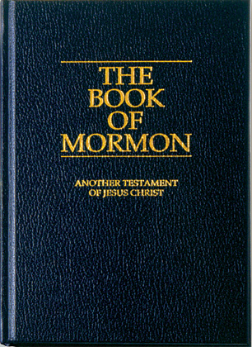
Polygamy in More Recent History
“Behold, David and Solomon truly had many wives and concubines, which thing was abominable before me, saith the Lord.” (Jacob 2:24).
Joseph Smith

Slide 21
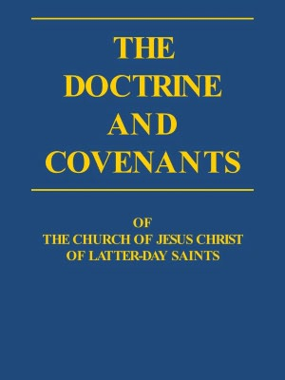
Polygamy in More Recent History
“David also received many wives and concubines, and also Solomon and Moses my servants, as also many others of my servants, from the beginning of creation until this time; and in nothing did they sin save in those things which they received not of me” (Doctrine and Covenants 132:38).
Joseph Smith

Slide 22
Smith’s False Vision
Doctrine and Covenants 132
Answer to Smith’s questions about polygamy practiced by Old Testament figures (132:1-2).
Answer involves a redefinition of the terms of marriage.
  It claimed, while all “covenants, contracts, bonds, obligations, oaths” and “vows” not “made and entered into and sealed by the Holy Spirit of promise” and Mormon leaders “for time and for all eternity” end at death (132:7).
  However, a supposed new type of marriage covenant is introduced that can be “sealed by the Holy Spirit” and Mormon leaders that “in time, and through all eternity” he claims “shall be in full force when they are out of this world” (132:19).

Slide 23
Jesus said, “those who are counted worthy to attain that age, and the resurrection from the dead, neither marry nor are given in marriage” (Luke 20:35).

Slide 24
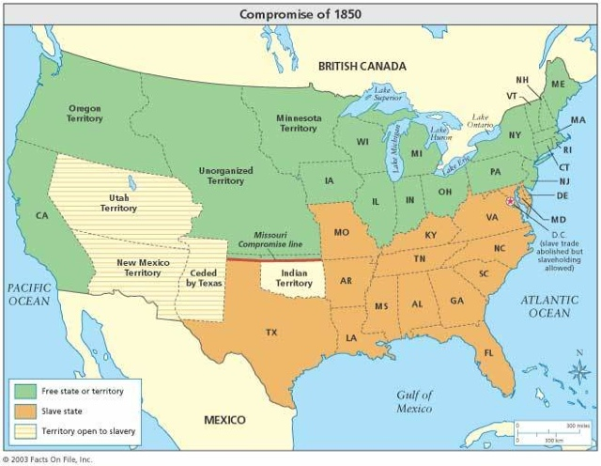
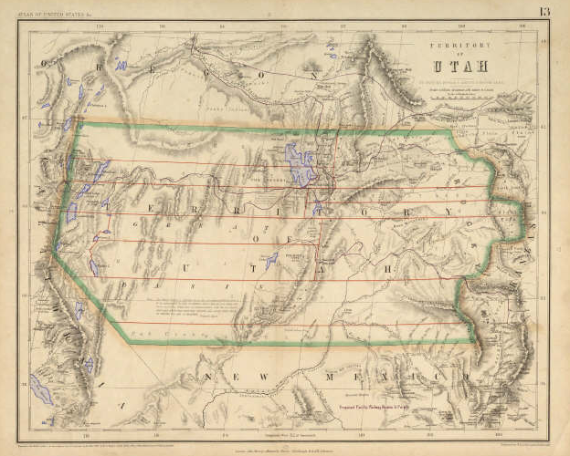
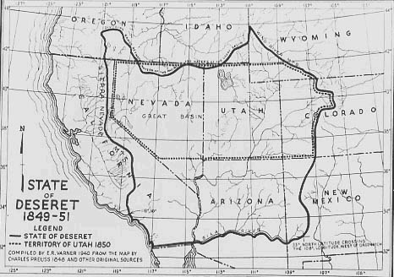
Mormon Hopes
The United States Government’s War on Polygamy
Failed Attempts at Statehood
1849
1856
1862
1872
1882
1887

Slide 25
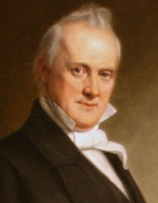
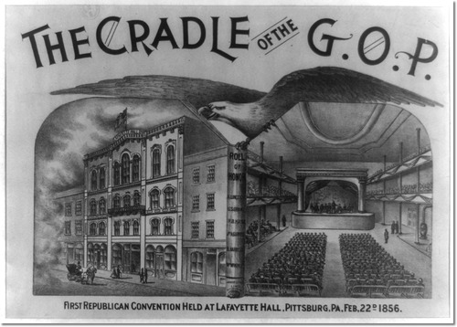
On the Brink of War
Federal troops were ready for war with Mormon citizens and militia in Utah Territory from May of 1857 to July of 1858.
President James Buchanon
In 1856 the newly formed Republican Party, in their party platform asserted that it was, “the right and the imperative duty of Congress to prohibit in the Territories those twin relics of barbarism—Polygamy, and Slavery” (Third Resolution).

Slide 26
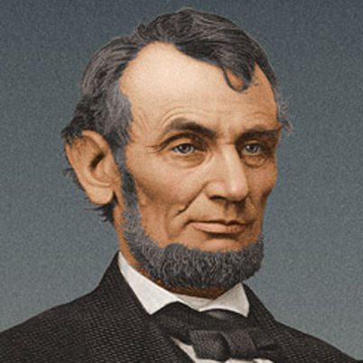
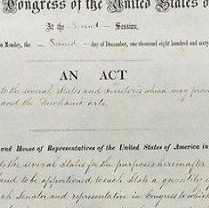
On the Brink of War
“Morrill Anti-Bigamy Act” July, 1862.
  Demanded $500.00 fine and five years in prison for “every person having a husband or wife living, who shall marry any other person, whether married or single, in a Territory of the United States” (501).
President Abraham Lincoln

Slide 27
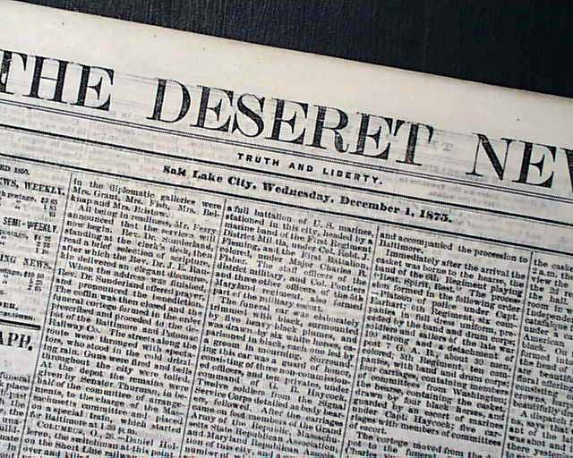
On the Brink of War
Lincoln did not enforce the “Morrill Anti-Bigamy Act” out of fears that Utah Territory would side with the Confederacy.
He told T.B.H. Stenhouse, assistant editor of the Mormon Deseret News:
  “You go back and tell Brigham Young that if he will let me alone I will let him alone” (Nibley, 369).
President Abraham Lincoln

Slide 28
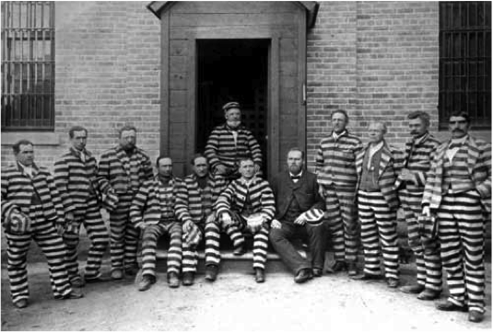
The Abolition of Mormon Polygamy
1882, “Edmunds Anti-Polygamy Act” made polygamy a felony, demanding that polygamists lose the right to vote, hold political office, or serve on a jury.
  Under this law 1300 Mormon men were imprisoned.
1885 Murphy vs. Ramsey, 114 U.S. 15 (1885), upheld anti-polygamy laws.
1887 the “Edmunds-Tucker Anti-Polygamy Act” further criminalized polygamy and required a marriage license for all marriages in Utah Territory.

Slide 29
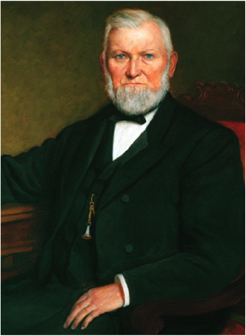
The Abolition of Mormon Polygamy
“The Manifesto”
“Inasmuch as laws have been enacted by Congress forbidding plural marriages, which laws have been pronounced constitutional by the court of last resort, I hereby declare my intention to submit to those laws, and to use my influence with the members of the Church over which I preside to have them do likewise” (Doctrine and Covenants, p. 257).
Wilford Woodruff

Slide 30
Homosexuality

Slide 31
The Men of Sodom
“Where are the men who came to you tonight? Bring them out to us, that we may know them” (Gen. 19:5, ESV).
“Know them carnally” (NKJV)
“Have relations with them” (NASB)
“Have sex them” (NIV, NLT)

Slide 32
The Men of Sodom
“I beg you, my brothers, do not act so wickedly.” (Gen. 19:7, NKJV).

Slide 33
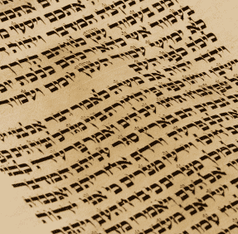

Mosaic Law
“You shall not lie with a male as with a woman. It is an abomination” (Lev. 18:22).
The Sin
Penalty

Slide 34
Mosaic Law
“If a man lies with a male as he lies with a woman, both of them have committed an abomination. They shall surely be put to death. Their blood shall be upon them” (Lev. 20:13).
The Sin
Penalty

Slide 35

Male Cult Prostitution
“There shall be no ritual harlot (q^{e}dēšâh) of the daughters of Israel, or a perverted one (qādēš) of the sons of Israel. You shall not bring the wages of a harlot or the price of a dog to the house of the LORD your God for any vowed offering, for both of these are an abomination to the LORD your God” (Deut. 23:17-18).

Slide 36
Male Cult Prostitution
There was to be no female “ritual harlot (q^{e}dēšâh)” in Israel (23:17a)… | …and they were not to accept “the wages of a harlot” (23:18a).
There was to be no male “perverted one (qādēš)” in Israel (23:17b)… | …and they were not to accept the “price of a dog” (23:18b).

Slide 37
Male Cult Prostitution
There was to be no female “ritual harlot (q^{e}dēšâh)” in Israel (23:17a)… | …and they were not to accept “the wages of a harlot” (23:18a).
There was to be no male “perverted one (qādēš)” in Israel (23:17b)… | …and they were not to accept the “price of a dog” (23:18b).

Slide 38
Male Cult Prostitution
There was to be no female “ritual harlot (q^{e}dēšâh)” in Israel (23:17a)… | …and they were not to accept “the wages of a harlot” (23:18a).
There was to be no male “perverted one (qādēš)” in Israel (23:17b)… | …and they were not to accept the “price of a dog” (23:18b).

Slide 39
Male Cult Prostitution
There was to be no female “ritual harlot (q^{e}dēšâh)” in Israel (23:17a)… | …and they were not to accept “the wages of a harlot” (23:18a).
There was to be no male “perverted one (qādēš)” in Israel (23:17b)… | …and they were not to accept the “price of a dog” (23:18b).

Slide 40
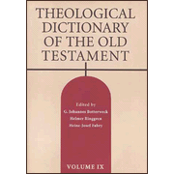
Some Scholars and Gay Advocates Question this View
“Although the two terms are generally associated with cultic prostitution, none of the passages offers any unequivocal evidence of such” (Helmer Ringren, Theological Dictionary of the Old Testament. Vol. 12. 542).

Slide 41
Some Scholars and Gay Advocates
Question this View
Q^{e}dēšâh clearly, however, referred to a female prostitute (cf. Gen. 38:21-22).
In Deuteronomy 23, the parallel association of qādēš (23:17b) and “dog” (23:18b) clearly (and graphically) demonstrates a reference to male homosexual prostitution (cf. Rev. 22:15).

Slide 42
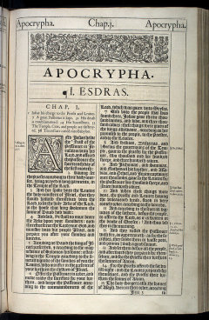
Was a Qādēš a Homosexual Harlot?
Second Maccabees
  Between the Old and New Testament, they carried on prostitution in the temple (6.4).
  This may have included homosexual prostitution because it claims they consorted “with harlots (hetairōn)” and also “with women (gunaixi).”

Slide 43
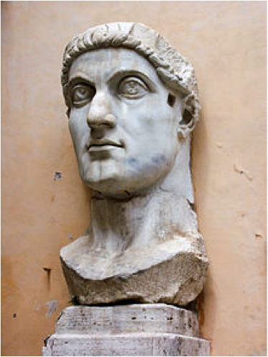
Was a Qādēš a Homosexual Harlot?
Eusebius
  Up to the time of Constantine, male temple prostitution was practiced in a temple of Venus on Mount Lebanon until Constantine destroyed the temple and ended this practice by the threat of punishment (Life of Constantine 3.55).
The Roman Emperor Constantine

Slide 44
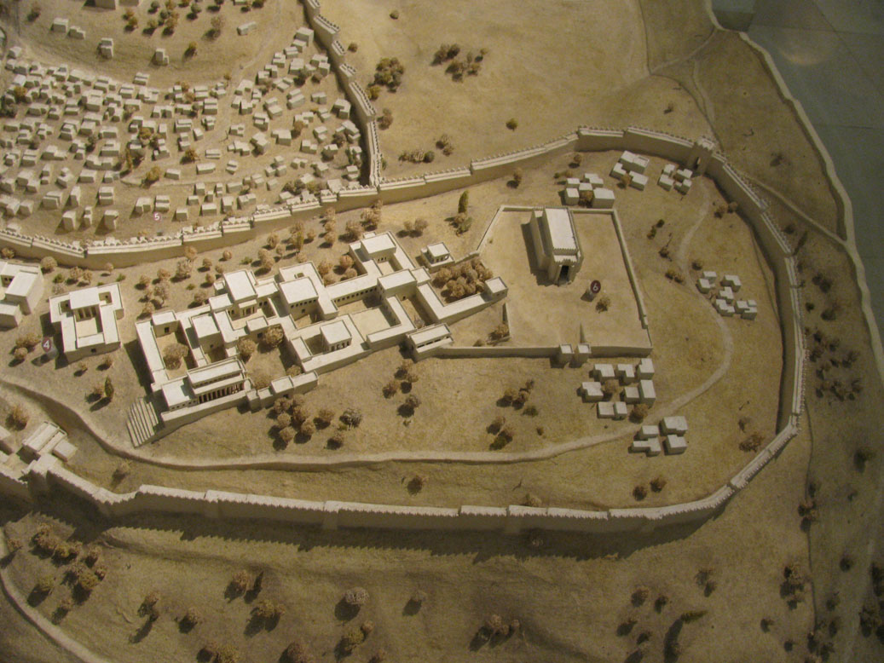
“Perverted Persons”
In the Temple
In the days of Rehoboam “there were also perverted persons (qādēš) in the land. They did according to all the abominations of the nations which the LORD had cast out before the children of Israel” (1 Kings 14:24).
Jehoshophat removed from the land, “the rest of the perverted persons (qādēš), who remained in the days of his father Asa” (1 Kings 22:46).

Slide 45
“Perverted Persons”
In the Temple
Asa was said to have “banished the perverted persons (q^{e}dēšîm) from the land and removed all of the idols that his fathers had made” (1 Kings 15:12).
Josiah, “tore down the ritual booths of the perverted persons (q^{e}dēšîm) that were in the house of the Lord, where the women wove hangings for the wooden image (’ăšērâh)” (2 Kings 23:7).

Slide 46
Homosexuality in the New Testament World
In 1 Timothy 1:10 Paul describes the behavior of fornicators and sodomites as that which, “is contrary to sound doctrine.”
In Romans 1:24-27 Paul such as “vile,”—“against nature” (1:26), and “shameful” (1:27).

Slide 47
Homosexuality in the New Testament World
In 1 Corinthians 6:9-10 Paul includes “homosexuals (malakoi),” meaning literally “soft”—“effeminate” (KJV) and “sodomites (arsenokoitai)” meaning literally “to lie with a man”—“abusers of themselves with men” (ASV), in a list of those who “will not inherit the kingdom of God.”

Slide 48

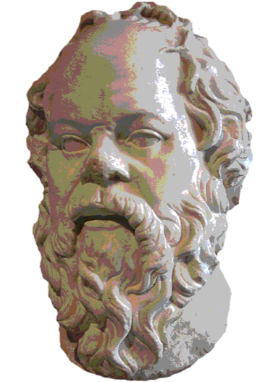
Pederasty in the Ancient World
It is our settled tradition that when a man freely devotes his service to another in the belief that his friend will make him better in point of wisdom, it may be, or in any of the other parts of virtue, this willing bondage also is no sort of baseness or flattery (184c)
Thus by all means it is right to bestow this favor for the sake of virtue. This is the Love that belongs to the Heavenly Goddess, heavenly itself and precious to both public and private life: for this compels lover and beloved alike to feel a zealous concern for their own virtue (185b-c).
Plato’s Symposium
Socrates

Slide 49
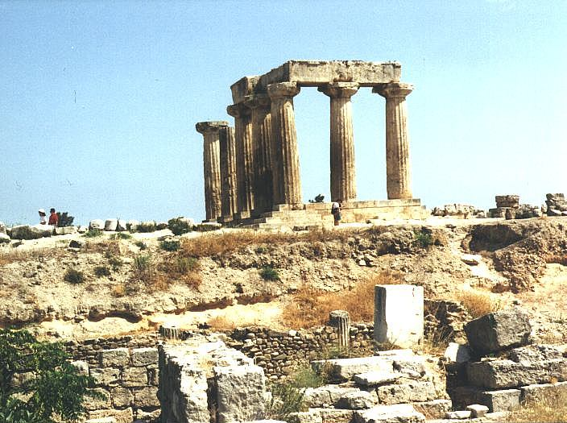
Into This World of Sin the Gospel Was Born
“...Such were some of you. But you were washed, but you were sanctified, but you were justified in the name of the Lord Jesus and by the Spirit of our God” (1 Cor. 6:11).

Slide 50
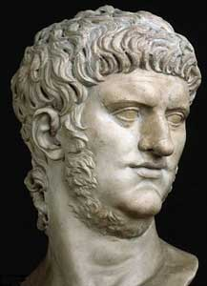
Homosexual Marriage in the Ancient World
Tacitus records that Nero played the bride, in a public marriage to a man named Pythagoras, wearing a veil, and calling for witnesses with “all the forms of regular marriage” (Annals 15.37.4).
The Roman Emperor Nero

Slide 51
Homosexual Marriage in the Ancient World
Suetonius says Nero went through another public marriage ceremony with a boy named Sporus whom he had castrated.
Sporus was provided a dowry, wore a veil, and was led to their house by a wedding procession (Nero 28.1).
The Roman Emperor Nero

Slide 52
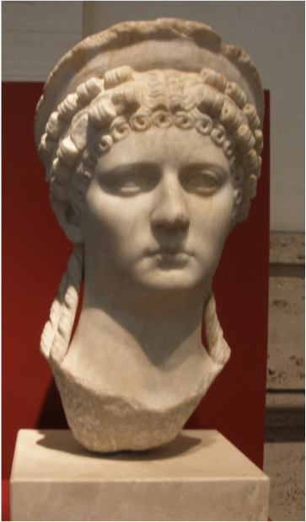
Homosexual Marriage in the Ancient World
According to Dio Cassius, Nero chose to marry Sporus, because Sporus looked like Sabina (Epitome 62.28).
  Poppaea Sabina was Nero’s dead wife (Suetonius, Nero 35.3).
When Nero was killed, Nymphidius Sabinus, the prefect of the Praetorian Guard who conspired in Nero’s death, took Sporus as his own lover, calling him “Poppaea” (Plutarch, Galba 9.3).
The Roman Emperor Nero
Poppaea Sabina

Slide 53
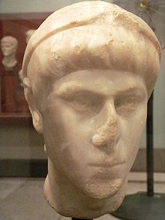
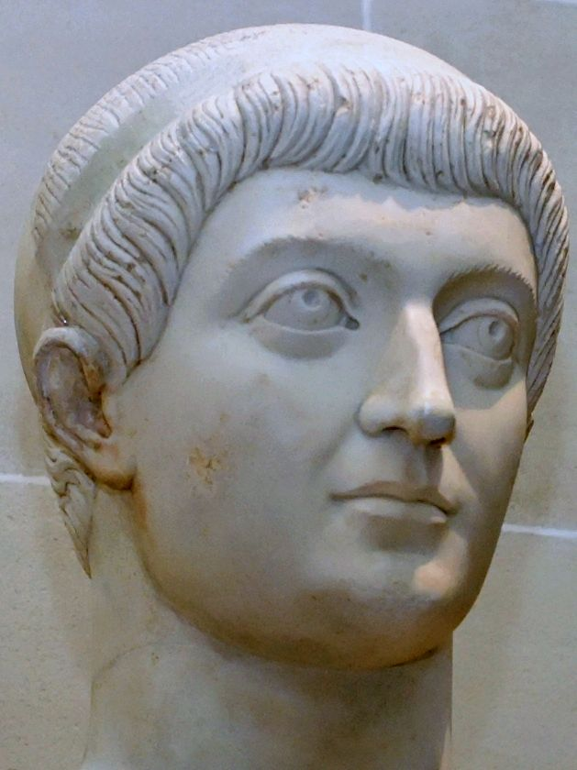
Homosexual Marriage in the Ancient World
In 342 A.D. Constantine’s sons, Constans and Constantius II passed a law prohibiting homosexual marriage and requiring the execution of those who violated this law.
Roman Emperors
Constans and Constantius II

