Slide 1
Redefining Marriage
A Historical Perspective

Slide 2

Redefinitions Throughout History
Five Major Attempts
Polygamy, Homosexuality, Sex outside of marriage, Divorce and remarriage, and Human attempts to control and define marriage.

Slide 3
Sex Outside of Marriage

Slide 4
God established the “one flesh” union of sexual contact within the covenant of marriage (Gen. 2:24).
Sexual contact outside of the marriage covenant attempts to change the definition of marriage into something God never intended it to be.

Slide 5
Sex Outside of Marriage
INCEST
PRE-MARITAL SEX
ADULTERY
PROSTITUTION

Slide 6

Incest
After leaving Sodom, Lot’s daughters committed fornication with their father (after they got him drunk) and conceived children, from whom the Moabite and Ammonite nations would descend (Gen. 19:31-38).
  We would call this “incest” from the Latin word incastus meaning “unclean.”

Slide 7
Incest
The Law of Moses
“None of you shall approach anyone who is near of kin to him to uncover his nakedness” (Lev. 18:6).
  A detailed list of relationships that were forbidden (Lev. 18:7-16).
If Abraham and Jacob had lived under Mosaic Law Abraham’s marriage to Sarah would have been sinful (Lev. 18:9).
Jacob’s marriage to sisters would have been sinful (Lev. 18:18).

Slide 8
Incest
The Law of Christ
In condemning fornication (and probably “uncleanness”) Christ’s law echoes Mosaic sexual prohibitions (Matt. 15:19; 2 Cor. 12:21; Gal. 5:19; Eph. 5:3; Col. 3:5).
All incest is condemned under Christ.

Slide 9

Pre-Marital Sex
Jacob purchased some land from Hamor, the father of a young man named Shechem (Gen. 33:19).
When Shechem saw Jacob’s daughter Dinah, “he took her and lay with her, and violated her” (Gen. 34:2).
  Shechem “loved the young woman and spoke kindly to her” (Gen. 34:3).
  Yet, “He had done a disgraceful thing in Israel by lying with Jacob’s daughter, a thing which ought not to be done” (Gen. 34:7).

Slide 10


Mosaic Law
Deuteronomy 22:13-29
If it was discovered that a women was not a virgin when she was married she was to be stoned—“because she has done a disgraceful thing in Israel” (22:21).
If a betrothed women had sex with another man in the city, both the man and the woman were to be stoned (22:23-24).

Slide 11

The Law of Christ
The Meaning of the Word “Fornication.”
In modern usage, man sometimes speaks of “fornication” when talking about premarital sex, and “adultery” when talking about sex outside of marriage.
The Greek word porneia refers to “illicit sexual intercourse in general” (Thayer). All types of sexual immorality are “fornication.”

Slide 12
The Law of Christ
The New Testament, in its condemnation of “fornication” echoed the Old Law’s condemnation of such things (Matt. 5:32; 15:20; 19:9; Mark 7:21; 1 Cor. 6:13, 18; 2 Cor. 12:21; Eph. 5:5; Col. 3:5; 1 Thess. 4:3).
Paul reasserts God’s original place for sexual contact, commanding, “because of sexual immorality, let each man have his own wife, and let each woman have her own husband” (1 Cor. 7:2).

Slide 13
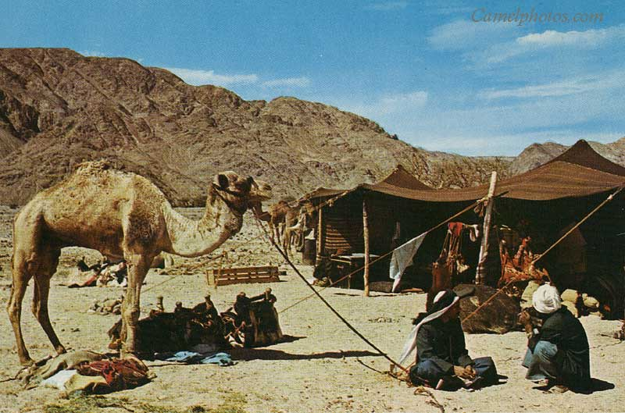
Adultery
PATRIARCHAL AGE:
Jacob’s oldest son, Reuben, “went in and lay with Bilhah, his father’s concubine” (Gen. 35:22).
  There is no question this was considered sinful under Patriarchal Law. Jacob later cursed Reuben because he “defiled” his father’s bed (Gen. 49:4).
When tempted by Potiphar’s wife, Joseph responded, “How then can I do this great wickedness, and sin against God?” (Gen. 39:9).

Slide 14
Mosaic Law
Adultery was prohibited under the Ten Commandments (Exod. 20:14; Deut. 5:18) and the death penalty was commanded for its violation (Lev. 20:10).
The same was required for the man who had intercourse with his father’s wife (Lev. 20:11).
  If Reuben had lived under the Mosaic Law heshould have been put to death.
When David took the wife of Uriah, he rightly deserved death (2 Sam. 11:1-27), had God not pardoned him (2 Sam. 12:13-15; cf. Psa. 51:1-19).

Slide 15
The Law of Christ
Adultery can disqualify one form inheriting the kingdom of heaven (1 Cor. 6:9-10; Gal. 5:19-20; Heb. 13:4). .
Jesus, extends the definition of adultery beyond its Old Testament sense to include remarriage after unscriptural divorce and remarriage ” (Matt. 5:32; 19:9; Mark 10:11-12; Luke 16:18).

Slide 16
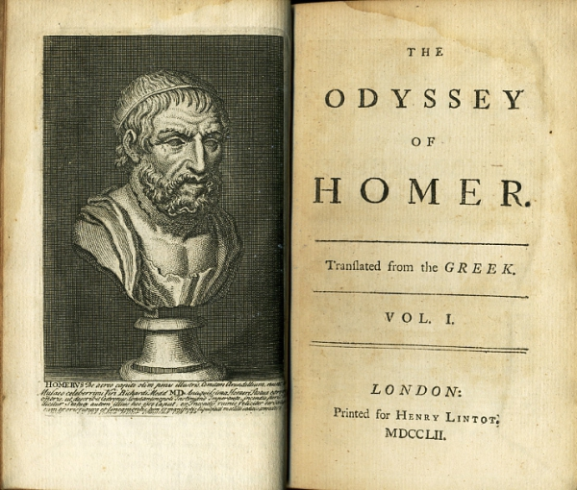
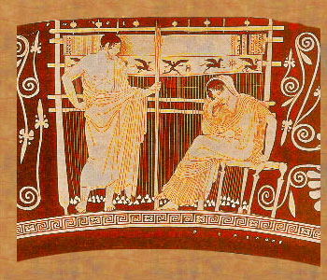
Ancient Tolerance of Adultery
“Constant Penelope”
The Odyssey, the Greek epic written ca. 700 B.C. relates without scorn, the exploits and numerous adulteries of “godly (dios) Odysseus,” (1.196ff.)—the standard epithet for Odysseus.
His wife Penelope’s faithfulness to him, however, is expected. She is “wise Penelope” or “constant Penelope” (4.111ff).

Slide 17
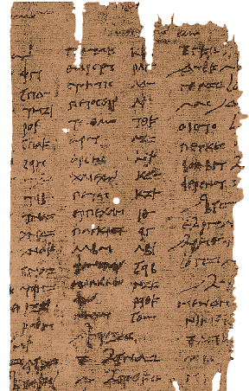
Ancient Tolerance of Adultery
G.W. Peterman has documented how this double standard was the common view in much of the ancient world.
In studying marriage contracts from New Testament times nd before often the woman promised not to “be with another man,” but for the man “the restriction is not against being with another woman, but against having” another woman (“Marriage and Sexual Fidelity in the Papyri, Plutarch, and Paul” 166).
Ancient Marriage Contract

Slide 18
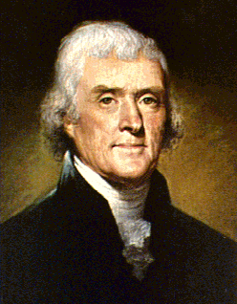
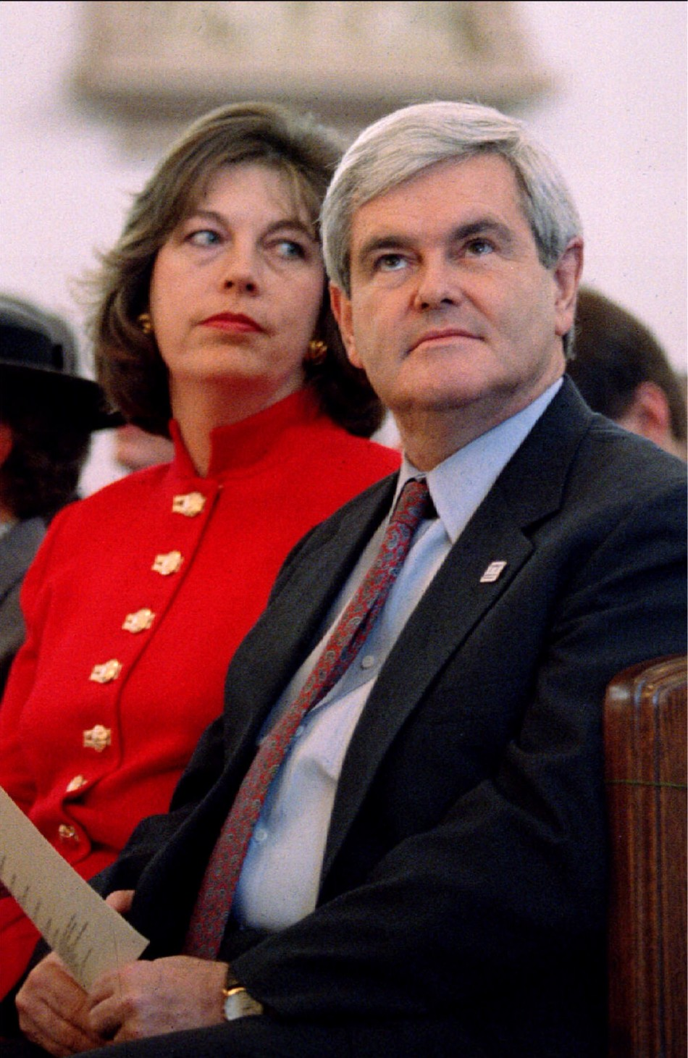

Modern Tolerance of Adultery
Speaker Newt Gingrich and Ex-wife Marriane
President Thomas Jefferson
Bill Gates

Slide 19
Whether it is the man or the woman, adultery is sin!
God demands and expects a husband and a wife to keep the covenant they make with one another for life (Rom. 7:2-3; 1 Cor. 7:39).

Slide 20
Prostitution
Simeon and Levi said of Shechem’s defilement of Dinah, “should he treat our sister like a harlot?” (Gen. 34:31).
Judah committed fornication with Tamar when she was dressed as a harlot (Gen. 38:12-23).
  Harlotry was considered a crime worthy of death (Gen. 38:24).

Slide 21
The Law of Moses
Israelites were not to allow their daughters to be harlots (Lev. 19:29a). Especially…
“There shall be no ritual harlot (q^{e}dēšâh) of the daughters of Israel” (Deut. 23:17a).
Even so there was harlotry in Israel (Judg. 11:1; Prov. 6:26) and the pagan nations around them (cf. Josh. 2:1; Judg. 16:1).

Slide 22
The Law of Christ
Harlotry is also condemned in the condemnation of “fornication” (Matt. 5:32; 15:20; 19:9; Mark 7:21; 1 Cor. 6:13, 18; 2 Cor. 12:21; Eph. 5:5; Col. 3:5; 1 Thess. 4:3).
  In fact, the verb form of the word porneia, translated “fornication,” is porneuō meaning “to play the harlot” (1 Cor. 6:18; 10:8; Rev. 2:14, 20; 17:2; 18:3, 9).

Slide 23



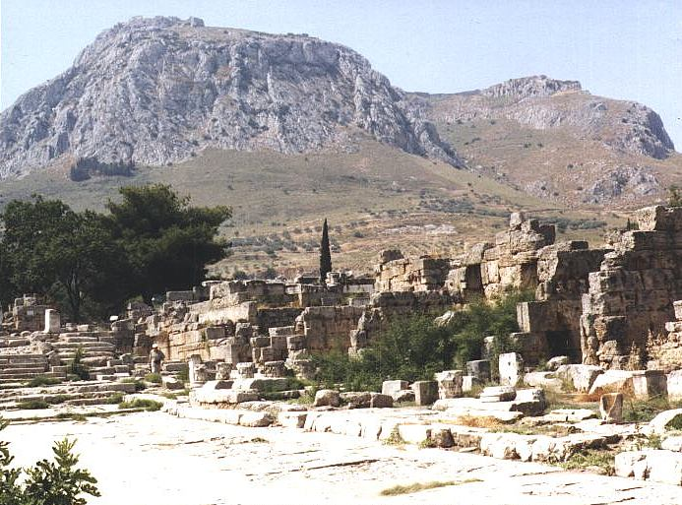
Harlotry in the Ancient World
• Strabo claimed that the temple of Aphrodite in Corinth at one point in history had 1000 shrine prostitutes (Geography 13.6.20).
  • The verb korinthiazomai, meant to “to act like a Corinthian” i.e. to commit fornication (Aristophanes, Fragments 370).
• No wonder Paul warned the Corinthians about being “one flesh” with a harlot (1 Cor. 6:15-16).
Notes:
Textured and layered background with title
(Advanced)
Tip: Some shape effects on this slide are created with the Combine Shapes commands. To access this command, you must add it to the Quick Access Toolbar, located above the File tab. To customize the Quick Access Toolbar, do the following:
Click the arrow next to the Quick Access Toolbar, and then under Customize Quick Access Toolbar click More Commands.
In the PowerPoint Options dialog box, in the Choose commands from list, select All Commands.
In the list of commands, click Combine Shapes, and then click Add.
To reproduce the shape effects on this slide, do the following:
On the Home tab, in the Slides group, click Layout, and then click Blank.
Also on the Home tab, in the Drawing group, click Shapes, and then under Rectangles click Rectangle.
On the slide, drag to draw a rectangle.
Select the rectangle. Under Drawing Tools, on the Format tab, in the Shape Styles group, click Shape Fill, point to Gradient, and then click More Gradients. In the Format Shape dialog box, click Fill in the left pane, in the Fill pane, click Gradient fill, and then do the following:
In the Type list, select Linear.
In the Angle box, enter 160°.
Under Gradient stops, click Add gradient stop or Remove gradient stop until four stops appear in the slider.
Also under Gradient stops, customize the gradient stops as follows:
Select the first stop in the slider, and then do the following:
In the Position box, enter 0%.
Click the button next to Color, click More Colors, and then in the Colors dialog box, on the Custom tab, enter values for Red: 200, Green: 149, and Blue: 4.
In the Transparency box, enter 79%.
Select the next stop in the slider, and then do the following:
In the Position box, enter 29%.
Click the button next to Color, click More Colors, and then in the Colors dialog box, on the Custom tab, enter values for Red: 124, Green: 93, and Blue: 30.
In the Transparency box, enter 84%.
Select the next stop in the slider, and then do the following:
In the Position box, enter 68%.
Click the button next to Color, click More Colors, and then in the Colors dialog box, on the Custom tab, enter values for Red: 131, Green: 104, and Blue: 7.
In the Transparency box, enter 74%.
Select the last stop in the slider, and then do the following:
In the Position box, enter 100%.
Click the button next to Color, click More Colors, and then in the Colors dialog box, on the Custom tab, enter values for Red: 98, Green: 61, and Blue: 40.
In the Transparency box, enter 51%.
Also in the Format Shape dialog box, click Line Color in the left pane, in the Line Color pane, select No line.
Also in the Format Shape dialog box, click Glow and Soft Edges in the left pane, in the Glow and Soft Edges pane, under Soft Edges, in the Size box, enter 5 pt.
Also in the Format Shape dialog box, click Size in the left pane, in the Size pane, enter 1.83” in the Height box and 10.33” in the Width box.
On the Home tab, in the Drawing group, click Arrange, point to Align, and then do the following:
Click Align to Slide.
Click Align Center.
To reproduce the clip art effects on this slide, do the following:
On the Insert tab, in the Images group, click Clip Art. In the Clip Art pane, in the Search for box, enter 00437948, select the Include Office.com content check box, and then click Go. Select the clip art file in the pane to insert it into the slide. (Note: If you choose another clip art file, the clip art must be in the Windows Metafile format [.wmf].)
Drag the clip art from the Clip Art pane to the slide.
Select the clip art. Under Picture Tools, on the Format tab, in the Size group, enter 6.99” in the Height box and 7.5” in the Width box.
On the Home tab, in the Drawing group, click Arrange, and then click Ungroup.
In the Microsoft Office PowerPoint dialog box, click Yes.
On the slide, select the converted clip art. On the Home tab, in the Editing group, click Select, and then click Selection Pane.
In the Selection and Visibility pane, select the top-level group. On the Home tab, in the Drawing group, click Arrange, and then click Ungroup.
Also in the Selection and Visibility pane, select the Autoshape object, and then press DELETE.
Press and hold CTRL, and then select all the clip art shapes. On the Quick Access Toolbar, click Combine Shapes, and then click Shape Union.
Position the new freeform shape in the bottom left corner of the slide so that it extends beyond the left and bottom edges of the slide.
Select the freeform shape. Under Drawing Tools, on the Format tab, in the Shape Styles group, click Shape Fill, point to Gradients, and then click More Gradients. In the Format Shape dialog box, click Fill in the left pane, in the Fill pane, click Solid fill, and then do the following:
Click the button next to Color, click More Colors, and then in the Colors dialog box, on the Custom tab, enter values for Red: 84, Green: 65, and Blue: 54.
In the Transparency box, enter 99%
Also in the Format Picture dialog box, click Glow and Soft Edges in the left pane, in the Glow and Soft Edges pane, under Glow, do the following:
Click the button next to Color, click More Colors, and then in the Colors dialog box, on the Custom tab, enter values for Red: 104, Green: 71, and Blue: 34.
In the Size box, enter 7 pt.
In the Transparency box, enter 90%.
To reproduce the text effects on this slide, do the following:
On the Insert tab, in the Text group, click Text Box.
On the slide, drag to draw a text box.
Enter text in the text box, and then select the text. On the Home tab, in the Font group, select Garamond from the Font list, select 54 pt. from the Font Size list, and then click Bold.
Under Drawing Tools, on the Format tab, in the WordArt Styles group, click the Format Text Effects dialog box launcher. In the Format Text Effects dialog box, click Shadow in the left pane, in the Shadow pane, do the following:
In the Transparency box, enter 70%.
In the Blur box, enter 5 pt.
In the Angle box, enter 315°.
In the Distance box, enter 4 pt.
Drag the text box inside the rectangle and on the right side of the slide.
To reproduce the first background layer on this slide, do the following:
On the Home tab, in the Drawing group, click Shapes, and then under Rectangles click Rectangle.
On the slide, drag to draw a rectangle.
Select the rectangle. Under Drawing Tools, on the Format tab, in the Shape Styles group, click the Format Shape dialog box launcher. In the Format Shape dialog box, click Fill in the left pane, in the Fill pane, click Picture or texture fill, and then do the following:
Click the button next to Texture, and then click Stationary (fourth row).
Clear the Tile picture as texture check box.
Also in the Format Shape dialog box, click Line Color in the left pane, in the Line Color pane, click No line.
Also in the Format Shape dialog box, click Size in the left pane, in the Size pane, under Size and rotate, enter 7.5” in the Height box and 10” in the Width box.
Select the rectangle. On the Home tab, in the Clipboard group, click Copy.
Press DELETE to delete the rectangle.
Also on the Home tab, in the Clipboard group, click the arrow below Paste, and select Paste Special. In the Paste Special dialog box, select Paste, and then under As, select Picture (PNG).
Select the picture. Under Picture Tools, on the Format tab, in the Adjust group, click Artistic Effects, and then click Artistic Effects Options. In the Format Picture dialog box, click Artistic Effects in the left pane, in the Artistic Effects pane, click the button next to Artistic Effect, and then click Paint Brush (second row).
Also in the Artistic Effects pane, do the following:
In the Transparency box, enter 15%.
In the Brush Size box, enter 2.
Also in the Format Picture dialog box, click Picture Color in the left pane, in the Picture Color pane, do the following:
Under Color Saturation, in the Saturation box, enter 200%.
Under Color Tone, click the button next to Presets and then click Temperature: 5,300 K.
Also in the Format Picture dialog box, click Picture Corrections in the left pane, in the Picture Corrections pane, do the following:
Under Sharpen and Soften, in the box next to Sharpen, enter -70%.
Under Brightness and Contrast, in the Contrast box, enter -10%.
Select the rectangle. On the Home tab, in the Drawing group, click Arrange, point to Align, and then do the following:
Click Align Middle.
Click Align Center.
On the Home tab, in the Drawing group, click Arrange, and then click Send to Back.
To reproduce the second background layer on this slide, do the following:
On the Home tab, in the Drawing group, click the button next to Shapes, and then under Rectangles click Rectangle.
On the slide, drag to draw a rectangle.
Select the rectangle. Under Drawing Tools, on the Format tab, in the Shape Styles group, click the Format Shape dialog box launcher. In the Format Shape dialog box, click Fill in the left pane, in the Fill pane, click Gradient fill, and then do the following:
In the Type list, select Linear.
In the Angle box, enter 160°.
Under Gradient stops, click Add gradient stop or Remove gradient stop until four stops appear in the slider.
Also under Gradient stops, customize the gradient stops as follows:
Select the first stop in the slider, and then do the following:
In the Position box, enter 0%.
Click the button next to Color, and then under Theme Colors click Black, Text 1 (first row).
In the Transparency box, enter 100%.
Select the next stop in the slider, and then do the following:
In the Position box, enter 29%.
Click the button next to Color, click More Colors, and then in the Colors dialog box, on the Custom tab, enter values for Red: 36, Green: 25, and Blue: 15.
In the Transparency box, enter 100%.
Select the next stop in the slider, and then do the following:
In the Position box, enter 68%.
Click the button next to Color, click More Colors, and then in the Colors dialog box, on the Custom tab, enter values for Red: 104, Green: 71, and Blue: 34.
In the Transparency box, enter 68%
Select the last stop in the slider, and then do the following:
In the Position box, enter 100%.
Click the button next to Color, click More Colors, and then in the Colors dialog box, on the Custom tab, enter values for Red: 84, Green: 65, and Blue: 54.
In the Transparency box, enter 37%.
Also in the Format Shape dialog box, click Line Color in the left pane, in the Line Color pane, select No line.
Also in the Format Shape dialog box, click Size in the left pane, in the Size pane, under Size and rotate, enter 7.5” in the Height box and 10” in the Width box.
Select the rectangle. On the Home tab, in the Drawing group, click Arrange, point to Align, and then do the following:
Click Align Middle.
Click Align Center.
To reproduce the third background layer on this slide, do the following:
On the Home tab, in the Drawing group, click Shapes, and then under Rectangles click Rectangle.
On the slide, drag to draw a rectangle.
Select the rectangle. Under Drawing Tools, on the Format tab, in the Shape Styles group, click the Format Shape dialog box. In the Format Shape dialog box, click Fill in the left pane, in the Fill pane, select Picture or texture fill, and then do the following:
Click the button next to Texture, and then click Cork (fifth row).
Clear the Tile picture as texture check box.
Under Stretch options, in the Transparency box, enter 84%.
Also in the Format Picture dialog box, click Line Color in the left pane, in the Line Color pane, select No line.
Also in the Format Picture dialog box, click Artistic Effects in the left pane, in the Artistic Effects pane, click the button next to Artistic Effect, click Paint Brush (second row), and then in the Brush Size box, enter 1.
Also in the Format Picture dialog box, click Picture Corrections in the left pane, in the Picture Corrections pane, under Brightness and Contrast, enter 1% in the Brightness box and 26% in the Contrast box.
Also in the Format Picture dialog box, click Size in the left pane, in the Size pane, under Size and rotate, enter 7.5” in the Height box and 10” in the Width box.
Select the rectangle. On the Home tab, in the Drawing group, click Arrange, point to Align, and then do the following:
Click Align Middle.
Click Align Center.
To reproduce the fourth background layer on this slide, do the following:
On the Home tab, in the Drawing group, click Shapes, and then under Rectangles click Rectangle.
On the slide, drag to draw a rectangle.
Select the rectangle. Under Drawing Tools, on the Format tab, in the Shape Styles group, click the Format Shape dialog box. In the Format Shape dialog box, click Fill in the left pane, in the Fill pane, select Picture or texture fill, and then do the following:
Click the button next to Texture, and then click Granite (third row).
Under Tiling options, in the Transparency box, enter 90%.
Also in the Format Picture dialog box, click Line Color in the left pane, in the Line Color pane, select No line.
Also in the Format Picture dialog box, click Artistic Effects in the left pane, in the Artistic Effects pane, click the button next to Artistic Effect, click Photocopy (fifth row), and then do the following:
In the Transparency box, enter 94%.
In the Detail box, enter 9.
Also in the Format Picture dialog box, click Picture Corrections in the left pane, in the Picture Corrections pane, under Brightness and Contrast, in the Contrast box, enter 35%.
Also in the Format Shape dialog box, click Size in the left pane, in the Size pane, under Size and rotate, enter 7.5” in the Height box and 10” in the Width box.
Select the rectangle. On the Home tab, in the Drawing group, click Arrange, point to Align, and then do the following:
Click Align Middle.
Click Align Center.

Slide 24
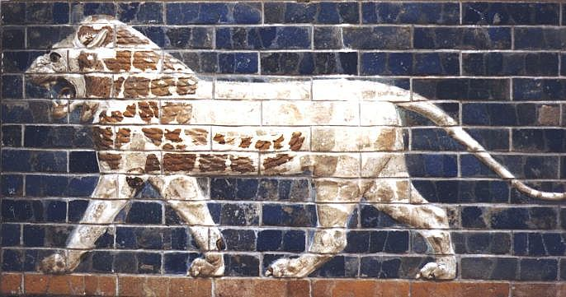
Harlotry in the Ancient World
• Herodotus records that in Babylon and parts of Cyprus the law required every woman of the land to serve as a temple prostitute at least once in her lifetime (Histories 1.199; cf. Rev. 17:5).
  Lucian describes similar requirements in Byblos. (On the Syrian Goddess 6).
• Herodotus tells us that in Lydia young women were expected to serve as prostitutes in order to earn their dowries before they could get married (Histories 1.93.4).
Notes:
Textured and layered background with title
(Advanced)
Tip: Some shape effects on this slide are created with the Combine Shapes commands. To access this command, you must add it to the Quick Access Toolbar, located above the File tab. To customize the Quick Access Toolbar, do the following:
Click the arrow next to the Quick Access Toolbar, and then under Customize Quick Access Toolbar click More Commands.
In the PowerPoint Options dialog box, in the Choose commands from list, select All Commands.
In the list of commands, click Combine Shapes, and then click Add.
To reproduce the shape effects on this slide, do the following:
On the Home tab, in the Slides group, click Layout, and then click Blank.
Also on the Home tab, in the Drawing group, click Shapes, and then under Rectangles click Rectangle.
On the slide, drag to draw a rectangle.
Select the rectangle. Under Drawing Tools, on the Format tab, in the Shape Styles group, click Shape Fill, point to Gradient, and then click More Gradients. In the Format Shape dialog box, click Fill in the left pane, in the Fill pane, click Gradient fill, and then do the following:
In the Type list, select Linear.
In the Angle box, enter 160°.
Under Gradient stops, click Add gradient stop or Remove gradient stop until four stops appear in the slider.
Also under Gradient stops, customize the gradient stops as follows:
Select the first stop in the slider, and then do the following:
In the Position box, enter 0%.
Click the button next to Color, click More Colors, and then in the Colors dialog box, on the Custom tab, enter values for Red: 200, Green: 149, and Blue: 4.
In the Transparency box, enter 79%.
Select the next stop in the slider, and then do the following:
In the Position box, enter 29%.
Click the button next to Color, click More Colors, and then in the Colors dialog box, on the Custom tab, enter values for Red: 124, Green: 93, and Blue: 30.
In the Transparency box, enter 84%.
Select the next stop in the slider, and then do the following:
In the Position box, enter 68%.
Click the button next to Color, click More Colors, and then in the Colors dialog box, on the Custom tab, enter values for Red: 131, Green: 104, and Blue: 7.
In the Transparency box, enter 74%.
Select the last stop in the slider, and then do the following:
In the Position box, enter 100%.
Click the button next to Color, click More Colors, and then in the Colors dialog box, on the Custom tab, enter values for Red: 98, Green: 61, and Blue: 40.
In the Transparency box, enter 51%.
Also in the Format Shape dialog box, click Line Color in the left pane, in the Line Color pane, select No line.
Also in the Format Shape dialog box, click Glow and Soft Edges in the left pane, in the Glow and Soft Edges pane, under Soft Edges, in the Size box, enter 5 pt.
Also in the Format Shape dialog box, click Size in the left pane, in the Size pane, enter 1.83” in the Height box and 10.33” in the Width box.
On the Home tab, in the Drawing group, click Arrange, point to Align, and then do the following:
Click Align to Slide.
Click Align Center.
To reproduce the clip art effects on this slide, do the following:
On the Insert tab, in the Images group, click Clip Art. In the Clip Art pane, in the Search for box, enter 00437948, select the Include Office.com content check box, and then click Go. Select the clip art file in the pane to insert it into the slide. (Note: If you choose another clip art file, the clip art must be in the Windows Metafile format [.wmf].)
Drag the clip art from the Clip Art pane to the slide.
Select the clip art. Under Picture Tools, on the Format tab, in the Size group, enter 6.99” in the Height box and 7.5” in the Width box.
On the Home tab, in the Drawing group, click Arrange, and then click Ungroup.
In the Microsoft Office PowerPoint dialog box, click Yes.
On the slide, select the converted clip art. On the Home tab, in the Editing group, click Select, and then click Selection Pane.
In the Selection and Visibility pane, select the top-level group. On the Home tab, in the Drawing group, click Arrange, and then click Ungroup.
Also in the Selection and Visibility pane, select the Autoshape object, and then press DELETE.
Press and hold CTRL, and then select all the clip art shapes. On the Quick Access Toolbar, click Combine Shapes, and then click Shape Union.
Position the new freeform shape in the bottom left corner of the slide so that it extends beyond the left and bottom edges of the slide.
Select the freeform shape. Under Drawing Tools, on the Format tab, in the Shape Styles group, click Shape Fill, point to Gradients, and then click More Gradients. In the Format Shape dialog box, click Fill in the left pane, in the Fill pane, click Solid fill, and then do the following:
Click the button next to Color, click More Colors, and then in the Colors dialog box, on the Custom tab, enter values for Red: 84, Green: 65, and Blue: 54.
In the Transparency box, enter 99%
Also in the Format Picture dialog box, click Glow and Soft Edges in the left pane, in the Glow and Soft Edges pane, under Glow, do the following:
Click the button next to Color, click More Colors, and then in the Colors dialog box, on the Custom tab, enter values for Red: 104, Green: 71, and Blue: 34.
In the Size box, enter 7 pt.
In the Transparency box, enter 90%.
To reproduce the text effects on this slide, do the following:
On the Insert tab, in the Text group, click Text Box.
On the slide, drag to draw a text box.
Enter text in the text box, and then select the text. On the Home tab, in the Font group, select Garamond from the Font list, select 54 pt. from the Font Size list, and then click Bold.
Under Drawing Tools, on the Format tab, in the WordArt Styles group, click the Format Text Effects dialog box launcher. In the Format Text Effects dialog box, click Shadow in the left pane, in the Shadow pane, do the following:
In the Transparency box, enter 70%.
In the Blur box, enter 5 pt.
In the Angle box, enter 315°.
In the Distance box, enter 4 pt.
Drag the text box inside the rectangle and on the right side of the slide.
To reproduce the first background layer on this slide, do the following:
On the Home tab, in the Drawing group, click Shapes, and then under Rectangles click Rectangle.
On the slide, drag to draw a rectangle.
Select the rectangle. Under Drawing Tools, on the Format tab, in the Shape Styles group, click the Format Shape dialog box launcher. In the Format Shape dialog box, click Fill in the left pane, in the Fill pane, click Picture or texture fill, and then do the following:
Click the button next to Texture, and then click Stationary (fourth row).
Clear the Tile picture as texture check box.
Also in the Format Shape dialog box, click Line Color in the left pane, in the Line Color pane, click No line.
Also in the Format Shape dialog box, click Size in the left pane, in the Size pane, under Size and rotate, enter 7.5” in the Height box and 10” in the Width box.
Select the rectangle. On the Home tab, in the Clipboard group, click Copy.
Press DELETE to delete the rectangle.
Also on the Home tab, in the Clipboard group, click the arrow below Paste, and select Paste Special. In the Paste Special dialog box, select Paste, and then under As, select Picture (PNG).
Select the picture. Under Picture Tools, on the Format tab, in the Adjust group, click Artistic Effects, and then click Artistic Effects Options. In the Format Picture dialog box, click Artistic Effects in the left pane, in the Artistic Effects pane, click the button next to Artistic Effect, and then click Paint Brush (second row).
Also in the Artistic Effects pane, do the following:
In the Transparency box, enter 15%.
In the Brush Size box, enter 2.
Also in the Format Picture dialog box, click Picture Color in the left pane, in the Picture Color pane, do the following:
Under Color Saturation, in the Saturation box, enter 200%.
Under Color Tone, click the button next to Presets and then click Temperature: 5,300 K.
Also in the Format Picture dialog box, click Picture Corrections in the left pane, in the Picture Corrections pane, do the following:
Under Sharpen and Soften, in the box next to Sharpen, enter -70%.
Under Brightness and Contrast, in the Contrast box, enter -10%.
Select the rectangle. On the Home tab, in the Drawing group, click Arrange, point to Align, and then do the following:
Click Align Middle.
Click Align Center.
On the Home tab, in the Drawing group, click Arrange, and then click Send to Back.
To reproduce the second background layer on this slide, do the following:
On the Home tab, in the Drawing group, click the button next to Shapes, and then under Rectangles click Rectangle.
On the slide, drag to draw a rectangle.
Select the rectangle. Under Drawing Tools, on the Format tab, in the Shape Styles group, click the Format Shape dialog box launcher. In the Format Shape dialog box, click Fill in the left pane, in the Fill pane, click Gradient fill, and then do the following:
In the Type list, select Linear.
In the Angle box, enter 160°.
Under Gradient stops, click Add gradient stop or Remove gradient stop until four stops appear in the slider.
Also under Gradient stops, customize the gradient stops as follows:
Select the first stop in the slider, and then do the following:
In the Position box, enter 0%.
Click the button next to Color, and then under Theme Colors click Black, Text 1 (first row).
In the Transparency box, enter 100%.
Select the next stop in the slider, and then do the following:
In the Position box, enter 29%.
Click the button next to Color, click More Colors, and then in the Colors dialog box, on the Custom tab, enter values for Red: 36, Green: 25, and Blue: 15.
In the Transparency box, enter 100%.
Select the next stop in the slider, and then do the following:
In the Position box, enter 68%.
Click the button next to Color, click More Colors, and then in the Colors dialog box, on the Custom tab, enter values for Red: 104, Green: 71, and Blue: 34.
In the Transparency box, enter 68%
Select the last stop in the slider, and then do the following:
In the Position box, enter 100%.
Click the button next to Color, click More Colors, and then in the Colors dialog box, on the Custom tab, enter values for Red: 84, Green: 65, and Blue: 54.
In the Transparency box, enter 37%.
Also in the Format Shape dialog box, click Line Color in the left pane, in the Line Color pane, select No line.
Also in the Format Shape dialog box, click Size in the left pane, in the Size pane, under Size and rotate, enter 7.5” in the Height box and 10” in the Width box.
Select the rectangle. On the Home tab, in the Drawing group, click Arrange, point to Align, and then do the following:
Click Align Middle.
Click Align Center.
To reproduce the third background layer on this slide, do the following:
On the Home tab, in the Drawing group, click Shapes, and then under Rectangles click Rectangle.
On the slide, drag to draw a rectangle.
Select the rectangle. Under Drawing Tools, on the Format tab, in the Shape Styles group, click the Format Shape dialog box. In the Format Shape dialog box, click Fill in the left pane, in the Fill pane, select Picture or texture fill, and then do the following:
Click the button next to Texture, and then click Cork (fifth row).
Clear the Tile picture as texture check box.
Under Stretch options, in the Transparency box, enter 84%.
Also in the Format Picture dialog box, click Line Color in the left pane, in the Line Color pane, select No line.
Also in the Format Picture dialog box, click Artistic Effects in the left pane, in the Artistic Effects pane, click the button next to Artistic Effect, click Paint Brush (second row), and then in the Brush Size box, enter 1.
Also in the Format Picture dialog box, click Picture Corrections in the left pane, in the Picture Corrections pane, under Brightness and Contrast, enter 1% in the Brightness box and 26% in the Contrast box.
Also in the Format Picture dialog box, click Size in the left pane, in the Size pane, under Size and rotate, enter 7.5” in the Height box and 10” in the Width box.
Select the rectangle. On the Home tab, in the Drawing group, click Arrange, point to Align, and then do the following:
Click Align Middle.
Click Align Center.
To reproduce the fourth background layer on this slide, do the following:
On the Home tab, in the Drawing group, click Shapes, and then under Rectangles click Rectangle.
On the slide, drag to draw a rectangle.
Select the rectangle. Under Drawing Tools, on the Format tab, in the Shape Styles group, click the Format Shape dialog box. In the Format Shape dialog box, click Fill in the left pane, in the Fill pane, select Picture or texture fill, and then do the following:
Click the button next to Texture, and then click Granite (third row).
Under Tiling options, in the Transparency box, enter 90%.
Also in the Format Picture dialog box, click Line Color in the left pane, in the Line Color pane, select No line.
Also in the Format Picture dialog box, click Artistic Effects in the left pane, in the Artistic Effects pane, click the button next to Artistic Effect, click Photocopy (fifth row), and then do the following:
In the Transparency box, enter 94%.
In the Detail box, enter 9.
Also in the Format Picture dialog box, click Picture Corrections in the left pane, in the Picture Corrections pane, under Brightness and Contrast, in the Contrast box, enter 35%.
Also in the Format Shape dialog box, click Size in the left pane, in the Size pane, under Size and rotate, enter 7.5” in the Height box and 10” in the Width box.
Select the rectangle. On the Home tab, in the Drawing group, click Arrange, point to Align, and then do the following:
Click Align Middle.
Click Align Center.

Slide 25
Divorce and Remarriage

Slide 26
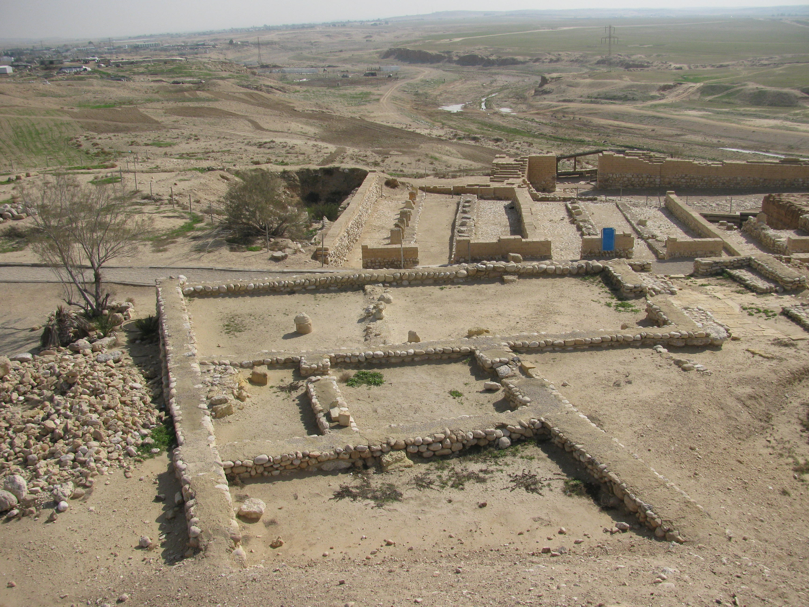
The First Divorce Recorded in the Bible
Sarah urged Abraham to “cast out the bondwoman” (Gen. 21:10).
“So Abraham rose early in the morning, and took bread and a skin of water; and putting it on her shoulder, he gave it and the boy to Hagar, and sent her away. Then she departed and wandered in the Wilderness of Beersheba” (Gen. 21:14).
  The Hebrew verb translated “sent [her] away” is the same word used in the Mosaic Law’s ordinance on divorce (Deut. 24:1-4) and in God’s later declaration that He “hates putting away” (Mal. 2:16).

Slide 27
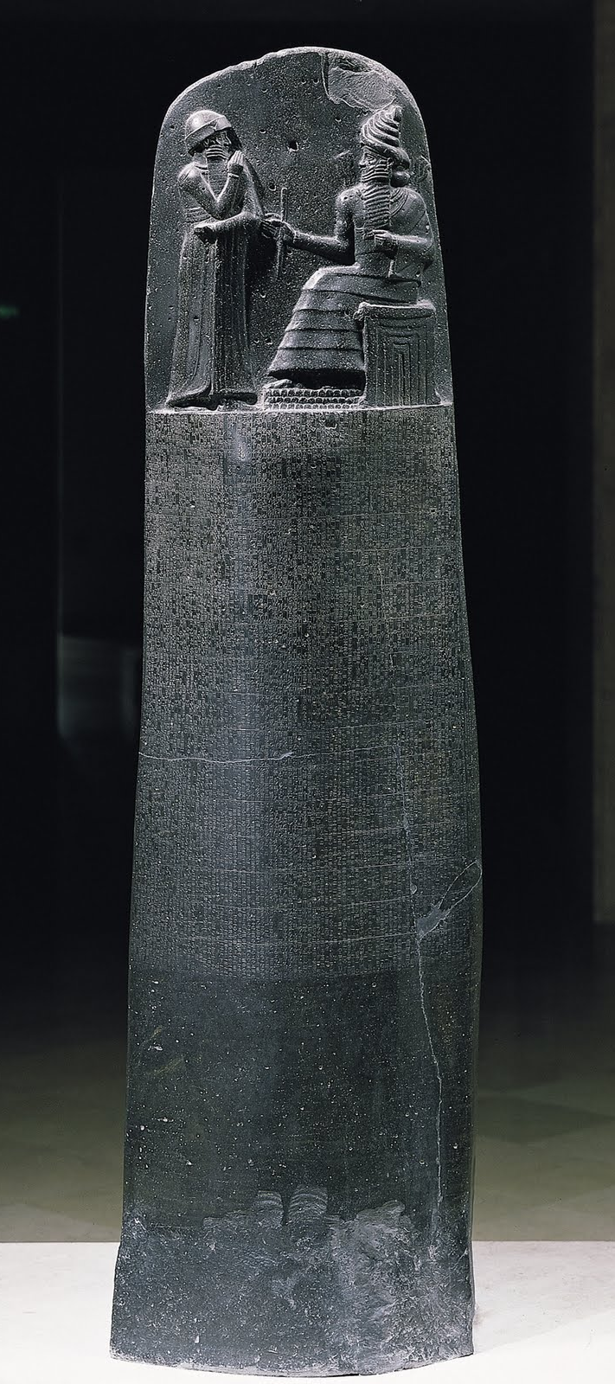
Divorce in Ancient Law
Code of Hammurabi.
  Required that if a woman wanted to leave her husband he had to give his consent, saying to her, “I have put her away,” she could go and he did not have to pay her a dowry.
  If he said, “I have not put her away” he could take another wife, and the woman who tried to leave had to become a servant in his house (141). .
18th century B.C. Babylonian Code

Slide 28
Mosaic Law
Mosaic Law demanded that a man give a wife a “certificate of divorce” and “send her from his house” if his wife no longer “found favor in his eyes” because he found in her some “uncleanness” (Deut. 24:1).
This “uncleanness” likely referred to some type of indecency short of adultery, since adultery would require the death penalty (Lev. 20:10).

Slide 29
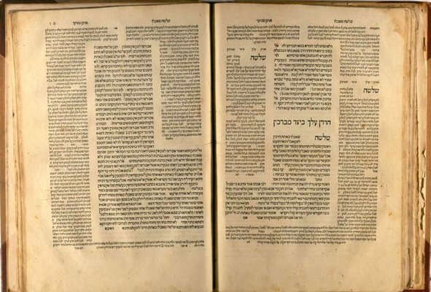
Rabbinical Debates
Over Divorce
Before the time of Jesus, Shammai taught that the “uncleanness” in this passage concerned sexual misconduct.
His opponent, Hillel taught that an “unseemly thing in her” could be something as minor as a wife spilling her husband’s food.
In New Testament times, the Jewish teacher Akiba taught that the phrase “no favor in his eyes” meant that a man could divorce his wife even if he just became attracted to another woman (Babylonian Talmud, Gittin 90a).

Slide 30
The Law of Christ
The only terms under which one may “put away” a wife and remarry without it being considered adultery is when the “putting away” is because of fornication (Matt. 5:32; 19:9).
All remarriage on the part of one “put away” is defined as “adultery” (cf. Mark 10:11-12; Luke 16:18).
Since God makes them one (Mal. 2:15), Jesus teaches “what God has joined together, let no man separate” (Matt. 19:6).

Slide 31

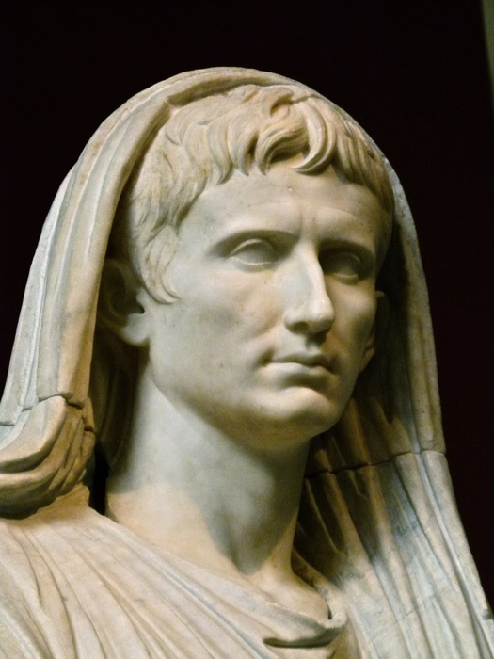
Divorce in the Ancient World
ROMAN DIVORCE
The Romans claimed that Romulus, the legendary founder of Rome, established marriage laws which allowed a man to put away his wife only for poisoning the children, counterfeiting the keys to the house, and adultery (Plutarch, Romulus,22).
Caesar Augustus passed laws intended to strengthen marriage and limit divorce, yet mostly these laws concerned financial penalties for unjustly divorcing a wife. (Seutonius, Augustus,34).
Caesar
Augustus

Slide 32
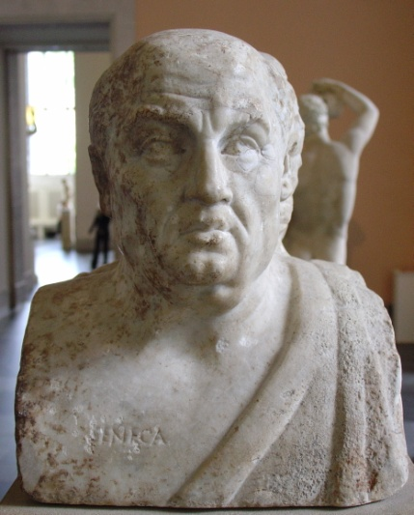
Divorce in the Ancient World
ROMAN DIVORCE
The Roman poet Seneca, Nero’s tutor, bemoaned the fact that in his day, “some noble ladies reckon the years of their lives, not by the number of the consuls, but by that of their husbands, now that they leave their homes in order to marry others, and marry only in order to be divorced” (On Benefits 3.16.2).
Seneca

Slide 33
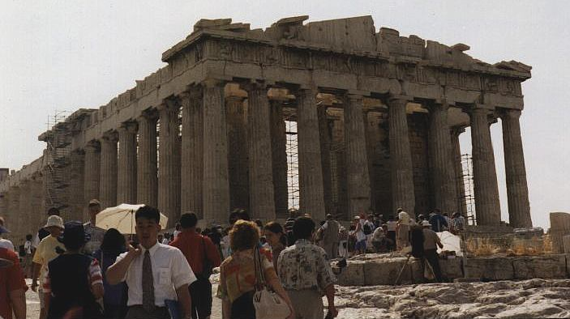
Divorce in the Ancient World
GREEK DIVORCE
In Athens while a woman seeking a divorce had to go before the Archon, a man could simply send a wife from his house. (Plutarch, Alcibiades 8).
Among the Spartans it was believed that a barren woman should be put away. (Herodotus, 5.39).

Slide 34
Ancient Divorce Procedures
Mosaic Law taught that a husband simply gave a “certificate of divorce” to the wife.
God would use this procedure in describing either His sustained faithfulness to Israel…
  He had not given her a certificate of divorce (Isa. 50:1)—or as proof that His covenant with them was broken…
  He had put Israel away and “given her a certificate of divorce” (Jer. 3:8).
The Babylonian Talmud, records the custom that a Jewish man could put away his wife (or betrothed wife) merely with two witnesses present (Gittin 5b).

Slide 35
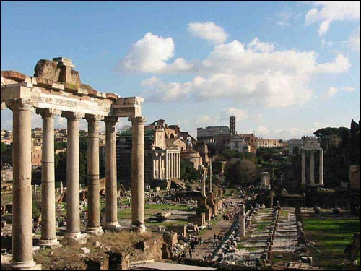
Ancient Divorce Procedures
In Roman divorce, typically the nuptial tablets were broken, and the husband said to the wife “you keep your things” (cf. Plautus, Amphitryon 3.2.47). A similar formula was used among the Greeks.
  Justin tells us of a Christian woman in the second century who submitted a repudium because of her husband’s fornication (Second Apology 2.6).
  Under the Lex Julia, enacted by Augustus, a repudium was required to take place in the presence of seven witnesses of full age who were Roman citizens (Digest 24.2.9).

Slide 36

Modern Divorce
In 1970 the National Conference of Commissioners on Uniform State Laws, a national conference of appointees sent by state governors drafted “The Uniform Marriage and Divorce Act (UMDA).”
  UMDA introduced the principle of “irreconcilable differences” as the only grounds needed to obtain divorce.
Only Arizona, Colorado, Illinois, Kentucky, Minnesota, Missouri, Montana and Washington fully adopted it, but this was very influential on state laws across the country in that it moved towards the elimination of “fault divorces.”

Slide 37
Challenges to Christians
Christians are to obey civil authorities (Rom. 13:1-7) and the laws they enact (1 Pet. 2:13-17), but…
  What about times when civil authority assists in the violation of what God commands?
When civil law commands the violation of divine ordinance we clearly must “obey God rather than men” (Acts 5:29).
  Jesus’ teaching against divorce acknowledges conditions in which one “puts away” a mate contrary to divine law (cf. Mark 10:11-12).

Slide 38
When is One “Put Away” in Modern Divorce?
Through most of human history this was not something that the civil government determined, but now it has presumed that right.
  We cannot just ignore our obligation to submit to civil authority.
  The Bible doesn’t teach a so-called “mental divorce,” but neither can we yield to wicked schemes of men to manipulate or ignore divine law in order to satisfy their own desires.

Slide 39
When is One “Put Away” in Modern Divorce?
As with a marriage covenant, something actually happens when two people marry. It is not just living together, or a feeling in the heart.
  Something must actually happen that properly determines when one has been “put away.”
At the same time, Christians must be careful never to make excuses that would allow us to violate God’s laws, or misjudge the sincere efforts of those trying to balance obedience to the Law of Christ and submission to a civil government disinterested in what Scripture teaches.

Slide 40
Human Control Over Marriage

Slide 41
“When Were You Married?”
Being joined in Genesis 2:24 involves what is understood to identify who is and who is not married.
  This does not mean that man has the right to define marriage.
Christians must obey civil authorities (Rom. 13:1-7) and the laws they enact (1 Pet. 2:13-17).
  What if man presumes authority he was never given?

Slide 42
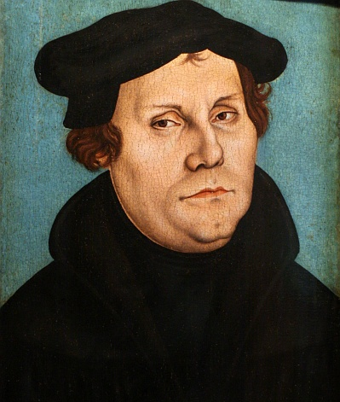
When Man’s Laws Conflict with God’s Laws
“The joining together of a man and a woman is a divine law and is binding, however it may conflict with the laws of men; the laws of men must give way before it without hesitation” (Babylonian Captivity, 263).

Slide 43
God and Man’s Roles in the Marriage Covenant.
In the Marriage Covenant
God
Acts as “witness”
“Makes them one”
Man and Woman
Make the covenant
Something had to happen.

Slide 44
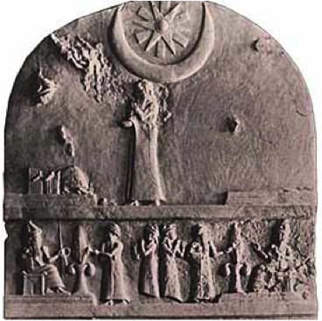
The Marriage Contract
Code of Ur-Nammu
  This Sumerian law code speaks of the necessity of a “marriage contract” (Col. 2, 250-255).
Stele of Ur-Nammu ca. 2047-2030 BC

Slide 45
The Marriage Contract
The Book of Tobit
  The apocryphal book of Tobit described a father and mother giving their daughter in marriage and writing and sealing for her “an instrument of covenants” (7:14).

Slide 46
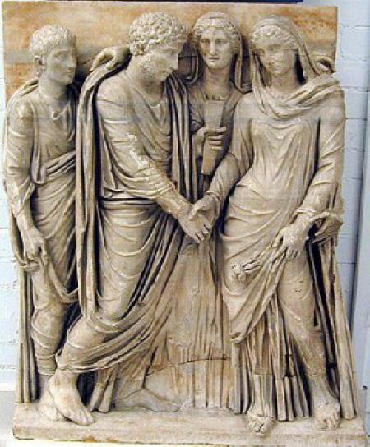
The Marriage Contract
Roman Tabulae
  Among the Romans tabulae contracts were signed by witnesses and the couple (Tacitus, Annals 11.27; Juvenal, Satires 2.119) and literally broken if a marriage was dissolved (Ibid., 9.75-76).
  – In the time of Tiberius (42 B.C. to A.D. 16), Tacitus records that an old ceremony once practiced to transfer a woman from the authority of her father to the authority of her husband was only rarely practiced (Annals 4.16), but contracts were still signed.

Slide 47
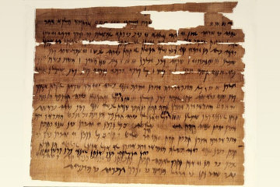
The Marriage Contract
Marriage Papyrii
  Many examples of ancient marriage contracts have survived. These are formal declarations of terms. Both parties are expected to honor the terms.
  – Any involvement by the government would simply be to enforce the terms agreed upon
  – This was not the same as a modern marriage license allowing a coupe to marry.
  – This was not the same as modern vows given less weight than business contracts.

Slide 48
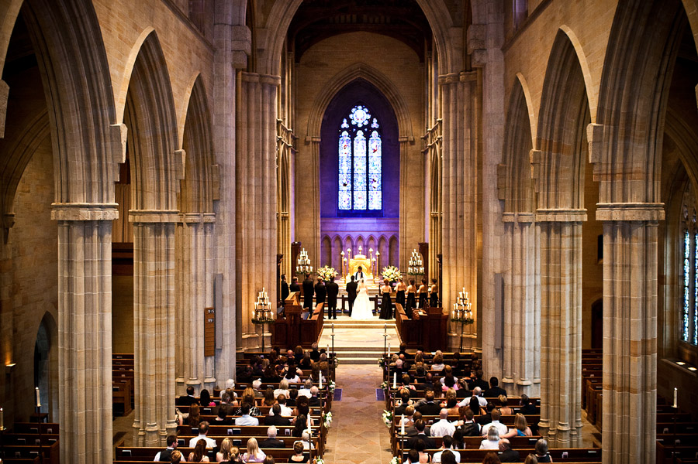
Church Control of Marriage
In turning to Christ Gentile Christians could not continue in any practices that involved idolatry (cf. 1 Cor. 10:28-29).
Tertullian claimed that one reason Christians did not marry pagan wives was because of the idolatry that was involved in the manner in which pagan marriages were initiated (On the Crown 13).
Ignatius taught, “it becomes both men and women who marry, to form their union with the approval of the bishop that their marriage may be according to God, and not after their own lust” (The Epistle of Ignatius to Polycarp 5).

Slide 49
Church Control of Marriage
Tertullian argued that marriages must be “first professed in presence of the Church” in order to avoid any appearance that the union between the couple was fornication (On Chastity 4.4).
Such notions of seeking the “approval of the bishop” and involving the church to avoid the appearance of wrongdoing, would expand quickly into a concept that marriage was a “sacrament” only truly administered by church officials.

Slide 50
Development of the Sacramental Concept of Marriage
In classical usage the Latin word sacramentum referred to a sum that was deposited by parties in a dispute then used for religious purposes by the losing party.
Over time this meaning expanded to refer to oaths, secrets, and even to things held to be sacred (Lewis and Short Latin Dictionary).

Slide 51
Development of the Sacramental Concept of Marriage
In Roman Catholic theology a “sacrament” is: 1) a religious rite, 2) that is a sign of inner sanctification, 3) it confers divine grace, and 4) this grace is bestowed through the rite (Lehmkuhl, “Sacrament of Marriage”).
Catholics believe there are seven sacraments: Baptism, Confirmation, the Eucharist, Penance, Extreme Unction (or last rites), Order (of church officials), and Matrimony.

Slide 52
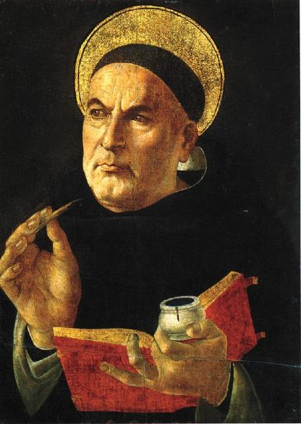
The Sacramental Concept of Marriage
Thomas Aquinas (A.D. 1225-1274) expressed it, “Matrimony, then, in that it consists in the union of a husband and wife purposing to generate and educate offspring for the worship of God, is a sacrament of the Church; hence, also, a certain blessing on those marrying is given by the ministers of the Church” (Contra Gentiles 4.78.2)
Thomas Aquinas

Slide 53

The Sacramental Concept of Marriage
“The name sacrament cannot be cited as satisfactory evidence, since it did not acquire until a late period the exclusively technical meaning it has today; both in pre-Christian times and in the first centuries of the Christian Era it had a much broader and more indefinite signification” (Augustinus
Lehmkuhl, “Sacaremnt of
Matrimony,” Catholic
Encyclopedia).

Slide 54

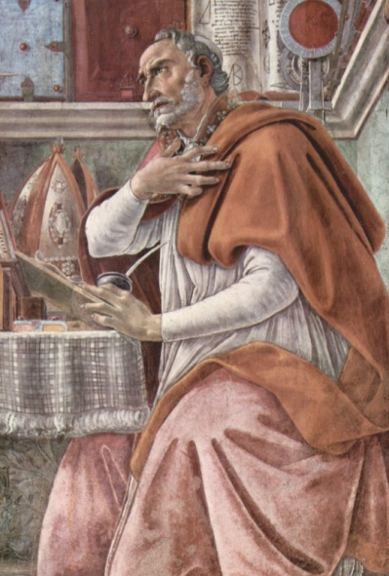
The Sacramental Concept of Marriage
After Paul’s quote of Genesis 2:24 in Ephesians 5:33, the Latin Vulgate (ca. 4th century) translated the Greek word mustērion, rendered “mystery” in most English translations, with the Latin word sacramentum.
Augustine (354-430), commenting on this text wrote, “This the apostle applies to the case of Christ and of the Church, and calls it then ‘a great sacrament.’ What, then, in Christ and in the Church is great, in the instances of each married pair it is but very small, but even then it is the sacrament of an inseparable union” (On Marriage and Concupiscence 1.23).

Slide 55
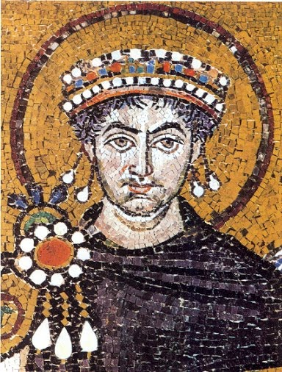
The Sacramental Concept of Marriage
Justinian I (ca. 482-565) in an effort to end false claims that “invent marriages that in fact were never contracted” (Novellae 74.4 preface), made laws that further established the concept that the Church defines marriage.
These laws required three witnesses in a church, with certificates filed in a church to preserve the record.
Emperor Justinian I

Slide 56
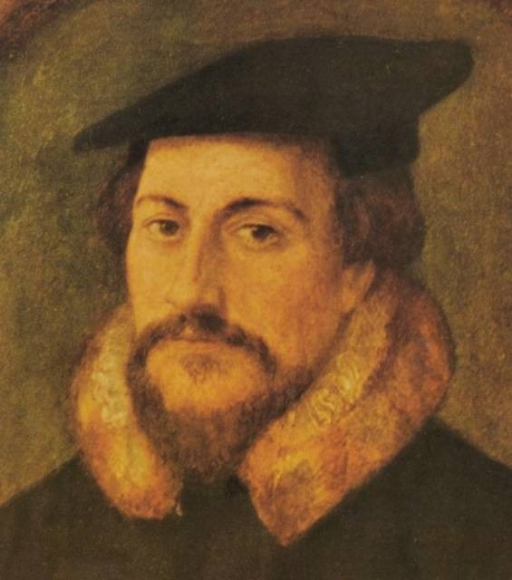
Church and State:
The Protestant Response
Martin Luther
The Protestants rejected the sacramental concept of marriage.
Martin Luther argued, “marriage is an outward, bodily thing, like any other worldly undertaking” (“Estate of Marriage,” 25).
John Calvin
John Calvin called it a “good and holy ordinance of God” but added that “agriculture, architecture, shoemaking, and shaving are lawful ordinances of God; but they are not sacraments” (Institutes 4.19.34).

Slide 57
Church and State:
The Protestant Response
Martin Luther
Luther and Calvin rejected the Vulgate’s translation of mustērion.
Luther wrote, “we read nowhere that the man who marries a wife receives any grace of God,” going on further to conclude, “since marriage existed from the beginning of the world and is still found among unbelievers, it cannot possibly be called a sacrament of the New Law and the exclusive possession of the Church” (“Babylonian Captivity,” 257).
John Calvin

Slide 58
Church and State:
The Protestant Response
Martin Luther
Luther and Calvin rejected the Vulgate’s translation of mustērion.
According to John Witte, Jr., The Marriage Ordinance of Geneva drafted by Calvin in 1545 set in place “the dual requirements of state registration and a church wedding to constitute marriage” (From Sacrament to Contract: Marriage, Religion, and Law in the Western Tradition182).
John Calvin

Slide 59
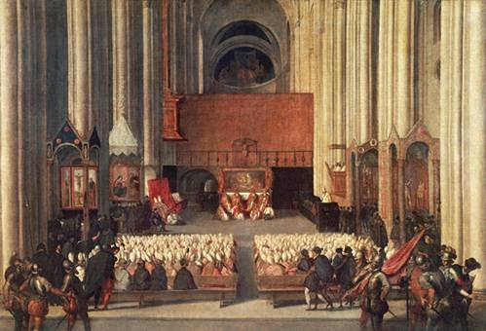
The Council of Trent
24th Session, 1563
“If any one saith, that matrimony is not truly and properly one of the seven sacraments of the evangelic law, (a sacrament) instituted by Christ the Lord; but that it has been invented by men in the Church; and that it does not confer grace; let him be anathema” (On the Sacrament of Matrimony, Canon 1).
“Whosoever contracts marriage, otherwise than in the presence of the Parish Priest and of two or three witnesses, contracts it invalidly” (Decree on the Reformation of Marriage, Ch. 1).

Slide 60
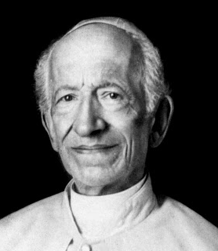
The Council of Trent
24th Session, 1563
This view has continued since then. In 1898 pope Leo XIII declared, “No marriage can be considered firmly ratified unless it is joined according to Church law and discipline” (Encyclical on Civil Marriage Law).
Pope Leo XIII

Slide 61
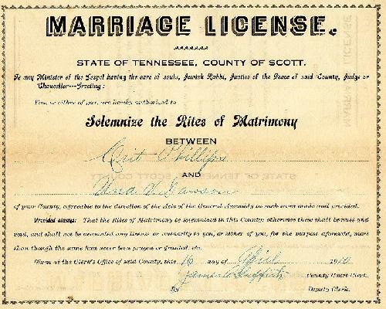
Marriage Licensing in the United States
In 1911 the Conference of Commissioners of Uniform State Laws submitted a proposed draft for marriage licensing procedures throughout the states.
  This draft, known as “American Uniform Marriage and Marriage License Act” was aimed, at least in part, at ending the practice of “common law” marriages.
It specified, “No person shall be joined in marriage within this state until a license shall have been obtained for that purpose” (§ 2).

Slide 62
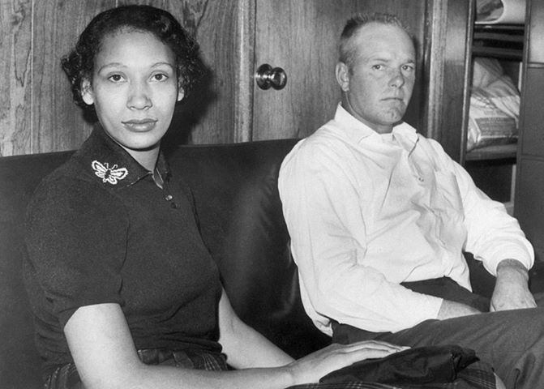
Marriage Licensing in the United States
The United States Supreme court, in Loving vs. Virginia, 388 U.S. 1 (1967) ruled it unconstitutional to restrict marriage on racial grounds.

Slide 63

Opposition to Marriage Licensing
The Libertarian Party argues that marriage licensing violates Article One, Section 10, of the U.S. Constitution, prohibiting any state from passing laws “impairing the obligation of contracts.”
Its 2012 platform asserted, “Government does not have the authority to define, license or restrict personal relationships” (1.3 Personal Relationships).

Slide 64
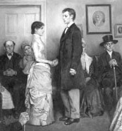
Opposition to Marriage Licensing
“The American Uniform Marriage and Marriage License Act” when first drafted proposed that provision be made for ceremonies such as those practiced by Quakers, in which there is no officiating officer, but may be satisfied “by declaring in the presence of at least two competent witnesses, that they take each other as husband and wife” (§ 1.2).
Some states recognize “Quaker Marriage.”

Slide 65
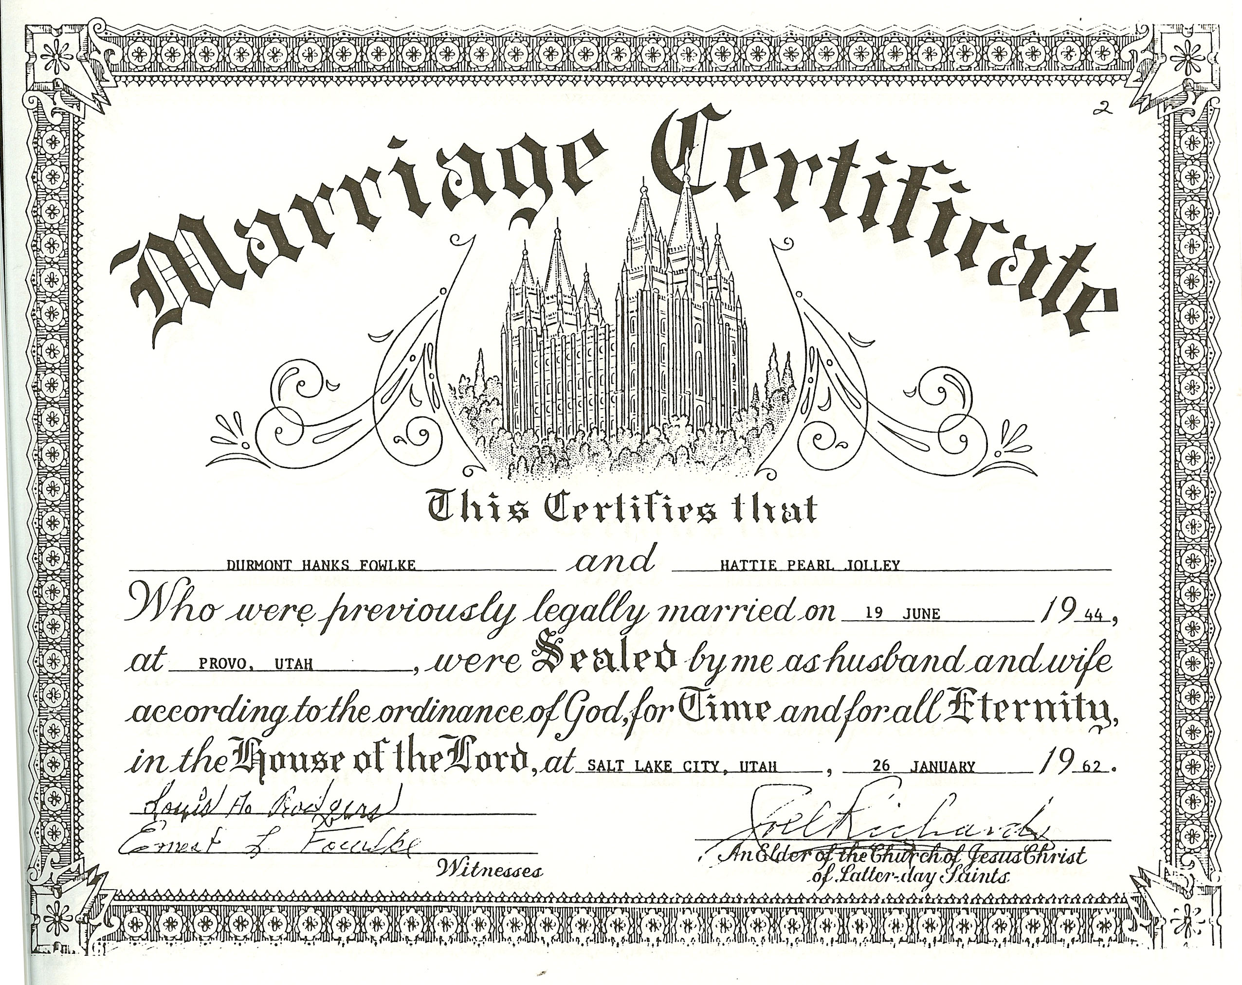
Opposition to Marriage Licensing
Today some Protestant fundamentalists argue that the very concept of licensing infers that the state holds authority to permit marriage which it was never given (Deschesne).
Advocates of this view secure a simple “Marriage Certificate” signed by witnesses and a preacher, that can be submitted to a local courthouse without a marriage license.

Slide 66
A Christian’s Responsibility
Christians must submit to the laws of the land (Rom. 13:13:1-7; 1 Pet. 2:13-17), but in doing so we must never surrender to civil authority rights that properly belong only to God.

Slide 67
Perspectives on the Present

Slide 68
Where Things Stand
“Worse than they have ever been”
“Everything is Falling Apart!”
The gospel was born in a world far more given to skewed definitions of marriage than our own.

Slide 69
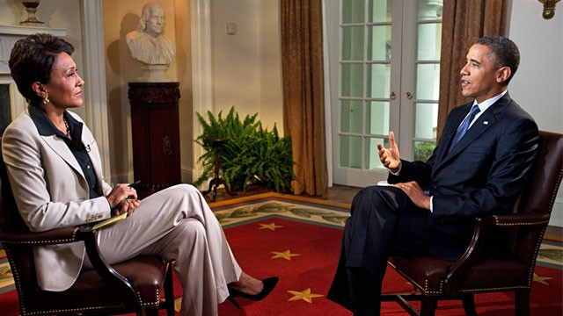
President Obama on Gay Marriage
“I’ve been going through an evolution on this issue….I had hesitated on gay marriage—in part, because I thought civil unions would be sufficient.…And—I was sensitive to the fact that—for a lot of people, you know, the—the word marriage was something that evokes very powerful traditions, religious beliefs, and so forth….”
Notes:
Textured and layered background with title
(Advanced)
Tip: Some shape effects on this slide are created with the Combine Shapes commands. To access this command, you must add it to the Quick Access Toolbar, located above the File tab. To customize the Quick Access Toolbar, do the following:
Click the arrow next to the Quick Access Toolbar, and then under Customize Quick Access Toolbar click More Commands.
In the PowerPoint Options dialog box, in the Choose commands from list, select All Commands.
In the list of commands, click Combine Shapes, and then click Add.
To reproduce the shape effects on this slide, do the following:
On the Home tab, in the Slides group, click Layout, and then click Blank.
Also on the Home tab, in the Drawing group, click Shapes, and then under Rectangles click Rectangle.
On the slide, drag to draw a rectangle.
Select the rectangle. Under Drawing Tools, on the Format tab, in the Shape Styles group, click Shape Fill, point to Gradient, and then click More Gradients. In the Format Shape dialog box, click Fill in the left pane, in the Fill pane, click Gradient fill, and then do the following:
In the Type list, select Linear.
In the Angle box, enter 160°.
Under Gradient stops, click Add gradient stop or Remove gradient stop until four stops appear in the slider.
Also under Gradient stops, customize the gradient stops as follows:
Select the first stop in the slider, and then do the following:
In the Position box, enter 0%.
Click the button next to Color, click More Colors, and then in the Colors dialog box, on the Custom tab, enter values for Red: 200, Green: 149, and Blue: 4.
In the Transparency box, enter 79%.
Select the next stop in the slider, and then do the following:
In the Position box, enter 29%.
Click the button next to Color, click More Colors, and then in the Colors dialog box, on the Custom tab, enter values for Red: 124, Green: 93, and Blue: 30.
In the Transparency box, enter 84%.
Select the next stop in the slider, and then do the following:
In the Position box, enter 68%.
Click the button next to Color, click More Colors, and then in the Colors dialog box, on the Custom tab, enter values for Red: 131, Green: 104, and Blue: 7.
In the Transparency box, enter 74%.
Select the last stop in the slider, and then do the following:
In the Position box, enter 100%.
Click the button next to Color, click More Colors, and then in the Colors dialog box, on the Custom tab, enter values for Red: 98, Green: 61, and Blue: 40.
In the Transparency box, enter 51%.
Also in the Format Shape dialog box, click Line Color in the left pane, in the Line Color pane, select No line.
Also in the Format Shape dialog box, click Glow and Soft Edges in the left pane, in the Glow and Soft Edges pane, under Soft Edges, in the Size box, enter 5 pt.
Also in the Format Shape dialog box, click Size in the left pane, in the Size pane, enter 1.83” in the Height box and 10.33” in the Width box.
On the Home tab, in the Drawing group, click Arrange, point to Align, and then do the following:
Click Align to Slide.
Click Align Center.
To reproduce the clip art effects on this slide, do the following:
On the Insert tab, in the Images group, click Clip Art. In the Clip Art pane, in the Search for box, enter 00437948, select the Include Office.com content check box, and then click Go. Select the clip art file in the pane to insert it into the slide. (Note: If you choose another clip art file, the clip art must be in the Windows Metafile format [.wmf].)
Drag the clip art from the Clip Art pane to the slide.
Select the clip art. Under Picture Tools, on the Format tab, in the Size group, enter 6.99” in the Height box and 7.5” in the Width box.
On the Home tab, in the Drawing group, click Arrange, and then click Ungroup.
In the Microsoft Office PowerPoint dialog box, click Yes.
On the slide, select the converted clip art. On the Home tab, in the Editing group, click Select, and then click Selection Pane.
In the Selection and Visibility pane, select the top-level group. On the Home tab, in the Drawing group, click Arrange, and then click Ungroup.
Also in the Selection and Visibility pane, select the Autoshape object, and then press DELETE.
Press and hold CTRL, and then select all the clip art shapes. On the Quick Access Toolbar, click Combine Shapes, and then click Shape Union.
Position the new freeform shape in the bottom left corner of the slide so that it extends beyond the left and bottom edges of the slide.
Select the freeform shape. Under Drawing Tools, on the Format tab, in the Shape Styles group, click Shape Fill, point to Gradients, and then click More Gradients. In the Format Shape dialog box, click Fill in the left pane, in the Fill pane, click Solid fill, and then do the following:
Click the button next to Color, click More Colors, and then in the Colors dialog box, on the Custom tab, enter values for Red: 84, Green: 65, and Blue: 54.
In the Transparency box, enter 99%
Also in the Format Picture dialog box, click Glow and Soft Edges in the left pane, in the Glow and Soft Edges pane, under Glow, do the following:
Click the button next to Color, click More Colors, and then in the Colors dialog box, on the Custom tab, enter values for Red: 104, Green: 71, and Blue: 34.
In the Size box, enter 7 pt.
In the Transparency box, enter 90%.
To reproduce the text effects on this slide, do the following:
On the Insert tab, in the Text group, click Text Box.
On the slide, drag to draw a text box.
Enter text in the text box, and then select the text. On the Home tab, in the Font group, select Garamond from the Font list, select 54 pt. from the Font Size list, and then click Bold.
Under Drawing Tools, on the Format tab, in the WordArt Styles group, click the Format Text Effects dialog box launcher. In the Format Text Effects dialog box, click Shadow in the left pane, in the Shadow pane, do the following:
In the Transparency box, enter 70%.
In the Blur box, enter 5 pt.
In the Angle box, enter 315°.
In the Distance box, enter 4 pt.
Drag the text box inside the rectangle and on the right side of the slide.
To reproduce the first background layer on this slide, do the following:
On the Home tab, in the Drawing group, click Shapes, and then under Rectangles click Rectangle.
On the slide, drag to draw a rectangle.
Select the rectangle. Under Drawing Tools, on the Format tab, in the Shape Styles group, click the Format Shape dialog box launcher. In the Format Shape dialog box, click Fill in the left pane, in the Fill pane, click Picture or texture fill, and then do the following:
Click the button next to Texture, and then click Stationary (fourth row).
Clear the Tile picture as texture check box.
Also in the Format Shape dialog box, click Line Color in the left pane, in the Line Color pane, click No line.
Also in the Format Shape dialog box, click Size in the left pane, in the Size pane, under Size and rotate, enter 7.5” in the Height box and 10” in the Width box.
Select the rectangle. On the Home tab, in the Clipboard group, click Copy.
Press DELETE to delete the rectangle.
Also on the Home tab, in the Clipboard group, click the arrow below Paste, and select Paste Special. In the Paste Special dialog box, select Paste, and then under As, select Picture (PNG).
Select the picture. Under Picture Tools, on the Format tab, in the Adjust group, click Artistic Effects, and then click Artistic Effects Options. In the Format Picture dialog box, click Artistic Effects in the left pane, in the Artistic Effects pane, click the button next to Artistic Effect, and then click Paint Brush (second row).
Also in the Artistic Effects pane, do the following:
In the Transparency box, enter 15%.
In the Brush Size box, enter 2.
Also in the Format Picture dialog box, click Picture Color in the left pane, in the Picture Color pane, do the following:
Under Color Saturation, in the Saturation box, enter 200%.
Under Color Tone, click the button next to Presets and then click Temperature: 5,300 K.
Also in the Format Picture dialog box, click Picture Corrections in the left pane, in the Picture Corrections pane, do the following:
Under Sharpen and Soften, in the box next to Sharpen, enter -70%.
Under Brightness and Contrast, in the Contrast box, enter -10%.
Select the rectangle. On the Home tab, in the Drawing group, click Arrange, point to Align, and then do the following:
Click Align Middle.
Click Align Center.
On the Home tab, in the Drawing group, click Arrange, and then click Send to Back.
To reproduce the second background layer on this slide, do the following:
On the Home tab, in the Drawing group, click the button next to Shapes, and then under Rectangles click Rectangle.
On the slide, drag to draw a rectangle.
Select the rectangle. Under Drawing Tools, on the Format tab, in the Shape Styles group, click the Format Shape dialog box launcher. In the Format Shape dialog box, click Fill in the left pane, in the Fill pane, click Gradient fill, and then do the following:
In the Type list, select Linear.
In the Angle box, enter 160°.
Under Gradient stops, click Add gradient stop or Remove gradient stop until four stops appear in the slider.
Also under Gradient stops, customize the gradient stops as follows:
Select the first stop in the slider, and then do the following:
In the Position box, enter 0%.
Click the button next to Color, and then under Theme Colors click Black, Text 1 (first row).
In the Transparency box, enter 100%.
Select the next stop in the slider, and then do the following:
In the Position box, enter 29%.
Click the button next to Color, click More Colors, and then in the Colors dialog box, on the Custom tab, enter values for Red: 36, Green: 25, and Blue: 15.
In the Transparency box, enter 100%.
Select the next stop in the slider, and then do the following:
In the Position box, enter 68%.
Click the button next to Color, click More Colors, and then in the Colors dialog box, on the Custom tab, enter values for Red: 104, Green: 71, and Blue: 34.
In the Transparency box, enter 68%
Select the last stop in the slider, and then do the following:
In the Position box, enter 100%.
Click the button next to Color, click More Colors, and then in the Colors dialog box, on the Custom tab, enter values for Red: 84, Green: 65, and Blue: 54.
In the Transparency box, enter 37%.
Also in the Format Shape dialog box, click Line Color in the left pane, in the Line Color pane, select No line.
Also in the Format Shape dialog box, click Size in the left pane, in the Size pane, under Size and rotate, enter 7.5” in the Height box and 10” in the Width box.
Select the rectangle. On the Home tab, in the Drawing group, click Arrange, point to Align, and then do the following:
Click Align Middle.
Click Align Center.
To reproduce the third background layer on this slide, do the following:
On the Home tab, in the Drawing group, click Shapes, and then under Rectangles click Rectangle.
On the slide, drag to draw a rectangle.
Select the rectangle. Under Drawing Tools, on the Format tab, in the Shape Styles group, click the Format Shape dialog box. In the Format Shape dialog box, click Fill in the left pane, in the Fill pane, select Picture or texture fill, and then do the following:
Click the button next to Texture, and then click Cork (fifth row).
Clear the Tile picture as texture check box.
Under Stretch options, in the Transparency box, enter 84%.
Also in the Format Picture dialog box, click Line Color in the left pane, in the Line Color pane, select No line.
Also in the Format Picture dialog box, click Artistic Effects in the left pane, in the Artistic Effects pane, click the button next to Artistic Effect, click Paint Brush (second row), and then in the Brush Size box, enter 1.
Also in the Format Picture dialog box, click Picture Corrections in the left pane, in the Picture Corrections pane, under Brightness and Contrast, enter 1% in the Brightness box and 26% in the Contrast box.
Also in the Format Picture dialog box, click Size in the left pane, in the Size pane, under Size and rotate, enter 7.5” in the Height box and 10” in the Width box.
Select the rectangle. On the Home tab, in the Drawing group, click Arrange, point to Align, and then do the following:
Click Align Middle.
Click Align Center.
To reproduce the fourth background layer on this slide, do the following:
On the Home tab, in the Drawing group, click Shapes, and then under Rectangles click Rectangle.
On the slide, drag to draw a rectangle.
Select the rectangle. Under Drawing Tools, on the Format tab, in the Shape Styles group, click the Format Shape dialog box. In the Format Shape dialog box, click Fill in the left pane, in the Fill pane, select Picture or texture fill, and then do the following:
Click the button next to Texture, and then click Granite (third row).
Under Tiling options, in the Transparency box, enter 90%.
Also in the Format Picture dialog box, click Line Color in the left pane, in the Line Color pane, select No line.
Also in the Format Picture dialog box, click Artistic Effects in the left pane, in the Artistic Effects pane, click the button next to Artistic Effect, click Photocopy (fifth row), and then do the following:
In the Transparency box, enter 94%.
In the Detail box, enter 9.
Also in the Format Picture dialog box, click Picture Corrections in the left pane, in the Picture Corrections pane, under Brightness and Contrast, in the Contrast box, enter 35%.
Also in the Format Shape dialog box, click Size in the left pane, in the Size pane, under Size and rotate, enter 7.5” in the Height box and 10” in the Width box.
Select the rectangle. On the Home tab, in the Drawing group, click Arrange, point to Align, and then do the following:
Click Align Middle.
Click Align Center.

Slide 70
President Obama on Gay Marriage
“….At a certain point, I’ve just concluded that—for me personally, it is important for me to go ahead and affirm that—I think same-sex couples should be able to get married”
Interview with Robin Roberts
ABC News, May 9, 2012
Notes:
Textured and layered background with title
(Advanced)
Tip: Some shape effects on this slide are created with the Combine Shapes commands. To access this command, you must add it to the Quick Access Toolbar, located above the File tab. To customize the Quick Access Toolbar, do the following:
Click the arrow next to the Quick Access Toolbar, and then under Customize Quick Access Toolbar click More Commands.
In the PowerPoint Options dialog box, in the Choose commands from list, select All Commands.
In the list of commands, click Combine Shapes, and then click Add.
To reproduce the shape effects on this slide, do the following:
On the Home tab, in the Slides group, click Layout, and then click Blank.
Also on the Home tab, in the Drawing group, click Shapes, and then under Rectangles click Rectangle.
On the slide, drag to draw a rectangle.
Select the rectangle. Under Drawing Tools, on the Format tab, in the Shape Styles group, click Shape Fill, point to Gradient, and then click More Gradients. In the Format Shape dialog box, click Fill in the left pane, in the Fill pane, click Gradient fill, and then do the following:
In the Type list, select Linear.
In the Angle box, enter 160°.
Under Gradient stops, click Add gradient stop or Remove gradient stop until four stops appear in the slider.
Also under Gradient stops, customize the gradient stops as follows:
Select the first stop in the slider, and then do the following:
In the Position box, enter 0%.
Click the button next to Color, click More Colors, and then in the Colors dialog box, on the Custom tab, enter values for Red: 200, Green: 149, and Blue: 4.
In the Transparency box, enter 79%.
Select the next stop in the slider, and then do the following:
In the Position box, enter 29%.
Click the button next to Color, click More Colors, and then in the Colors dialog box, on the Custom tab, enter values for Red: 124, Green: 93, and Blue: 30.
In the Transparency box, enter 84%.
Select the next stop in the slider, and then do the following:
In the Position box, enter 68%.
Click the button next to Color, click More Colors, and then in the Colors dialog box, on the Custom tab, enter values for Red: 131, Green: 104, and Blue: 7.
In the Transparency box, enter 74%.
Select the last stop in the slider, and then do the following:
In the Position box, enter 100%.
Click the button next to Color, click More Colors, and then in the Colors dialog box, on the Custom tab, enter values for Red: 98, Green: 61, and Blue: 40.
In the Transparency box, enter 51%.
Also in the Format Shape dialog box, click Line Color in the left pane, in the Line Color pane, select No line.
Also in the Format Shape dialog box, click Glow and Soft Edges in the left pane, in the Glow and Soft Edges pane, under Soft Edges, in the Size box, enter 5 pt.
Also in the Format Shape dialog box, click Size in the left pane, in the Size pane, enter 1.83” in the Height box and 10.33” in the Width box.
On the Home tab, in the Drawing group, click Arrange, point to Align, and then do the following:
Click Align to Slide.
Click Align Center.
To reproduce the clip art effects on this slide, do the following:
On the Insert tab, in the Images group, click Clip Art. In the Clip Art pane, in the Search for box, enter 00437948, select the Include Office.com content check box, and then click Go. Select the clip art file in the pane to insert it into the slide. (Note: If you choose another clip art file, the clip art must be in the Windows Metafile format [.wmf].)
Drag the clip art from the Clip Art pane to the slide.
Select the clip art. Under Picture Tools, on the Format tab, in the Size group, enter 6.99” in the Height box and 7.5” in the Width box.
On the Home tab, in the Drawing group, click Arrange, and then click Ungroup.
In the Microsoft Office PowerPoint dialog box, click Yes.
On the slide, select the converted clip art. On the Home tab, in the Editing group, click Select, and then click Selection Pane.
In the Selection and Visibility pane, select the top-level group. On the Home tab, in the Drawing group, click Arrange, and then click Ungroup.
Also in the Selection and Visibility pane, select the Autoshape object, and then press DELETE.
Press and hold CTRL, and then select all the clip art shapes. On the Quick Access Toolbar, click Combine Shapes, and then click Shape Union.
Position the new freeform shape in the bottom left corner of the slide so that it extends beyond the left and bottom edges of the slide.
Select the freeform shape. Under Drawing Tools, on the Format tab, in the Shape Styles group, click Shape Fill, point to Gradients, and then click More Gradients. In the Format Shape dialog box, click Fill in the left pane, in the Fill pane, click Solid fill, and then do the following:
Click the button next to Color, click More Colors, and then in the Colors dialog box, on the Custom tab, enter values for Red: 84, Green: 65, and Blue: 54.
In the Transparency box, enter 99%
Also in the Format Picture dialog box, click Glow and Soft Edges in the left pane, in the Glow and Soft Edges pane, under Glow, do the following:
Click the button next to Color, click More Colors, and then in the Colors dialog box, on the Custom tab, enter values for Red: 104, Green: 71, and Blue: 34.
In the Size box, enter 7 pt.
In the Transparency box, enter 90%.
To reproduce the text effects on this slide, do the following:
On the Insert tab, in the Text group, click Text Box.
On the slide, drag to draw a text box.
Enter text in the text box, and then select the text. On the Home tab, in the Font group, select Garamond from the Font list, select 54 pt. from the Font Size list, and then click Bold.
Under Drawing Tools, on the Format tab, in the WordArt Styles group, click the Format Text Effects dialog box launcher. In the Format Text Effects dialog box, click Shadow in the left pane, in the Shadow pane, do the following:
In the Transparency box, enter 70%.
In the Blur box, enter 5 pt.
In the Angle box, enter 315°.
In the Distance box, enter 4 pt.
Drag the text box inside the rectangle and on the right side of the slide.
To reproduce the first background layer on this slide, do the following:
On the Home tab, in the Drawing group, click Shapes, and then under Rectangles click Rectangle.
On the slide, drag to draw a rectangle.
Select the rectangle. Under Drawing Tools, on the Format tab, in the Shape Styles group, click the Format Shape dialog box launcher. In the Format Shape dialog box, click Fill in the left pane, in the Fill pane, click Picture or texture fill, and then do the following:
Click the button next to Texture, and then click Stationary (fourth row).
Clear the Tile picture as texture check box.
Also in the Format Shape dialog box, click Line Color in the left pane, in the Line Color pane, click No line.
Also in the Format Shape dialog box, click Size in the left pane, in the Size pane, under Size and rotate, enter 7.5” in the Height box and 10” in the Width box.
Select the rectangle. On the Home tab, in the Clipboard group, click Copy.
Press DELETE to delete the rectangle.
Also on the Home tab, in the Clipboard group, click the arrow below Paste, and select Paste Special. In the Paste Special dialog box, select Paste, and then under As, select Picture (PNG).
Select the picture. Under Picture Tools, on the Format tab, in the Adjust group, click Artistic Effects, and then click Artistic Effects Options. In the Format Picture dialog box, click Artistic Effects in the left pane, in the Artistic Effects pane, click the button next to Artistic Effect, and then click Paint Brush (second row).
Also in the Artistic Effects pane, do the following:
In the Transparency box, enter 15%.
In the Brush Size box, enter 2.
Also in the Format Picture dialog box, click Picture Color in the left pane, in the Picture Color pane, do the following:
Under Color Saturation, in the Saturation box, enter 200%.
Under Color Tone, click the button next to Presets and then click Temperature: 5,300 K.
Also in the Format Picture dialog box, click Picture Corrections in the left pane, in the Picture Corrections pane, do the following:
Under Sharpen and Soften, in the box next to Sharpen, enter -70%.
Under Brightness and Contrast, in the Contrast box, enter -10%.
Select the rectangle. On the Home tab, in the Drawing group, click Arrange, point to Align, and then do the following:
Click Align Middle.
Click Align Center.
On the Home tab, in the Drawing group, click Arrange, and then click Send to Back.
To reproduce the second background layer on this slide, do the following:
On the Home tab, in the Drawing group, click the button next to Shapes, and then under Rectangles click Rectangle.
On the slide, drag to draw a rectangle.
Select the rectangle. Under Drawing Tools, on the Format tab, in the Shape Styles group, click the Format Shape dialog box launcher. In the Format Shape dialog box, click Fill in the left pane, in the Fill pane, click Gradient fill, and then do the following:
In the Type list, select Linear.
In the Angle box, enter 160°.
Under Gradient stops, click Add gradient stop or Remove gradient stop until four stops appear in the slider.
Also under Gradient stops, customize the gradient stops as follows:
Select the first stop in the slider, and then do the following:
In the Position box, enter 0%.
Click the button next to Color, and then under Theme Colors click Black, Text 1 (first row).
In the Transparency box, enter 100%.
Select the next stop in the slider, and then do the following:
In the Position box, enter 29%.
Click the button next to Color, click More Colors, and then in the Colors dialog box, on the Custom tab, enter values for Red: 36, Green: 25, and Blue: 15.
In the Transparency box, enter 100%.
Select the next stop in the slider, and then do the following:
In the Position box, enter 68%.
Click the button next to Color, click More Colors, and then in the Colors dialog box, on the Custom tab, enter values for Red: 104, Green: 71, and Blue: 34.
In the Transparency box, enter 68%
Select the last stop in the slider, and then do the following:
In the Position box, enter 100%.
Click the button next to Color, click More Colors, and then in the Colors dialog box, on the Custom tab, enter values for Red: 84, Green: 65, and Blue: 54.
In the Transparency box, enter 37%.
Also in the Format Shape dialog box, click Line Color in the left pane, in the Line Color pane, select No line.
Also in the Format Shape dialog box, click Size in the left pane, in the Size pane, under Size and rotate, enter 7.5” in the Height box and 10” in the Width box.
Select the rectangle. On the Home tab, in the Drawing group, click Arrange, point to Align, and then do the following:
Click Align Middle.
Click Align Center.
To reproduce the third background layer on this slide, do the following:
On the Home tab, in the Drawing group, click Shapes, and then under Rectangles click Rectangle.
On the slide, drag to draw a rectangle.
Select the rectangle. Under Drawing Tools, on the Format tab, in the Shape Styles group, click the Format Shape dialog box. In the Format Shape dialog box, click Fill in the left pane, in the Fill pane, select Picture or texture fill, and then do the following:
Click the button next to Texture, and then click Cork (fifth row).
Clear the Tile picture as texture check box.
Under Stretch options, in the Transparency box, enter 84%.
Also in the Format Picture dialog box, click Line Color in the left pane, in the Line Color pane, select No line.
Also in the Format Picture dialog box, click Artistic Effects in the left pane, in the Artistic Effects pane, click the button next to Artistic Effect, click Paint Brush (second row), and then in the Brush Size box, enter 1.
Also in the Format Picture dialog box, click Picture Corrections in the left pane, in the Picture Corrections pane, under Brightness and Contrast, enter 1% in the Brightness box and 26% in the Contrast box.
Also in the Format Picture dialog box, click Size in the left pane, in the Size pane, under Size and rotate, enter 7.5” in the Height box and 10” in the Width box.
Select the rectangle. On the Home tab, in the Drawing group, click Arrange, point to Align, and then do the following:
Click Align Middle.
Click Align Center.
To reproduce the fourth background layer on this slide, do the following:
On the Home tab, in the Drawing group, click Shapes, and then under Rectangles click Rectangle.
On the slide, drag to draw a rectangle.
Select the rectangle. Under Drawing Tools, on the Format tab, in the Shape Styles group, click the Format Shape dialog box. In the Format Shape dialog box, click Fill in the left pane, in the Fill pane, select Picture or texture fill, and then do the following:
Click the button next to Texture, and then click Granite (third row).
Under Tiling options, in the Transparency box, enter 90%.
Also in the Format Picture dialog box, click Line Color in the left pane, in the Line Color pane, select No line.
Also in the Format Picture dialog box, click Artistic Effects in the left pane, in the Artistic Effects pane, click the button next to Artistic Effect, click Photocopy (fifth row), and then do the following:
In the Transparency box, enter 94%.
In the Detail box, enter 9.
Also in the Format Picture dialog box, click Picture Corrections in the left pane, in the Picture Corrections pane, under Brightness and Contrast, in the Contrast box, enter 35%.
Also in the Format Shape dialog box, click Size in the left pane, in the Size pane, under Size and rotate, enter 7.5” in the Height box and 10” in the Width box.
Select the rectangle. On the Home tab, in the Drawing group, click Arrange, point to Align, and then do the following:
Click Align Middle.
Click Align Center.

Slide 71


California’s Proposition 8
February 28, 2013 Obama administration filed a “friend-of-the-court” brief urging the court to overturn.
June 26, 2013 the Supreme Court “vacated and remanded” the appeal back to the lower court.

Slide 72
It is not the role of the church to promote political action.
The church is a spiritual kingdom that permeates the hearts and souls of its subjects (Luke 17:21).
It is the responsibility of the church and Christians as individuals to teach the truth.
The Lord’s church must maintain its role as “the pillar and ground of the truth” (1 Tim. 3:15).

