Slide 1

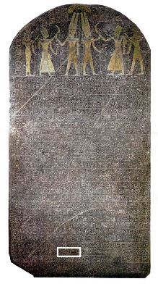
The Stele of Merneptah II
(ca. 1220 BC)
“Great rejoicing has arisen in Egypt, jubilation has issued from the towns of T0-Meri [another name for Egypt]; they recount the victories which Merne-ptah wrought in Tehnu [i.e. Lybia]. How beloved he is, the victorious ruler! How exalted is the king among the gods!” (Thomas) “…The princes lie prostrate, saying, ‘Mercy!’ No one raises his head among the Nine-Bows [an Egyptian idiom for subjugated peoples…”

Slide 2
The Stele of Merneptah II
(ca. 1220 BC)
“…Desolation is for Tehenu [i.e. Lybia]. Hatti [i.e. the Hittite Empire] is pacified. Plundered is Canaan with every evil; carried off is Ashkelon; seized upon is Gezer. Yanoam [an unknown town] is made as that which does not exist… All lands together , they are pacified; everyone who was restless, has been bound by the king” (Pritchard).

Slide 3
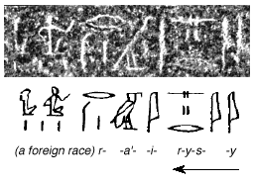

The Stele of Merneptah II
(ca. 1220 BC)
“Israel lies desolate, its seed is no more.”
The Oldest Reference to Israel Outside of the Bible

Slide 4
The Seed of Israel
Abraham (Gen. 22:15-18).
Israel (Gen. 28:10-14; 32:28).
In Egypt (Exod. 1:1-11).

Slide 5
The Seed of Israel
Sons of Abraham (Gal. 3:5-9, 13-18).
Fleshly Israel (1 Cor. 10:18).
Israel of God (Gal. 6:15-16).
Not All Israel (Rom. 9:6-8).
Jew Inwardly (Rom. 2:25-29).

Slide 6
The Seed of Israel
Flesh vs. Spirit (Rom. 9:1-5; 10:1-4).
The Remnant (Rom. 11:1-5).
All Israel will be Saved (Rom. 11:25-27).
Salvation for Israel (Acts 13:15-24).

