Slide 1
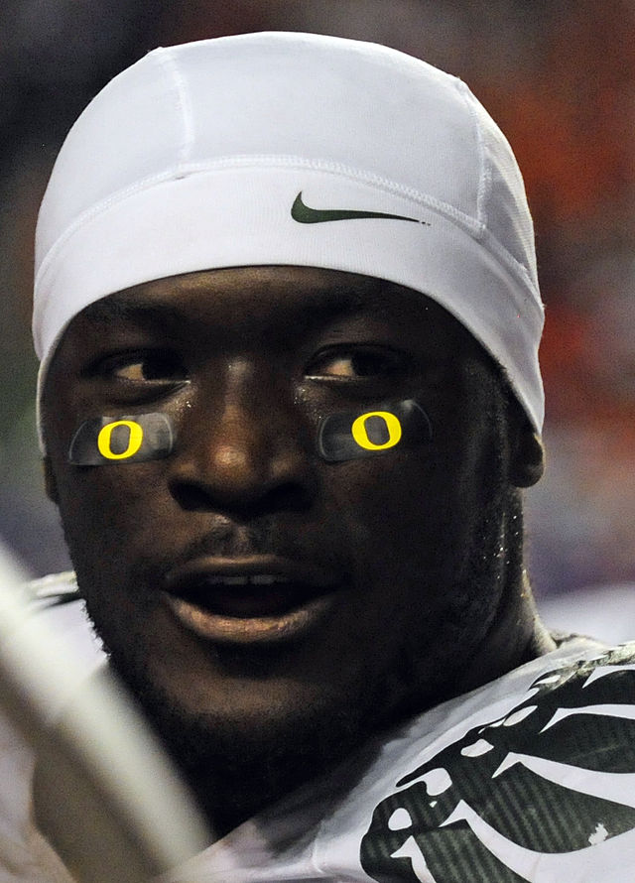
A Second Chance
On Sept. 3, 2009, a nationally televised game was played between the University of Oregon and Boise State University.
A player for Oregon, named LeGarrette Blount was upset with his individual and team’s performance that night.
An ugly incident happened in which Blount responded to taunting by hitting some Boise State players.

Slide 2
A Second Chance
Blount was suspended for most of the season but as a result of his remorseful response to his action he was reinstated and allowed to play in the last game, in which he scored a touchdown.
He expressed his thankfulness to his coach for showing that he “cares enough to offer me this second chance.”

Slide 3
A Second Chance
Blount understood the value of a second chance.
Every Christian should also understand this.
Christians are blessed in obedience to the gospel to receive a second chance from God.

Slide 4

Psalm 116:8-14
⁸ For You have delivered my soul from death, My eyes from tears, And my feet from falling.
⁹ I will walk before the Lord In the land of the living.
¹⁰ I believed, therefore I spoke, “I am greatly afflicted.”

Slide 5
Psalm 116:8-14
¹¹ I said in my haste, “All men are liars.”
¹² What shall I render to the Lord For all His benefits toward me?
¹³ I will take up the cup of salvation, And call upon the name of the Lord.
¹⁴ I will pay my vows to the Lord Now in the presence of all His people.

Slide 6
A Second Chance
1. “I will walk before the Lord” (v. 9).
  One of the first things that David vowed to do with his second chance was to walk before the Lord.
  This involved purposing in his heart that he would live right before God.
  His second chance renewed his resolve and strengthened his commitment to serve God.

Slide 7
A Second Chance
1. “I will walk before the Lord” (v. 9).
  God told Abram “walk before Me and be blameless” (Gen. 17:1-6).
  The idea of walking before God is living right before His eyes (Col. 1:9-11).
  That’s what being a Christian is all about!
  That’s what having a second chance is all about!

Slide 8
A Second Chance
I. “I will walk before the Lord” (v. 9).
  Paul’s question: “What shall we say then? Shall we continue in sin that grace may abound?” (Rom. 6:1).
  Paul’s answer: “Certainly not!” (Rom. 6:2).
  When you are given a second chance you don’t do what you did before (2 Cor. 5:17).

Slide 9
A Second Chance
1I. “I will take up the cup of salvation” (v. 13).
  Some think this may refer to a public proclamation of thankfulness to God.
  This was his response on another occasion (Psa. 51:12-13).
  That was what Jesus called the apostles to do (Matt. 28:19-20).

Slide 10
A Second Chance
1I. “I will take up the cup of salvation” (v. 13).
  Many in Scripture who were healed rushed to tell others what had happened.
  Jeremiah couldn’t stop speaking about God (Jer. 20:9).
  Paul couldn’t stop preaching the gospel (1 Cor. 9:16 ).

Slide 11
A Second Chance
1I. “I will take up the cup of salvation” (v. 13).
  When we are given a second chance that changes our eternal destiny we ought to want to tell everyone we can about it.
  It is an opportunity that is extended to all who will take it (Matt. 11:28-29).
  Those who have been given a second chance should offer others that same chance.

Slide 12
A Second Chance
1II. “I will pay my vows to the Lord” (v. 14).
  David was intent on being a man of his word.
  Obedience to the gospel is a vow—it is a covenant with God (Heb. 8:8-12).
  When a vow is made to the Lord we had better keep it (Ecc. 5:1-6).
  Jesus teaches us to keep our word (Matt. 5:33-37)—The response due a second chance.

