Slide 1
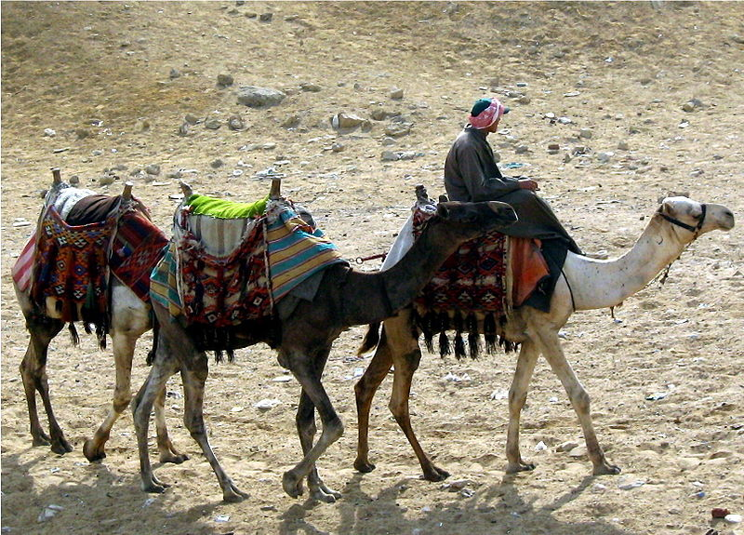
Camels and the Accuracy of the Bible

Slide 2
3 Facts About the Bible
It is inspired by God – II Peter 1:20-21
It is all sufficient – II Timothy 3:16-17
It can be understood – Ephesians 3:4

Slide 3

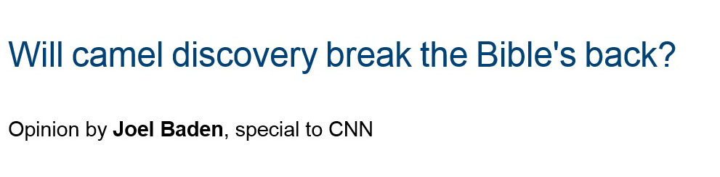

Slide 4
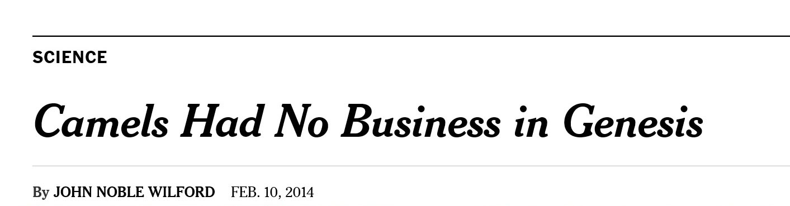

Slide 5
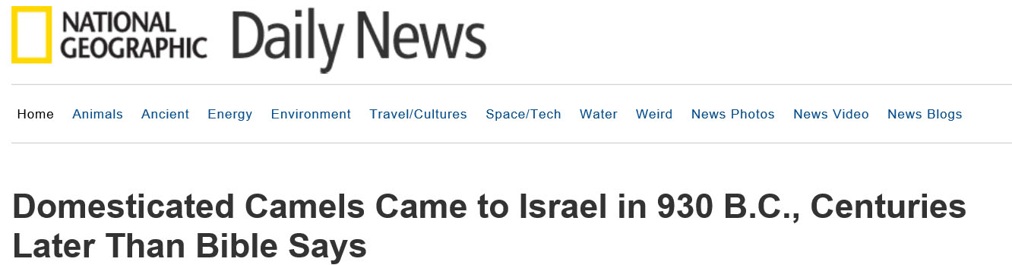
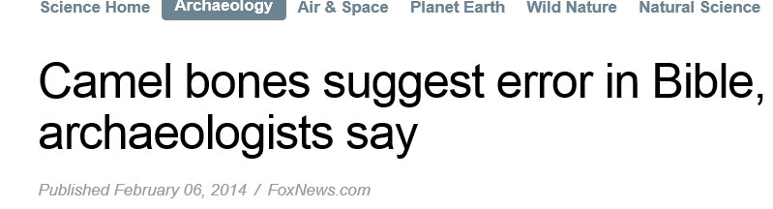


Slide 6
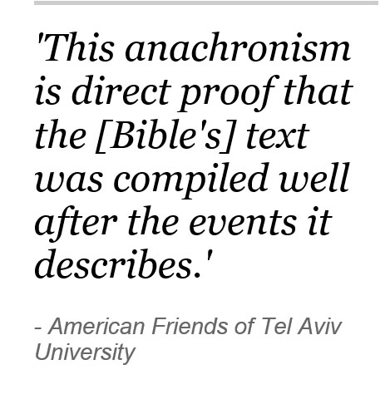

Slide 7
According to the Bible…..
(Pharaoh) treated Abram well for her sake. He had sheep, oxen, male donkeys, male and female servants, female donkeys, and camels. Genesis 12:16

Slide 8
“Academics” are saying…..
2000BC
1000BC

Slide 9
“Academics” are saying…..
Abram lived here…..
2000BC
1000BC

Slide 10
“Academics” are saying…..
Abram lived here…..
but camels were not till here…
2000BC
1000BC

Slide 11
“Academics” are saying…..
Abram lived here…..
but camels were not till here…
2000BC
1000BC

Slide 12
Why does this matter?
To many, it does not……
78% of mainline Protestants say humans have evolved….. a majority of Catholics (68%) also believe in evolution.
Pew Research Center April 2013

Slide 13
Why does this matter?
Witness Credibility
If a witness lies on one part of their oath…
….. their testimony is invalid

Slide 14
Why does this matter?
Moses’ Credibility
If Moses lied on one part of his book…
….. His testimony is invalid

Slide 15
Why does this matter?
Moses’ Credibility
"For if you believed Moses, you would believe Me; for he wrote about Me.” John 5:46

Slide 16
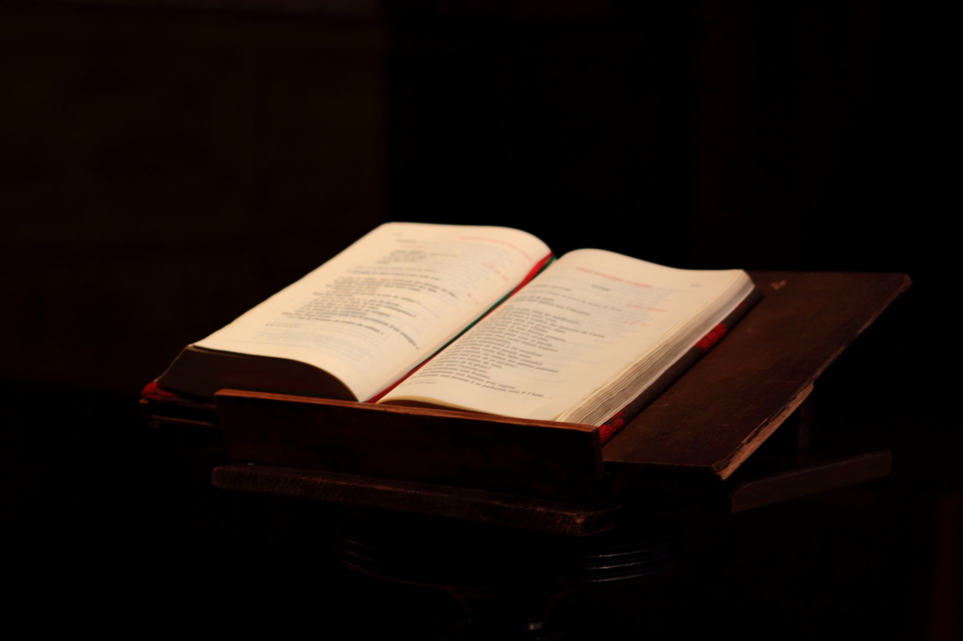
Why does this matter?
God’s Credibility
All Scripture is given by inspiration of God 2 Timothy 3:16a

Slide 17
Why does this matter?
God’s Credibility
Prophecy never came by the will of man, but holy men of God spoke as they were moved by the Holy Spirit. 2 Peter 1:21

Slide 18
Why does this matter?
For if the dead do not rise, then Christ is not risen. And if Christ is not risen, your faith is futile; you are still in your sins! Then also those who have fallen asleep in Christ have perished. If in this life only we have hope in Christ, we are of all men the most pitiable.
1 Corinthians 15:16-19
If there is no Genesis, then:
There is no sin
There is no God
There is no life after this

Slide 19
Why does this matter?
The Bible necessitates us to believe
All or Nothing

Slide 20
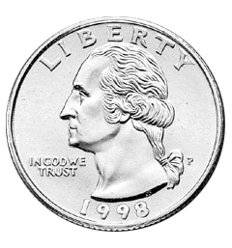
So is it true?
Negative evidence = positive proof?
Specifically: does dated evidence preclude potential older evidences?
Notes:
If we searched the room for quarters, and found that the oldest one we had was 1998, would that be direct proof that there were no quarters before 1998?

Slide 21
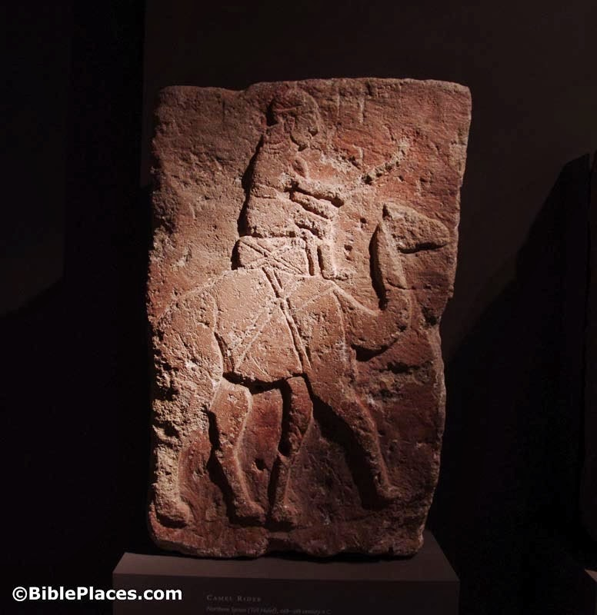
So is it true?
Image of Camel at Tel Halaf, 11th century

Slide 22
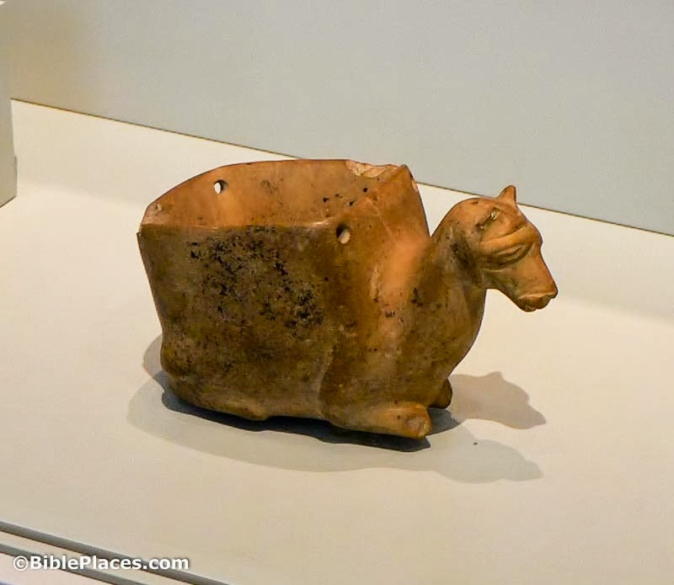
So is it true?
Egyptian camel, nearly 3000BC

Slide 23
So is it true?
Bad archeology
Poorly reported
Poorly researched
Why?

Slide 24
Assault Against the Bible
“Academia” has ALWAYS resisted the Bible
I Corinthians 1:19-27
Acts 17:19-21;32
But the Pharisees and lawyers rejected the will of God for themselves, not having been baptized by him. Luke 7:30

Slide 25
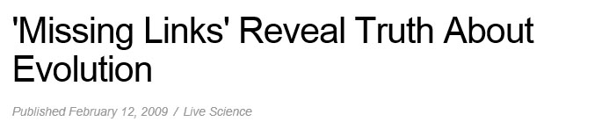
Assault Against the Bible

Slide 26
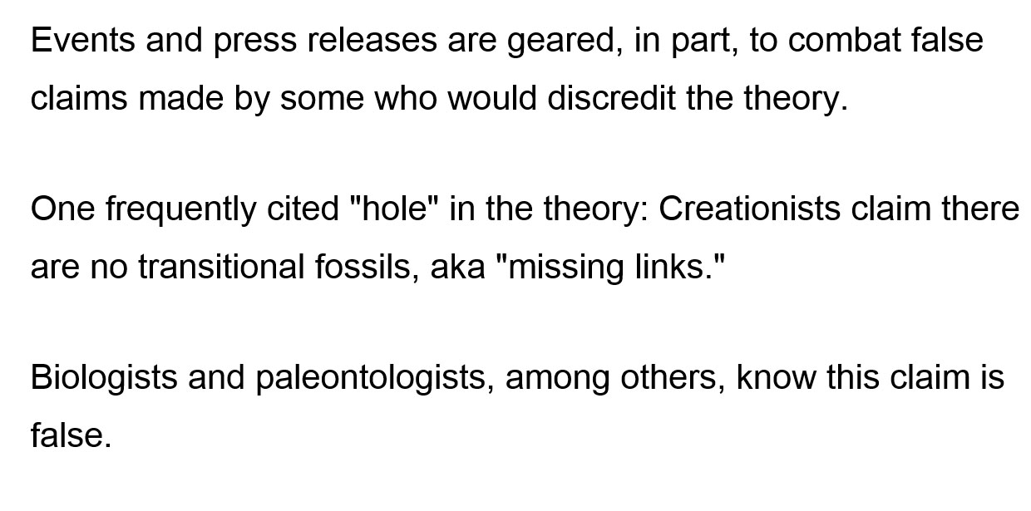
Assault Against the Bible

Slide 27
Assault Against the Bible

Slide 28
Assault Against the Bible

Slide 29

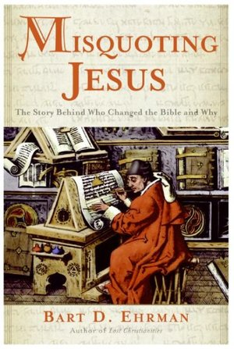
Assault Against the Bible

Slide 30
Assault Against the Bible
Matthew 23:24 "Blind guides, who strain out a gnat and swallow a camel!”

Slide 31
Assault Against the Bible
Be prepared for assaults on the Bible
Know what you believe and why
Look for their purpose and intent

Slide 32
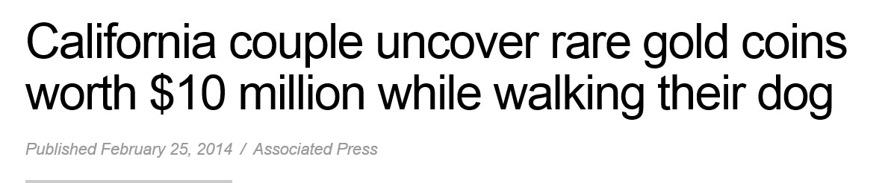

Finding a Buried Treasure
"Again, the kingdom of heaven is like treasure hidden in a field, which a man found and hid; and for joy over it he goes and sells all that he has and buys that field. Matthew 13:44
Notes:
http://www.foxnews.com/us/2014/02/25/california-couple-uncover-rare-gold-coins-worth-10-million-while-walking-their/

Slide 33
To Obtain the Gospel Treasure:
Hear and Believe the truth: Romans 10:17
Confess Jesus as Lord: Romans 10:9
Repent of your sins: Acts 2:38
Be baptized into the Kingdom: John 3:3
Obedience until death: Revelation 2:10
Notes:
http://www.foxnews.com/us/2014/02/25/california-couple-uncover-rare-gold-coins-worth-10-million-while-walking-their/

