Slide 1
1 Corinthians 1:10
“Now I plead with you, brethren, by the name of our Lord Jesus Christ, that you all speak the same thing, and that there be no divisions among you, but that you be perfectly joined together in the same mind and in the same judgment” (NKJV).

Slide 2
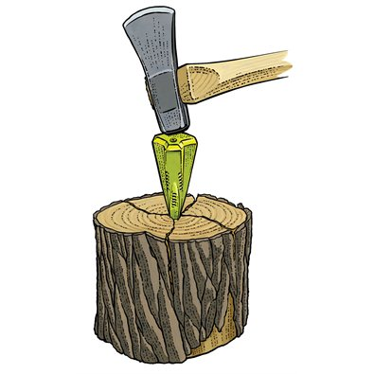
Causing Division
I. God hates one who sows discord among brethren (Prov. 6:16-19).
  A. “Discord” Heb. m^{e}dan “strife or contention” (BDB).
  B. We can sow peace or stir up strife.
    1. God hates this behavior.

Slide 3
Causing Division
II. Sensual persons who do not have the Spirit “cause divisions” (Jude 17-19).
  A. “Sensual” Gr. psuchikos. Prop. “pertaining to the soul.”
    1. When used in contrast to the spirit—following emotion, feeling, or desire.
  B. “Cause divisions” Gr. apodiorizo “to disjoin, part, separate from another” (Thayer).
    1. From a word that means to mark off boundaries.

Slide 4
Causing Division
III. Separating into parties is “carnal” (1 Cor. 3:3-4).
  “Carnal” Gr. sarkikos “having the nature of flesh, i.e. under the control of the animal appetites” (Thayer).
  B. The “carnal mind” cannot please God (Rom. 8:5-9).
    The “carnal mind” is death (vs. 6).
    The “carnal mind is enmity against God” (vs. 7a; Prov. 6:19).
    This attitude “is not subject to God”—it cannot be (vs. 7b).

Slide 5
Causing Division
IV. Christians are to “note” those who cause divisions and “avoid them” (Rom. 16:17-18).
  KJV “mark” Gr. skopeo “to fix one’s eyes upon, direct one’s attention to” (Thayer).
  B. “Divisions” dichostasia “dissension, division” (Thayer), from the prefix meaning “two” and the noun stasia referring to one’s state or standing.
    1. This is a person that creates two standings—two parties.

Slide 6
Causing Division
IV. Christians are to “note” those who cause divisions and “avoid them” (Rom. 16:18-18).
  “Avoid” Gr. ekklino “to turn aside”—“turn away from” (Thayer).
  D. A stronger charge is found to those in Thessalonica (2 Thess. 3:13-15).
    1. “Note” Gr. semeioo “to mark, to note, distinguish by marking” (Thayer).

Slide 7
Causing Division
V. The church is to reject a “divisive man” after the first and second admonition (Titus 3:9-11).
  KJV “heretick” transliterates Gr. hairetikos meaning literally “fitted or able to take or choose a thing” but came to refer to one who was “factious” (ASV, NASB) or a “divisive person” (NIV), “a person who stirs up division” (ESV)—(John 17:21).
  B. “Reject” Gr. paraiteomai meaning lit. “to ask along side, beg to have near one”—“to refuse, decline, to shun, avoid” (Thayer).

Slide 8
Causing Division
VI. The church is not what it ought to be when it comes together and there are “divisions” (1 Cor. 11:17-19).
  Paul says when it happens the church coming “together” is “for the worse” (vs. 17)—(Heb. 10:25).
  B. What the assembly should be (1 Cor. 14:25).
  C. The one who causes division causes a command of God to be “for the worse.”

Slide 9
Causing Division
Are There Ever Times When Division is Necessary?
  “There must also be factions among you, that those who are approved may be recognized among you.” (1 Cor. 11:19).
  Is he talking about those “approved” by God or “approved” in their party divisions?
  The church is to “avoid,” “reject,” and in some cases to even withdraw from the “divisive person.” That is necessary division (cf. 2 John 9-11).

