Slide 1
1 Corinthians 10:13
“No temptation has overtaken you except such as is common to man; but God is faithful, who will not allow you to be tempted beyond what you are able, but with the temptation will also make the way of escape, that you may be able to bear it” (NKJV).
1. No One Has to Sin.

Slide 2
1 Corinthians 10:13
“No temptation has overtaken you except such as is common to man; but God is faithful, who will not allow you to be tempted beyond what you are able, but with the temptation will also make the way of escape, that you may be able to bear it” (NKJV).
“common to man”
1. No One Has to Sin.

Slide 3
1 Corinthians 10:13
“No temptation has overtaken you except such as is common to man; but God is faithful, who will not allow you to be tempted beyond what you are able, but with the temptation will also make the way of escape, that you may be able to bear it” (NKJV).
“beyond what you are able”
1. No One Has to Sin.

Slide 4
1 Corinthians 10:13
“No temptation has overtaken you except such as is common to man; but God is faithful, who will not allow you to be tempted beyond what you are able, but with the temptation will also make the way of escape, that you may be able to bear it” (NKJV).
“able to bear”
1. No One Has to Sin.

Slide 5
1. No One Has to Sin.
“All have sinned” (Rom. 3:23).
“Under sin” (Rom. 3:9).
All at some point choose to sin(Rom. 3:10-18).

Slide 6
1 Corinthians 10:13
“No temptation has overtaken you except such as is common to man; but God is faithful, who will not allow you to be tempted beyond what you are able, but with the temptation will also make the way of escape, that you may be able to bear it” (NKJV).
2. God’s Law Can Be Obeyed.

Slide 7
1 Corinthians 10:13
“No temptation has overtaken you except such as is common to man; but God is faithful, who will not allow you to be tempted beyond what you are able, but with the temptation will also make the way of escape, that you may be able to bear it” (NKJV).
“not allow…to be tempted”
2. God’s Law Can Be Obeyed.

Slide 8
1 Corinthians 10:13
“No temptation has overtaken you except such as is common to man; but God is faithful, who will not allow you to be tempted beyond what you are able, but with the temptation will also make the way of escape, that you may be able to bear it” (NKJV).
“with the temptation”
2. God’s Law Can Be Obeyed.

Slide 9
2. God’s Law Can Be Obeyed.
“You may do it” (Deut. 30:11-16).
The gospel can be obeyed (Rom. 10:5-11).

Slide 10
1 Corinthians 10:13
“No temptation has overtaken you except such as is common to man; but God is faithful, who will not allow you to be tempted beyond what you are able, but with the temptation will also make the way of escape, that you may be able to bear it” (NKJV).
3. There is always a way of escape.

Slide 11
1 Corinthians 10:13
“No temptation has overtaken you except such as is common to man; but God is faithful, who will not allow you to be tempted beyond what you are able, but with the temptation will also make the way of escape, that you may be able to bear it” (NKJV).
“way of escape”
3. There is always a way of escape.

Slide 12
3. There is always a way of escape.
“God tests the hearts and minds” (Psa. 7:9).
“There is a way that seems right to a man, but its end is the way of death” (Prov. 14:12).

Slide 13
David’s Ways of Escape
I. David’s Sin with Bathsheba: Three Opportunities Missed (2 Sam. 11:1-25).
First “Way of Escape” (2 Sam. 11:1).
Second “Way of Escape” (2 Sam. 11:2; Josh 2:6, 8; Neh. 8:16).

Slide 14
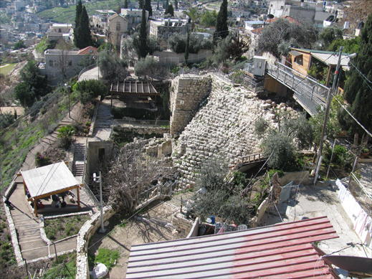
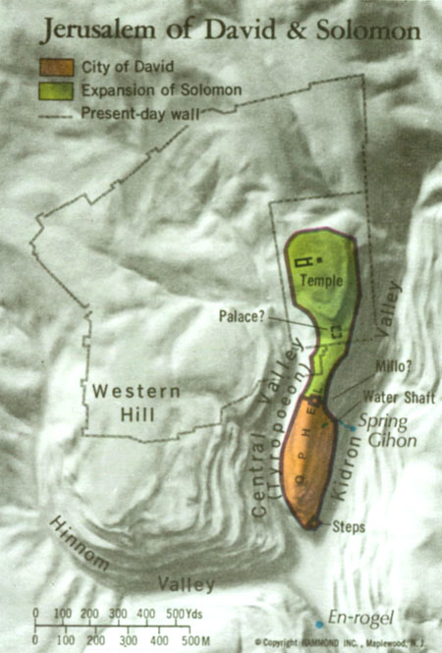
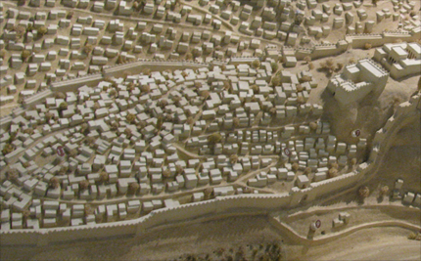
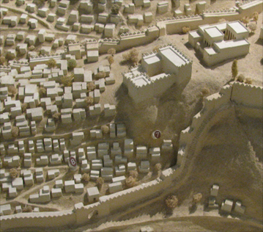
David’s Jerusalem
Modern Ruins
Kidron Valley
David’s Palace
David’s Jerusalem

Slide 15
David’s Ways of Escape
I. David’s Sin with Bathsheba: Three Opportunities Missed (2 Sam. 11:1-25).
First “Way of Escape” (2 Sam. 11:1).
Second “Way of Escape” (2 Sam. 11:2; Josh 2:6, 8; Neh. 8:16).
Third “Way of Escape” (2 Sam. 11:3; 1 Sam. 13:14; Exod. 20:14; Lev. 20:10; Deut. 17:14-20; Ecc. 9:17).

Slide 16
David’s Ways of Escape
II. After David’s Sin with Bathsheba: Four More Missed Opportunities.
“Immediately he went after her, as an ox goes to the slaughter” (Prov. 7:22).
The “sweet psalmist of Israel” (2 Sam. 23:1)…
Committed adultery with another man’s wife (2 Sam. 11:4)! Then…
He chose to “add sin to sin” (Isa. 30:1).

Slide 17
David’s Ways of Escape
II. After David’s Sin with Bathsheba: Four More Missed Opportunities.
Fourth “Way of Escape” (Prov. 28:13; 2 Sam. 11:5; 1 Sam. 17:36).
Fifth “Way of Escape” (2 Sam. 11:6-8, 9-11; 1 Sam. 24:4-6).
Sixth “Way of Escape” (2 Sam. 11:4, 5, 6, 10, 13).

Slide 18
David’s Ways of Escape
II. After David’s Sin with Bathsheba: Four More Missed Opportunities.
Seventh “Way of Escape” (2 Sam. 11:14-25; Psa. 139:7, 11-12).

