Slide 1
John 1:14-17
“And the Word became flesh and dwelt among us, and we beheld His glory, the glory as of the only begotten of the Father, full of grace and truth. John bore witness of Him and cried out, saying, “This was He of whom I said, ‘He who comes after me is preferred before me, for He was before me.’” And of His fullness we have all received, and grace for grace. For the law was given through Moses, but grace and truth came through Jesus Christ” (NKJV).

Slide 2
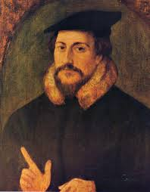
John 1:14-17
“Grace and truth came through Jesus Christ”
Was there no grace in the Old Testament?
“The law had neither the one nor the other” John Calvin (Commentary on John 1:17).
John Calvin
Protestant Reformer
(1509-1564)

Slide 3
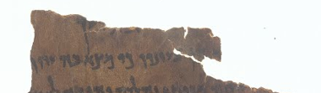
The Grace of God
In the Old Testament
I. Words for “grace” in the Old Testament.
    Hebrew noun chen “favour, grace, charm” (BDB).
    In Deut. 24:1 from a Dead Sea Scroll (4QDeutª)

Slide 4
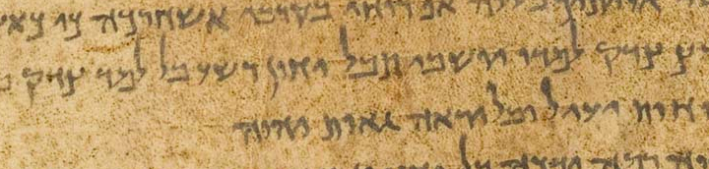
The Grace of God
In the Old Testament
I. Words for “grace” in the Old Testament.
    Hebrew verb chanan “to be gracious, show favour, pity…to seek favour” (BDB).
    In Isaiah 26:10 from Dead Sea Scroll (1QIsaª)

Slide 5
The Grace of God
In the Old Testament
I. Words for “grace” in the Old Testament.
    Grace is not just a New Testament concept.
    It runs throughout the Old Testament

Slide 6
The Grace of God
In the Old Testament
II. God clearly extended grace to His people in the Old Testament.
    “Noah found grace in the eyes of the LORD” (Gen. 6:5-8).
    Jacob declared “God has dealt graciously with me” (Gen. 33:8-11).
    Israel “found grace in the wilderness” (Jer. 30:23-31:3).

Slide 7
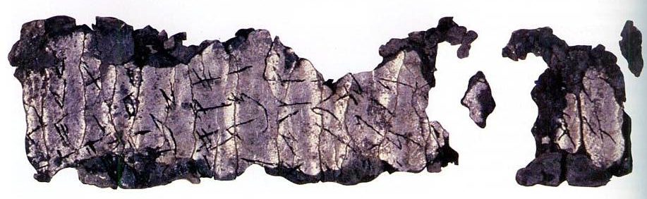
The Grace of God
In the Old Testament
II. God clearly extended grace to His people in the Old Testament.
    The blessing Mosaic priests were to offer over the people spoke of grace (Num. 6:23-27).
    The oldest known biblical text contains a portion of this blessing, dated to 600 BC.

Slide 8
The Grace of God
In the Old Testament
II. God clearly extended grace to His people in the Old Testament.
    The blessing Mosaic priests were to offer over the people spoke of grace (Num. 6:23-27).
    During the days of Jehoahaz “the LORD was gracious” unto Israel (2 Kings 13:20-23).
    Jonah resisted preaching to Nineveh knowing that God was “a gracious and merciful God” (Jon. 3:10-4:3).

Slide 9
The Grace of God
In the Old Testament
II. God clearly extended grace to His people in the Old Testament.
    In sparing a remnant after the exile, Ezra recognized “grace has been shown from the LORD our God” (Ezra 9:5-9).
    The wise man proclaimed that God “gives grace to the humble” (Prov. 3:31-34; Jas. 4:6).
    The psalmist declared, “The LORD gives grace and glory” (Psa. 84:8-12, NASB).

