Slide 1
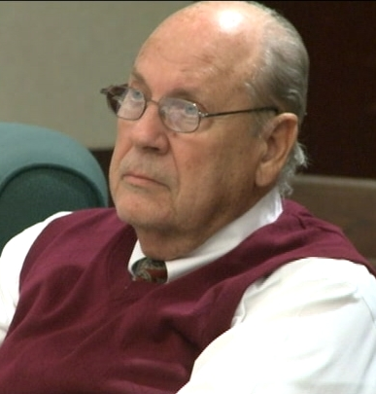
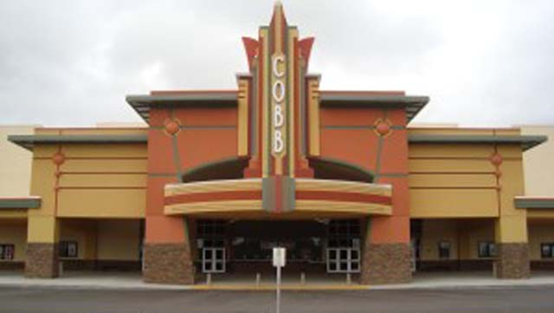
Chad Oulson
Curtis Reeves
How Could This Happen?

Slide 2
Overreaction
I. Biblical Examples of Overreaction.
A. Problems.
1. Rehoboam overreacted when facing a challenge to his authority (1 Kings 12:1-17).
B. Emotional Trials.
1. James and John overreacted in their response to rejection (Luke 9:51-56; Isa. 53:3; 1 Pet. 2:23).

Slide 3
Overreaction
I. Biblical Examples of Overreaction.
A. Problems.
1. Rehoboam overreacted when facing a challenge to his authority (1 Kings 12:1-17).
B. Emotional Trials.
2. The “Gentiles” overreact in their anxiety over life’s necessities (Matt. 6:25-34; 1 Thess. 4:11).

Slide 4
Overreaction
I. Biblical Examples of Overreaction.
C. Spiritual Choices.
1. Peter overreacted in a desire to honor Jesus (Matt. 17:1-7).
2. Jeroboam overreacted in his desire to lead Israel (1 Kings 11:29-39; 12:25-33).
D. The Sins of Others.
1. Absalom overreacted in response to a sin against his sister (2 Sam. 3:2-3; 13:1-15, 28; Gal. 6:1).

Slide 5
Overreaction
I. Biblical Examples of Overreaction.
E. Temptation.
1. Saul overreacted to his jealousy of David (1 Sam. 13:14; 19:9-10).
2. David overreacted in the face of temptation (2 Sam. 11:1-5; Prov. 16:32).

Slide 6
Overreaction
II. Avoiding Overreaction.
A. A Common Problem We Must Address.
“How to Stop Overreacting” by Julie Hanks
1. Don’t neglect the basics.
2. Tune in and name it.
3. Put a positive spin on it.
4. Breathe before responding.
5. Identify and resolve emotional “leftovers.”

Slide 7
Overreaction
II. Avoiding Overreaction.
B. Biblical Solutions to Overreaction.
1. Stop and consider (Psa. 4:4; Prov. 14:15-18)..
2. Find the River in the Storm (Psa. 46:1-11).
3. Listen before you speak (Jas. 1:19-20).
4. Consider how to answer (Prov. 15:28; Prov. 15:1)..
5. Surround yourself by those who help you avoid overreaction (1 Sam. 25:3-33).

Slide 8
Overreaction
II. Avoiding Overreaction.
B. Biblical Solutions to Overreaction.
6. Be willing to receive correction (Prov. 15:5)..
7. See the unseen, eternal things (2 Cor. 4:18; Rom. 8:28).

