Slide 1
Does Jesus Care?
By Frank Graeff
Does Jesus care when my heart is pained
Too deeply for mirth or song,
As the burdens press, and the cares distress,
And the way grows weary and long?
Does Jesus care when my way is dark
With a nameless dread and fear?
As the daylight fades into deep night shades,
Does He care enough to be near?

Slide 2
Does Jesus Care?
By Frank Graeff
Does Jesus care when I’ve tried and failed
To resist some temptation strong;
When for my deep grief there is no relief,
Though my tears flow all the night long?
Does Jesus care when I’ve said “goodbye”
To the dearest on earth to me,
And my sad heart aches till it nearly breaks—
Is it aught to Him? Does He see?

Slide 3
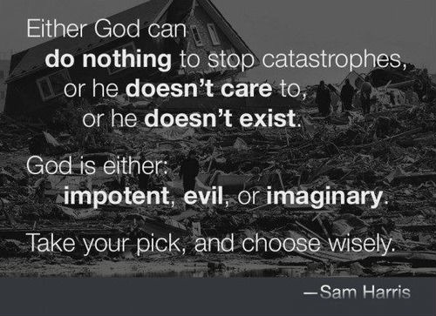
D
O
E
S
G
O
D
C
A
R
E

Slide 4
How Can You Know Someone’s Thoughts?
D
O
E
S
G
O
D
C
A
R
E
Actions
  This is often true—“I will show you my faith by my works” (Jas. 2:18).
  But not always—“All their works they do to be seen” (Matt. 23:5).
  Some works are misunderstood—“They did not understand” (Acts 7:25). Cf. husband and wife.

Slide 5
How Can You Know Someone’s Thoughts?
D
O
E
S
G
O
D
C
A
R
E
Results
  Sometimes—“out of the abundance of the heart the mouth speaks”
  (Matt. 12:34)—“You will know them by their fruits” (Matt. 7:16).
  But not always—“Do not judge according to appearance” (John 7:24). Cf. discipline (Heb. 12:8-11).

Slide 6
How Can You Know Someone’s Thoughts?
D
O
E
S
G
O
D
C
A
R
E
Communication (1 Cor. 2:9-13).
  “What man knows the things of a man except the spirit of the man which is in him?” (11a).
  “No one knows the things of God except the Spirit of God” (11b).
  God has revealed His mind to us through the gospel (9-10).
What Does God Say About His Care?

Slide 7
His Word Says He Cares
D
O
E
S
G
O
D
C
A
R
E
“Therefore humble yourselves under the mighty hand of God, that He may exalt you in due time, casting all your care upon Him, for He cares for you” (1 Pet. 5:6-7).
The Challenge of Faith is to Trust What He Says About His Care

Slide 8
As a Comforting Mother
D
O
E
S
G
O
D
C
A
R
E
God punished Israel, but He also promised to comfort His people (Isa. 66:13-14).
What If We Have Not Known the Comfort of a Mother?
This comparison appeals to proper maternal care.
God’s comforting care is seen in the death of Jesus (Rom. 5:6-10).

Slide 9
As a Sympathetic Father
D
O
E
S
G
O
D
C
A
R
E
He “pities us” and “knows our frame” (Psa. 103:13-14)—i.e. He understands our frailties.
He can be moved by our appeals like a father hears his children (Matt. 7:9-11).
What if We Have Not Known a Father’s Care?
Children do not Always Understand

Slide 10
As a Seeking Shepherd
D
O
E
S
G
O
D
C
A
R
E
He seeks out His sheep because He cares for them (Ezek. 34:11-12).
There is risk to others because He seeks those who are lost (Matt. 18:12-14).
Jesus is the “Good Shepherd”—He gives His life for His sheep (John 10:11-14).

Slide 11
As a Protective Hen
D
O
E
S
G
O
D
C
A
R
E
God wants to care for people but their own choices can hinder His care (Matt. 23:37).
God stretches out His hand to care for those who rebel against Him (Isa. 65:2-7).
We May Not See His Care Because We Rebel Against Him
We May Not See His Care Because We Fail to Trust Him

Slide 12
Does Jesus Care?
By Frank Graeff
D
O
E
S
G
O
D
C
A
R
E
Chorus:
Oh, yes, He cares, I know He cares,
His heart is touched with my grief;
When the days are weary, the long nights dreary,
I know my Savior cares.

