Slide 1
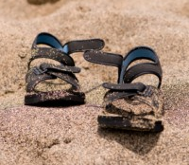
Holy Ground in the Bible.
Moses: “Then He said, ‘Do not draw near this place. Take your sandals off your feet, for the place where you stand is holy ground.’ Moreover He said, ‘I am the God of your father — the God of Abraham, the God of Isaac, and the God of Jacob.’ And Moses hid his face, for he was afraid to look upon God” (Exod. 3:5-6; cf. Acts 7:33).

Slide 2
Holy Ground in the Bible.
What Made this Ground Holy?
Moses noticed the bush burned but was not consumed.
An Angel appeared to him in the flame.
God called to him from the bush.
The presence of God made this a holy place.

Slide 3
Holy Ground in the Bible.
God Gave a Warning to Moses.
“Do not draw near this place.”
God called him to the burning bush.
Take the sandals off your feet for the place where you stand is “holy ground.”
Near enough to hear but careful lest he show a lack of reverence.

Slide 4
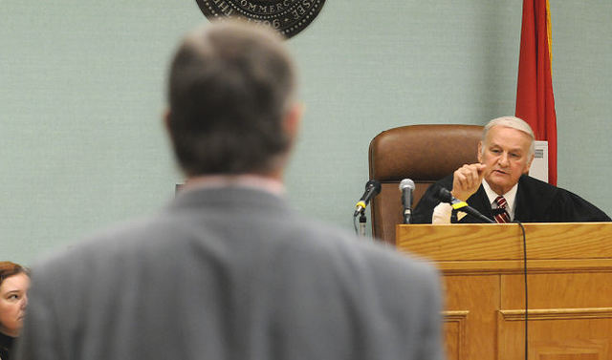
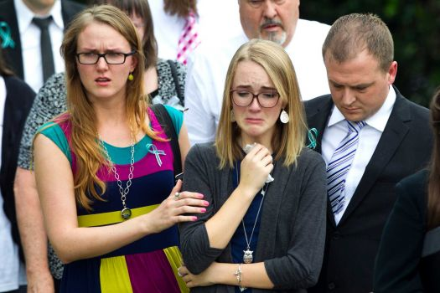
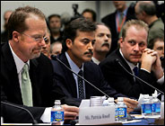
How Would You React Today?
District or Federal Court before a Judge?
At a funeral before a grieving family?
Appearing before Congress to answer questions about something?
On a witness stand answering questions at a capital murder trial for your life?
At the scene of an accident where you just ran over a young child?

Slide 5
What Does God Desire From Us?
Is it not respect in His presence?
When are we in His presence?
God called to him from the bush.
“If I say, ‘Surely the darkness shall fall on me,’ Even the night shall be light about me; Indeed, the darkness shall not hide from You, But the night shines as the day; The darkness and the light are both alike to You” (Ps. 139:11-12).

Slide 6
Is There Holy Ground Today?
“O LORD, You have searched me and known me. You know my sitting down and my rising up; You understand my thought afar off. You comprehend my path and my lying down, And are acquainted with all my ways. For there is not a word on my tongue, But behold, O LORD, You know it altogether. You have hedged me behind and before, And laid Your hand upon me. Such knowledge is too wonderful for me; It is high, I cannot attain it.” (Ps 139:1-6).

Slide 7
Is There Holy Ground Today?
“Where can I go from Your Spirit? Or where can I flee from Your presence? If I ascend into heaven, You are there; If I make my bed in hell, behold, You are there. If I take the wings of the morning, And dwell in the uttermost parts of the sea, Even there Your hand shall lead me, And Your right hand shall hold me” (Ps 139:7-10).
Yes—it is all around us everyday.
But there are also some special times.

Slide 8
Is There Holy Ground Today?
God is present when His people assemble (Matt. 18:15-20).
God is present in church worship (1 Cor. 14:23-25).
Do we treat these times as special and important? In our attitudes? In our dress?
There is a move today to diminish the importance of church worship—do we support this by our actions? By our attitudes?

Slide 9
What Makes It Holy?
God’s presence—What does this mean for us?
“Tremble, O earth, at the presence of the Lord, At the presence of the God of Jacob” (Ps. 114:7).
“The mountains melt like wax at the presence of the LORD, at the presence of the Lord of the whole earth. The heavens declare His righteousness, And all the peoples see His glory” (Ps. 97:5-6).

Slide 10
What Makes It Holy?
God’s power should be reverenced.
“You shall not profane My holy name, but I will be hallowed among the children of Israel. I am the LORD who sanctifies you, who brought you out of the land of Egypt, to be your God: I am the LORD” (Lev. 22:32-33).
To “profane” is to treat as common.
Do we live every day in reverence to God?
Do we treat times of worship as common?

Slide 11
How Can We Avoid This?
Fear the Lord (Ps. 111:10).
Remember His desire (Ezek. 39:7-8).
Do Not Forget (Deut. 8:11-17).

Slide 12
By Christopher Beatty (Ken Craig)
This is holy ground, we’re standing on holy ground,
For the Lord is present and where He is is holy.
(Repeat).
You are holy God, a perfect and holy God;
We will come before You with hearts made clean by Jesus’ blood. (Repeat).
Hymns for Worship
(Supplement) No. 111

Slide 13
By Geron Davis
When I walked through the doors, I sensed His presence, and I knew this was a place where love abounds.
For this is a temple the God we love abides here, and we are standing in His presence on holy ground.
Chorus: We are standing on holy ground, and I know that there are angels all around.
Let us praise Jesus now, we are standing in His presence on holy ground.
Sing Joyfully No. 83

