Slide 1
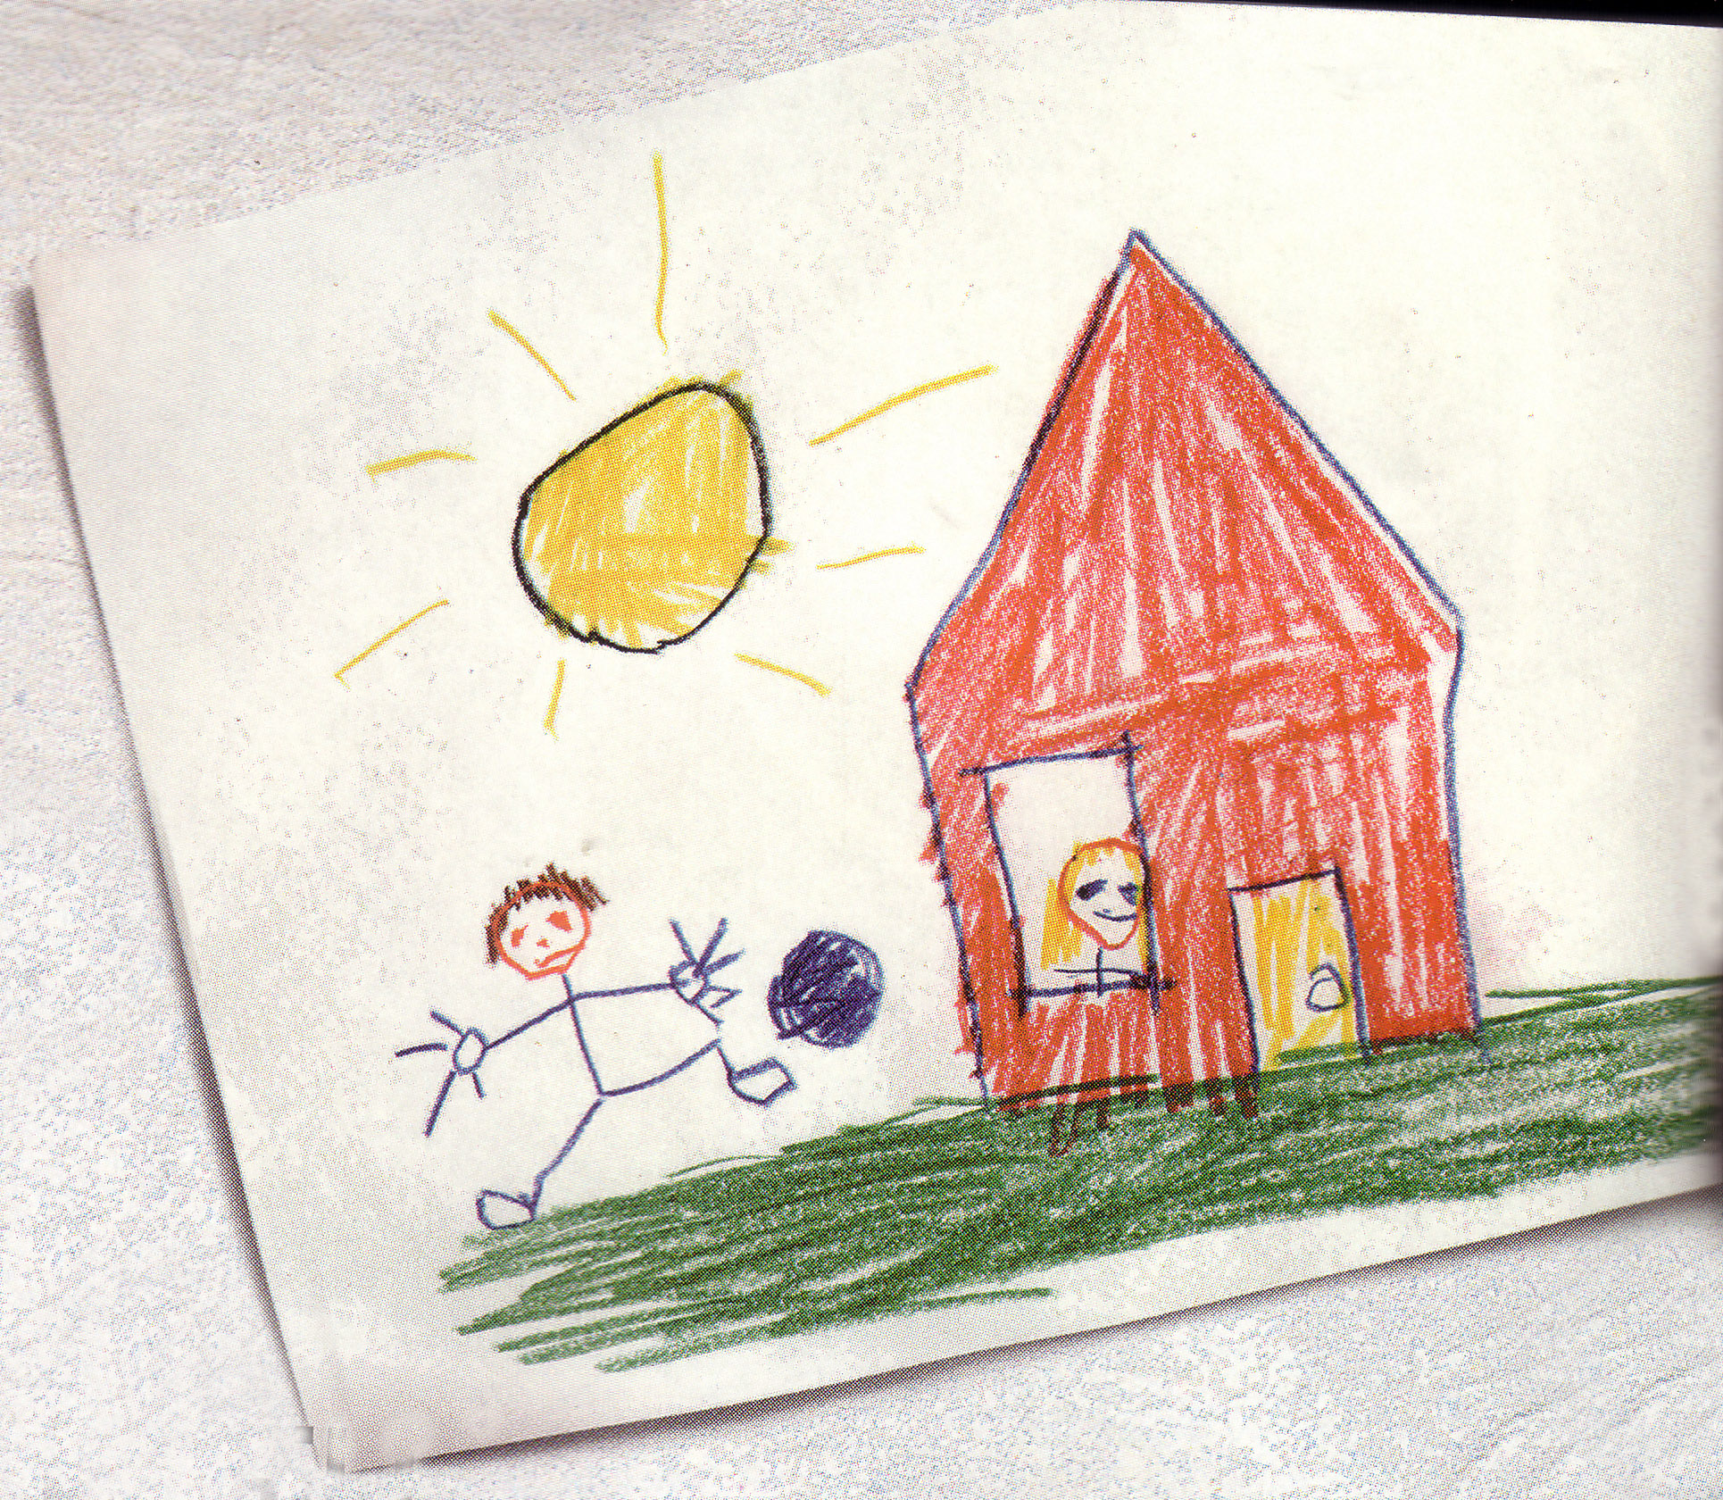

Slide 3

The Prodigal Son

Slide 4


Luke 15:11-32

Slide 5
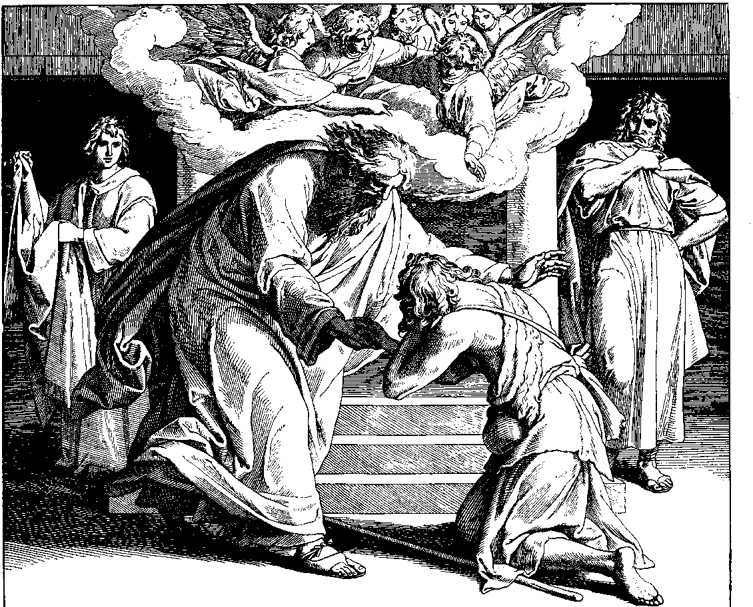

Slide 6

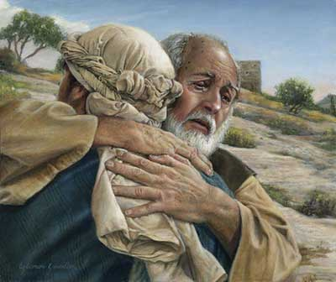
The Face of Grace

Slide 7

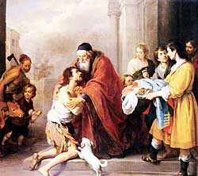
This parable gives us a snapshot of God
The power of this parable is not in the son’s guilt but in the father’s grace
Every command of the father illustrates the extravagance of grace

Slide 8

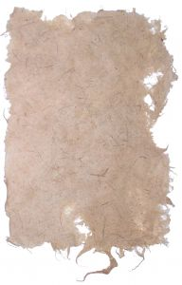

1. You can leave the Father’s presence, but you can never leave His heart
1 Jn 4:19 We love, because He first loved us.
God loves us even though we choose to leave Him

Slide 9

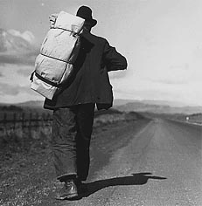
The Far Country was a rejection of the
values
morals
And life that he had been raised

Slide 10


The far country is the world in which everything at home is disregarded

Slide 11


The Far Country
Promises freedom and adventure
Offers unconditional love without cost
The call is:
loud
constant
everywhere

Slide 12

It tells us that we cannot be happy until we leave

Slide 13

The far country calls the young who have never tried things before
It calls the discouraged who are tired of obligations
It calls those who once were in the far country

Slide 14
1. God loves us even though we choose to leave Him

Slide 15

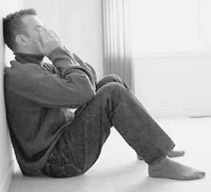
2. God loves us even though we ruin our lives
You can break the Father’s heart, but you can never destroy His love

Slide 16
2. God loves us even though we ruin our lives
The prodigal learned that the far country lied to him
He wasn’t better off
He wasn’t free
He wasn’t happy

Slide 17

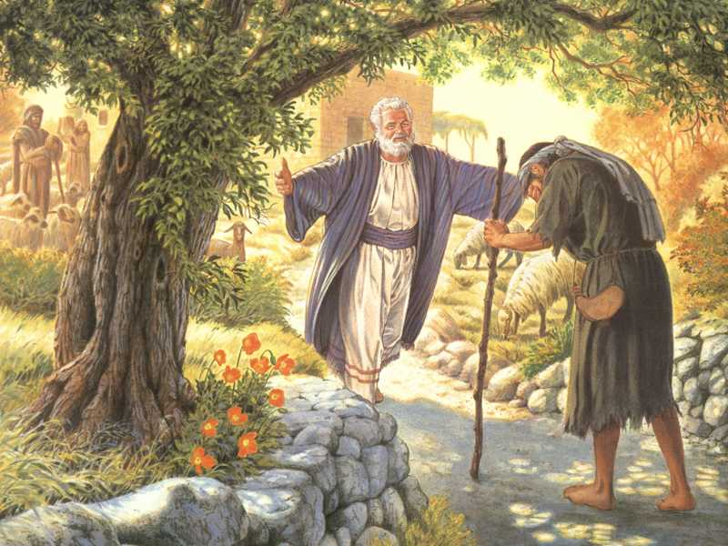
3. God loves us even though we are not worthy to return
Grace doesn’t make sense

Slide 18

Eph 2:8 For by grace you have been saved through faith; and that not of yourselves, it is the gift of God;

Slide 19

Mt 21:33-40

Slide 20

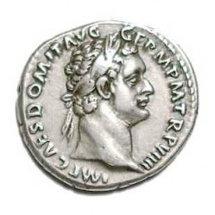
Amazing Grace
Mt 18:23-27
1 Denarii = 1 day of work
600 Denarii = 1 talent
10,000 talents = 6 million denarii
10,000 talents = 6 million days of work (16,438 years)

Slide 21
Romans 5:8
But God demonstrates His own love toward us, in that while we were yet sinners, Christ died for us.

Slide 22

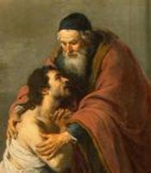
Grace changes relationships
Grace is a gift
Grace is expensive
Grace removes guilt

Slide 23
Jn 1:14 And the Word became flesh, and dwelt among us, and we beheld His glory, glory as of the only begotten from the Father, full of grace and truth.
Heb 4:16 Let us therefore draw near with confidence to the throne of grace, that we may receive mercy and may find grace to help in time of need.

Slide 24

Grace Accepts
Grace Teaches
Titus 2:11-12 For the grace of God has appeared, bringing salvation to all men, instructing us to deny ungodliness and worldly desires and to live sensibly, righteously and godly in the present age,

Slide 25

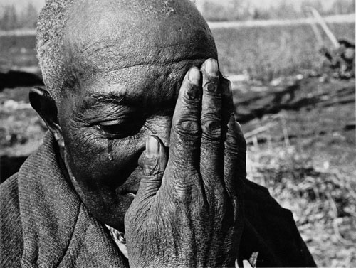
4. God loves us even though we have a hard time extending grace to others

