Slide 1
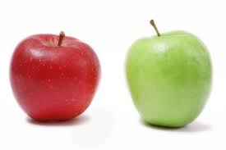
Comparisons
Comparisons
Comparisons

Slide 2

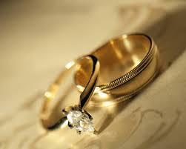
What Marriage Teaches About Fellowship

Slide 3


Psalms 34:3 O magnify the Lord with me, and let us exalt His name together
Psalms 133 “Behold, how good and how pleasant it is for brothers to dwell together in unity! It is like the precious oil upon the head, coming down upon the beard, even Aaron’s beard, coming down upon the edge of his robes. It is like the dew of Hermon, coming down upon the mountains of Zion; for there the Lord commanded the blessing – life forever.”

Slide 4

Acts 2:41, 42, 44 “So then, those who had received his word were baptized; and that day there were added about three thousand souls. They were continually devoting themselves to the apostles’ teaching and to fellowship, to the breaking of bread and to prayer… And all those who had believed were together and had all things in common”

Slide 5

Husband & Wife
Fellowship
Rom 12:16 Be of the same mind toward one another; do not be haughty in mind, but associate with the lowly. Do not be wise in your own estimation.
Rom 15:6 “so that with one accord you may with one voice glorify the God and Father of our Lord Jesus Christ.

Slide 6

Husband & Wife
Fellowship
Phil 1:27 Only conduct yourselves in a manner worthy of the gospel of Christ, so that whether I come and see you or remain absent, I will hear of you that you are standing firm in one spirit, with one mind striving together for the faith of the gospel;

Slide 7
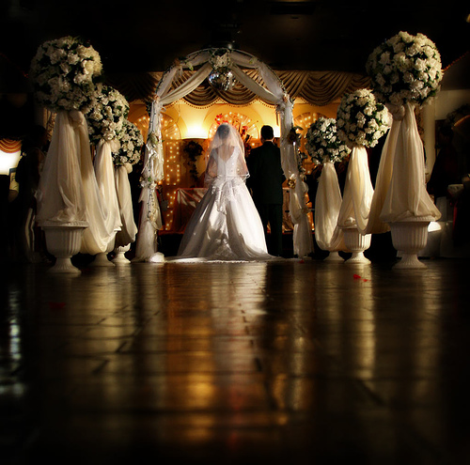

1 Pet 3:7 You husbands likewise, live with your wives in an understanding way, as with a weaker vessel, since she is a woman; and grant her honor as a fellow heir of the grace of life, so that your prayers may not be hindered.
You are to live with her in an understanding way
You are to treat your wife as a weaker vessel
You are fellow heir

Slide 8

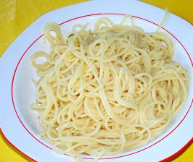

Men are like waffles
Women are like spaghetti

Slide 9


Col 3:12-13 And so, as those who have been chosen of God, holy and beloved, put on a heart of compassion, kindness, humility, gentleness and patience; bearing with one another, and forgiving each other, whoever has a complaint against anyone; just as the Lord forgave you, so also should you.
Paul is describing what it is like to be a Christian
A change has taken place (5, 8-10)
A new goal takes over (v. 2)

Slide 10

Put on (Put off) – (8, 9, 10, 12, 14)

Slide 11

1. Be the person you are supposed to be (12)
Paul lists two central components of togetherness
Too often in a marriage we focus on finding the right person

Slide 12


The Insides
Put on a heart of Compassion: CARE
Put on a heart of Kindness: DOING
Put on a heart of Humility: how we see OURSELVES
Put on a heart of Gentleness: a better word is MEEKNESS – our relationship with the LORD
Put on a heart of Patience: that ability to wait and not come unglued

Slide 13

The Outsides
Bear with one another: PUT UP
Forgive one another: We are not PERFECT
Put on Love: This is God’s love

Slide 14

In our Fellowship
Same thoughts
Be the right person
My insides matter
My outsides reflect how I feel

