Slide 1

1 Peter
those who no longer fit in

Slide 2

1 Peter 2:11-12 Dear friends, I urge you, as foreigners and exiles, to abstain from sinful desires, which wage war against your soul. Live such good lives among the pagans that, though they accuse you of doing wrong, they may see your good deeds and glorify God on the day he visits us.

Slide 3
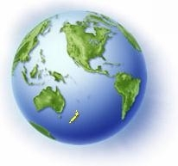
1 Peter 1:17 Since you call on a Father who judges each person’s work impartially, live out your time as foreigners here in reverent fear.

Slide 4


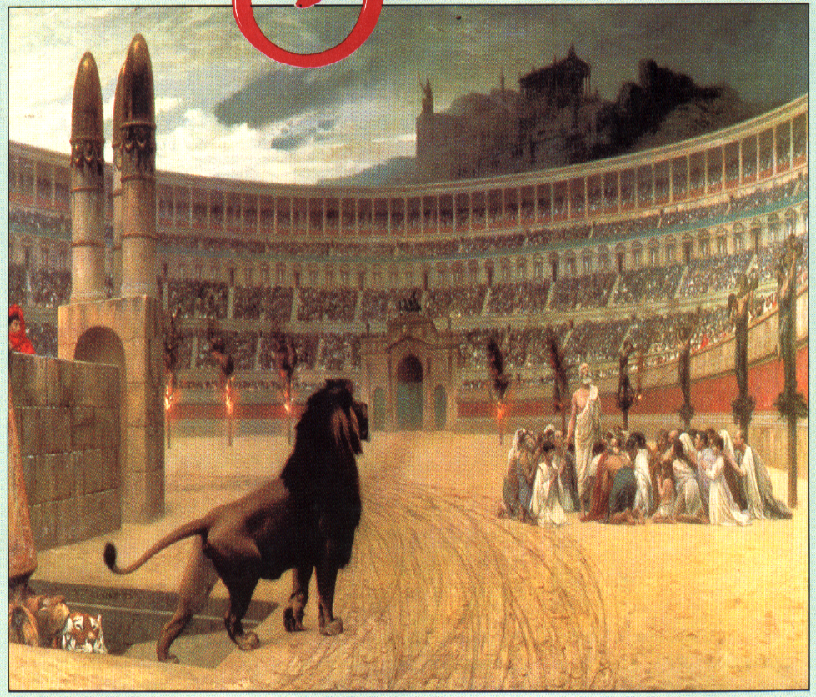
15x Peter refers to the suffering saints

Slide 5

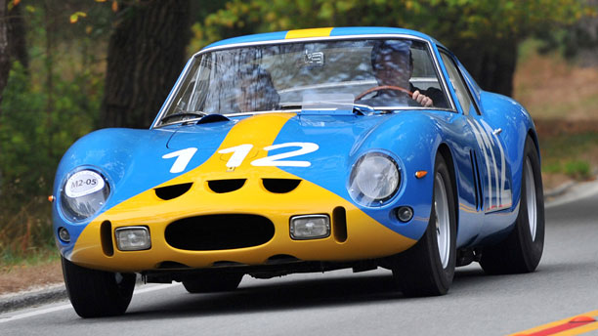
Hope is what drives a person

Slide 6

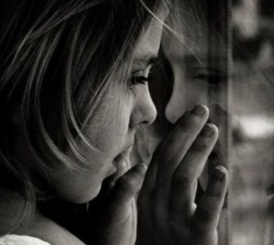
Luke 7:12 Now as he approached the gate of the city, a dead man was being carried out, the only son of his mother, and she was a widow and a sizeable crowd from the city was with her.
Hopeless People Jesus Met

Slide 7
John 11:21 “Martha then said to Jesus, ‘Lord, if you had been here, my brother would not have died.”
Hopeless People Jesus Met

Slide 8
John 8:4-5 “They said to Him, ‘Teacher, this woman has been caught in adultery, in the very act. Now in the Law Moses commanded us to stone such a woman; what then do you say?’”
Hopeless People Jesus Met

Slide 9


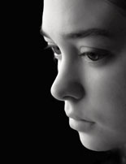
Ephesians 2:12 “remember thatyou were at that time separate from Christ, excluded from the commonwealth of Israel, and strangers to the covenant of promise, having no hope and without God in the world.”.”

Slide 10
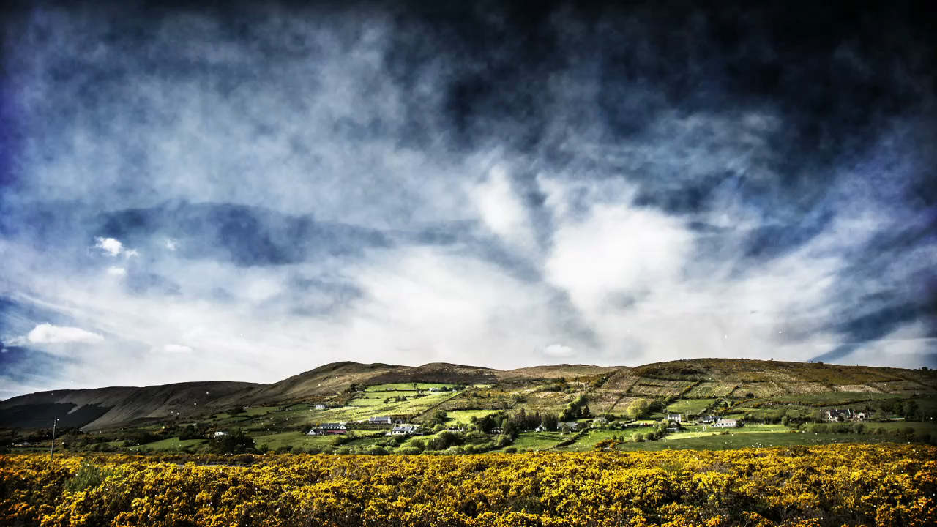
Challenges facing Christians today
Keeping Hope Alive

Slide 11

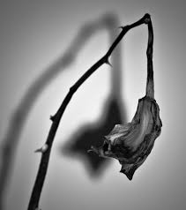
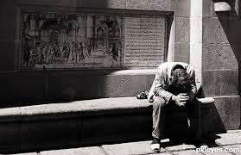
Without hope we quit
Without hope we doubt
Without hope discouragement and defeat conquer us

Slide 12

Hebrews 6:19 We have this hope as an anchor for the soul, firm and secure. It enters the inner sanctuary behind the curtain,

Slide 13

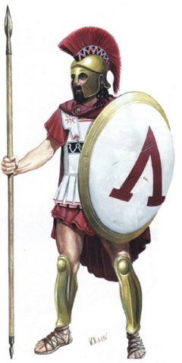
2 Kings 6:24-31
Elisha is the prophet
Joram is the king of Israel
Syrian army is at war with Israel

Slide 14

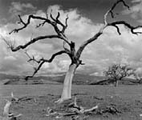
Three Steps Leading to Hopelessness
1. Begins when problems seem too great for us

Slide 15
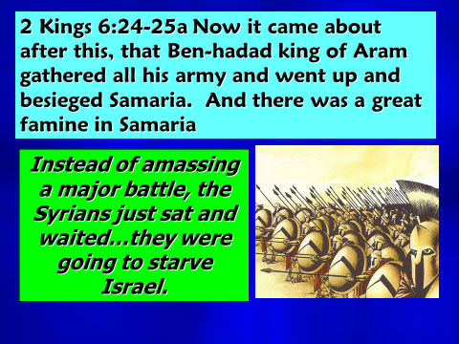

Slide 16
Three Steps Leading to Hopelessness
2. Desperation leads a person to doing things they never thought they would

Slide 17

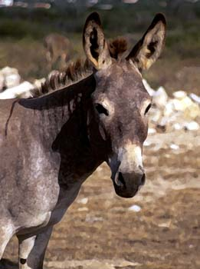
2 Kings 6:25-30
And there was a great famine in Samaria; and behold, they besieged it, until a donkey's head was sold for eighty shekels of silver, and a fourth of a kab of dove's dung for five shekels of silver.

Slide 18
2 Kings 6:25-30
And there was a great famine in Samaria; and behold, they besieged it, until a donkey's head was sold for eighty shekels of silver, and a fourth of a kab of dove's dung for five shekels of silver.

Slide 19
2 Kings 6:25-30
And there was a great famine in Samaria; and behold, they besieged it, until a donkey's head was sold for eighty shekels of silver, and a fourth of a kab of dove's dung for five shekels of silver.

Slide 20

2 Kings 6:25-30
And the king said to her, "What is the matter with you?" And she answered, "This woman said to me, 'Give your son that we may eat him today, and we will eat my son tomorrow.'
Donkey heads
Bird droppings

Slide 21
2 Kings 6:25-30
"So we boiled my son and ate him…
Donkey heads
Bird droppings

Slide 22
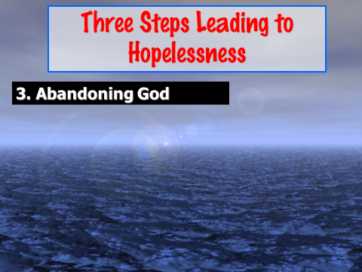

Slide 23

1 Peter 1:3-5 Praise be to the God and Father of our Lord Jesus Christ! In his great mercy he has given us new birth into a living hope through the resurrection of Jesus Christ from the dead, and into an inheritance that can never perish, spoil or fade.

Slide 24
1 Peter 1:3-5 This inheritance is kept in heaven for you, who through faith are shielded by God’s power until the coming of the salvation that is ready to be revealed in the last time.

Slide 25


It is a living hope (3)
God through His mercy caused us to be born again
It is based upon the Living Christ
It is founded upon the Living Word
It is surrounded by the Living Promises of God

Slide 26

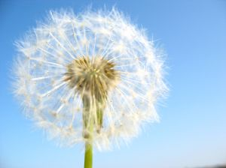
It is a hope that leads to Heaven (4)
This new birth, born again, puts us not in the same family, but a new family

Slide 27

Romans 8:24-25 For in this hope we were saved. But hope that is seen is no hope at all. Who hopes for what they already have? But if we hope for what we do not yet have, we wait for it patiently.

Slide 28

It is a hope that is sure (5)

Slide 29

Our challenge is not to give up on this hope. It is not to be so caught up in this world that we forget our hope. It is not to let problems conquer us. It is not to become so tried that we get weary.

Slide 30

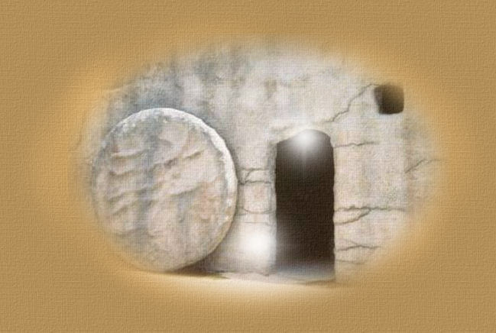
1. What happens on the outside doesn’t change the inside
2. Someday all these problems will end
3. Someday hope will be realized

