Slide 1
“His Face Shone Like the Sun”
The Transfiguration of Jesus
THE EVENT
TIMING
WITNESSES
LOCATION
TERMS
PARTICIPANTS
SUGGESTION
RESPONSE
AFTERMATH
QUESTIONS
MEANING
DEITY
END OF OLD LAW
RESURRECTION
Biblical Record of the Event
Each of the synoptic gospels records this event (Matt. 17:1-13; Mark 9:2-13; Luke 9:28-36).
The gospel written by John, a witness to this event, does not.
An act of economy or humility, not contradiction.

Slide 2
“His Face Shone Like the Sun”
The Transfiguration of Jesus
THE EVENT
TIMING
WITNESSES
LOCATION
TERMS
PARTICIPANTS
SUGGESTION
RESPONSE
AFTERMATH
QUESTIONS
MEANING
DEITY
END OF OLD LAW
RESURRECTION
Timing of the Transfiguration
After three events:
  Peter’s confession (Matt. 16:13-20; Mark 8:27-30; Luke 9:18-21).
  Foretelling His death (Matt. 16:21-23; Mark 8:31-33; Luke 9:22).
  Teaching on self-denial (Matt. 16:24-28; Mark 8:34-9:1; Luke 9:23-27).
“After six days” (Matt. 17:1; Mark 9:2).
“About eight days” (Luke 9:28).

Slide 3
“His Face Shone Like the Sun”
The Transfiguration of Jesus
THE EVENT
TIMING
WITNESSES
LOCATION
TERMS
PARTICIPANTS
SUGGESTION
RESPONSE
AFTERMATH
QUESTIONS
MEANING
DEITY
END OF OLD LAW
RESURRECTION
Witnesses of the Transfiguration
Peter, James and John:
  The Transfiguration.
  The healing of Jairus’ daughter (Mark 5:37; Luke 8:51).
  Agony in the garden (Mark 14:33).
Coffman ““Matthew was omitted from that inner circle of three disciples who witnessed the marvel here related, … one can find only amazement at the complete detachment and objectivity of his narrative” (Commentary 261).

Slide 4
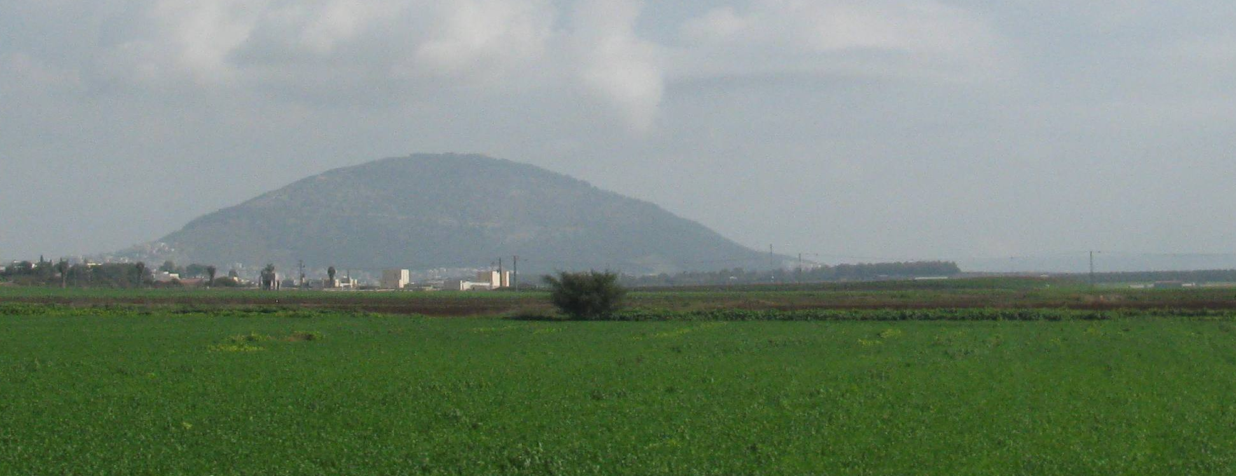
“His Face Shone Like the Sun”
The Transfiguration of Jesus
THE EVENT
TIMING
WITNESSES
LOCATION
TERMS
PARTICIPANTS
SUGGESTION
RESPONSE
AFTERMATH
QUESTIONS
MEANING
DEITY
END OF OLD LAW
RESURRECTION
Location of the Transfiguration
  Mount Tabor (Cyril, Jerome).

Slide 5
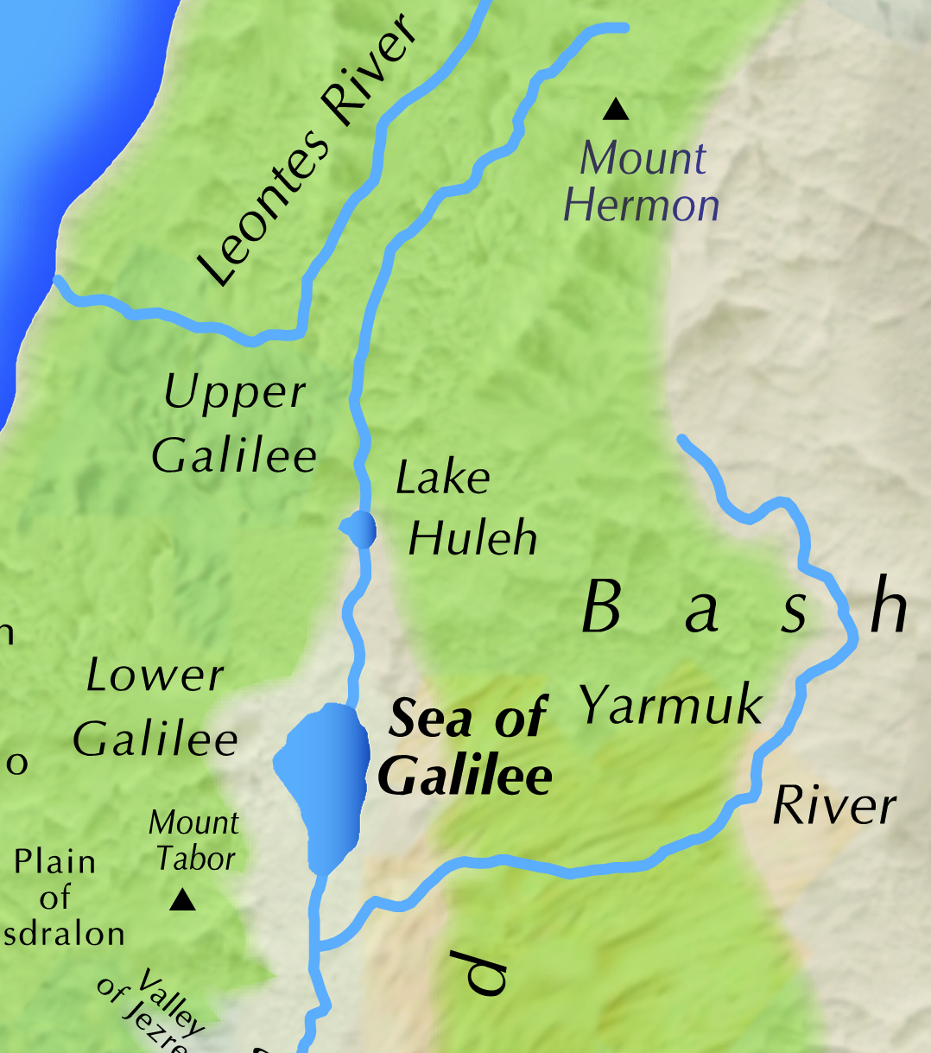
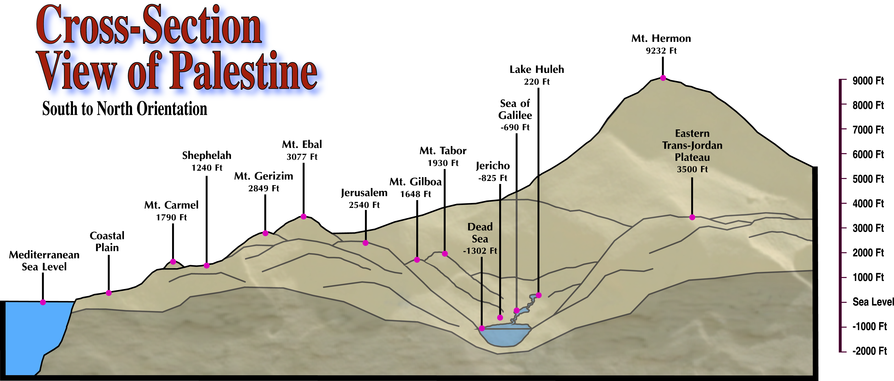
The Transfiguration of Jesus
Mount Tabor

Slide 6
“His Face Shone Like the Sun”
The Transfiguration of Jesus
THE EVENT
TIMING
WITNESSES
LOCATION
TERMS
PARTICIPANTS
SUGGESTION
RESPONSE
AFTERMATH
QUESTIONS
MEANING
DEITY
END OF OLD LAW
RESURRECTION
Location of the Transfiguration
  Mount Tabor (Cyril, Jerome).
  Josephus says it was fortified (Life of Flavius Josephus 37).

Slide 7
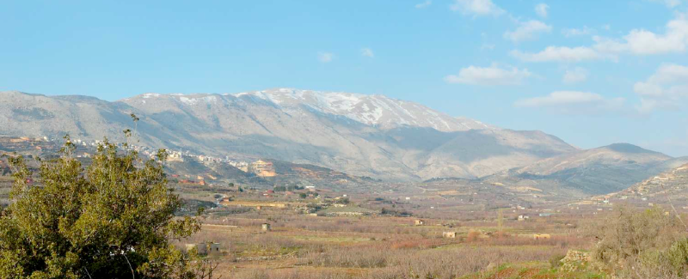
“His Face Shone Like the Sun”
The Transfiguration of Jesus
THE EVENT
TIMING
WITNESSES
LOCATION
TERMS
PARTICIPANTS
SUGGESTION
RESPONSE
AFTERMATH
QUESTIONS
MEANING
DEITY
END OF OLD LAW
RESURRECTION
Location of the Transfiguration
  Mount Hermon (Caesarea Philippi - Matt. 16:13; Mark 8:27).

Slide 8
The Transfiguration of Jesus
Mount Hermon

Slide 9
“His Face Shone Like the Sun”
The Transfiguration of Jesus
THE EVENT
TIMING
WITNESSES
LOCATION
TERMS
PARTICIPANTS
SUGGESTION
RESPONSE
AFTERMATH
QUESTIONS
MEANING
DEITY
END OF OLD LAW
RESURRECTION
Location of the Transfiguration
  Mount Hermon (Caesarea Philippi - Matt. 16:13; Mark 8:27)
  “High (hupsēlos)” (Matt. 4:8; Luke 4:5).

Slide 10
“His Face Shone Like the Sun”
The Transfiguration of Jesus
THE EVENT
TIMING
WITNESSES
LOCATION
TERMS
PARTICIPANTS
SUGGESTION
RESPONSE
AFTERMATH
QUESTIONS
MEANING
DEITY
END OF OLD LAW
RESURRECTION
Location of the Transfiguration
  Luke records…
  He went up on the mountain “to pray” and…
  The transfiguration took place “as He was praying” (Luke 9:28-29).
  Heavenly comfort? (cf. Matt. 4:11; Luke 22:43).

Slide 11
“His Face Shone Like the Sun”
The Transfiguration of Jesus
THE EVENT
TIMING
WITNESSES
LOCATION
TERMS
PARTICIPANTS
SUGGESTION
RESPONSE
AFTERMATH
QUESTIONS
MEANING
DEITY
END OF OLD LAW
RESURRECTION
Meaning of “Transfigured”
Matthew and Mark—“trans-figured (metamorphōthē) before them” (Matt. 17:2; Mark 9:2).
  Lat. transfiguro “to change in shape.”
Luke—“the appearance of His face was altered” (Luke 9:29).
  Ovid’s, Metamorphoses described the transformation of pagan gods into human and animal forms.

Slide 12
“His Face Shone Like the Sun”
The Transfiguration of Jesus
THE EVENT
TIMING
WITNESSES
LOCATION
TERMS
PARTICIPANTS
SUGGESTION
RESPONSE
AFTERMATH
QUESTIONS
MEANING
DEITY
END OF OLD LAW
RESURRECTION
Meaning of “Transfigured”
Vincent’s Word Studies—Conceptual distinction in Greek between the terms “form” (morphē—“the distinctive nature and character on an object”) and “fashion” (schēma—“the changeable outward fashion”) (99).
  “Transfigured (metamorphōthē),” —“the visible change gets its real character and meaning from that which is essential in our Lord—His divine nature” (100).

Slide 13
“His Face Shone Like the Sun”
The Transfiguration of Jesus
THE EVENT
TIMING
WITNESSES
LOCATION
TERMS
PARTICIPANTS
SUGGESTION
RESPONSE
AFTERMATH
QUESTIONS
MEANING
DEITY
END OF OLD LAW
RESURRECTION
Meaning of “Transfigured”
His clothes became “white as the light” (Matt. 17:2)
  “His robe became white and glistening (exestraptōn)” (Luke 9:29).
  “His clothes became shining (stilbonta), exceedingly white, like snow, such as no launderer on earth can whiten them” (Mark 9:3).
There was radiance that projected from Jesus’ body and clothing.

Slide 14
“His Face Shone Like the Sun”
The Transfiguration of Jesus
THE EVENT
TIMING
WITNESSES
LOCATION
TERMS
PARTICIPANTS
SUGGESTION
RESPONSE
AFTERMATH
QUESTIONS
MEANING
DEITY
END OF OLD LAW
RESURRECTION
Meaning of “Transfigured”
Spiritual beings are often described as shining or radiating light.
  Daniel’s vision of an angel (Dan. 10:5-6).
  Angels at the tomb “in shining garments” (Luke 24:4).
  “Wise” in the resurrection (Dan. 12:3).
  “Alpha and Omega”— “His countenance was like the sun shining in its strength” (Rev. 1:16).

Slide 15
“His Face Shone Like the Sun”
The Transfiguration of Jesus
THE EVENT
TIMING
WITNESSES
LOCATION
TERMS
PARTICIPANTS
SUGGESTION
RESPONSE
AFTERMATH
QUESTIONS
MEANING
DEITY
END OF OLD LAW
RESURRECTION
Participants in the Transfiguration
Moses and Elijah, “appeared to them” and talked with Jesus (Matt. 17:3; Mark 9:4; Luke 9:30).
  Their appearance was not changed—they were revealed in their spiritual state.
  They “appeared in glory” (Luke 9:31).
Luke on the content of the discussion (Luke 9:31-33).

Slide 16
“His Face Shone Like the Sun”
The Transfiguration of Jesus
THE EVENT
TIMING
WITNESSES
LOCATION
TERMS
PARTICIPANTS
SUGGESTION
RESPONSE
AFTERMATH
QUESTIONS
MEANING
DEITY
END OF OLD LAW
RESURRECTION
Participants in the Transfiguration
Their discussion concerned His “departure (exodos),” that He would accomplish “at Jerusalem.”.
  Alfred Edersheim, Life and Times of Jesus the Messiah— Luke uses exodos for Jesus’ death and eisodos (“coming in”) of Jesus’ entrance into the world in Acts 13:24 (97).

Slide 17
“His Face Shone Like the Sun”
The Transfiguration of Jesus
THE EVENT
TIMING
WITNESSES
LOCATION
TERMS
PARTICIPANTS
SUGGESTION
RESPONSE
AFTERMATH
QUESTIONS
MEANING
DEITY
END OF OLD LAW
RESURRECTION
Peter’s Presumptuous Suggestion
Construction of three “tabernacles” for each of them (Matt. 17:4; Mark 9:5; Luke 9:33).
  He spoke, “not knowing what he said” (Luke 9:33).
  “They were greatly afraid” (Mark 9:6).
Honor them? Compel them to stay?
  Son of God (Matt. 16:16) but also Immanuel “God with us” (Matt. 1:23).

Slide 18
“His Face Shone Like the Sun”
The Transfiguration of Jesus
THE EVENT
TIMING
WITNESSES
LOCATION
TERMS
PARTICIPANTS
SUGGESTION
RESPONSE
AFTERMATH
QUESTIONS
MEANING
DEITY
END OF OLD LAW
RESURRECTION
The Heavenly Response
While he was speaking a cloud “overshadowed them” (Matt. 17:5; Mark 9:7; Luke 9:34).
  It was a “bright cloud (nephelē phōteinē)” (Matt. 17:5).
  Gr. phōteinos means “composed of light” or “full of light” (Thayer).
  The disciples were afraid as they “entered the cloud” (Luke 9:34).

Slide 19
“His Face Shone Like the Sun”
The Transfiguration of Jesus
THE EVENT
TIMING
WITNESSES
LOCATION
TERMS
PARTICIPANTS
SUGGESTION
RESPONSE
AFTERMATH
QUESTIONS
MEANING
DEITY
END OF OLD LAW
RESURRECTION
The Heavenly Response
From within the cloud a voice said—“This is My Beloved Son. Hear Him!” (Mark 9:7; Luke 9:35).
Matthew and Peter—“This is My Beloved Son, in whom I am well-pleased. Hear Him!” (Matt. 17:5; 2 Peter 1:17).

Slide 20
“His Face Shone Like the Sun”
The Transfiguration of Jesus
THE EVENT
TIMING
WITNESSES
LOCATION
TERMS
PARTICIPANTS
SUGGESTION
RESPONSE
AFTERMATH
QUESTIONS
MEANING
DEITY
END OF OLD LAW
RESURRECTION
The Heavenly Response
The “bright cloud” in the OT.
  When God gave manna—“the glory of the Lord appeared in the cloud” (Exod. 16:10).
  At Sinai cloud covered the mountain (Exod. 24:15) and God spoke from the cloud (Exod. 24:16).
  Moses went into the midst of the cloud (Exod. 24:18).
Shekinah? Holy Spirit?

Slide 21
“His Face Shone Like the Sun”
The Transfiguration of Jesus
THE EVENT
TIMING
WITNESSES
LOCATION
TERMS
PARTICIPANTS
SUGGESTION
RESPONSE
AFTERMATH
QUESTIONS
MEANING
DEITY
END OF OLD LAW
RESURRECTION
The Heavenly Response
Second heavenly proclamation— “My beloved Son.”
  First at His baptism (Matt. 3:17).
  Second at the transfiguration.
  Later Jesus tells the parable of the wicked vinedressers the owner sends his “beloved son” (Luke 20:13).

Slide 22
“His Face Shone Like the Sun”
The Transfiguration of Jesus
THE EVENT
TIMING
WITNESSES
LOCATION
TERMS
PARTICIPANTS
SUGGESTION
RESPONSE
AFTERMATH
QUESTIONS
MEANING
DEITY
END OF OLD LAW
RESURRECTION
Aftermath of the Transfiguration
When God speaks it is frightening.
  When God spoke from Sinai the people begged that it not happen again (Exod. 20:18-19).
  Context of messianic prophetic promise (Deut. 18:18-19).
They were already afraid (Mark 9:6).
After the voice “they fell on their faces and were greatly afraid” (Matt. 17:6). and “they kept quiet” (Luke 9:36).

Slide 23
“His Face Shone Like the Sun”
The Transfiguration of Jesus
THE EVENT
TIMING
WITNESSES
LOCATION
TERMS
PARTICIPANTS
SUGGESTION
RESPONSE
AFTERMATH
QUESTIONS
MEANING
DEITY
END OF OLD LAW
RESURRECTION
Aftermath of the Transfiguration
Jesus’ reaction to their fear:
  He touched them (Matt. 17:7a).
  He told them to “arise” (17:7b).
  He told them not to fear (17:7c).
Christ is our Mediator (1 Tim. 2:5).
  One day He will call the dead to arise (John 5:28-29).
  His “perfect love”—“casts out fear” (1 John 4:18).
  He alone grants access to God (Heb. 10:19).

Slide 24
“His Face Shone Like the Sun”
The Transfiguration of Jesus
THE EVENT
TIMING
WITNESSES
LOCATION
TERMS
PARTICIPANTS
SUGGESTION
RESPONSE
AFTERMATH
QUESTIONS
MEANING
DEITY
END OF OLD LAW
RESURRECTION
Aftermath of the Transfiguration
Jesus commands them not to tell about this until after His resurrection (Matt. 17:9).
  He had previously foretold His death and resurrection (Matt. 16:21-23; Mark 8:31-33; Luke 9:22).
  They question among themselves what He meant by “rising from the dead” (Mark 9:10).
Why the command of silence?

Slide 25
“His Face Shone Like the Sun”
The Transfiguration of Jesus
THE EVENT
TIMING
WITNESSES
LOCATION
TERMS
PARTICIPANTS
SUGGESTION
RESPONSE
AFTERMATH
QUESTIONS
MEANING
DEITY
END OF OLD LAW
RESURRECTION
Apostles’ Questions About Elijah
“Why do the scribes say that Elijah must come first?” (Mark 9:11; cf. Matt. 17:10).
  Malachi’s prophecy concerning Elijah (Mal. 4:5).
Jesus already said of John “he is Elijah who is to come” (Matt. 11:14).
  Elijah “came already” (Matt. 17:12, NASB).

Slide 26
“His Face Shone Like the Sun”
The Transfiguration of Jesus
THE EVENT
TIMING
WITNESSES
LOCATION
TERMS
PARTICIPANTS
SUGGESTION
RESPONSE
AFTERMATH
QUESTIONS
MEANING
DEITY
END OF OLD LAW
RESURRECTION
Apostles’ Questions About Elijah
John was not Elijah reincarnated!
  John: “I am not” (John 1:21).
  “Spirit and power of Elijah” (Luke 1:17).
In Scripture a shared disposition and purpose is described as a shared spirit (cf. Luke 9:55).
  Seventy elders (Num. 11:17).
  Elisha (2 Kings 2:15).

Slide 27
“His Face Shone Like the Sun”
The Transfiguration of Jesus
THE EVENT
TIMING
WITNESSES
LOCATION
TERMS
PARTICIPANTS
SUGGESTION
RESPONSE
AFTERMATH
QUESTIONS
MEANING
DEITY
END OF OLD LAW
RESURRECTION
Meaning of the Transfiguration
Peter (2 Pet. 1:16-18)—Evidence.
James (Acts 12:1-2)—Martyrdom.
John (John 1:14)—Beheld His glory.
H. Leo Boles, Commentary on Matthew:
  “Three great doctrines were taught in the transfiguration, namely, the Divinity of Christ, the end of the Jewish covenant, and the resurrection” (357).

Slide 28
“His Face Shone Like the Sun”
The Transfiguration of Jesus
THE EVENT
TIMING
WITNESSES
LOCATION
TERMS
PARTICIPANTS
SUGGESTION
RESPONSE
AFTERMATH
QUESTIONS
MEANING
DEITY
END OF OLD LAW
RESURRECTION
The Deity of Christ
The transfiguration showed Jesus’ underlying “essential” character—His “divine nature” (Vincent, 100),
In Jesus “God was manifested in the flesh” (1 Tim. 3:16, NKJV—majority of mss.)
The identification by God the Father of Jesus as “My beloved Son” was heaven’s testimony to Jesus’ divine nature.

Slide 29
“His Face Shone Like the Sun”
The Transfiguration of Jesus
THE EVENT
TIMING
WITNESSES
LOCATION
TERMS
PARTICIPANTS
SUGGESTION
RESPONSE
AFTERMATH
QUESTIONS
MEANING
DEITY
END OF OLD LAW
RESURRECTION
The Deity of Christ
“Sons of God” in Scripture.
  Angels (Job 1:6; 2:1),
  Faithful to the Lord (Gen. 6:2, 4).
  Obedient to the gospel (Gal. 3:26-27).
  “Sons of the resurrection” (Luke 20:36).
“The Son (singular) of God.”
  High Priest—“Tell us if you are the Christ, the Son of God!” (Matt. 26:63).

Slide 30
“His Face Shone Like the Sun”
The Transfiguration of Jesus
THE EVENT
TIMING
WITNESSES
LOCATION
TERMS
PARTICIPANTS
SUGGESTION
RESPONSE
AFTERMATH
QUESTIONS
MEANING
DEITY
END OF OLD LAW
RESURRECTION
The Deity of Christ
Messianic wording of Psalm 2:1-12.
  Connects God’s “Anointed,” i.e., His Messiah or Christ (Christou—LXX), with His “Son.”
  “The Lord has said to Me, ‘You are my Son, today I have begotten You’” (Ps. 2:7).
  “Kiss the Son” (Ps. 2:12).
  Dead Sea Scroll 4Qflorilequium (4Q174)—Psalm 2 with Messiah.

Slide 31
“His Face Shone Like the Sun”
The Transfiguration of Jesus
THE EVENT
TIMING
WITNESSES
LOCATION
TERMS
PARTICIPANTS
SUGGESTION
RESPONSE
AFTERMATH
QUESTIONS
MEANING
DEITY
END OF OLD LAW
RESURRECTION
End of the Jewish Covenant
Jewish division of OT—Law, Prophets, and Writings (cf. Luke 24:44).
  Often two parts stand for the whole: “the Law and the Prophets” (Matt. 5:17; 7:12; 11:13; Luke 16:16; John 1:45; Acts 13:15; 24:14; 28:23; Rom. 3:21).
  Origen: “Moses, the law and Elijah, in the way of synecdoche, not one prophet only, but all the prophets holding converse with Jesus” (Commentary on Matthew 12.38).

Slide 32
“His Face Shone Like the Sun”
The Transfiguration of Jesus
THE EVENT
TIMING
WITNESSES
LOCATION
TERMS
PARTICIPANTS
SUGGESTION
RESPONSE
AFTERMATH
QUESTIONS
MEANING
DEITY
END OF OLD LAW
RESURRECTION
End of the Jewish Covenant
Moses: “The Lord your God will raise up for you a Prophet like me from your midst, from your brethren. Him you shall hear” (Deut. 18:15).
  He is allowed to see its fulfillment.
Elijah: Didn’t write any preserved texts but he symbolizes the prophets as a whole who foretold the Messiah.
  He is allowed to see the Messiah they pointed towards.

Slide 33
“His Face Shone Like the Sun”
The Transfiguration of Jesus
THE EVENT
TIMING
WITNESSES
LOCATION
TERMS
PARTICIPANTS
SUGGESTION
RESPONSE
AFTERMATH
QUESTIONS
MEANING
DEITY
END OF OLD LAW
RESURRECTION
End of the Jewish Covenant
“Hear Him” is a declaration of Christ’s relationship to the Old Covenant.
  Boles: “The withdrawal of Moses and Elijah was suggestive; a greater than both of these remained” (Commentary on Matthew, 356).
  David McClister: “The transfiguration was a statement about the authority of Jesus. On that mountain was demonstrated that it is now Jesus alone who has authority over men. Moses and Elijah served only a temporary purpose in the plan of God (cf. Rom. 3:21)”
  (“Understanding the Transfiguration” 21).

Slide 34
“His Face Shone Like the Sun”
The Transfiguration of Jesus
THE EVENT
TIMING
WITNESSES
LOCATION
TERMS
PARTICIPANTS
SUGGESTION
RESPONSE
AFTERMATH
QUESTIONS
MEANING
DEITY
END OF OLD LAW
RESURRECTION
The Resurrection
Men who lived centuries before Jesus continue to live!
The form of Moses and Elijah.
  Samuel was recognizable although he was in a disembodied form (1 Sam. 28:7-25).
  The same is true of the rich man, Lazarus, and Abraham in Hades (cf. Luke 16:19-31).
This foreshadows the resurrection of the dead, both of the just and the unjust”
(Acts 24:15).

