Slide 1
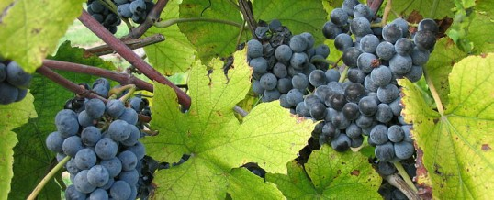
What The Spies Saw

Slide 2
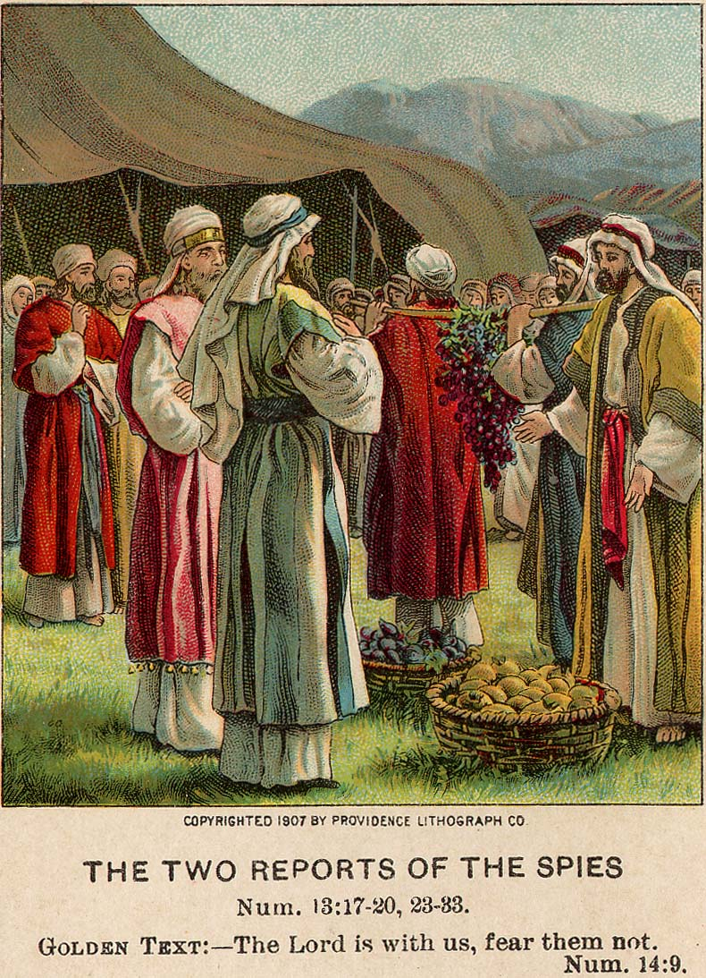
What The Spies Saw
Numbers 13:1-2
“And the Lord spoke to Moses, saying, ‘Send men to spy out the land of Canaan, which I am giving to the children of Israel; from each tribe of their fathers you shall send a man, every one a leader among them’” (NKJV)

Slide 3
What The Spies Saw
Numbers 13:1-2
“And the Lord spoke to Moses, saying, ‘Send men to spy out the land of Canaan, which I am giving to the children of Israel; from each tribe of their fathers you shall send a man, every one a leader among them’” (NKJV)

Slide 4
What The Spies Saw
These men were leaders in their tribes.
They were not novices.

Slide 5
What The Spies Saw
Numbers 13:17-18
“Then Moses sent them to spy out the land of Canaan, and said to them, ‘Go up this way into the South, and go up to the mountains, and see what the land is like: whether the people who dwell in it are strong or weak, few or many.’”

Slide 6
What The Spies Saw
Numbers 13:19-20
“…whether the land they dwell in is good or bad; whether the cities they inhabit are like camps or strongholds; whether the land is rich or poor; and whether there are forests there or not. Be of good courage. And bring some of the fruit of the land.”

Slide 7
What The Spies Saw
Their job was to spy out the land that God had promised them.
They were to assess all of the qualities of the people and land.

Slide 8
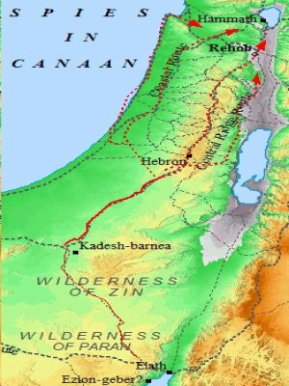
What The Spies Saw
Numbers 13:21
“So they went up and spied out the land from the Wilderness of Zin as far as Rehob, near the entrance of Hamath. And they went up through the South and came to Hebron”

Slide 9
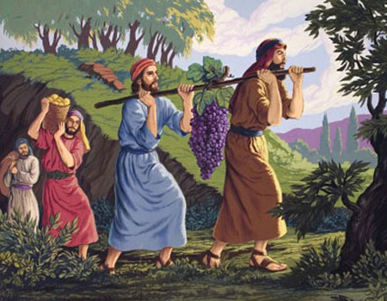
The Report of the Spies
Numbers 13:27
“We went to the land where you sent us. It truly flows with milk and honey, and this is its fruit.” (The Ten)
Numbers 14:27
“The land we passed through to spy out is an exceedingly good land.” (The Two)

Slide 10
The Report of the Spies
The Ten
The land is good
The Two
The land is good
We all want to go to heaven.
We all agree that heaven is a “good land.”
Will we have the courage to confess Christ ? (Matt. 10:32-33)
Will we be willing to fight “the good fight” of faith? (1 Tim. 6:10-12)

Slide 11
The Report of the Spies
The Ten
The land is good
“Nevertheless…”
The Two
The land is good

Slide 12
The Report of the Spies
Numbers 13:28
“Nevertheless the people who dwell in the land are strong; the cities are fortified and very large; moreover we saw the descendants of Anak there.”

Slide 13
The Report of the Spies
The Ten
The land is good
“Nevertheless…”
The Two
The land is good
People often try to excuse a lack of faith. Did they forget what God did for them?
Do we excuse our lack of faith?
Do we forget what God has done for us?

Slide 14
The Report of the Spies
The Ten
The land is good
“Nevertheless…”
The fight is too hard!
The Two
The land is good
They gave up before the fight!
“We are not able” (Num. 13:31-33).
They judged by appearances.
Do we do the same (1 Sam. 16:7)?

Slide 15
The Report of the Spies
The Ten
The land is good
“Nevertheless…”
The fight is too hard!
Let’s go back to the way it used to be!
The Two
The land is good

Slide 16
The Report of the Spies
Numbers 14:1-2
“So all the congregation lifted up their voices and cried, and the people wept that night. And all the children of Israel complain-ed against Moses and Aaron, and the whole congregation said to them, ‘If only we had died in the land of Egypt! Or if only we had died in this wilderness!’”

Slide 17
The Report of the Spies
Numbers 14:3-4
“‘Why has the Lord brought us to this land to fall by the sword, that our wives and children should become victims? Would it not be better for us to return to Egypt?’ So they said to one another, ‘Let us select a leader and return to Egypt.’”

Slide 18
The Report of the Spies
The Ten
The land is good
“Nevertheless…”
The fight is too hard!
Let’s go back to the way it used to be!
The Two
The land is good
Are we so comfortable with our old life of sin that when things get spiritually tough we go back to sin (Rom. 6:16-18)?

Slide 19
The Report of the Spies
The Ten
The land is good
“Nevertheless…”
The fight is too hard!
Let’s go back to the way it used to be!
The Two
The land is good
We can do it because the Lord is with us!

Slide 20
The Report of the Spies
Numbers 14:6-7
“But Joshua the son of Nun and Caleb the son of Jephunneh, who were among those who had spied out the land, tore their clothes; and they spoke to all the congregation of the children of Israel, saying: ‘The land we passed through to spy out is an exceedingly good land.’”

Slide 21
The Report of the Spies
Numbers 14:8-9
“… If the Lord delights in us, then He will bring us into this land and give it to us, ‘a land which flows with milk and honey. Only do not rebel against the Lord, nor fear the people of the land, for they are our bread; their protection has departed from them, and the Lord is with us. Do not fear them.’”

Slide 22
The Report of the Spies
The Ten
The land is good
“Nevertheless…”
The fight is too hard!
Let’s go back to the way it used to be!
They feared and did not believe in God!
The Two
The land is good
We can do it because the Lord is with us!
They “wholly followed the Lord” (Josh. 14:6-12).

Slide 23
The Report of the Spies
Numbers 14:11
“Then the Lord said to Moses: “How long will these people reject Me? And how long will they not believe Me, with all the signs which I have performed among them?”

Slide 24
What Did the Spies See?
The Ten
Saw a fearful world they did not think could be overcome by a god they considered to be too weak!
The Two
Saw an obstacle that a powerful and almighty God could overcome as He has all obstacles they had faced before!
What will we see?
1 Peter 2:11-12
1 John 4:4-5

