Slide 1
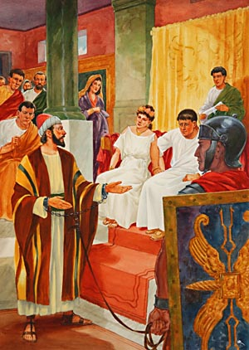
“As I Am Except for These Chains”
Acts 26:24-29

Slide 2
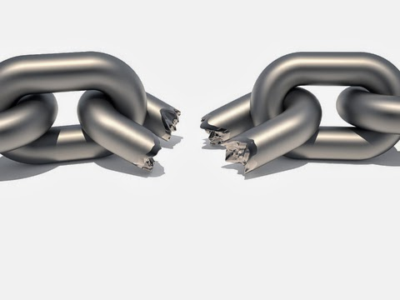
1. Free From the Bondage of Sin
The one who commits sin is a slave of sin (John 8:31-36).
Freedom from sin comes when we obey the gospel (Rom. 6:17-18).
We are set free from the consequences of sin—spiritual death (Rom. 6:21-22).

Slide 3
2. Free From the Guilt of His Past
Paul left a path of violence and destruction in his opposition to the Lord’s church (Acts 26:9-11; Gal. 1:13).
In Christ these sins were no longer held against him (Heb. 8:12).

Slide 4
2. Free From the Guilt of His Past
Paul could leave behind these haunting memories (Phil. 3:13-14).
He was a new creation (2 Cor. 5:17).
  Paul was able to start over spiritually.

Slide 5
3. Free From Uncertainty
God’s word gives…
Light (Psa. 119:105).
A goal to press toward (Phil. 3:14).
A pattern to follow (Phil. 3:17).
Our life meaning and purpose (Matt. 5:16).

