Slide 1

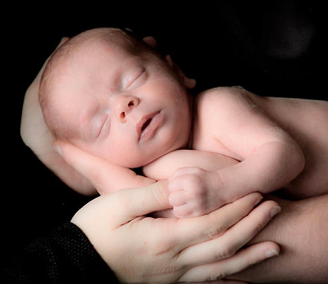
“I’m not holding on to You, but You're holding on to me”
Denominational Music Group:
Casting Crowns – “East to West”

Slide 2
“So when you’re on your knees and answers seem so far away
You’re not alone, stop holding on and just be held
Your world’s not falling apart, it’s falling into place
I’m on the throne, stop holding on and just be held”
Casting Crowns – “Just Be Held”

Slide 3
I appreciate some things about the sentiment of these words.
We can trust God (1 Thess. 5:23-24; 2 Tim. 1:12).
Suffering in this world does not overpower God (Rom. 8:18, 28).
There is only so much we can control in this life—God is on the throne (Heb. 13:5).

Slide 4
But, it is our choice to follow God or not. We are to hold on to God.
He has “laid hold” of us, but we “press on” to Him (Phil. 3:8-12).
We are to “hold fast” (1 Cor. 15:1-2; 1 Tim. 6:12; Heb. 10:23; Rev. 3:11).

Slide 5
When we trust God and obey His word—trusting in His mercy to forgive as we repent —we allow ourselves to be safely held in the loving hands of God.

Slide 6
“Hold to His hand, to God’s unchanging hand.”
Jennie Wilson and F.L. Eiland –
“Hold To God’s Unchanging Hand”

Slide 7
I. We are Protected.
  Psa. 31:14-15
  Psa. 139:8-10
  Psa. 138:7
  John 10:29
  Rom. 8:37-39

Slide 8
II. We’re Made Beautiful.
  Gen. 1:31
  Ecc. 3:11
  Isa. 64:8
  1 Cor. 6:9-11
  1 Pet. 5:6

Slide 9
III. He Cares for Us.
  Job 12:7-10
  Ecc. 9:1
  Psa. 145:15-16
  Matt. 6:31-33
  Isa. 41:10

