Slide 1
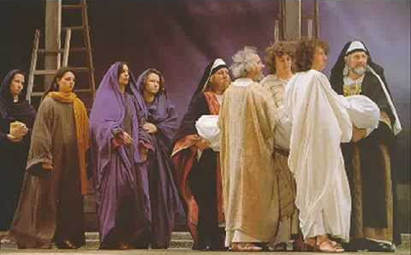
Joseph of Arimathea

Slide 2
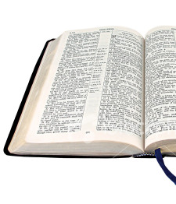
Joseph of Arimathea
Matthew 27:57-60
Mark 15:42-46
Luke 23:50-53
John 19:38-42

Slide 3
Secret Discipleship
Fear - John 19:38
Ashamed - Rom. 1:16; Mark 8:38
Love of the World – 1 John 2:15-17

Slide 4
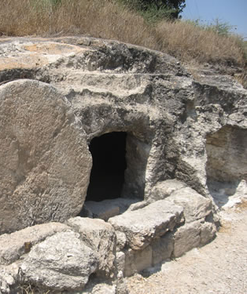
Good Lessons From Joseph of Arimathea
He did not go along with the majority
Luke 23:51
He overcame his fear
Mark 15:43
He was willing to pay a price
Luke 14:25-33

