Slide 1
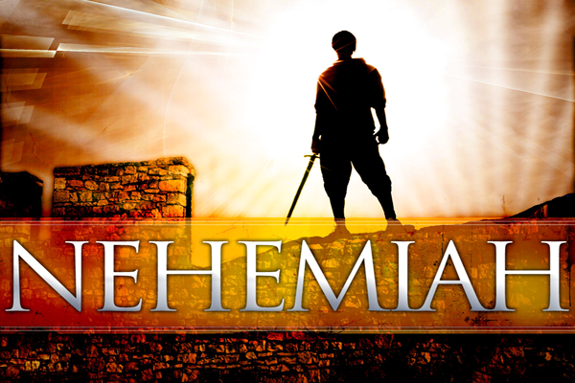
A Great Leader
I. He demonstrated great concern for the Lord’s cause, and for his brethren (1:1-4).
      He left the comforts of Shushan for the ruins of Jerusalem (ch. 2).
      His concern was reflected in his prayer (1:5-11).

Slide 2
A Great Leader
II. He believed that God could answer prayer.
  We find Nehemiah in prayer throughout the book (2:4; 4:4-5, 9; 5:19; 6:9, 14; 13:14, 22, 29, 31).
  Leaders of God’s people pray to God for and about His people.

Slide 3
A Great Leader
III. He showed great boldness—especially during his appearance before the king (2:1-8).
He had a plan of action (2:7-8).
He stirred his brethren to action (2:17-18).

Slide 4
A Great Leader
IV. He didn’t let opposition stop him or his brethren.
  Opposition from without, from the enemies of the Jews (2:19-20; 4:1-3, 6; 4:17-20; 6:1-3).
  Opposition from within (5:1-9).
  But the work got done—in 52 days (6:15).
He showed great humility and did not exalt himself above his brethren (5:14-18).

Slide 5
A Great Leader
V. He got everyone involved (ch. 3).
  Wall divided into portions, and each portion was assigned to a particular group or family.
  Women involved in the work (3:12).
  Some were assigned a portion of the wall close to their home (3:10, 23, 28, 29, 30).
  Unfortunately, some did not work (3:5).

