Slide 1
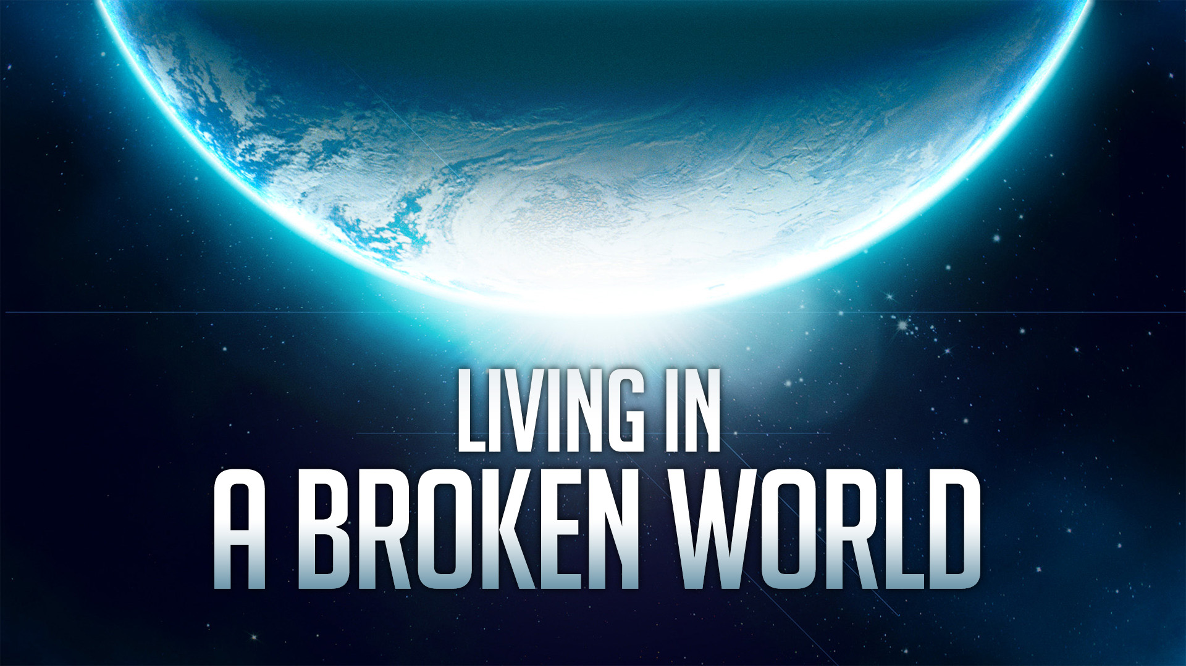
Living In A Broken World

Slide 2
Our Broken World
This is a World Where Evil Abounds.
Galatians 5:19-25; Isaiah 5:20
It’s Been Broken A Long Time.
Genesis 3:17-24
We must not Conform, but be Transformed.
Romans 12:1-2
How Do We Navigate These Troubling Surroundings?

Slide 3
Learning From Lot
2 Peter 2:4-9; Gen. 19:1-11
Lot Engaged The Men In Conversation (19:7).
Lot Spoke With Kindness but Honesty.
Lot Addressed Their Kinship.
Lot Rebuked The Act and Urged What is Right.
Lot Expressed His Moral Judgment.
But, Lot Offered A Horrible Compromise (19:8).

Slide 4
What Should Christians Do?
Like Abraham, Petition God For Mercy For The Sake of the Righteous.
Genesis 18:23
Like Abraham, Keep Some Distance, So You Can Fulfill Your Responsibility.
Genesis 18:19
Keep Your Distance Despite The Advantages the World Offers.
Genesis 13:8-13

Slide 5
What Should Christians Do?
Keep Enough Distance To Protect Your Family.
Genesis 19:14-16
Keep Enough Distance That When You Must Walk Away – Everyone’s Hearts Can Let Go.
Genesis 19:26
Know That Judgment Will Come.
Genesis 19:27-29

