Slide 1
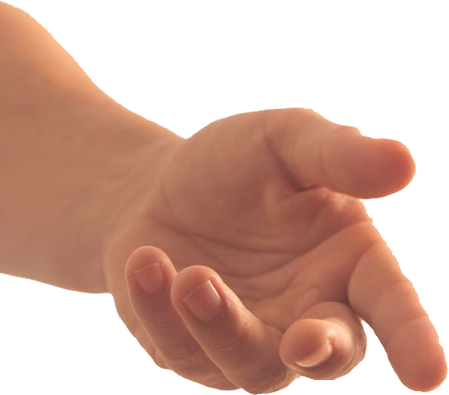
God Does Great Things with Small Things
David Defeated Goliath (1 Sam. 17).
A Boy’s Lunch Fed A Multitude (John 6:9).
Widow’s Two Mites (Luke 21:1-4).
“What Is That In Your Hand?”
(Exodus 4:1-5)

Slide 2
Church Directory?
Bible?
Phone?
Car Keys?
Groceries?
Lawn mower?
Time?
What’s In Your Hand?

Slide 3
Why Do Good For Others?
The Example Jesus Left For Us (Acts 10:38).
There is a Need (Titus 3:14).
To Show Love For Others (1 John 3:16-18).
What’s In Your Hand?

Slide 4
Why Do Good For Others?
To Show Love For God (Matt. 25:34-40).
To Obey Christ (Matt. 7:12).
What’s In Your Hand?

Slide 5
What Will Be Said of Us?
“She has done what she could” (Mark 14:3-9).
“You wicked and lazy servant” (Matt. 25:24-30).
What’s In Your Hand?

