Slide 1
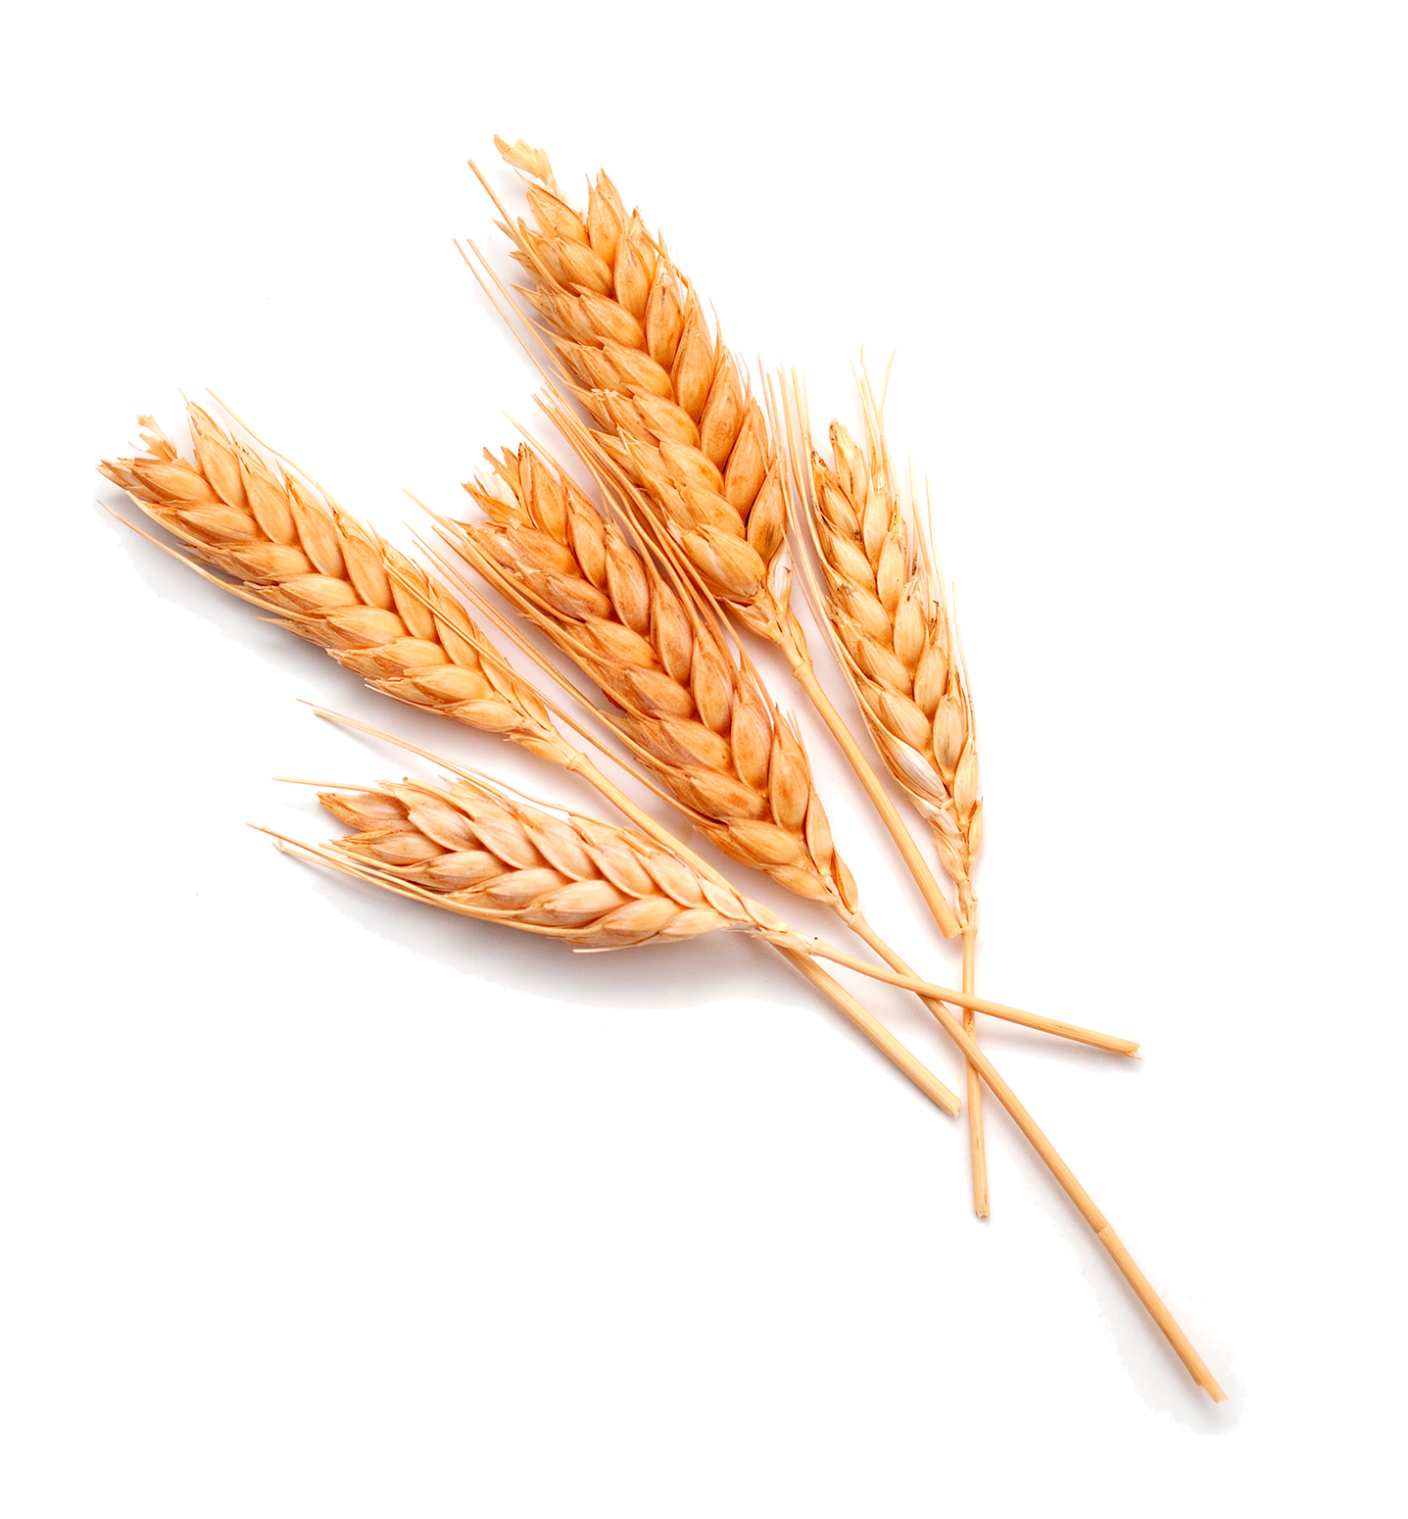
Parable of the Wheat and Tares
Matt 13.24-30

Slide 2
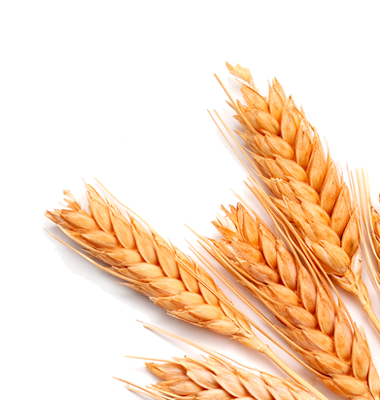
Three Parts of Parable
The Sowers
Son of Man (during the day)
Satan (under cover of darkness)
The Seeds (Wheat and Tares)
The Soil (The World)

Slide 3
The Devil is Real…
Real personality – Verse 39
Gen. 3:1-5; Job 1:6-12; Matt. 4:1-11
Father of lies – John 8:44
Works in various ways
Eph. 2:2; 2 Cor. 11:3, 13-15; 1 Pet. 5:8-9
Mainly by perverting the right ways of God – Acts 13:10; Gal. 1:7

Slide 4
Nature of Harvest Depends on Nature of Seed Sown…
Verses 24-26
In teaching - 1 Tim. 4:16; 1 Pet. 2:2
In lives we live – Gal. 6:7-8; Hos. 8:7

Slide 5
Full Harvest is not Immediate
Verses 28-30
Psa. 37; Gal 6:9; 1 Cor. 3:6-7; Heb. 12:11

Slide 6
The Judgment is a Real and Certain Appointment
Verses 30, 39-43
Acts 17:31; 2 Pet. 3:9-10; Matt. 25:31-33, 46

Slide 7
Wheat or Tares… Which are You?

