Slide 1
Acts 17:22-28
“Then Paul stood in the midst of the Areopagus and said, ‘Men of Athens, I perceive that in all things you are very religious; for as I was passing through and considering the objects of your worship, I even found an altar with this inscription: TO THE UNKNOWN GOD. Therefore, the One whom you worship without knowing, Him I proclaim to you: God, who made the world and everything in it, since He is Lord of heaven and earth, does not dwell in temples made with hands. Nor is He worshiped with men’s hands, as though He needed anything, since He gives to all life, breath, and all things…’”

Slide 2
Acts 17:22-28
“‘And He has made from one blood every nation of men to dwell on all the face of the earth, and has determined their preappointed times and the boundaries of their dwellings, so that they should seek the Lord, in the hope that they might grope for Him and find Him, though He is not far from each one of us; for in Him we live and move and have our being, as also some of your own poets have said, ‘For we are also His offspring’” (NKJV).

Slide 3
Quotes a friend he knew ten years earlier to say:
“I cannot accept a God who is so infatuated with Himself that He makes a whole universe just to praise and worship him! How self-centered can you get?! The Christian religion says in one of its creeds that the “chief goal of man is to glorify God”--why is God such a glory-hog? I cannot respect a God that creates a race of people just to grovel before Him, and to constantly fill his ears with sycophantic (and threat-induced!) praise! This looks more like an insecure individual, with a horrible Napoleonic complex!”
Glenn Miller August 30, 1997
Blog Christian-thinktank.com
http://christianthinktank.com/l083097.html

Slide 4
WHY
GOD?
What is Worship?
Heb. shachah (שָׁחָה) “to bow down”

Slide 5
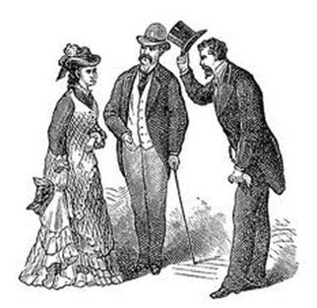
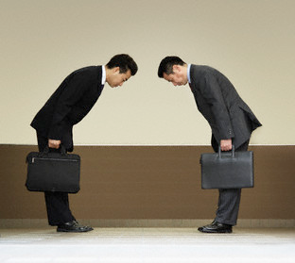
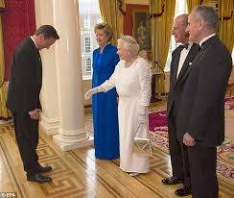
Gesture of honor and respect

Slide 6
WHY
GOD?
What is Worship?
Heb. shachah (שָׁחָה) “to bow down”
Gr. proskuneo (προσκυνέω) lit. “kiss towards”

Slide 7
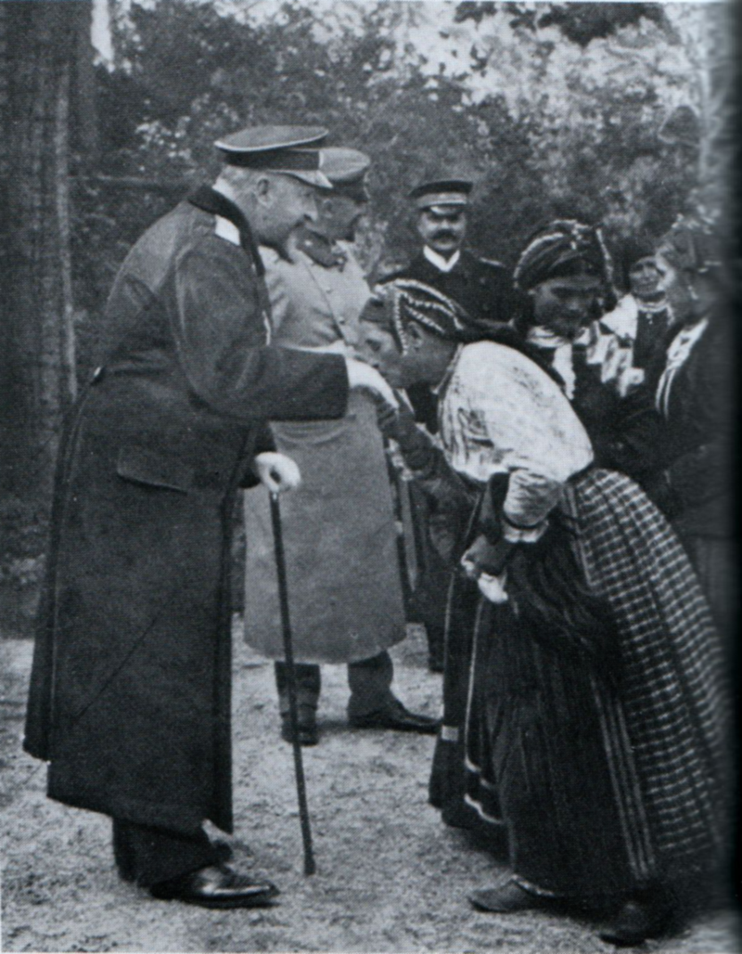
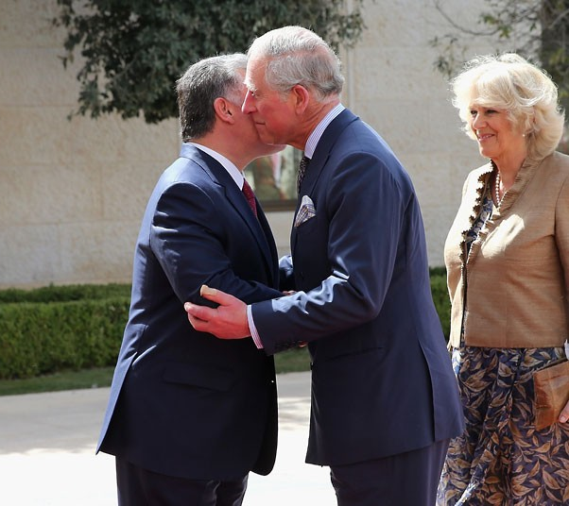
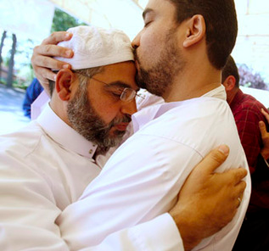
Gesture of affection and honor

Slide 8
WHY
GOD?
What is Worship?
Heb. shachah (שָׁחָה) “to bow down”
Gr. proskuneo (προσκυνέω) lit. “kiss towards”
Much of what the Bible says about worship concerns what we should NOT worship (Deut. 4:15-19; Isa. 2:8-9).

Slide 9
Acts 17:23
“I even found an altar with this inscription: TO THE UNKNOWN GOD. Therefore, the One whom you worship without knowing, Him I proclaim to you.”

Slide 10
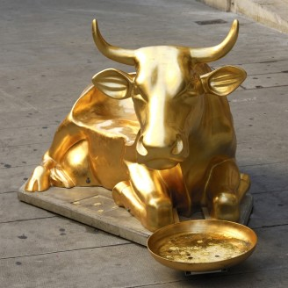
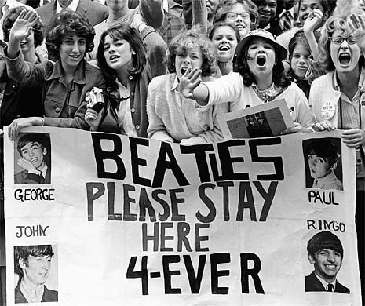
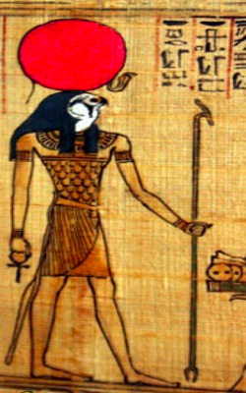
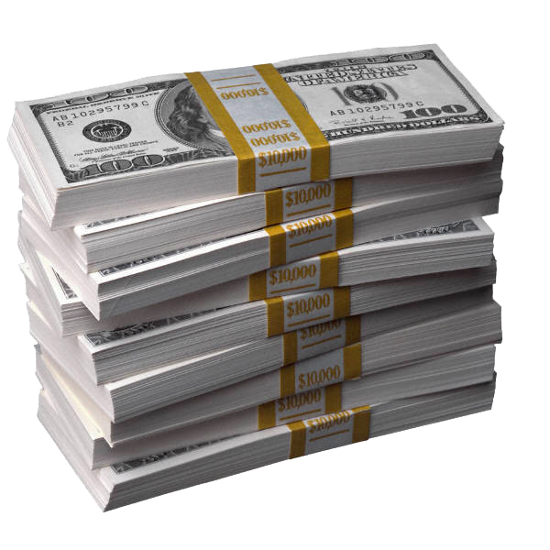
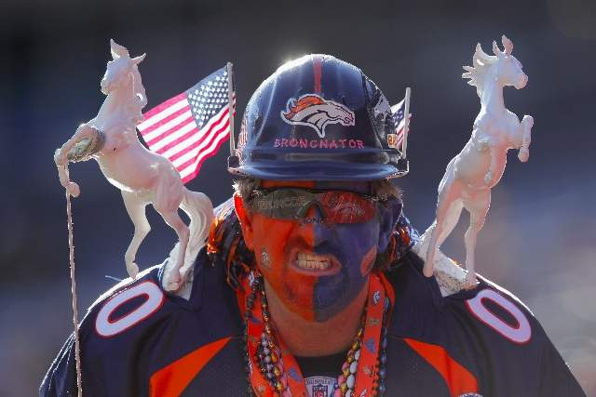
Humans WILL worship something!

Slide 11
WHY
GOD?
What is Worship?
It is not adoration without relationship.
It is not mindless devotion (John 4:20-24).
It is the conscious decision to appreciate God for who He is.

Slide 12
Acts 17:28a
“…In Him we live and move and have our being.”

Slide 13
WHY
GOD?
What is Worship?
It is not adoration without relationship.
It is not mindless devotion (John 4:20-24).
It is the conscious decision to appreciate God for who He is.
It is the response of those who love and respect Him.

Slide 14
WHY
GOD?
He is our Creator (Psa. 95:6-10).
We were made to worship Him.

Slide 15
Acts 17:26-27
“…He has made from one blood every nation of men to dwell on all the face of the earth… so that they should seek the Lord, in the hope that they might grope for Him and find Him, though He is not far from each one of us.”

Slide 16
WHY
GOD?
He is our Creator (Psa. 95:6-10).
We were made to worship Him.
He has all power (Job 42:1-2; Psa. 33:6-9).

Slide 17
Acts 17:24a
“God, who made the world and everything in it, since He is Lord of heaven and earth...”

Slide 18
WHY
GOD?
He is our Creator (Psa. 95:6-10).
We were made to worship Him.
He has all power (Job 42:1-2; Psa. 33:6-9).
Only those with proper reverence may enter His presence (Psa. 24:3-5).

Slide 19
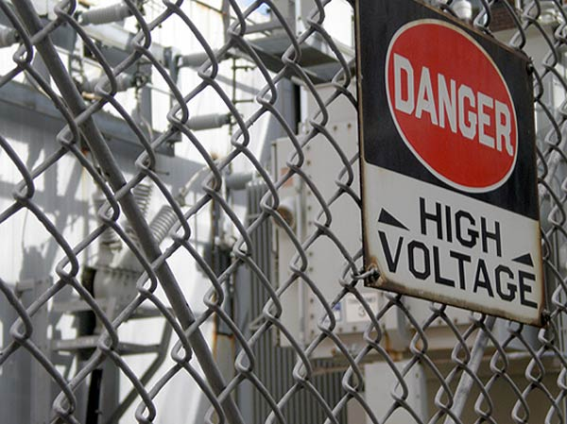
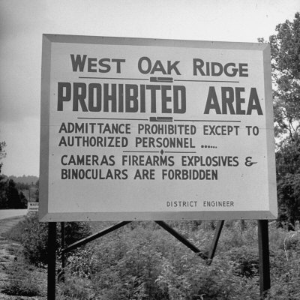
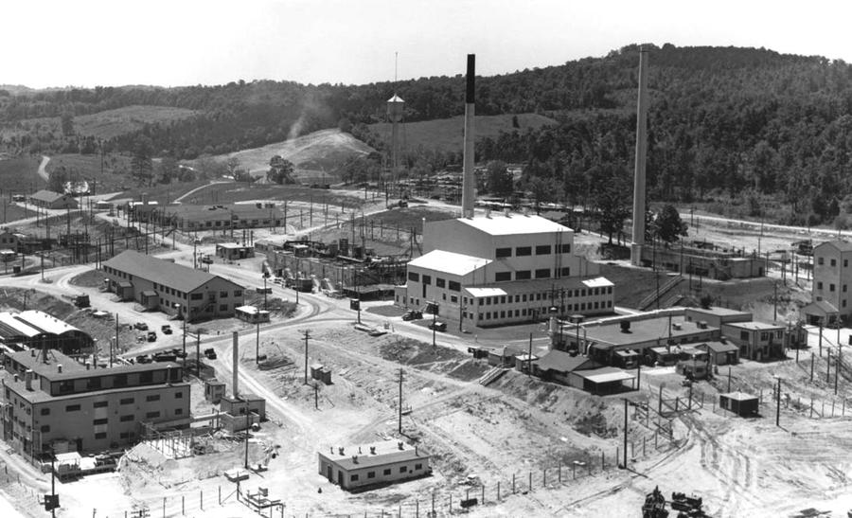

Slide 20
WHY
GOD?
He is our Heavenly Father.

Slide 21
Acts 17:28b
“…we are also His offspring”

Slide 22
John 4:23
“…the hour is coming, and now is, when the true worshipers will worship the Father in spirit and truth; for the Father is seeking such to worship Him”

Slide 23
WHY
GOD?
He is our Heavenly Father.
Our Father deserves respect (Heb. 12:9).
He loves us (Rom. 5:8-10; Eph. 2:4-7).
In ways we cannot even comprehend, He has loved us from the beginning of time.

Slide 24
Acts 17:25
“Nor is He worshiped with men’s hands, as though He needed anything, since He gives to all life, breath, and all things.”

Slide 25
WHY
GOD?
We Owe God Our Worship!

