Slide 1
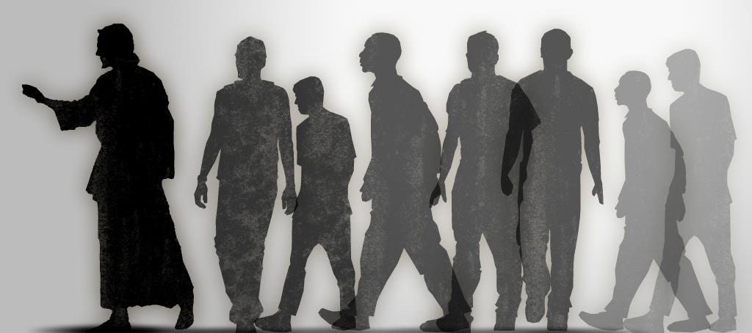
Disciples Indeed
John 8:31-32

Slide 2
Disciple
A learner or pupil
“Of John” (Matt. 9:14); “of Herod” (22:16); “of Moses” (John 9:28)

Slide 3

Disciples of Christ
Of the Twelve
Matt 10:1-4
Of Other Followers
Luke 6:17
Of All Followers After Pentecost
Acts 6:1-7

Slide 4
Disciples of Christ
Met certain CREDENTIALS
They were BAPTIZED
Matt 28.19-20
They were COMMITTED
Luke 14:26-27
They LOVED each other
John 13:35
They BORE FRUIT
John 15:5-8

Slide 5
What Kind of Disciple are You?

