Slide 1
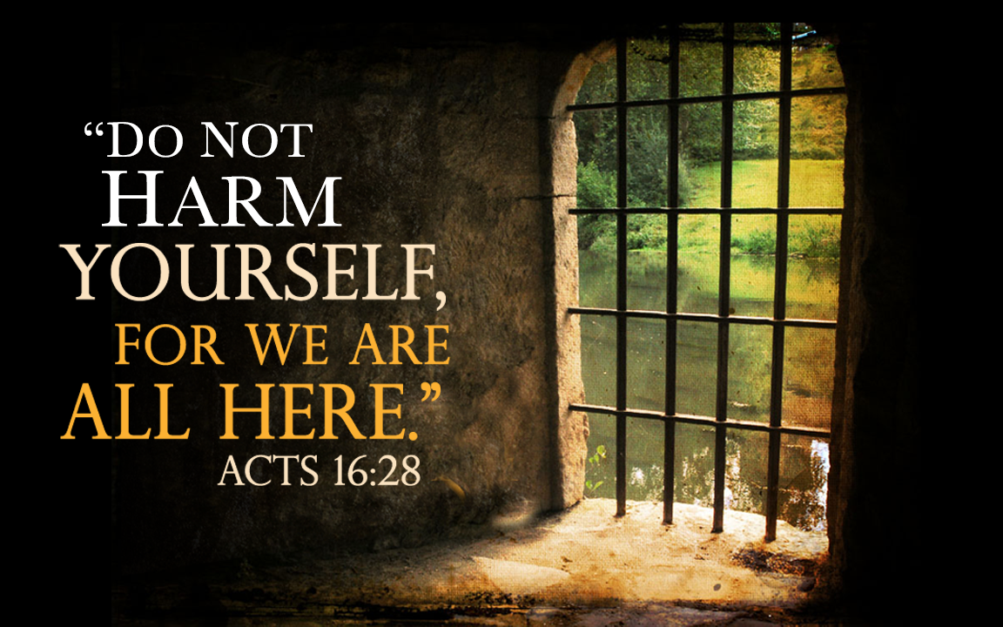
Do Not Harm Yourself

Slide 2
Acts 16:16-28
The Philippian Jailer’s Plan
His Plan Is Prompted By His Circumstances.
  “And the keeper of the prison, awaking from sleep and seeing the prison doors open, supposing the prisoners had fled, drew his sword and was about to kill himself” (vs. 27).
His Plan Is Prompted By His Perception.
  “Supposing the prisoners had fled” (vs. 27b)
God Sees, Cares, & Has A Plan of His Own!
  “Do Not Harm Yourself…”

Slide 3
Do Not Harm Yourself:
There Are People Here Who Care
By Providence Paul and Silas Were Brought To Precisely Where They Needed To Be.
  Acts 16:16-19, 26
The Jailer May Have Been Touched By The Words Paul & Silas Had Sung.
  Acts 16:25, 29
Paul and Silas Could Provide Exactly The Help The Jailer Needed.
  Acts 16:31

Slide 4
Do Not Harm Yourself:
Your Perception Is Incomplete
You Are Not The Failure You May Assume!
You Are Not The Disgrace You Feel You Are!
You Are Not The Nobody You May Feel You Are!
You Are Not a Hopeless Case!
“For to this end we both labor and suffer reproach, because we trust in the living God [NASB ‘we have fixed our hope on the living God’], who is the Savior of all men, especially of those who believe”
(1 Timothy 4:10).

Slide 5
Do Not Harm Yourself:
You Really Matter to Others!
You Can Help Others In Need.
  The Jailer’s Help To Paul and Silas (vs. 33)
You Can Enjoy and Share Salvation.
  The Jailer’s Family (vs. 34)
You Can Enjoy New Friendships.
  The Jailer’s New Spiritual Family (vs. 40)
You Can Be A Blessing In The Future.
  Philippians 4:15-16

Slide 6
Do Not Harm Yourself:
You Really Matter To God!
You Are too Prized to Lose!
  God Sent His Son With Love and His Messengers with Good News Full of Hope.
Will You Place Your Faith In Christ? (30-31)
Will You Turn Your Heart To Christ? (33a)
Will You Be Baptized Into Christ? (33b)
There’s No Better Time Than This “Very Hour.”
  Acts 16:31

Slide 7
Do Not Harm Yourself

