Slide 1
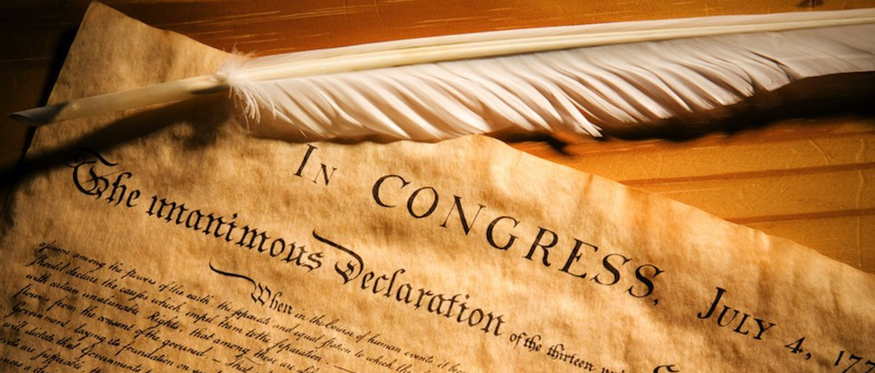
The Foundation of Our Rights
The Declaration of Independence
“Laws of Nature and of Nature’s God”
“We hold these truths to be self-evident, that all men are created equal, that they are endowed by their Creator with certain unalienable Rights, that among these are Life, Liberty and the pursuit of Happiness.”
Unalienable (Inalienable)
“unable to be taken away from or given away by the possessor” (New Oxford American Dictionary).

Slide 2
The Foundation of Our Rights
The Biblical Foundation of Rights
Rights are “authority” or “power” one has over things.
  God gives man “power to eat of” the labor of his hands as a “gift of God” (Eccl. 5:19).
  One is to exercise “power over his own will” (1 Cor. 7:37).
  Although Paul had the “power” to have a wife or receive support from churches (1 Cor. 9:4-6, KJV), he did not “use this authority” (GLT) lest he hinder the “gospel of Christ” (1 Cor. 9:12,).
  “There is no authority except from God” (Rom. 13:1b).
This is true of civil authority and personal rights—true rights are only derived from God.

Slide 3
The Foundation of Our Rights
The Biblical Foundation of Rights
How are these rights known?
  “Ordinances” over the heavens and the earth (Job 38:33; Ps. 119:90-91)
  “The way of man is not in himself; It is not in man who walks to direct his own steps” (Jer. 10:23).
  Man’s steps must be directed by God’s word (Ps. 119:133).
  Through “God-breathed” Scripture (NIV) one is “equipped for every good work” (2 Tim. 3:16-17, NKJV).
Any concept of “natural law” is only true if it conforms to God’s revealed law.

Slide 4
The Foundation of Our Rights
The Biblical Foundation of Rights
Does God’s law grant inalienable rights?
There are obligations to God that can’t be surrendered. “We must obey God rather than men” (Acts 5:29, NASB).
Higher divine law supersedes any power that others (even civil government) exercise over us.
Each person must act based upon the dictates of personal conscience. Paul taught, “whatever is not from faith is sin” (Rom. 14:23b, NKJV).
While it is always wrong to act contrary to our conscience, if our conscience is not properly trained by Scripture we can condemn ourselves by acting contrary to God’s law (Rom. 14:22b; cf. Acts 23:1).

Slide 5
The Foundation of Our Rights
The Biblical Foundation of Rights
Liberty is a relative right.
Paul taught, “Where the Spirit of the Lord is, there is liberty” (2 Cor. 3:17) and James called the Law of Christ, “the perfect law of liberty” (Jas. 1:25).
This addresses freedom from sin and the burdens of the Old Law.
If one has the right to act on the dictates of conscience there is an inalienable right to freewill. However, that does not mean we have an inalienable right to liberty in all areas of our lives.
Paul commanded, “Let every soul be subject to the governing authorities” (Rom. 13:1a).
The Bible does not teach individual sovereignty. All souls have obligations to others and to the government that is over them.

Slide 6
The Foundation of Our Rights
The Biblical Foundation of Rights
Liberty can be limited based on behavior or economic need.
When Paul was arrested, he defended his own innocence (Acts 25:7), but didn’t object to the right of the government to restrict his liberty.
When Paul taught on slavery (an institution in ancient times built on financial need or victory in battle rather than race) he did not condemn masters for restricting the liberty of slaves. He taught proper behavior servants and masters should practice (Eph. 6:5-9; Col. 3:22-4:1; 1 Tim. 6:1-2; Titus 2:9-10; 1 Pet. 2:18-20).
Employee-employer relationship demands the surrender of a measure of personal liberty to meet our obligations on the job.

Slide 7
The Foundation of Our Rights
The Biblical Foundation of Rights
Liberty can be limited based on behavior or economic need.
A Christian must be willing to surrender some rights for the good of others (Rom. 14:21; 1 Cor. 8:13).
A Christian must endure mistreatment in certain cases (Matt. 5:39-42; 1 Cor. 6:7)
In other cases a Christian he has the right to flee from persecution (Matt. 10:23).

Slide 8
The Foundation of Our Rights
The Biblical Foundation of Rights
Does government establish or grant rights?
If there is no authority except from God, civil authority does not grant or establish rights—it is its duty to uphold principles God has revealed (Rom. 13:17).
The right to life should be upheld by civil authority (1 Tim. 2:1-2)
Behavior can require the forfeiture of this right (Acts 25:11).
Government has the right to take life in punishment for wrong-doing (cf. Rom. 13:4), but it must act with justice and impartiality in doing so (Deut. 16:19).

Slide 9
The Foundation of Our Rights
The Biblical Foundation of Rights
Is it our right to pursue happiness?
As the Bible teaches it, happiness comes as a consequence of serving God (Ps. 146:5; Prov. 29:18), but any right to pursue it must be conditioned upon obedience to divine law.
There is no right to pursue whatever makes us happy if it does not conform to God’s law.
God promises contentment and happiness in obedience to Him, but does not set personal happiness as the ultimate goal of life (cf. 1 Pet. 5:10)

