Slide 1
Notes:
John 8:12 is a seemingly simple statement that is pregnant with meaning
The figures of light and dark are two of the most often used figures and can speak to a variety of concepts
Light is used in Scripture to reference God’s presence, salvation, revelation and provision
Dark is used to refer to sin, eternal separation, the chaos of God’s absence
The passage is filled with hope and promise

Slide 2
A Turning Point
⁶⁰ Therefore many of His disciples, when they heard this said, “This is a difficult statement; who can listen to it?” … ⁶⁶ As a result of this many of His disciples withdrew and were not walking with Him anymore.
John 6:60–66 (NASB95)
Notes:
John 6 served as a turning point in John’s presentation of the ministry of Christ
Having attempted to force Jesus to become their king, the crowds turn against Him when He describes the true nature of discipleship

Slide 3
A Turning Point
Increased Hostility
¹ After these things Jesus was walking in Galilee, for He was unwilling to walk in Judea because the Jews were seeking to kill Him.
John 7:1 (NASB95)
Notes:
Hostility toward Jesus was increasing among the Jews - 7:1
Jesus withdrew to Galilee “because the Jews were seeking to kill Him”
This follows the events of chapter 6 when the people attempted to force Him to be their king and then rejected Him because they did not wish to submit in true discipleship - Jn 6:59

Slide 4
A Turning Point
Increased Hostility
Subject of Debate
A good man or a deceiver?
The Messiah or not?
Follow Him or kill Him?
Notes:
In Chapter 7 we see that He is the subject of much discussion in Jerusalem as well
Jn 7:11-13 - Is He a good man or a deceiver?
Jn 7:26-27 - Is He the Messiah or not?
Jn 7:30-32 - Should we follow Him or kill Him?

Slide 5
The Feast of Tabernacles
A seven day sabbath
Lived in booths (tents) simulating their time in the wilderness
It was a celebration of God’s power and provision
‘On exactly the fifteenth day of the seventh month, when you have gathered in the crops of the land, you shall celebrate the feast of the Lord for seven days, with a rest on the first day and a rest on the eighth day.
Leviticus 23:39 (NASB95)
Notes:
By the 1st century a number of traditions had come to be a part of the feast
The ceremonial drawing of water from the pool of Siloam to be used during the drink offering
The lighting of the court of the Women where great candelabras would be lit illuminating the temple representing the shekeniah which led Israel through the wilderness and illuminated the temple at its dedication
Jesus spoke the words recorded in vs 8 while standing in the very courtyard that which housed the lamps (vs. 20 - the court of the Women was the contained 13 large vases into which various donations were placed)
Jesus spoke these words either bathed in the light of the lamps or in all likelihood in the darkness following the feast
In such a moment the words would have a tremendous and immediate impact - I am the light that your fathers followed, I am the light that even now you seek, turn to me and enjoy God’s presence

Slide 6
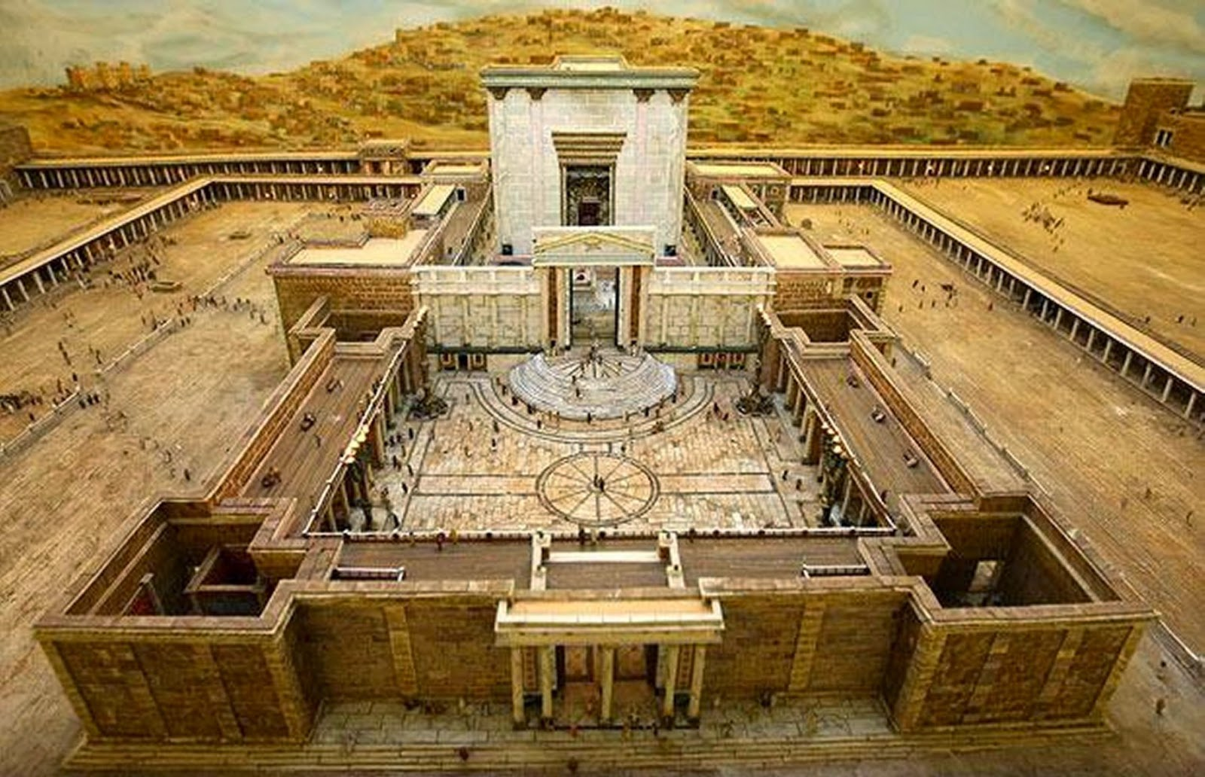
Notes:
The outer courtyard was the courtyard of the Gentiles, the first inner courtyard was the courtyard of the Women

Slide 7
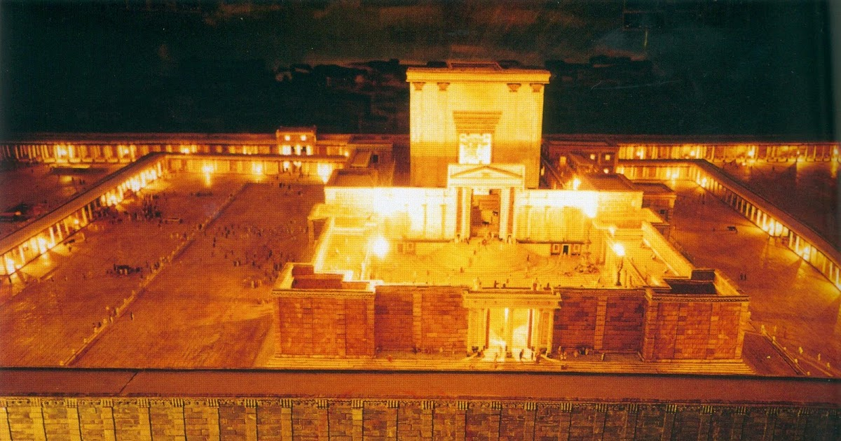

Slide 8
The Light of the World
A Claim to Deity
⁶ He says, “It is too small a thing that You should be My Servant To raise up the tribes of Jacob and to restore the preserved ones of Israel; I will also make You a light of the nations So that My salvation may reach to the end of the earth.”
Isaiah 49:6 (NASB95)
Notes:
A CLAIM TO DEITY
The Messianic import of Jesus’ words cannot overlooked
Is 49:6 - Many scholars suggest this is the prophetic background behind Jesus statement in John 8:12
Isaiah’s servant passages are filled with such language speaking of the coming Messiah as a light that shows the way of salvation to the Jews as well as to the Nations, the world, the Gentiles

Slide 9
The Light of the World
A Claim to Deity
¹² …“I am the Light of the world; he who follows Me will not walk in the darkness, but will have the Light of life.”
John 8:12 (NASB95)
Notes:
This was a clear claim to divinity - the Pharisees seem to miss this point at first but the claim cannot be overlooked in the context
The statement was an assertion of authority - not “a light” the “light of Judah” as a Rabbi might have spoken, no He claimed to be “the” light leaving room for no other
He employed the “I Am” formula of Ex 3, not once but four times in the chapter (vs 18, 24, 28, 59)

Slide 10
The Light of the World
A Claim to Deity
A Promise of Salvation
¹ The Lord is my light and my salvation
Psalm 27:1 (NASB95)
Notes:
THE GIFT OF ILLUMINATION (REVELATION OF GOD’S WILL)
John 1:4-5 - The creation serves as a revelation of the presence of God
Jn 1:18 - He “explained” the Father, allowing us to know His character, His nature, His truth and grace
It is interesting that the divisions and motives of the crowds in Jn 7-8 seemed to prevent them from seeing what was becoming so obvious - Jesus is the I AM

Slide 11
The Light of the World
A Claim to Deity
A Promise of Salvation
The Gift of Illumination
¹⁸ No one has seen God at any time; the only begotten God who is in the bosom of the Father, He has explained Him.
John 1:18 (NASB95)
Notes:
THE GIFT OF ILLUMINATION (REVELATION OF GOD’S WILL)
John 1:4-5 - The creation serves as a revelation of the presence of God
Jn 1:18 - He “explained” the Father, allowing us to know His character, His nature, His truth and grace
It is interesting that the divisions and motives of the crowds in Jn 7-8 seemed to prevent them from seeing what was becoming so obvious - Jesus is the I AM

Slide 12
A Humble Manifestation
He lacked the appearance of royalty
² For He grew up before Him like a tender shoot, And like a root out of parched ground; He has no stately form or majesty That we should look upon Him, Nor appearance that we should be attracted to Him.
Isaiah 53:2 (NASB95)
Notes:
THE CONVERSATION OF JOHN 7
John 7 seems to encapsulate the issue many people had with recognizing Jesus as the Messiah - the humble way in which He was presented to the world
He did not come in great demonstrations of power, but in apparent obscurity
A baby in a manger
A child developing as children do
Rejected and overlooked
They seemed to expect the king to come on a magnificent steed and yet he came “lowly and riding on a donkey”

Slide 13
A Humble Manifestation
He lacked the appearance of royalty
His willingness to give of self was essential
²⁷ “Now My soul has become troubled; and what shall I say, ‘Father, save Me from this hour’? But for this purpose I came to this hour.
John 12:27 (NASB95)
Notes:
HIS WILLINGNESS TO GIVE OF SELF ALLOWED HIM TO BE THE LIGHT
We have noticed that the Light was the Servant of Isaiah
Notice in Jn 7, he is the provider for God’s people - vs.37
Jn 12 - It is ultimately through His death that He presents the offer of salvation that the Light came to show us
vs. 27 - Notice the willing manner in which He went to the cross
vs. 28-30 - Even in this exchange His mind is on others, He is working on their behalf
vs. 35-36 - He offered Himself that we might become sons of light

Slide 14
How should we respond?
Walk as children of light
⁸ for you were formerly darkness, but now you are Light in the Lord; walk as children of Light
Ephesians 5:8 (NASB95)
Notes:
WALK AS CHILDREN OF LIGHT - EPH 5
Realize the darkness exists, and that there is an objective standard that we must conform to
We must read these passages from a “me first” mentality -not seeking to find fault in others first, but to recognize our own fault
We must make a determined effort to seek Him out and to emulate His life

Slide 15
How should we respond?
Walk as children of light
Walk in the light
⁶ If we say that we have fellowship with Him and yet walk in the darkness, we lie and do not practice the truth; 7 but if we walk in the Light as He Himself is in the Light, we have fellowship with one another, and the blood of Jesus His Son cleanses us from all sin.
1 John 1:6–7 (NASB95)
Notes:
WALK IN THE LIGHT - 1John 1:5-7
The light here speaks of God’s character, truth, holiness, purity
The “walk” is the condition of fellowship with God and His people - in other words our manner of life must be consistent with His character to be in fellowship with Him - 2:6
2:9-10 - We see this carried out in self-giving other centered love of the brethren which reflects the very light that saves us

Slide 16
14 “You are the light of the world. A city set on a hill cannot be hidden; 15 nor does anyone light a lamp and put it under a basket, but on the lampstand, and it gives light to all who are in the house. 16 “Let your light shine before men in such a way that they may see your good works, and glorify your Father who is in heaven.
Matthew 5:14–16 (NASB95)
How should we respond?
Walk as children of light
Walk in the light
Reflect the Light
Notes:
Matt 5:14 - We do not become light in the sense that Jesus was using in John 8; however we are to become beacons reflecting that light into the dark world around us
vs. 16 - We must live our lives in a manner that the character, nature, grace and truth of God is seen in us by those around us

