Slide 1
CREATION
Beyond Genesis One

Slide 2
DAY FOUR

Slide 3
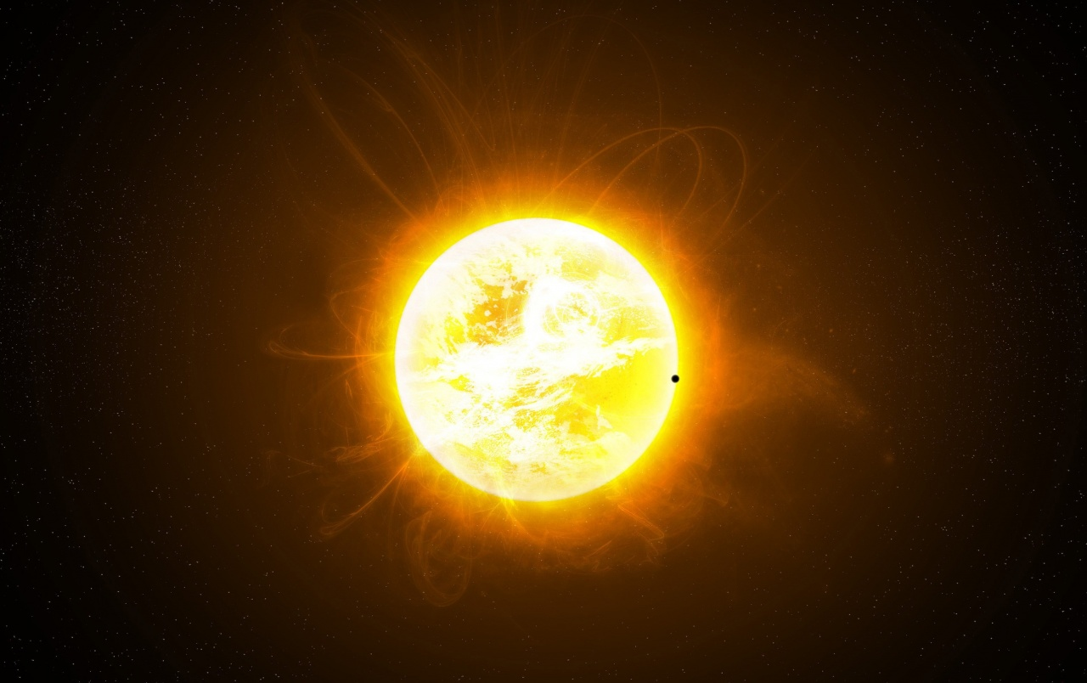
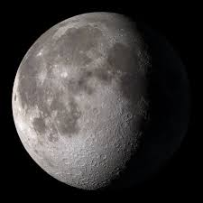
Genesis 1:14-19
“Then God said, ‘Let there be lights in the firmament of the heavens to divide the day from the night; and let them be for signs and seasons, and for days and years; and let them be for lights in the firmament of the heavens to give light on the earth’; and it was so. Then God made two great lights: the greater light to rule the day, and the lesser light to rule the night...”

Slide 4
Genesis 1:14-19
“…He made the stars also. God set them in the firmament of the heavens to give light on the earth, and to rule over the day and over the night, and to divide the light from the darkness. And God saw that it was good. So the evening and the morning were the fourth day” (NKJV).

Slide 5
God Made the Sun, Moon, and Stars
“Thus says the LORD, Who gives the sun for a light by day, the ordinances of the moon and the stars for a light by night, Who disturbs the sea, And its waves roar (The LORD of hosts is His name)” (Jer. 31:35).

Slide 6
God Made the Sun, Moon, and Stars
“When I consider Your heavens, the work of Your fingers, The moon and the stars, which You have ordained, What is man that You are mindful of him, And the son of man that You visit him?” (Psa. 8:3-4).

Slide 7
God Made the Sun, Moon, and Stars
“Oh, give thanks to the God of gods! …To Him who made great lights, For His mercy endures forever— The sun to rule by day, For His mercy endures forever; The moon and stars to rule by night, For His mercy endures forever” (Psa. 136:2-9).

Slide 8
God Made the Sun, Moon, and Stars
“To whom will you compare me? Or who is my equal?” says the Holy One. Lift your eyes and look to the heavens: Who created all these? He who brings out the starry host one by one, and calls them each by name. Because of his great power and mighty strength, not one of them is missing” (Isa. 40:25-26, NIV).

Slide 9
DAY FIVE

Slide 10
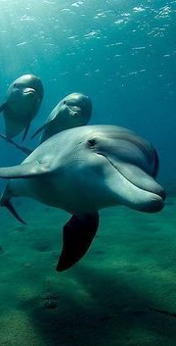
Genesis 1:20-23
“Then God said, ‘Let the waters abound with an abundance of living creatures, and let birds fly above the earth across the face of the firmament of the heavens.’ So God created great sea creatures and every living thing that moves, with which the waters abounded, according to their kind, and every winged bird according to its kind…”

Slide 11
Genesis 1:20-23
“…And God saw that it was good. And God blessed them, saying, ‘Be fruitful and multiply, and fill the waters in the seas, and let birds multiply on the earth.’ So the evening and the morning were the fifth day” (Gen. 1:20-23).

Slide 12
God Made Creatures of the Sea
“O LORD, how manifold are Your works! In wisdom You have made them all. The earth is full of Your possessions—This great and wide sea, In which are innumerable teeming things, Living things both small and great” (Psa. 104:24-25).

Slide 13
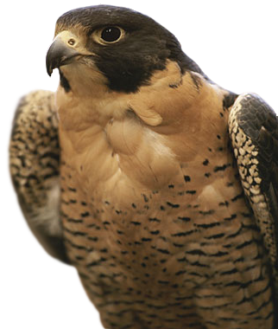
God Created Birds
“Who provides food for the raven, when its young ones cry to God, and wander about for lack of food?” (Job 38:41).

Slide 14
God Created Birds
“Does the hawk fly by your wisdom, and spread its wings toward the south? Does the eagle mount up at your command, and make its nest on high? On the rocks it dwells and resides, on the crag of the rock and the stronghold. From there it spies out the prey; Its eyes observe from afar” (Job 39:26-29).

Slide 15
God Created Birds
“Consider the ravens, for they neither sow nor reap, which have neither storehouse nor barn; and God feeds them. Of how much more value are you than the birds?” (Luke 12:24).

Slide 16
DAY SIX

Slide 17

Genesis 1:24-31
“Then God said, ‘Let the earth bring forth the living creature according to its kind: cattle and creeping thing and beast of the earth, each according to its kind’; and it was so. And God made the beast of the earth according to its kind, cattle according to its kind, and everything that creeps on the earth according to its kind. And God saw that it was good...”

Slide 18
Genesis 1:24-31
“…Then God said, ‘Let Us make man in Our image, according to Our likeness; let them have dominion over the fish of the sea, over the birds of the air, and over the cattle, over all the earth and over every creeping thing that creeps on the earth.’ So God created man in His own image; in the image of God He created him; male and female He created them…”

Slide 19
Genesis 1:24-31
“…Then God blessed them, and God said to them, ‘Be fruitful and multiply; fill the earth and subdue it; have dominion over the fish of the sea, over the birds of the air, and over every living thing that moves on the earth. And God said, ‘See, I have given you every herb that yields seed which is on the face of all the earth, and every tree whose fruit yields seed; to you it shall be for food…”

Slide 20
Genesis 1:24-31
“…Also, to every beast of the earth, to every bird of the air, and to everything that creeps on the earth, in which there is life, I have given every green herb for food,’ and it was so. Then God saw everything that He had made, and indeed it was very good. So the evening and the morning were the sixth day.”

Slide 21
God Made All Living Things
“…You take away their breath, they die and return to their dust. You send forth Your Spirit, they are created…” (Psa. 104:29b-30a).

Slide 22
God Made Human Beings
“And the LORD God caused a deep sleep to fall on Adam, and he slept; and He took one of his ribs, and closed up the flesh in its place. Then the rib which the LORD God had taken from man He made into a woman, and He brought her to the man. And Adam said: ‘This is now bone of my bones and flesh of my flesh; She shall be called Woman, because she was taken out of Man’” (Gen. 2:21-23).

Slide 23
God Made Human Beings
“Know that the LORD, He is God; It is He who has made us, and not we ourselves; We are His people and the sheep of His pasture” (Psa. 100:3).

Slide 24
God Made Human Beings
“But now, O LORD, You are our Father; we are the clay, and You our potter; and all we are the work of Your hand” (Isa. 64:8).

Slide 25
God Made Human Beings
“…God made man upright, but they have sought out many schemes” (Eccl. 7:29).

Slide 26
God Made Human Beings
“As a father pities his children, so the LORD pities those who fear Him. For He knows our frame; He remembers that we are dust” (Psa. 103:13-14).

Slide 27
God Made Human Beings
“And He has made from one blood every nation of men to dwell on all the face of the earth, and has determined their preappointed times and the boundaries of their dwellings” (Acts 17:26).

Slide 28
We Are Made in God’s Image
“This is the book of the genealogy of Adam. In the day that God created man, He made him in the likeness of God. He created them male and female, and blessed them and called them Mankind in the day they were created” (Gen. 5:1-2).

Slide 29
We Are Made in God’s Image
“Whoever sheds man’s blood, by man his blood shall be shed; for in the image of God He made man” (Gen. 9:6).

Slide 30
We Are Made in God’s Image
“Do not lie to one another, since you have put off the old man with his deeds, and have put on the new man who is renewed in knowledge according to the image of Him who created him” (Col. 3:9-10).

Slide 31
We Are Made in God’s Image
“But no man can tame the tongue. It is an unruly evil, full of deadly poison. With it we bless our God and Father, and with it we curse men, who have been made in the similitude of God. Out of the same mouth proceed blessing and cursing. My brethren, these things ought not to be so” (James 3:8-10).

Slide 32
God Became Man That We Might Be Saved
“The first man was of the earth, made of dust; the second Man is the Lord from heaven. As was the man of dust, so also are those who are made of dust; and as is the heavenly Man, so also are those who are heavenly. And as we have borne the image of the man of dust, we shall also bear the image of the heavenly Man” (1 Cor. 15:47-49).

Slide 33
God Became Man That We Might Be Saved
“…Put off, concerning your former conduct, the old man which grows corrupt according to the deceitful lusts, and be renewed in the spirit of your mind, and that you put on the new man which was created according to God, in true righteousness and holiness” (Eph. 4:22-24).

Slide 34
God Became Man That We Might Be Saved
“For you are all sons of God through faith in Christ Jesus. For as many of you as were baptized into Christ have put on Christ” (Gal. 3:26-27).

