Slide 1
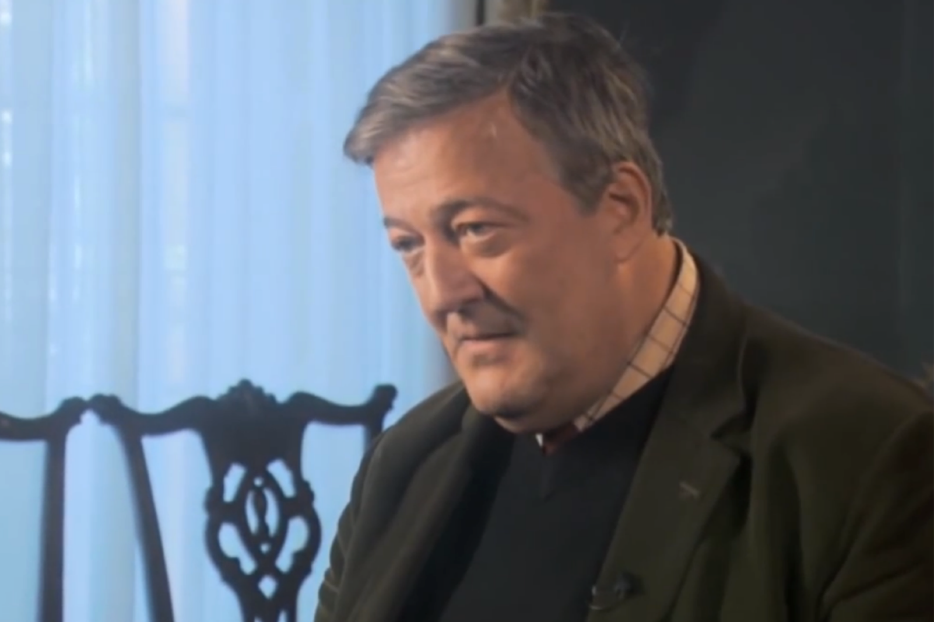

Slide 2
Common Struggle
Theme of Habakkuk
“O LORD, how long shall I cry, and You will not hear?” (Hab. 1:2a, NKJV)

Slide 3
Our own bewilderment over what God is or does really has nothing to do with whether He does or does not exist.

Slide 4
1. The Transcendence of God
Above, beyond, and outside of His creation
He made all things by His word (Heb. 11:3; Col. 1:16; Psa. 33:6)
Such power demands rules for safe contact (Exod. 33:20), cf. natural forces.

Slide 5
2. Humans Share the “Image” of God
What if He created beings in His image?
“God is spirit” (John 4:24).
“The Father of spirits” (Heb. 12:9)
We are eternal beings (Eccl. 3:11).

Slide 6
2. Humans Share the “Image” of God
What is God to do with those creatures whom He has made like Him, with an eternal nature, who reject and refuse to follow rules of interaction with Him and safeguards regarding Divine power?

Slide 7
2. Humans Share the “Image” of God
Biblical history is the demonstration of God’s efforts to teach, motivate, warn, correct, and guide man into an understanding of how interaction with Him is attainable.

Slide 8
3. Suffering Compared to Eternity
Romans 8:18-22
Present “suffering” vs. future “glory”
God allows this “in hope” of future liberation.
Suffering is like “birth pangs.”

Slide 9
3. Suffering Compared to Eternity
Hebrews 12:4-11
The importance of perspective
Childhood vs. adult perspective

Slide 10
4. God Knows What We Can Not Understand.
He knows principles of behavior, disposition, attitude, and good and evil that we do not.
We (like little children) might think things we endure now are cruel—not recognizing how important they are for life in the age to come.

Slide 11
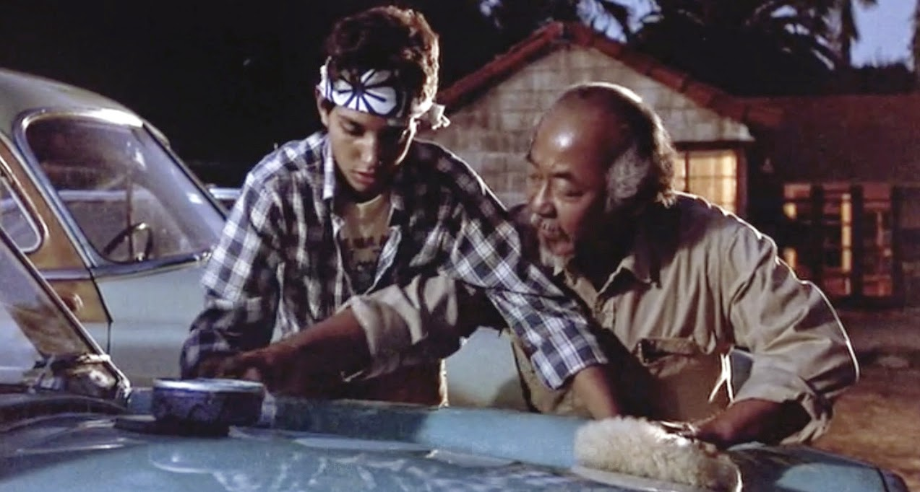
4. God Knows What We Can Not Understand.
What is God teaching us?
We must follow His word.
We must trust Him even when it is hard to see why.

Slide 12
5. Cruelty or Consequence?
Is God cruel in this life?
No. All suffering in this life is limited and temporary.
Humans are limited in their cruelty to others.

Slide 13
5. Cruelty or Consequence?
Is eternal punishment cruel?
Compare radioactive waste
Must be completely removed from contact with anyone else to prevent it from doing any damage to others.

Slide 14
5. Cruelty or Consequence?
“Depart from Me” (Matt. 7:23; 25:41; Luke 13:27)
“Every good and perfect gift” (Jas. 1:17)
“I have no pleasure in the death of one who dies” (Ezek. 18:33).

Slide 15
5. Cruelty or Consequence?
God does not want to remove us from His presence—He has done all that He can to allow us to have eternal life with Him.
But, when we reject all that He offers to escape this punishment, we deserve it if we receive it.

